Slide 1
Mobile Communications and Antennas
Describing and comparing antennas through radiation patterns with home construction techniques
CS 556 Mobile Communications
Fall 2008
Timothy John Adams
Notes:
Good morning. I am Tim Adams and my research project dealt with antennas and radiation patterns of antennas.

Slide 2
Introduction
Antennas used for mobile communications and other applications
Basic theory behind antennas and gain
Comparison of antenna gain using radiation pattern graphs
Uses of antennas
Homemade antennas
Notes:
Today I will highlight the information I found while discovering a great deal of information about antennas. I will show you several different types of antennas used for mobile communications and other applications. I will give some basic information behind antennas and the concept of antenna gain. I will show the use of radiation pattern graphs and how they are used to compare antennas and how different antennas are used. At the conclusion I will describe plans for constructing 3 different types of antennas from somewhat common supplies.

Slide 3
Basic information for antennas
What is an antenna
  Antennas are conductors
  Electric current in the conductor
  Electromagnetic fields
  Radiated power
Isotropic antenna
Notes:
What is an antenna? Most simply an antenna is just a conductor. A straightened paper clip will actually work as an antenna. When an alternating electric current is applied to a conductor electric and magnetic fields are produced. For short conductors, a small fraction of the wavelength, the generated fields are lost in a short distance. But as the length of the conductor approaches one-half wavelength, the radiated power reaches a maximum and nearly all power fed into the antenna is radiated out. The isotropic antenna is the ideal, theoretical antenna.

Slide 4
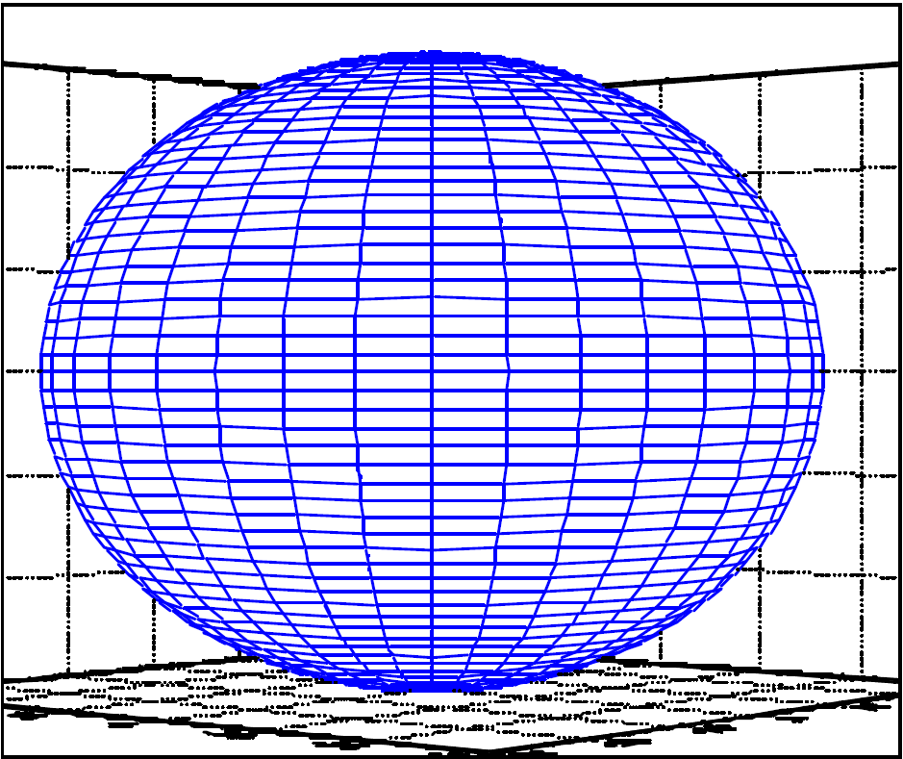
Isotropic power
Spherical pattern representing the power radiated from an isotropic antenna
Notes:
The power radiated from an isotropic antenna radiates equally in all directions

Slide 5
Antenna Gain
Isotropic power level
Directed power
Half-wave dipole antenna power
The decibel
Ratio of power is gain
  Gain of isotropic antenna is 1 or 0 dBi
  Gain of dipole antenna is 1.64 or 2.15 dBi
Notes:
When you consider the power output of the isotropic antenna, that is considered the basis for measuring antenna gain. The power output of an antenna will be constant so if you can direct the power there will be a gain in the power level in the direction of peak power. One of the most common antenna types is the half-wave dipole. Due to its design, there are areas of minimal power at the ends of the antenna so the power generated in all other directions is increased. One way of measuring this increase in power is the decibel. The gain of an isotropic antenna is 1 or 0 dBi. The gain of a dipole antenna is 1.64 or 2.15 dBi.

Slide 6
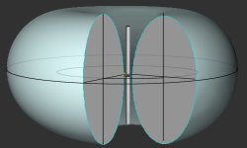
Half-wave dipole
Radiation pattern of a center-fed half-wave dipole antenna
Notes:
This radiation pattern plot of the half-wave dipole shows how the null areas affect the field as compared to the isotropic.

Slide 7
Omni-directional antennas
Half-wave dipole
Quarter-wave monopole
Radiation pattern characteristics
Notes:
When maximum coverage is needed by an antenna, we use omni-directional antennas. Two common types are the half-wave dipole already discussed and the quarter-wave monopole. The quarter-wave monopole is constructed on a ground plane that causes the quarter-wave portion to be reflected making it appear as a half-wave dipole. What distinguishes the different omni-directional antennas are the radiation patterns in the vertical plan.

Slide 8
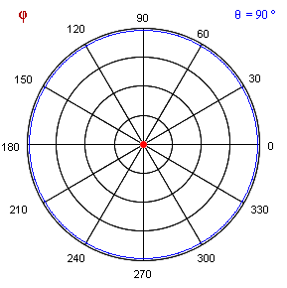
Omni-directional radiation pattern in the horizontal plane
Horizontal plan of radiation pattern for half-wave dipole, as if looking down on the antenna from above
Notes:
Although this is idealized, it shows that the horizontal plane of omni-directional antennas have equal power in all directions.

Slide 9
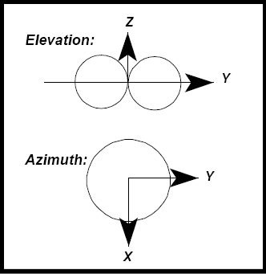
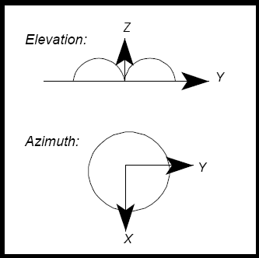
Different elevations but still omni-directional
Half-wave dipole pattern
Quarter-wave monopole pattern
Notes:
But when you compare the elevation patterns of the antennas, you see they can be very different.

Slide 10
Directional Antennas
Yagi-Uda
Horn
Parabolic
Helical
Notes:
But sometimes you want to increase the antennas signal in only one or maybe a few directions. That is when you use a directional antenna. Several different types of directional antennas are the Yagi-Uda, the Horn, the Parabolic and the Helical.

Slide 11
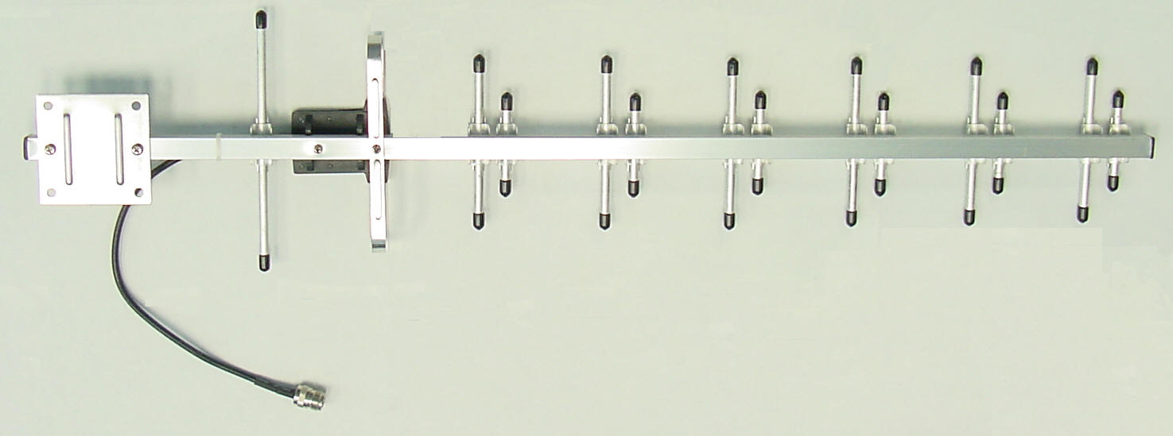
Yagi-Uda
14 element Yagi-Uda Antenna
Notes:
The Yagi-Uda antenna uses multiple elements to direct the radiated power of the antenna. A reflector keeps the power from radiating off the back by creating a point of high impedance. To do this, the reflector element is made larger than the feed element. The feed element can be just a simple half-wave dipole and is the only powered element of the antenna. The directional elements will all be smaller than the feed element. The distance between the elements will affect the efficiency of the antenna and is generally about two-tenths of the wavelength.

Slide 12
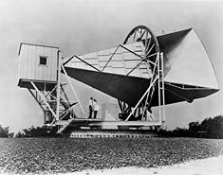
Horn
50 foot horn antenna can pick up weak background radiation from space
Notes:
The horn antenna uses the horn to collect the radiation from a wide area and feed it into the receiver. Although this one is quite large and may be used for investigating background radiation in space, the same principle can be used with smaller antennas for different frequencies.

Slide 13
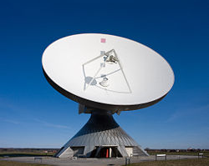
Parabolic
Large parabolic antenna, actually the biggest facility for satellite communication in the world, based in Raisting, Bavaria, Germany.
Notes:
The parabolic antenna uses a dish to concentrate the radio signal from a wide area into a small area for reception.

Slide 14
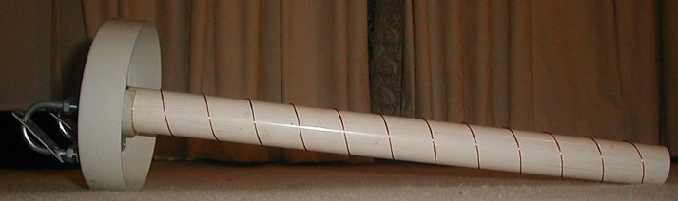
Helical
Homemade helical antenna
Notes:
This is an example of a helical antenna built by an individual. This antenna uses the coiled wire to direct the path of the radiated energy.

Slide 15
Radiation patterns
Omni-directional
Directional
Notes:
We have already discussed the radiation pattern of omni-directional antennas but how do they differ from the radiation patterns of highly directional antennas.

Slide 16
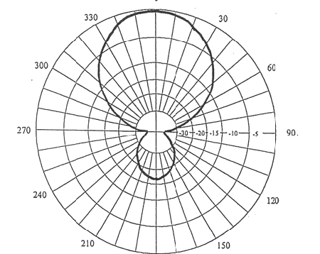
Directional radiation pattern
Directed gain from a Yagi-Uda antenna
Notes:
As this radiation pattern shows, the power of a directional antenna concentrates the majority of its power in one direction while minimizing the power radiated in other directions. You can see that not all the power is directed in one direction and the residual power may be directed into a back-lobe or even several side-lobes.

Slide 17
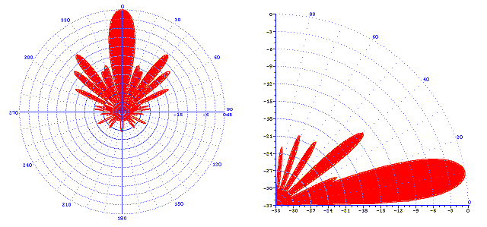
Directional radiation pattern
More complex pattern from rhombic (wire) antenna
Notes:
This is a much more complex pattern generated by a rhombic antenna. There are many side lobes and additionally, the elevation pattern also has different power characteristics.

Slide 18
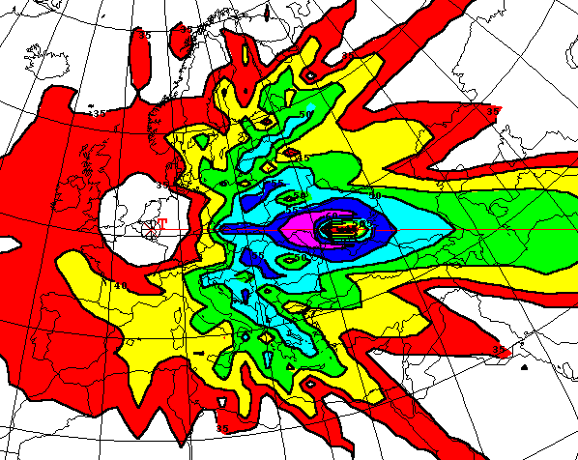
Coverage area from directional antenna
Coverage area from rhombic (wire) antenna
Notes:
The power pattern in the previous slide produces this coverage for the antenna being measured. You can see how the actual coverage of an antenna resembles the radiated power graph.

Slide 19
Uses of antennas
Omni-directional
  Mobile Receivers
  Base Stations
Directional
  Confined Spaces
  To Prevent Interference
Notes:
It may be easy to visualize when you would use certain antennas. Omni-directional antennas are common in mobile receivers and base stations so you don’t have to worry about orienting yourself toward the antenna. Directional antennas are used in confined spaces where you do not want stray signals to spill over causing interference in other directions.

Slide 20
Homemade Antennas
Quarter-wave monopole
Quarter-wave monopole with waveguide
8-segment Coaxial/Collinear (COCO)
Notes:
To finish up I will briefly go over the methods for constructing these three different types of antennas

Slide 21
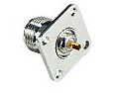
N-female chassis mounted connector
Basic connector for most homemade antennas
Notes:
Most of the plans for making antennas found on the internet use the N-female chassis mounted connector

Slide 22
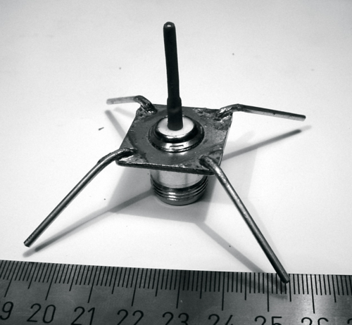
Quarter-wave monopole antenna with ground plane
Quarter-wave monopole
Notes:
In fact, that is almost all that is involved in this antenna. A simple quarter-wave monopole antenna using quarter-wave radials to create a ground plane for the antenna. For 2.4 GHz antennas, the quarter-wave length is about 31 mm. The radials in this antenna are angled down at an angle between 30 and 45 degrees.

Slide 23
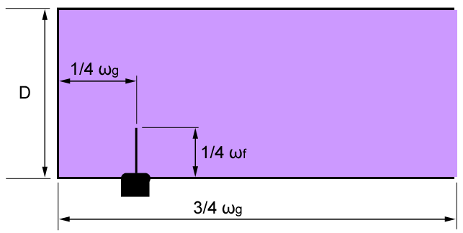
Quarter-wave monopole with waveguide
Basic “cantenna”
Notes:
You can improve the use of the quarter-wave monopole by adding a waveguide. This is the idea behind the “cantenna” where a can, like a Pringles can, soup can or coffee can is used as a waveguide. The dimensions of the waveguide are based upon the standing wave wavelength for the waveguide which is dependent on the diameter of the can and the cutoff frequency.

Slide 24
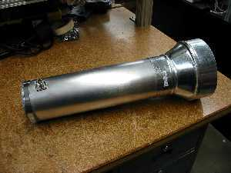
Quarter-wave monopole with waveguide and funnel feed
Funnel increases reception capabilities
Notes:
The waveguide can be improved further with the addition of a funnel at the end to increase the reception area. This example uses simple duct pipe and converter to create the waveguide.

Slide 25

8-segment Coaxial/Collinear antenna
Uses basic coaxial cable
Notes:
Finally, another simple antenna that may take a little more time. This just uses coaxial cable to create a collinear segment array. Each segment in the array is one-half wavelength and the inner conductor of the cable is soldered to the outer conductor of the next segment and ends with a quarter-wave end of the inner conductor. The one-half wave segments are not exactly one-half of the free space wavelength due to the velocity factor of the cable.

Slide 26
Concluding Remarks
Notes:
I was surprised at the wealth of information available on the internet regarding radiation patterns. Most commercial vendors use radiation patterns to help sell their antennas. The ease of making your own antennas also surprised me. But it is good that it is so easy to work with antennas because without them, we cannot have radio communications.

