Slide 1
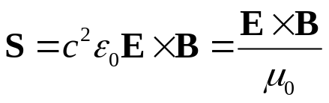
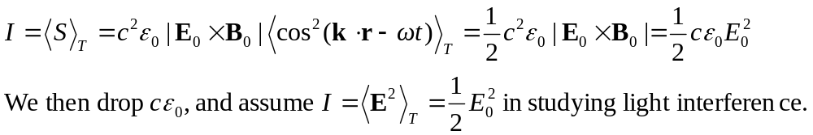
Chapter 9 Interference
November 4 General considerations of interference
9.1 General considerations
Introduction: Wave equation → Superposition principle
Interference: The interaction between two or more waves produces in space a resultant irradiance which is different from the sum of the component irradiances:
E = E₁+E₂, but I ≠I₁+ I₂.
Interferometric devices: wavefront splitting and amplitude splitting.
Poynting vector: is the instantaneous power flow across an unit
area whose normal is parallel to S.
For a harmonic, linearly polarized plane wave:
Irradiance (intensity): The time-averaged energy transport per unit area per unit time.

Slide 2
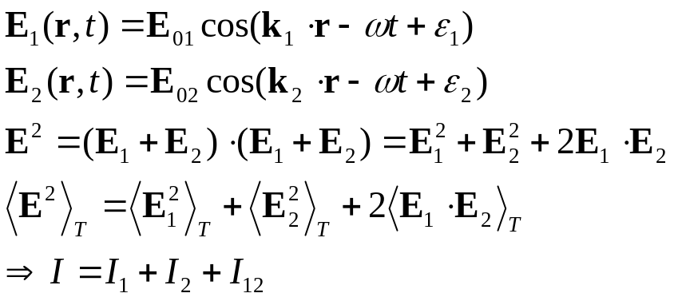
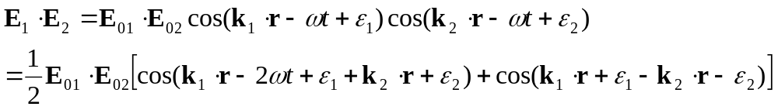
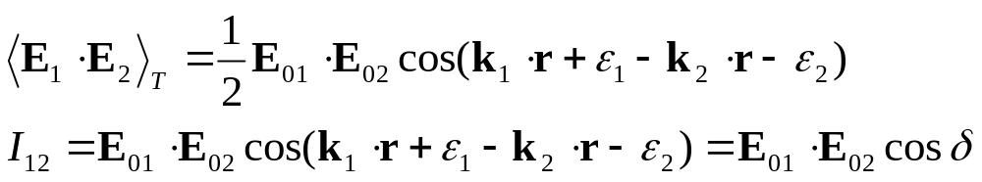



Superposition of two planar, linearly polarized waves (vector model):
interference term
Phase difference
When E₀₁ and E₀₂ are perpendicular, I₁₂=0, no interference.
When E₀₁ and E₀₂ are parallel,
Note that cosδ averages to 0 in space: energy is conserved.

Slide 3


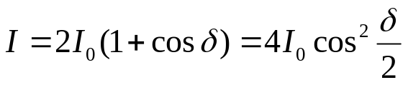
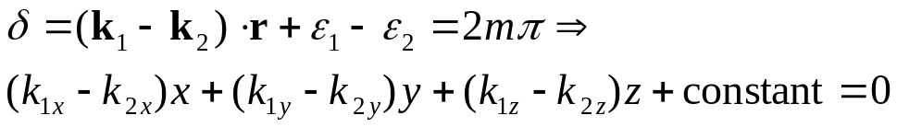
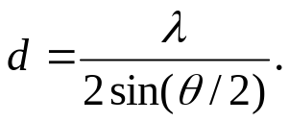

Total constructive interference:
Total destructive interference:
When I₁=I₂=I₀,
Interference fringes between two plane-waves:
Bright fringes:
k₁
θ
d
k₁-k₂
k₂
→ Fringes are parallel planes perpendicular to k₁-k₂ .
Exercise: Prove that the distance between the interference planes is
Hint:
Discussion: Fabrication of photographic gratings.

Slide 4
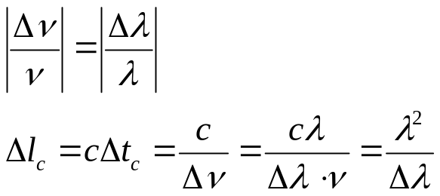
9.2 Conditions for interference
For producing stable patterns, the two sources must have the same frequency.
For producing interference patterns, the two fields must have parallel components.
For producing clear patterns, the two sources must have similar amplitude.
For producing interference patterns, coherent sources are required.
=Relative phase predictable
Temporal coherence:
Coherence time: Time interval Δt_{c} in which the light resembles a sinusoidal wave. (~10 ns for quasi-monochromatic light sources.)
Coherence length: Δl_{c}= cΔt_{c.}
Relation to bandwidth (uncertainty principle): ΔνΔt_{c} ~1.
Useful relations:
Spatial coherence:
The correlation of the phase of a light wave between different spatial locations. Depends on the size of the light source.

Slide 5
Read: Ch9: 1-2
Homework: Ch9: 2,3
Due: November 15

Slide 6
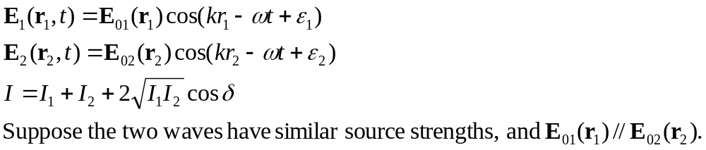
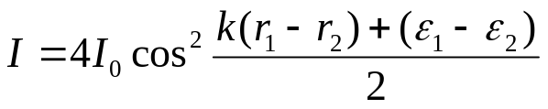
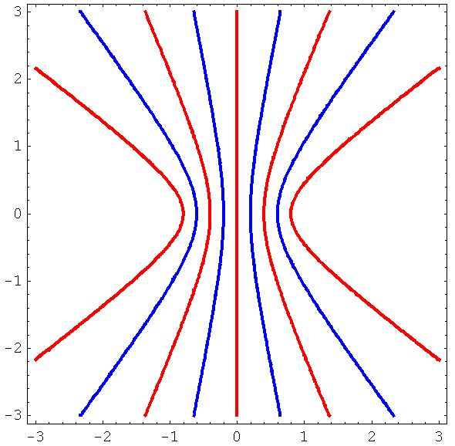


November 11 Interference of spherical waves
Superposition of two spherical waves:
P
r₁
r₂
S₁
S₂
At a far field, I₁≈I₂=I_{0.}
Maximum:
Minimum:
m=-1 0 +1
P
Hyperboloids
r₁
r₂
S₁
a
S₂
m = M
Interference patterns:
Viewing screen perpendicular to the S₁-S₂ axis: Concentric rings.
Viewing screen parallel to the axis: Parallel fringes (Young’s experiment).
Maximum order of rings: -M < m <M, where M =a/λ. (-a <r₁-r₂ <a )

Slide 7
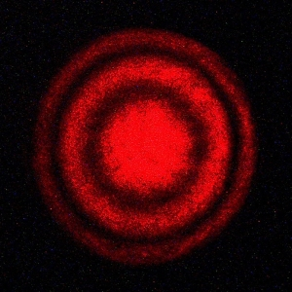
Variation of the interference rings:
When reducing a :
The rings swallow. (What we observed in the Michelson interferometer.)
The distances between adjacent rings at a fixed viewing point increases.
m=-1 0 +1
P
r₁
r₂
S₁
a
S₂
m = M
Superposition of a plane wave and a spherical wave:
Move S₁ to infinity.

Slide 8
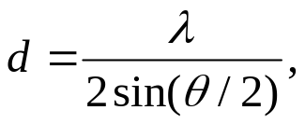
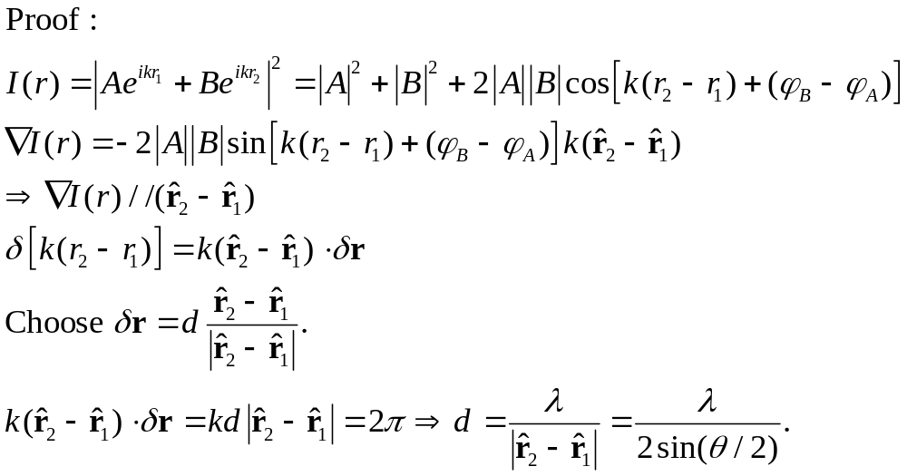
(*Reading) Bisector theorem of interference planes :
m=-1 0 +1
Theorem: For the interference of two spherical waves, the local interference plane bisects the rays from the two sources. The local distance between the interference planes is
where θ is the angle between the two rays.
P
r₁
r₂
S₁
a
S₂
m = M

Slide 9
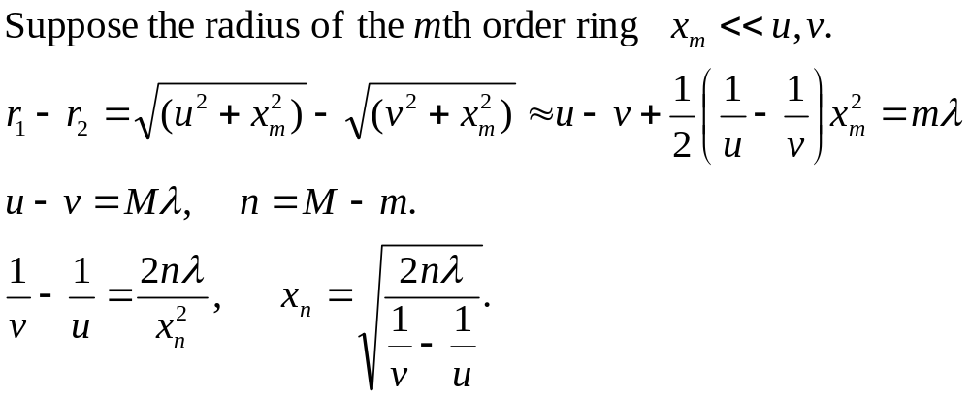

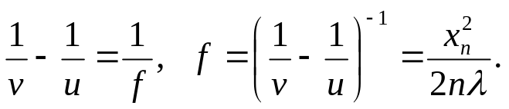
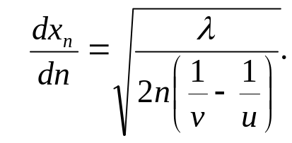
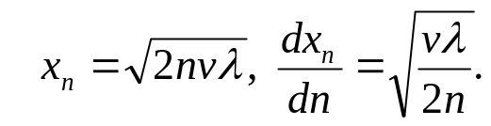
(*Reading) Size of the interference rings:
P
r₁
r₂
x_{m}
(x_{n})
S₁
S₂
v
u
Note:
The size of the nth ring from the center:
S₁, S₂ and the viewing screen form a lens system:
Distance between rings:
For interference between a plane wave and a spherical wave:

Slide 10
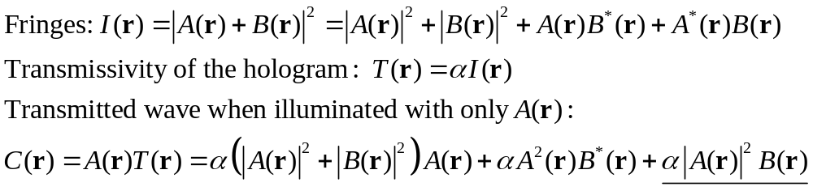
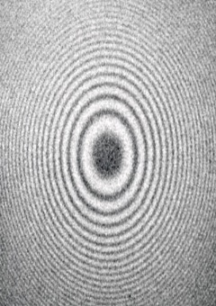


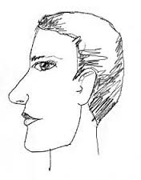
(*Reading) Interference pattern and holography:
Two coherent waves produce an interference pattern.
The interference pattern is photographically recorded, which makes a hologram.
Now remove one of the waves (called the object wave), and illuminate the hologram with the other wave (called the reference wave). The removed wave is then magically reproduced in space!
A
B
A
Record
Reconstruction

Slide 11
Read: Ch9: 1-2
No homework

Slide 12
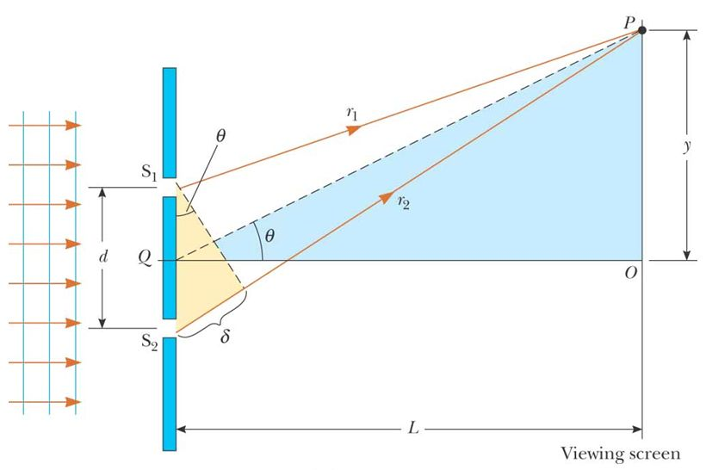

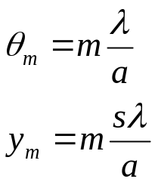

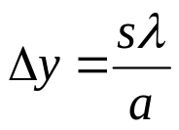
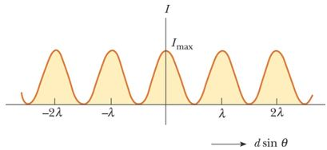
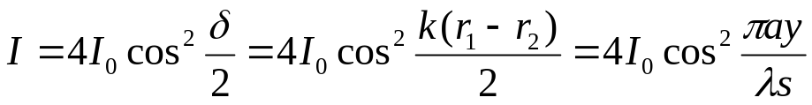
November 13 Wavefront-splitting Interferometers
9.3 Wavefront-splitting interferometers
9.3.1 Young’s experiment (1801)
Young’s originality: Obtaining spatially coherent light from a pinhole, and splitting the wavefront of the spatially coherent light with two pinholes.
Optical path difference:
r₂ – r₁ = a sin θ = ay/s ( If s>> a, s>> y )
Positions of bright fringes:
m = 0, ±1, ±2, … is the order number.
a
Λ
s
Distance between fringes:
Intensity distribution of the fringes:
ay/s

Slide 13
Effects of finite coherence length:
Light from each slit has a coherence length l_{c}.
For sunlight (blackbody) l_{c}~3λ.
The waves from two slits can only interfere if
r₂ – r₁ <l_{c}.
The contrast of the fringes degrades when the amount of the overlap between uncorrelated wavegroups increases.
B
A
P
l_{c}
A'
B'
r₂ – r₁
Other wavefront-splitting interferometers
Fresnel’s double mirror:
Slits S₁ and S₂ act as virtual coherent sources. They are images of slit S in the two mirrors.
Λ= r₂ – r₁
Shield
M₁
S
P
r₁
S₁
y
a
Space between fringes:
s
r₂
M₂
S₂

Slide 14
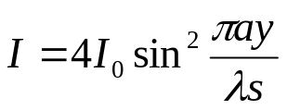
Fresnel’s double prism:
Interference between light refracted from the upper and the lower prisms. The prisms produce two virtual coherent source S₁ and S₂.
Question: Where are S₁ and S₂?
S₁
θ
a
S
S₂
Lloyd’s mirror:
Interference between light from source S and its image S ' in the mirror.
Glancing incidence causes a phase shift of π, therefore the fringes are complementary to those of Young’s.
S
y
a
s
S'

Slide 15
Read: Ch9: 3
Homework: Ch9: 6,20,23,27 (optional)
Due: November 22

Slide 16
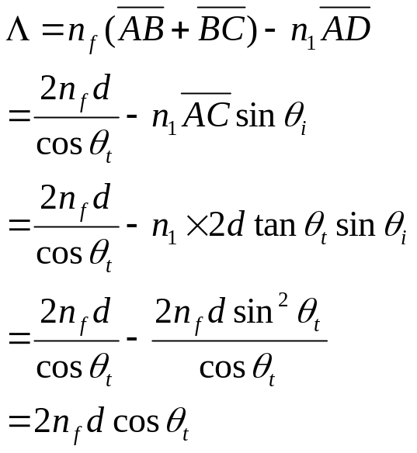

November 15 Amplitude-splitting Interferometers-1
9.4 Amplitude-splitting interferometers
9.4.1 Dielectric films – double-beam interference
Application: Optical coating reduces or enhances the reflection of optical devices through thin-film interference effects.
Fringes of equal inclination
Consider the first two reflections (other reflections are weak if the reflectance is not large).
Optical path length difference:
P
S
θ_{i}
D
n₁
A
C
d
n_{f}
θ_{t}
n₂
B

Slide 17
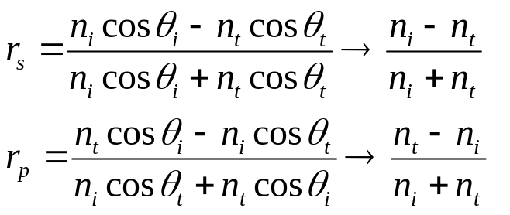
Phase shift in reflections when the angle of incidence is small:
E_{ip}
E_{rp}
k_{r}
E_{is}
k_{i}
θ_{i}
θ_{r}
E_{rs}
n_{i}
n_{t}
θ_{t}
E_{ts}
E_{tp}
k_{t}
1) External reflection, n_{i}<n_{t} .
There is a phase shift of π between the incident electric field and the reflected electric field.
2) Internal reflection, n_{i}>n_{t} .
There is no phase shift between the incident electric field and the reflected electric field.

Slide 18
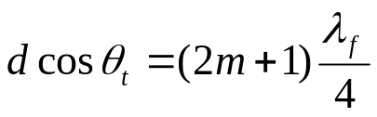
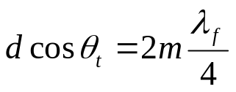
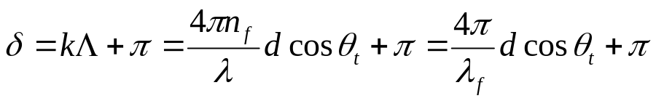
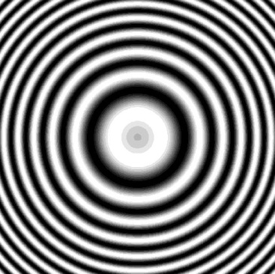
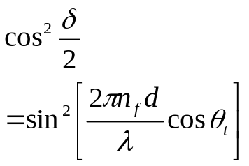
Phase difference:
Assume n_{f} >n₁, n_{f} >n₂. There is a phase shift of π between external and internal reflections (when the incident angle is not large).
Bright spot:
Dark spot:
Extended source: All rays inclined at the same angle arrive at the same point.
→Fringes of equal inclination:
Arcs centered on the perpendicular from the eye to the film (where θ_{i}=0).
Haidinger fringes: The fringes of equal inclination viewed at nearly normal incidence.
Concentric circular bands.

Slide 19
Read: Ch9: 4-5
Homework: Ch9: 35,38,41,42,44,46(optional)
Due: November 22

Slide 20
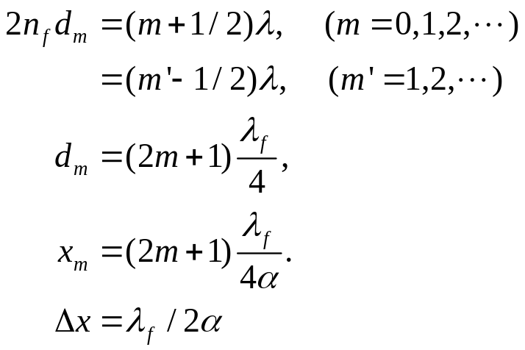
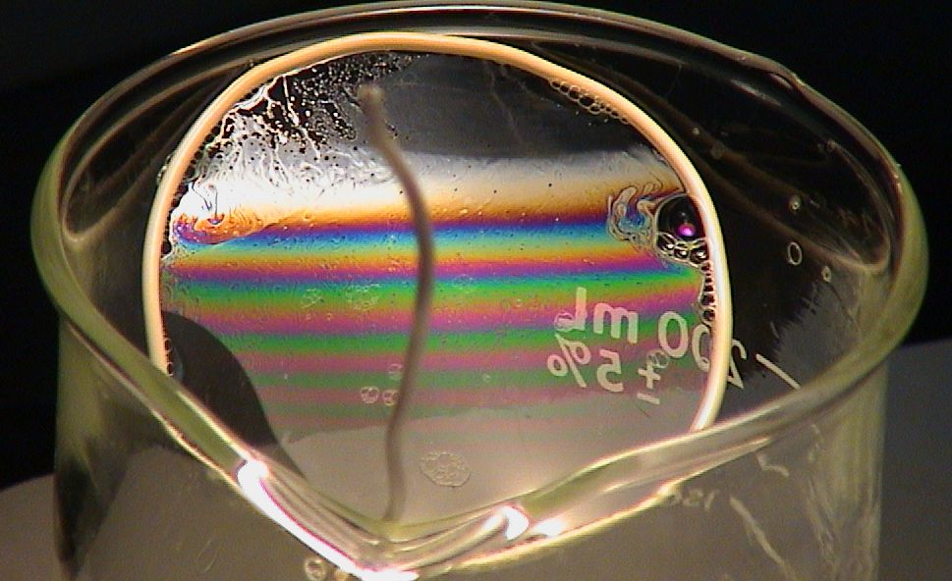
November 18 Amplitude-splitting Interferometers-2
Fringes of equal thickness
Fizeau fringes: Contours from a non-uniform film when viewed at nearly normal incidence.
Thickness of a wedge: d = α x
Interference maximum:
n₁
d
n_{f}
α
x
n₂
Compare: For the interference between two plane waves, the distance between
the fringe planes is

Slide 21
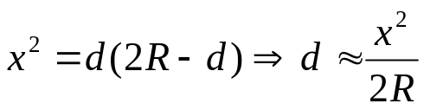
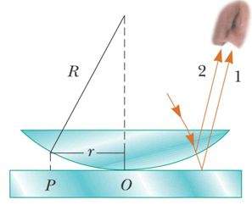
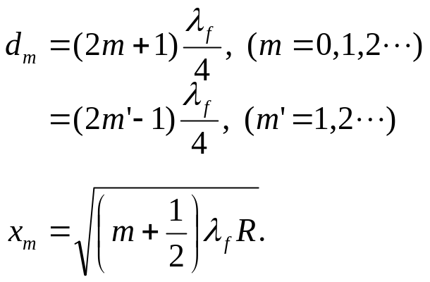

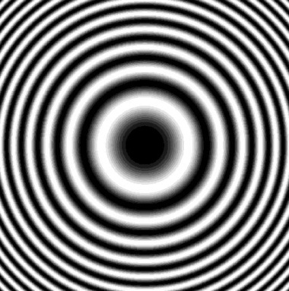
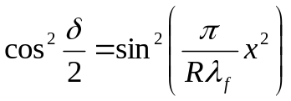
Newton’s rings: Interference pattern from an air film between two glass surfaces.
Thickness:
Bright rings: 2n_{f} d_{m} = (m + ½)λ,
Dark rings:
x
d
Discussions:
Fabricating zone plates.

Slide 22


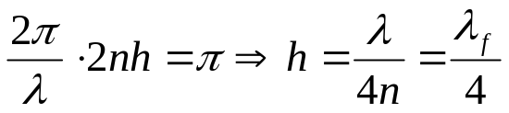



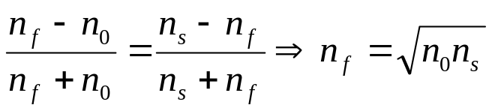
Single-layer antireflection coating:
In order to let the two reflected light waves cancel each other, we need
The two reflected waves has a phase shift or π :
The amplitudes of the two reflected waves are nearly equal:
air
film
substance

Slide 23
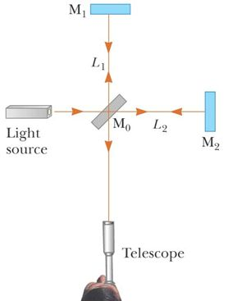

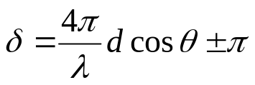
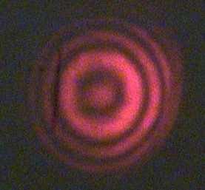

9.4.2 Mirrored interferometers
Michelson interferometer
Compensation plate: Negates dispersion from the beam splitter
Collimated source: Fringes of equal thickness
Point source: Interference of spherical waves
Extended source: Fringes of equal inclination
S
S₁
S₂
Movable mirror
θ
P
2dcosθ
Beam splitter
Σ
M₁
M₂
Optical path length difference:
Phase difference:
Dark fringes:
π from the splitter.
Application: Accurate length measurement.
Example 9.9

Slide 24
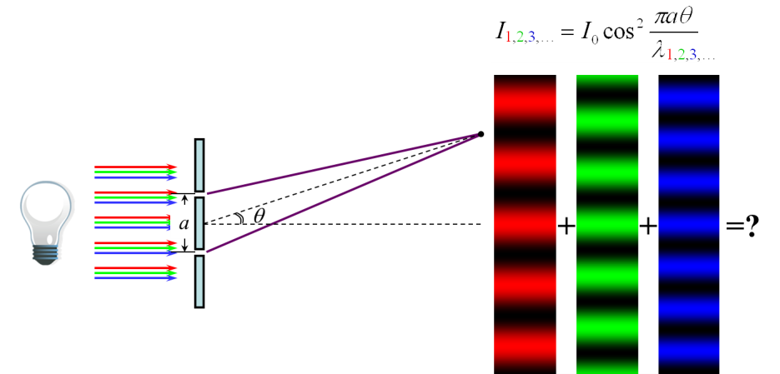
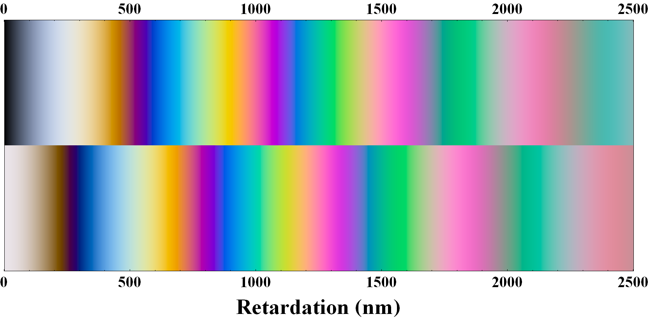
*Reading: Interference colors
When a white light source is used in an interference experiment, each spectral component will produce its own interference pattern in space. The overlapped interference patterns from all spectral components result in the appearance of a special sequence of colors.
Calculated interference colors
Crossed polarizers
Parallel polarizers
Examples:
Soap bubbles
Oil films
Thin film coatings
Crystals between polarizers
Applications:
Identify minerals
Control coatings
Inspect strains

Slide 25
Read: Ch9: 4-5
No homework

Slide 26
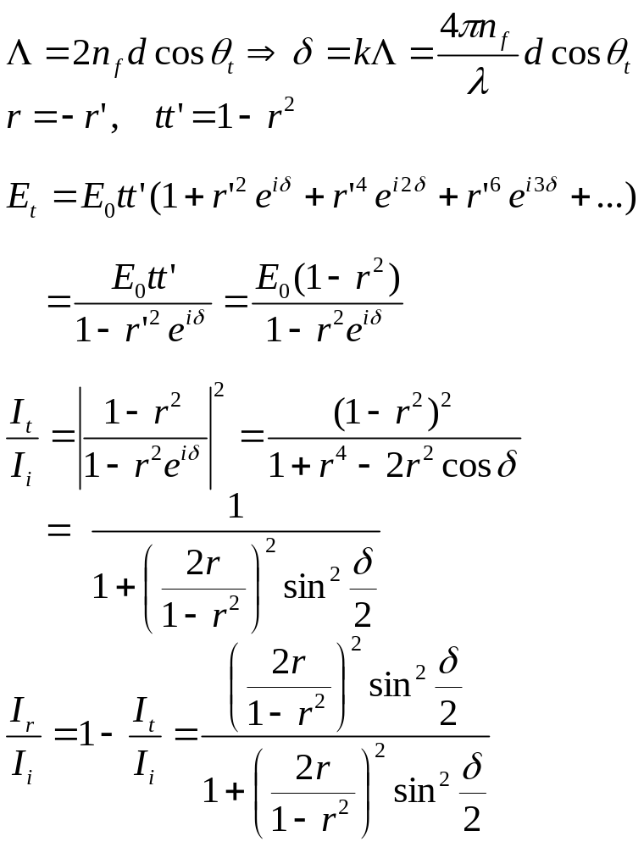








November 20, 22 Multiple beam interference
9.6 Multiple beam interference
Interference between multiple reflection and multiple refractions:
S
θ_{i}
d
n_{f}
θ_{t}
Reduces to fringes of equal inclination when r is small.

Slide 27






Coefficient of finesse:
Airy function:
F = 0.2 (r² = 0.046)
F = 1 (r² = 0.17)
F = 200 (r² = 0.87)

Slide 28






9.6.1 The Fabry-Perot interferometer
High resolving power
Prototype of laser cavity
Half-width of transmission:
Finesse:
S
P
d

Slide 29



Applications:
I. How a laser wavelength is selected.
1) The laser itself is a Fabry-Perot cavity. Two highly reflective mirrors select an output of a certain wavelength with an extremely narrow bandwidth, which is called a mode.
2) The mode separation in a laser cavity (Δν =c/2l) can be smaller than the gain profile of the laser medium, therefore output of multiple modes is possible.
3) Laser modes can be longitudinal or transverse.

Slide 30



II. How a scanning spectrum analyzer works.
A scanning spectrum analyzer can be used to study the modes of a laser.
2) The analyzer is a Fabry-Perot interferometer whose length can be slightly varied by a piezoelectric device.
3) A saw-tooth voltage is used to repeatedly change the cavity length, and the output signal is displayed on an oscilloscope.
scanning
scanning

Slide 31

1
tt'
r
r²
θ_{i}
θ_{r}
r
n_{i}
n_{t}
rt
θ_{t}
t
tr'
t

Slide 32
Read: Ch9: 6
Homework: Ch9: 50,53,54,56,59,61
Due: December 6

Slide 33
Hat man sein Warum des Lebens, so verträgt man sich fast mit jedem Wie.
He who has a why to live for can bear with almost any how.
Friedrich Nietzsche

