Slide 1
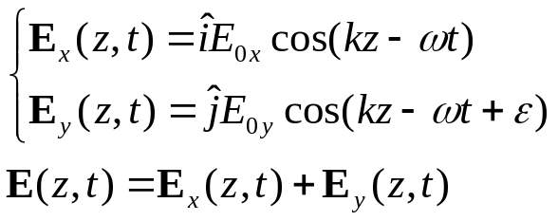


Chapter 8 Polarization
October 21, 23 Nature of polarization
8.1 The nature of polarized light
Introduction:
Since F = qE, the polarization governs the force direction.
Description, observation and control of polarization.
I) Linear polarization
y
y
E_{y}
E
E
E_{x}
x
x
E_{x}
E_{y}
phase lag
1) When ε = 0, the two waves are in-phase,
The resultant wave is linearly polarized in the 1st and 3rd quadrants.
2) When ε = ±π, the two waves are out-of-phase,
The resultant wave is linearly polarized in the 2nd and 4th quadrants.

Slide 2
y
y
II) Circular polarization
E₀
E₀
E
E₀
ωt
E₀
x
x
-ωt
E
1) When E_{0x}=E_{0y}=E₀, ε = -π /2 ,
α = kz-ωt, the resultant wave is right-circularly polarized (rotate clockwise).
2) When E_{0x}=E_{0y}=E₀, ε = π /2 ,
α = -kz +ωt, the resultant wave is left-circularly polarized (rotate counterclockwise).
Circular light:
The amplitude E₀ does not change.
The direction of E rotates.
The end point of E traces out a circle.
A circularly polarized wave can be synthesized by two orthogonally linearly polarized waves of equal amplitude.
A linearly polarized wave can be synthesized by two oppositely polarized circular waves of equal amplitude.

Slide 3
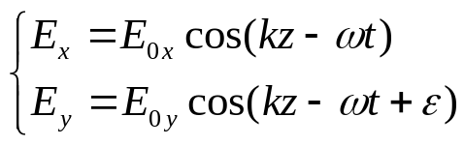
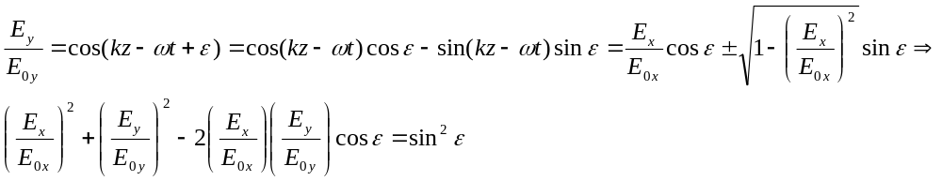
III) Elliptical polarization
Elliptical light: The E vector rotates and changes its magnitude as well. The end point of E traces out an ellipse.
For a harmonic wave propagating in the z direction, its two components on the x and y axes are
E_{0y}
E
α
E_{0x}
1) Trajectory of the E vector.
Let us eliminate kz-ωt and see what is the relation between E_{x} and E_{y}:
In the E_{x}-E_{y} plane this is an ellipse.

Slide 4
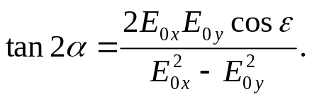
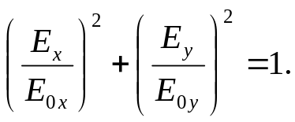
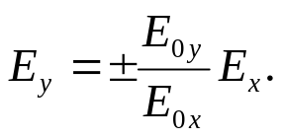
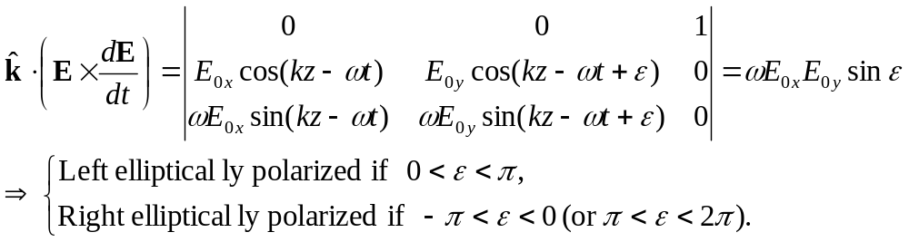
E_{0y}
E
2) Tilting angle of the ellipse.
The tilting angle α is given by
When ε = ±π /2, we have
When ε = 0, ±π, we have
α
E_{0x}
3) Sense of rotation of the ellipse.

Slide 5
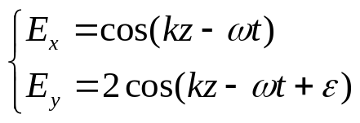
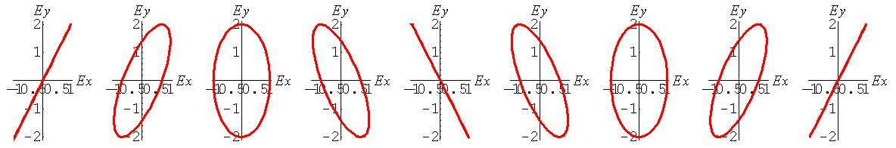
Example:
ε = 0 π/4 π/2 3π/4 π 5π/4 3π/2 7π/4 2π
State of polarization:
Right-circular light: R-state
Left-circular light: L-state
Linearly polarized light: P-state, superposition of R- and L-states with equal amplitude.
Elliptically polarized light: E-state, superposition of R- and L-states with different amplitudes.

Slide 6

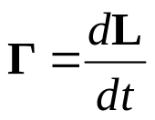
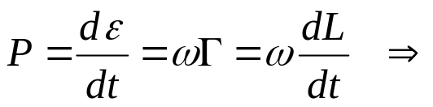
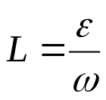
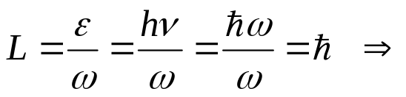

Nature light:
Each atom emits a polarized wave train of ~ 10⁻⁸s. The wave trains are random in polarization. As a result, nature light is unpolarized, or randomly polarized.
8.1.5 Angular momentum and the photon picture
Circularly polarized light sets a charge into circular motion.
E-field exerts a torque on the charge: (with the same frequency as light)
Newton’s second law for rotation: (L is the angular momentum of the charge)
Power generated by a torque:
Direction of L: -k for R-state, +k for L-state (right-hand rule).
When a circularly polarized photon is absorbed, it transfers an angular momentum:
The intrinsic angular momentum (spin) of a photon is .

Slide 7

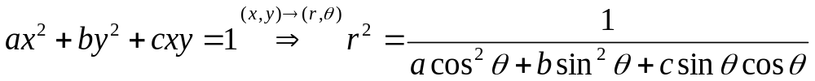
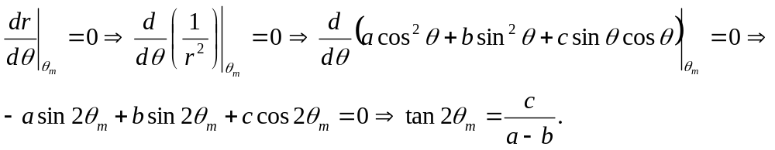
Reading: How is oriented in space?
Answer: In polar coordinates,
Suppose one of the two axes of the ellipse are oriented at angle θ_{m}, then

Slide 8
Read: Ch8: 1
Homework: Ch8: 6,8,9 Due: November 1

Slide 9

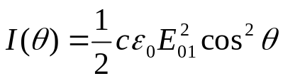
October 25 Birefringence
8.2 Polarizers
Polarizer: An optical device whose output is a certain form of polarized light.
Example: Linear polarizers, circular polarizers.
Polarizer and analyzer, transmission axis, extinction axis
Physical mechanisms of polarizers:
Dichroism (selective absorption)
Reflection
Scattering
Birefringence (double refraction)
Malus’s law:
Transmitted intensity
E₀₁
E₀₂
θ

Slide 10
8.3 Dichroism
Dichroism: Selective absorption of one of the two orthogonal P-state light.
Wire-grid polarizers:
The transmission axis of the grid is perpendicular
to the wires.
Dichroic crystals: (example: tourmaline)
The E-field perpendicular to the optic axis is strongly absorbed.
Polaroids: Dichroic sheet polarizers.

Slide 11
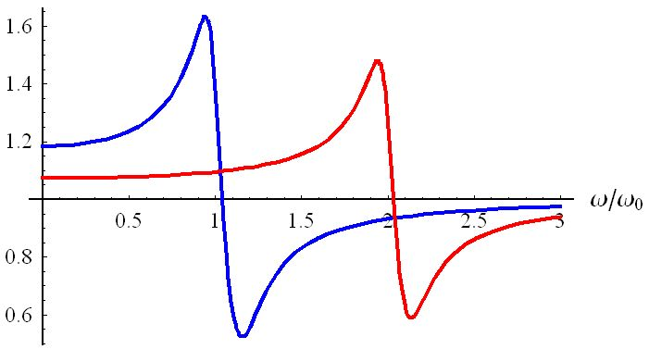
8.4 Birefringence
Anisotropy of the binding force of an electron cloud causes the anisotropy in the refractive indexes for different light polarizations.
8.4.1 Calcite (CaCO₃)
Optic axis: Inside the (uniaxial) crystal there is a special direction along which when light is propagating there is no birefringence occurs. This direction is called the optic axis.
Principal plane: A plane that contains the optic axis and the ray direction.
Ray direction: Energy flow direction.
The refractive index depends on whether the E-field is parallel or perpendicular to the principal plane.
o-ray: E-field normal to the principal plane.
e-ray: E-field parallel to the principal plane.
n_{y}
Absorption band,
polarizers
n_{x}
Birefringence
Optic
axis
E_{e}
e-ray
o-ray
E_{o}

Slide 12
Principle: Light whose polarization is parallel to the optic axis feels a refractive index of n_{e} and propagates with a speed of v//. Light whose polarization is perpendicular to the optic axis feels a refractive index of n_{o} and propagates with a speed of v┴.
Huygens’s explanation:
o-ray, wavelets expand with v┴.
e-ray, E-field component parallel to the optic axis propagates with v//. E-field component perpendicular to the optic axis propagates with v┴. This results in elliptical wavelets.
Ray direction: from the origin of each wavelet to its tangent point with the planar envelope.
o-ray
Optic
axis
8.4.2 Birefringent crystals
Cubic, uniaxial, biaxial crystals.
Negative (n_{e}<n_{o}) and positive (n_{e}>n_{o}) uniaxial birefringent crystals.
e-ray
Optic
axis

Slide 13
Wavelets in uniaxial crystals:
v//
Positive
uniaxial
crystal
Negative
uniaxial
crystal
v//
v┴
v┴
Optic
axis
Optic
axis
o-wave
e-wave
e-wave
o-wave
8.4.3 Birefringent polarizers
Example: Glan-Foucault (Glan-Air) polarizer.
Calcite, n_{o}=1.6584, n_{e}=1.4864
θ_{c}(o-ray) =37.08º, θ_{c}(e-ray) =42.28º.
θ_{B}(e-ray) =33.93º
Glan-Foucault
polarizer
Mostly o-ray
38.5º
e-ray
Optic
axis

Slide 14
Read: Ch8: 2-4
Homework: Ch8: 11,18,25,27,30(Optional)
Due: November 1

Slide 15

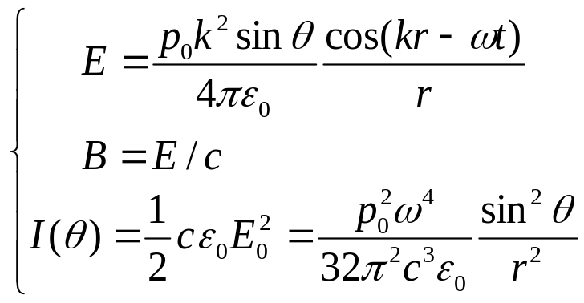


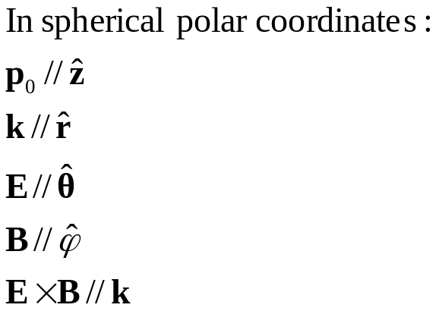
October 28 Scattering and polarization
Scattering of light from an induced dipole: Electric dipole radiation.
+
B
θ
+
E
-
Important features:
Inverse square law.
Angular distribution (toroidal).
Frequency dependence.
Directions of E, B, and k.

Slide 16
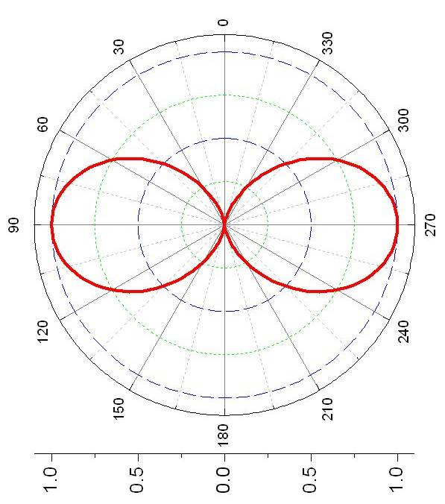

8.5 Scattering and polarization
Polarization by scattering:
If the incident ray is unpolarized, we can decompose it into a horizontally and a vertically polarized light with equal strength.
The scattered light in the forward direction is unpolarized.
The scattered light at 90º from the incident ray is linearly polarized, which is perpendicular to both the incident ray and the scattered ray.
The scattered light in other directions are partially polarized.
+
B
S
θ
+
E
-
The polarization of the scattered light from a linear dipole is along the longitudinal line (S-N, or ).

Slide 17

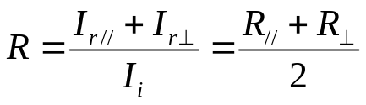
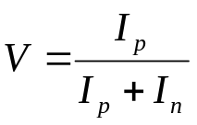
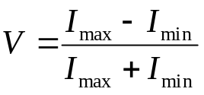
8.6 Polarization by reflection
Brewster angle (polarization angle):
For an unpolarized incident light, at the Brewster angle, only the component with E-field normal to the incidence plane can be reflected.
Application of Fresnel equations:
The reflectance of nature light:
r// = 0
θ_{p}
Brewster
angle
E
Degree of polarization:
I_{p} and I_{n} are the constituent flux densities of the incident polarized and unpolarized light. If an analyzer is used, then

Slide 18
Read: Ch8: 5-6
Homework: Ch8: 46,47,49,52
Due: November 8

Slide 19
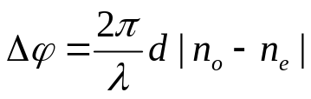

October 30 Retarders
8.7 Retarders
Retarder: An optical element that changes the polarization of the incident wave.
Principle of retarders: One constituent P-state is phase-retarded with respect to the other.
8.7.1 Wave plates and rhombs
The optic axis is parallel to the surfaces of the plate.
Relative phase difference (phase retardation) between the emerging e-and o-waves:
Linear retardation: relative optical path length difference
Fast axis: The axis along which a light polarized will propagate faster.
For n_{e}< n_{o}, the optic axis is the fast axis.
For n_{e} >n_{o}, the axis that is perpendicular to the optic axis is the fast axis.
o
e
v//
Optic
axis
v┴

Slide 20
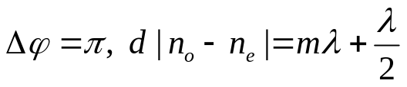
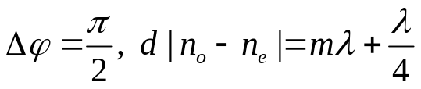
Half-wave plate (HWP):
e
e
θ
θ
o
o
Optic
axis
Optic
axis
Linear input: Rotate light initially polarized at angle θ by an angle of 2θ.
Elliptical input: Flip the tilting angle, and invert the handedness.
Both can be thought as a mirror imaging with respect to the fast or slow axis.
e
e
θ
θ
o
o
Optic
axis
Optic
axis
Quarter-wave plate (QWP):
e
e
θ = 45º
Linear input: Covert into elliptical light.
Linear input at ±45º: Covert into circular light.
Handedness: From the linear light to the slow axis of the wave plate using the smallest angle.
o
o
Optic
axis
or
Optic
axis

Slide 21
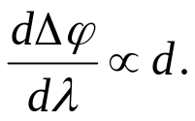
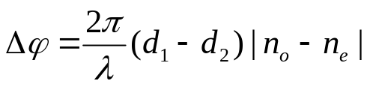
General considerations of waveplates:
Zero-order wave plate: m = 0.
Example: Quartz at 550 nm, n_{e}-n_{o}=0.0092, d =15 μm for QWP, and d =30 μm for HWP.
Multiple-order wave plate:
Less expensive, but sensitive to wavelength, incident angle and temperature.
Compound zero-order wave plate:
Eliminates the bandwidth and temperature effects.
×
Example 8.8, 8.9
8.7.2 Compensators and variable retarders
Compensator: An optical device that produces controllable retardation.
Babinet compensator:
×

Slide 22
Read: Ch8: 7-8
Homework: Ch8: 54,55,56,68(Optional),69
Due: November 8

Slide 23

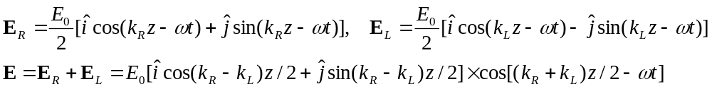
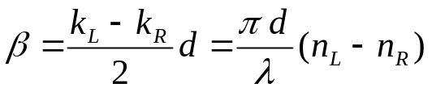
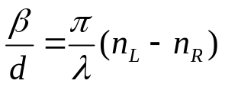
November 1 Optical activity and induced optical effects
8.10 Optical activity
Optical activity (optical rotation): The polarization plane of a linearly polarized light is rotated when traveling through certain materials. It occurs in solutions of chiral molecules (a molecule not superimposable on its mirror image), and some solids. E.g., corn syrup, crystal quartz.
Dextrorotatory (d-rotatory) materials and levorotatory (l-rotatory) materials.
Fresnel’s explanation (1825):
Circular birefringence: R-state and L-state have different propagation speeds.
Incidence:
In the medium at the location z:
Rotation direction: k_{R} > k_{L}, counterclockwise, l-rotatory; k_{R} < k_{L}, clockwise, d-rotatory.
Angle of rotation (traditional):
Specific rotation: , e.g, +30º/inch for corn syrup, 21º/mm for quartz.

Slide 24

8.11 Induced optical effects ― optical modulators
I) Photoelasticity (mechanical birefringence, stress birefringence, Brewster 1816):
Under compression or tension, a material obtains the property of a uniaxial crystal.
The effective optical axis is in the direction of the stress, and the induced birefringence is proportional to the stress.
II) Faraday effect (Faraday 1845):
The plane-of-vibration of a linearly polarized light inside a medium is rotated by a strong magnetic field in the light propagation direction.
Rotation angle:
V = Verdet constant, B = magnetic field, d = length of the medium
Sign convention:
Positive V (most materials) →
l-rotatory when k//B, d-rotatory when k//-B.
The actual rotation thus does not depend on the sign of k.
No such reversal occurs in nature optical activity.
β
k
B
Classical explanation: P = R+L → Circular light drives circular orbits of electron → B-field introduces radial force whose direction depends on R or L → two possible polarization (n_{R} and n_{L}) for a given B-field.
Applications: 1) Optical modulator, 2) Faraday insulator
d
k
k
B
B

Slide 25


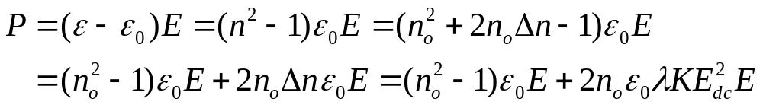
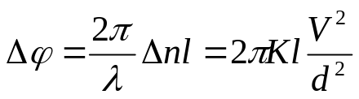
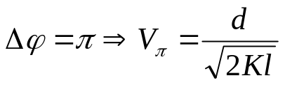
III) Kerr effect (Kerr 1875):
An isotropic substance becomes birefringent in an E-field. The optic axis is in the direction of the E-field, the birefringence
K = Kerr constant (mostly positive). Quadratic electro-optic effect.
Third order nonlinear effect
Retardation:
Half-wave voltage:
Example:
Nitrobenzene: K =220×10⁻⁷cm/statvolt²,
V_{π}=30000 V.
Applications:
High-speed shutters, Q-switches. Frequency ~10¹⁰ Hz.
E_{x}
E
k
E_{y}
Optic
axis

Slide 26
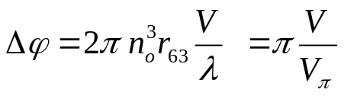
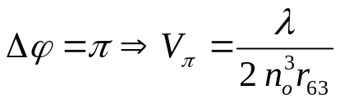
III) Pockels effect (Pockels 1893):
An electro-optic effect where the induced birefringence is proportional to the E-field and is thus proportional to the applied voltage (second order nonlinear effect).
Exists only in crystals that have no center of symmetry.
Response time < 10 ns, up to 25 GHz.
Pockels cell configurations: transverse (E⊥k) and longitudinal (E // k) modulation
Example: Longitudinal configuration in KDP
E_{x}
E
Retardation:
r₆₃: Electro-optic constant
(an element of the second-rank electro-optical tensor r_{ij})
Half-wave voltage:
Example:
KDP: r₆₃=10.6 pm/V, V_{π}=7600 V (a factor of 5 less than Kerr cell).
k
E_{y}
Optic
axis

Slide 27
Read: Ch8: 10-11
Homework: Ch8: 73,74,88(Optional)
Due: November 8

Slide 28

“Everything is a lost horse.”

