Slide 1
Chapter 10 Diffraction
December 2 Fraunhofer diffraction: the single slit
10.1 Preliminary considerations
Diffraction: The deviation of light from propagation in a straight line.
There is no essential physical distinction between interference and diffraction.
Huygens-Fresnel Principle: Every unobstructed point of a wave front serves as a source of spherical wavelets. The amplitude of the optical field at any point beyond is the superposition of all these wavelets, taking into account their amplitudes and phases.
Fraunhofer (far field) diffraction: Both the incoming and outgoing waves approach being planar. a²/λ<< R, where R is the smaller of the two distances from the source to the aperture and from the aperture to the observation point. a is the size of the aperture. The diffraction pattern does not change when moving the observation plane further away.
Fresnel (near field) diffraction: The light source or the plane of observation is close to the aperture. General case of diffraction. The diffraction pattern changes when the observation plane moves.
P
S
a
R₂
R₁

Slide 2
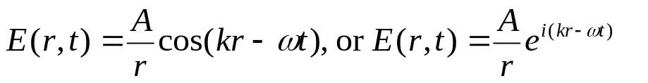
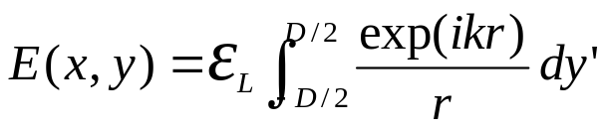
Mathematical criteria for Fraunhofer diffraction:
The phase for the rays meeting at the observation point is a linear function of the aperture variables.
P
S
y'
Waves from a point source:
Harmonic spherical wave:
y' sinθ
A is the source strength.
y
P (x,y)
D/2
r
Coherent line source:
dy'
x
-D/2
ε_{L} is the source strength per unit length.
This equation changes a diffraction problem into an integration (interference) problem.

Slide 3
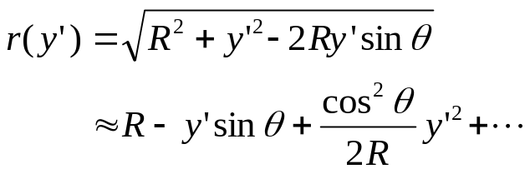
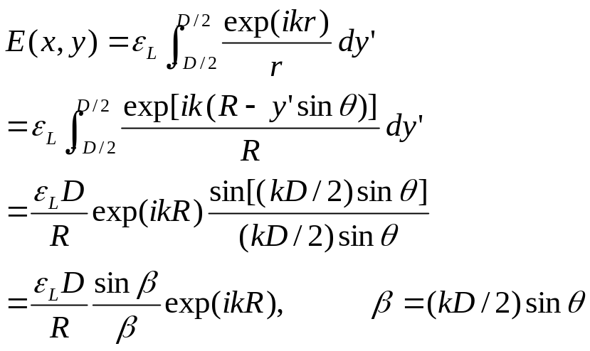
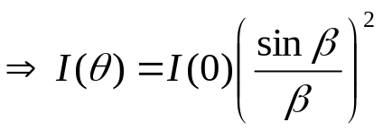
10.2 Fraunhofer diffraction
10.2.1 The single slit
y
P (x,y)
D/2
r
The slit is along the z-axis and has a width of D.
y'
R
θ
x
-D/2
In the phase, r is approximated by R-y' sinθ, if D²/Rλ <<1.
Fraunhofer diffraction condition.
In the amplitude, r is approximated by R.
The overall phase is the same as a point source at the center of the slit.
Integrate over z gives the same function.

Slide 4
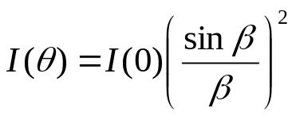
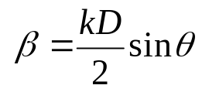
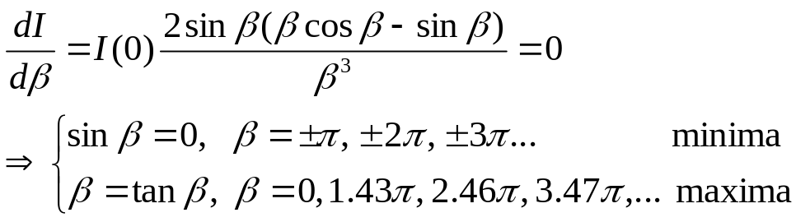
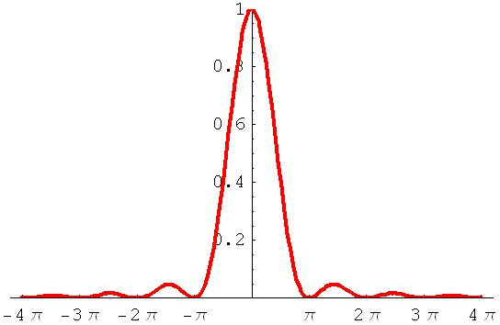

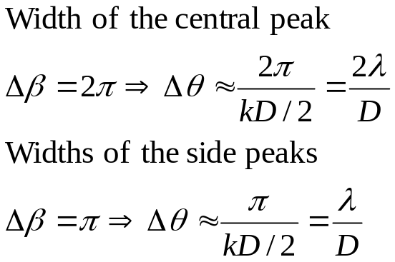

y
P (x,y)
D/2
r
y'
R
θ
x
-D/2
I/I(0)=
0.047
0.016
β

Slide 5

Phasor model of single slit Fraunhofer diffraction: rolling paper

Slide 6
Read: Ch10: 1-2
Homework: Ch10: 2,7,8,9
Due: December 9

Slide 7
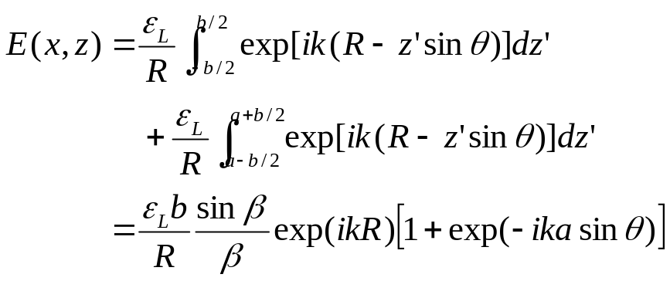
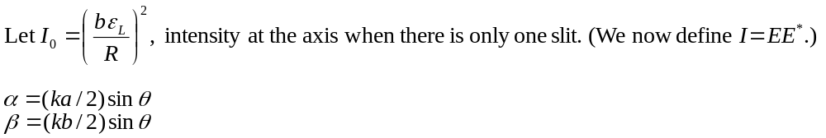
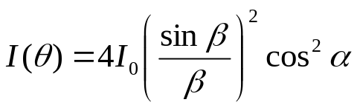
December 4 Double slit and many slits
10.2.2 The double slit
z
P (x,z)
R-a sinθ
b
a
R
θ
x
The result is a rapidly varying double-slit interference pattern (cos²α) modulated by a slowly varying single-slit diffraction pattern (sin²β/β ²).

Slide 8
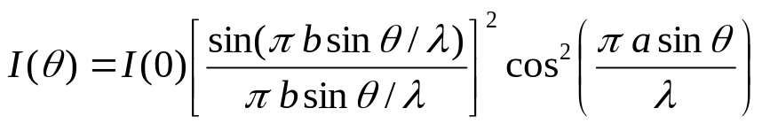
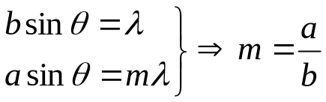
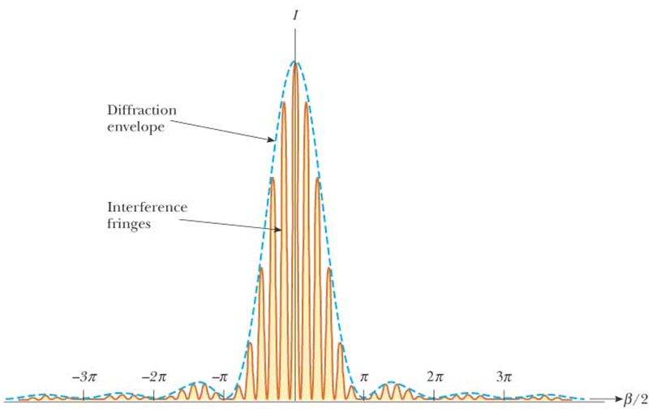
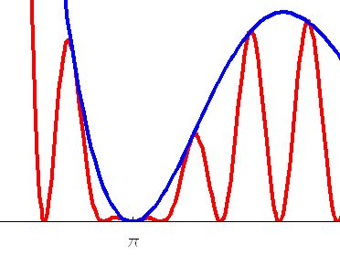
Question:
Which interference maximum coincides with the first diffraction minimum?
Single-slit diffraction
Two-slit interference
“Half-fringe” (split fringe) may occur there. Our author counts a half-fringe as 0.5 fringe.
Envelope
Fringes
half-fringe

Slide 9
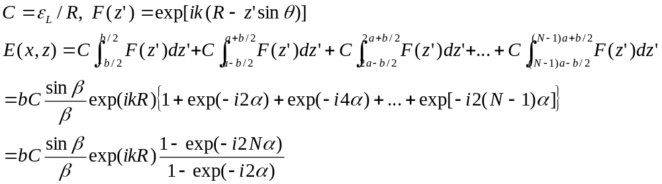
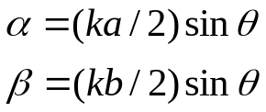
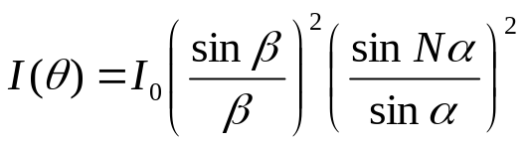
10.2.3 Diffraction by many slits
z
P (x,z)
R-2a sinθ
R-a sinθ
b
R
a
θ
x

Slide 10

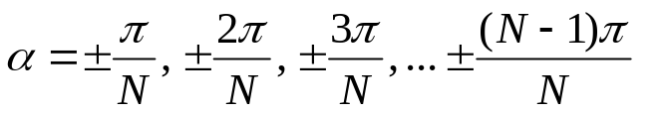
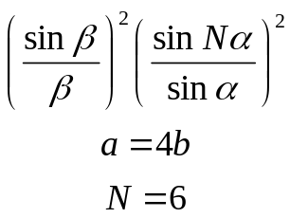
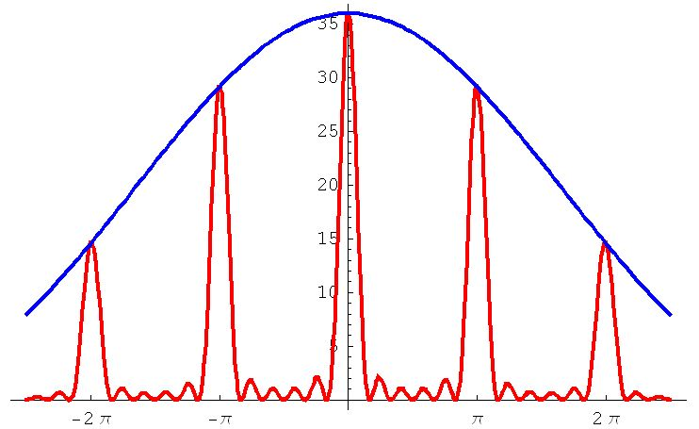
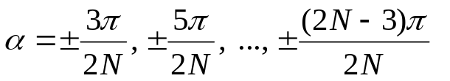
Principle maxima:
Minima (totally N-1):
Subsidiary maxima (totally N-2):
α

Slide 11
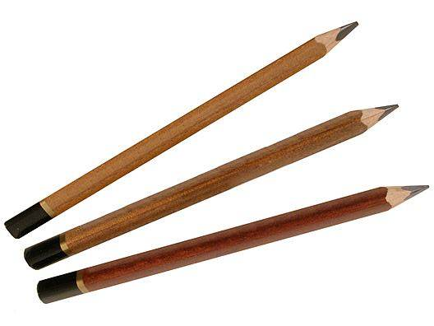
Phasor model of three-slit interference: rotating sticks

Slide 12
Read: Ch10: 2
Homework: Ch10: 14,15,17
Due: December 9

Slide 13
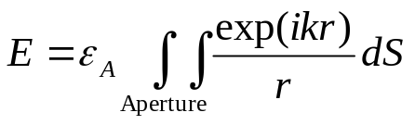
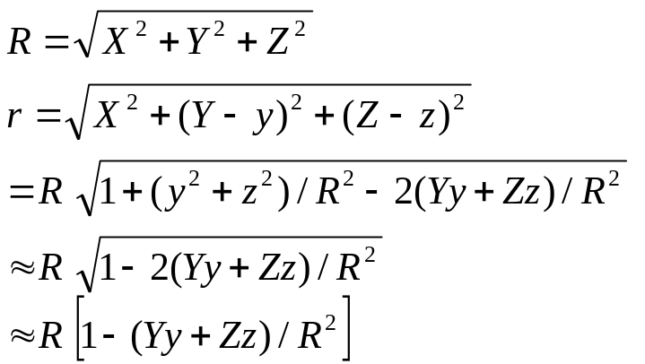
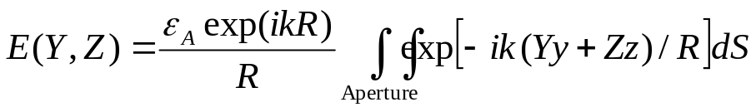
December 6 Rectangular aperture and circular aperture
10.2.4 The rectangular aperture
Coherent aperture:
y
Y
dS=dydz
r
P(Y,Z)
R
x
X
z
Z
Fraunhofer diffraction condition

Slide 14
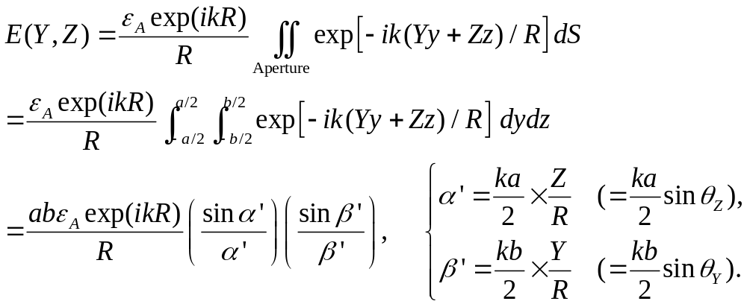
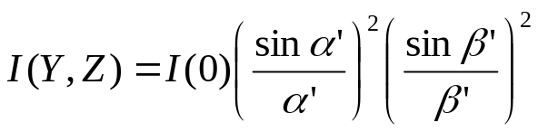
Rectangular aperture:
y
Y
dS=dydz
r
P(Y,Z)
R
b
x
z
a
Z

Slide 15
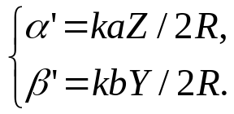
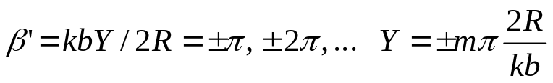
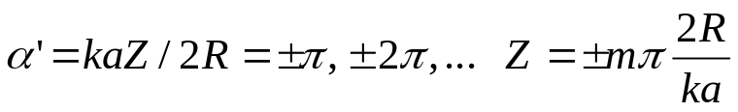
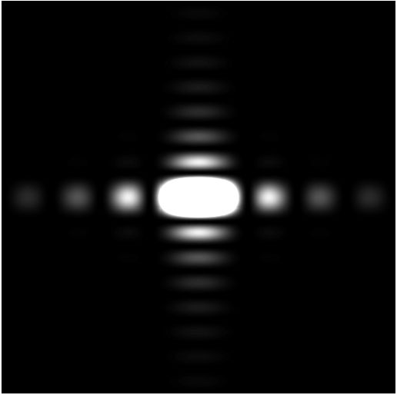
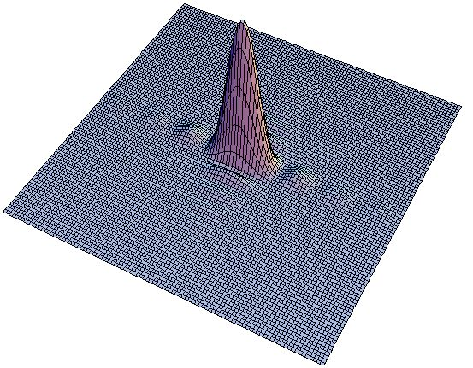
Y minimum:
Z minimum:

Slide 16
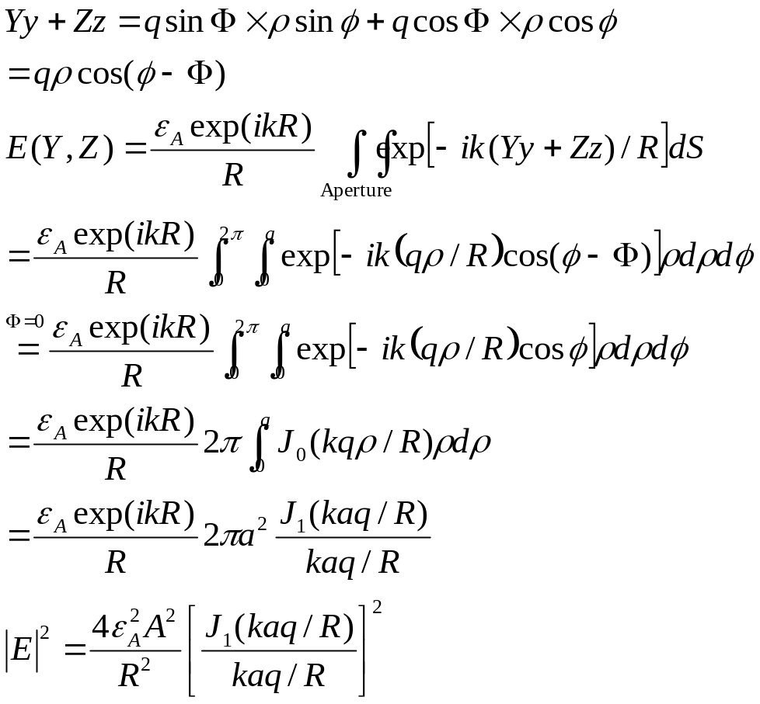
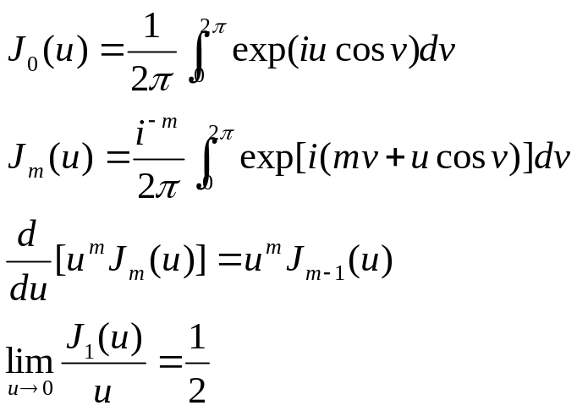
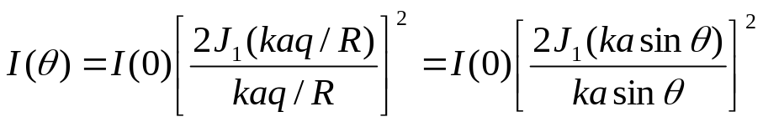
y
Y
10.2.5 The circular aperture
Importance in optical instrumentation: The image of a distant point source is not a point, but a diffraction pattern because of the limited size of the lenses.
P(Y,Z)
ρ
R
q
φ
θ
Φ
a
x
z
Z
Bessel functions:.

Slide 17
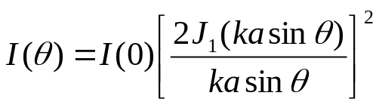
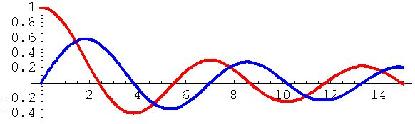

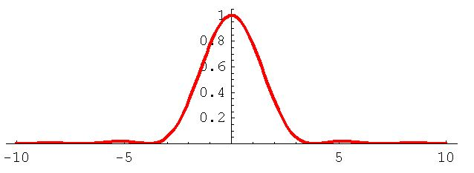

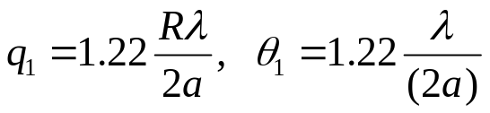
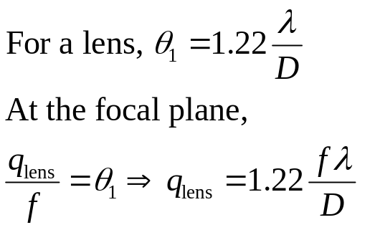

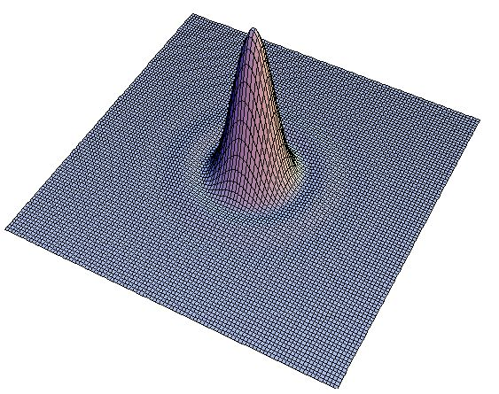
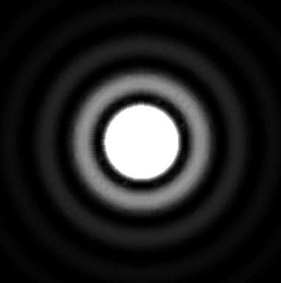
J₀(u)
J₁(u)
u
Radius of Airy disk:
0.018
3.83
D
P
q₁
f

Slide 18
Read: Ch10: 2
Homework: Ch10: 25(Optional),28,40
Due: December 9

Slide 19
未知の世界へ

