Slide 1
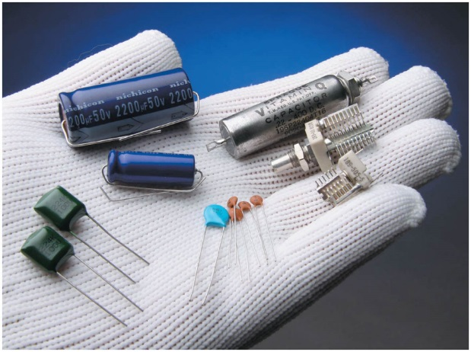
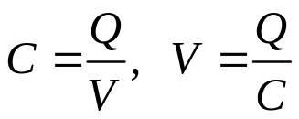

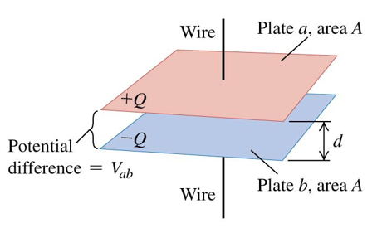
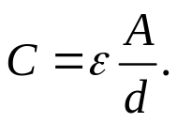

Lecture 4: Capacitors and inductors
1. Capacitors
Capacitor: Any two conductors separated by an insulator.
Usually a capacitor is charged so that one conductor has + Q, they other has – Q.
The potential difference V between the conductors is proportional to Q.
Capacitance of a capacitor is:
Capacitance measures the ability of a capacitor to store charge. The unit of capacitance is farad,
1 F = 1 C/V. More convenient units are μF and pF.
For a parallel-plate capacitor with an area A and separation distance d:
K is the dielectric constant.
ε₀ is the permissively of free space.
When using a capacitor, in addition to its capacitance, it is important to know its voltage rating to avoid electrical breakdown.

Slide 2
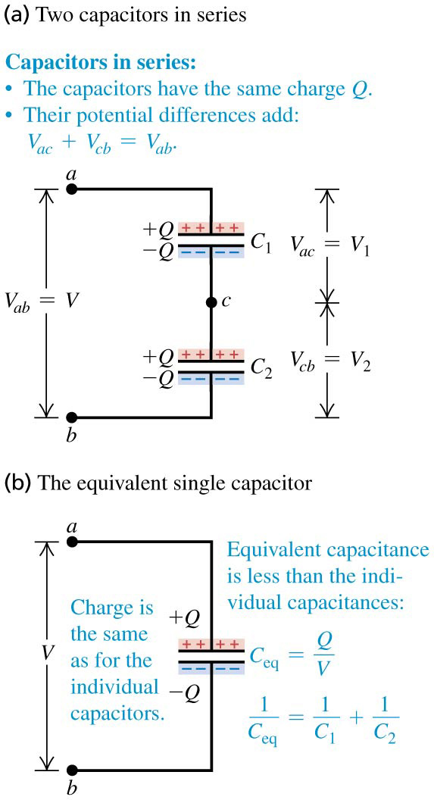
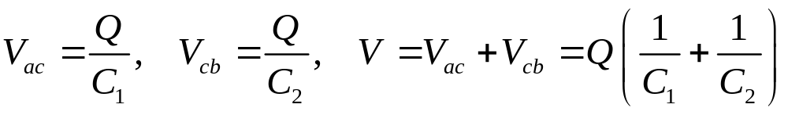
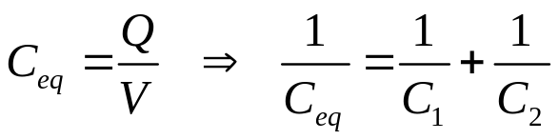
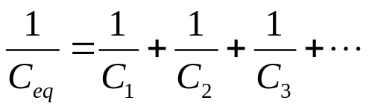
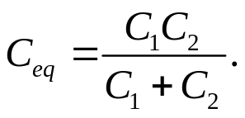
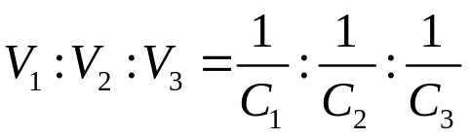
2. Capacitor combinations
Capacitors in series:
In a series connection, the charge on all capacitors is the same.
The equivalent capacitance C_{eq} is
For a number of capacitors in series,
For 2 capacitors,
It follows that , the smaller capacitor has more voltage.

Slide 3
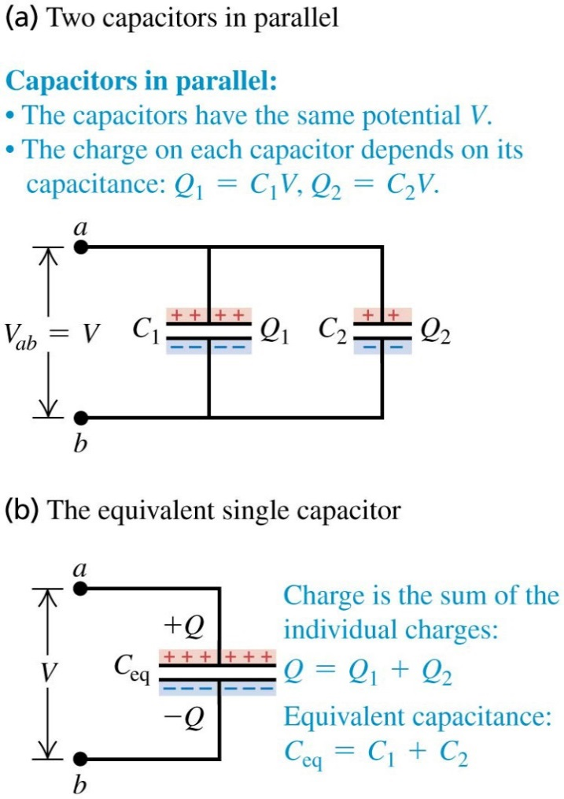
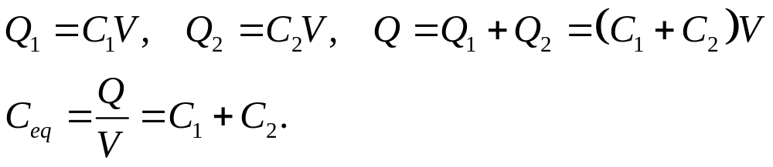

Capacitors in parallel:
In a parallel connection, the potential difference on each capacitor is the same.
For a number of capacitors in parallel,

Slide 4
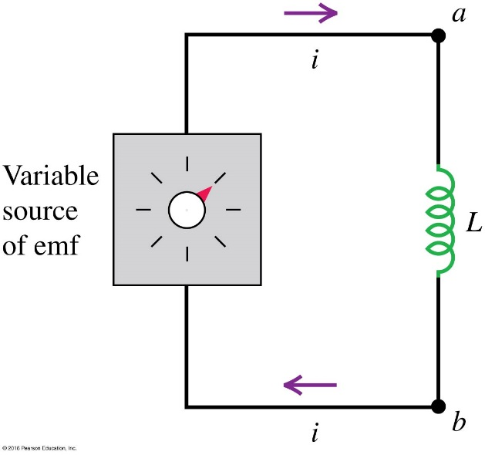
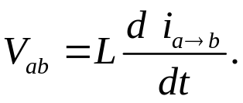

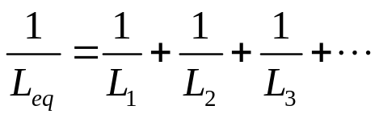
3. Inductors
Inductor: An inductor is a coil that stores magnetic energy. Due to electromagnetic induction, the voltage on an inductor is
L is called the inductance. The SI unit of inductance
is the henry (H), 1 H = 1Wb/A.
Inductors cause voltage spikes when a circuit is switched on or off.
Inductors are seldomly combined. When they are well separated, using L_{eq}=V/(dI/dt), we can prove that
For series connection:
For parallel connection:
Therefore, the combination laws for inductors are similar to that for resistors.

Slide 5
Homework:
Ch2: 1

Slide 6
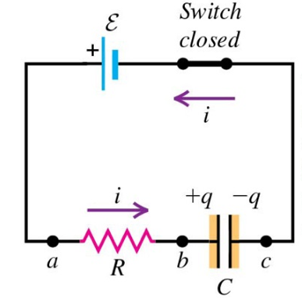
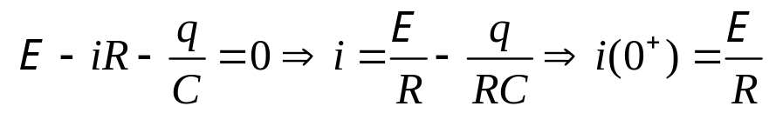
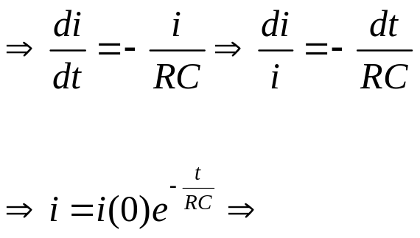
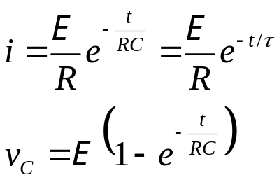
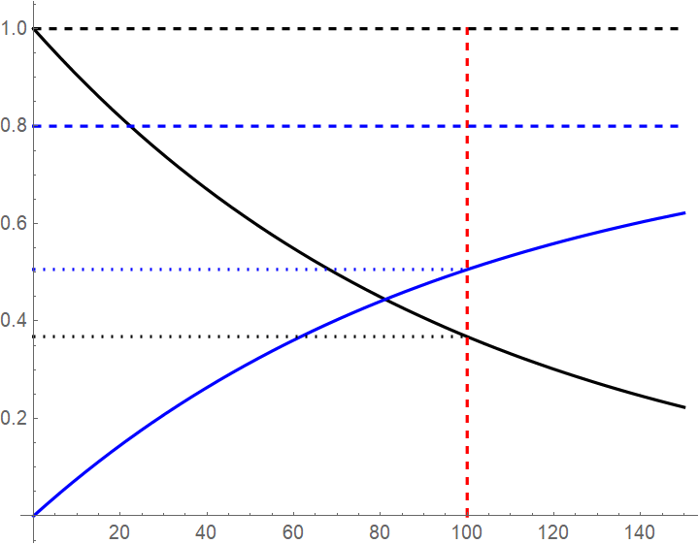

Lecture 5: RC and RL circuits
1. RC circuit: charging a capacitor
At t = 0 the switch is closed. Let q, i, and v_{C} be the instantaneous charge, current and voltage on the capacitor.
Kirchhoff's loop rule:
i
Time constant:
At t = τ, the current decreases to 1/e = 0.368 ≈ 1/3 of its initial value, and the voltage has reached 1−1/e = 0.632 ≈ 2/3 of its final value.
v_{C}
t
τ = RC

Slide 7
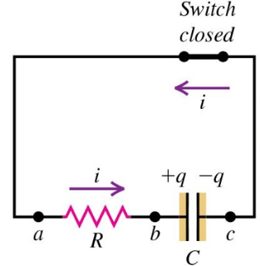
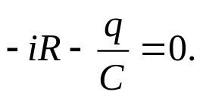
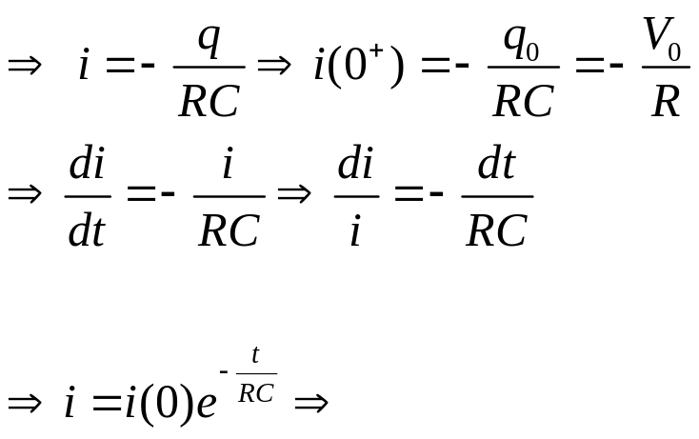
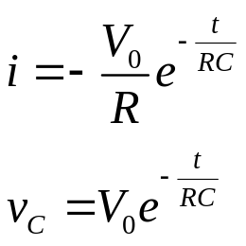
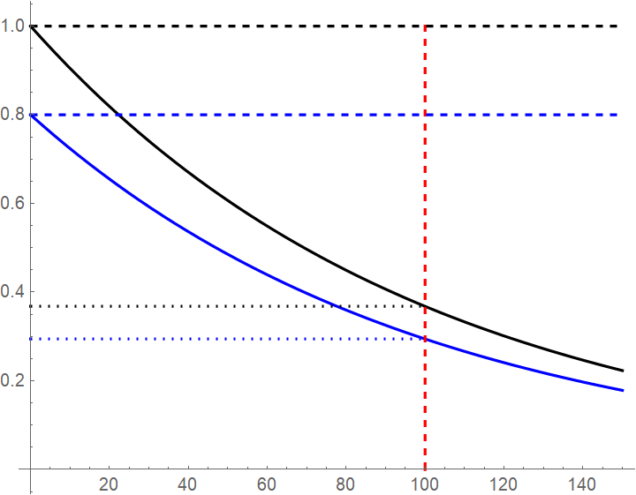
2. RC circuit: discharging a capacitor
At t = 0 the switch is closed.
Kirchhoff’s loop rule:
-i
v_{C}
t
τ = RC

Slide 8
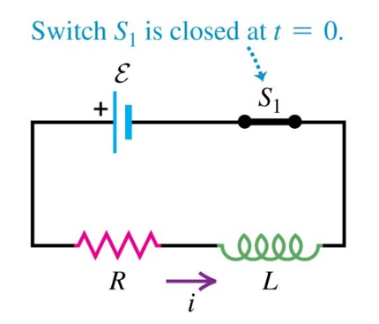
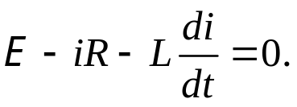
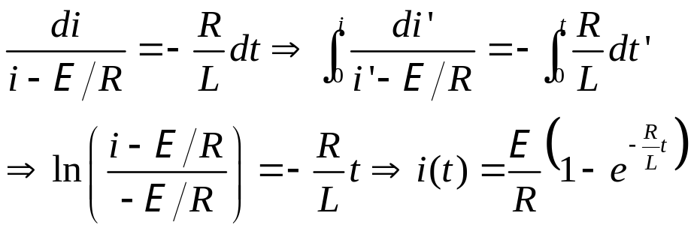
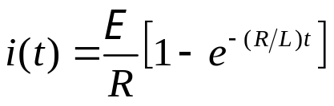
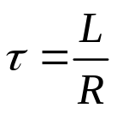
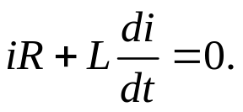
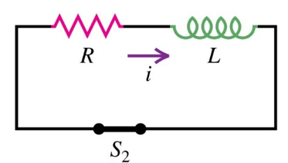

3. RL circuit: current growth
Kirchhoff’s rule:
Solving for i(t),
Time constant:
4. RL circuit: current decay
Kirchhoff’s rule:
Solving for i(t),

Slide 9
Homework:
Ch2: 2,3,4

Slide 10

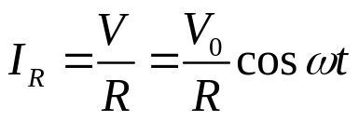
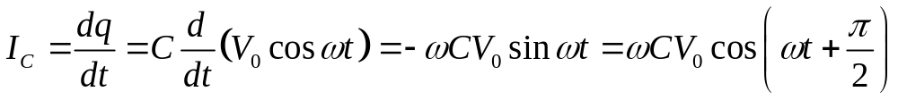
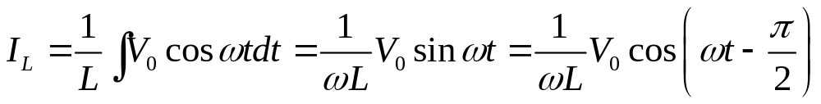
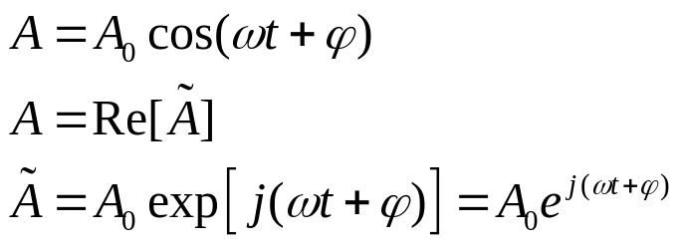
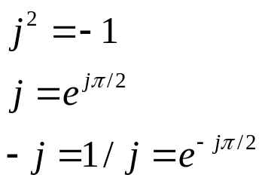
Lecture 6: Reactance and impedance
1. AC current through R, C and L
We now find the AC current through R, C, and L, for a given sinusoidal voltage across the element,
For a resistor,
For a capacitor,
For an inductor,
2. Complex reactance of R, C and L
The complex representation of a real sinusoidal signal is

Slide 11
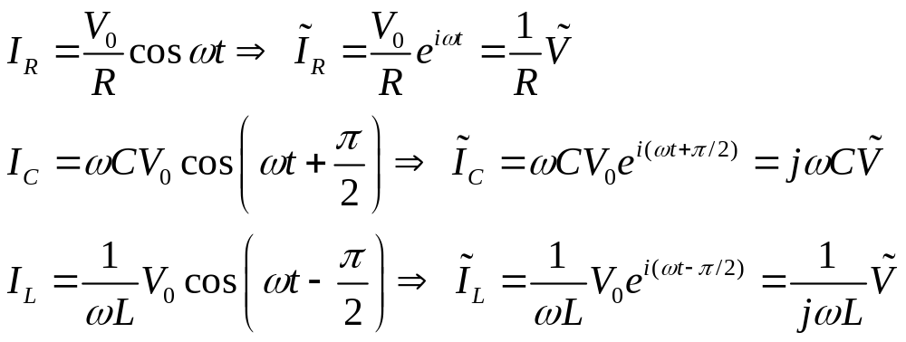
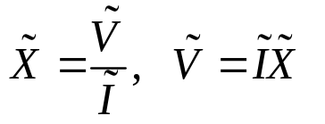
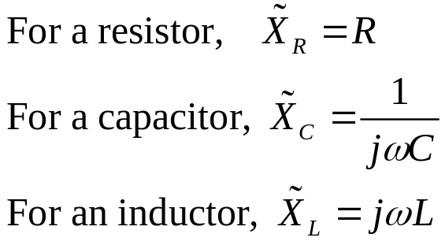

The relation between the complex current and the complex voltage of R, C, L is now
The complex reactance of an electronic component is the ratio between its complex voltage and complex current: .
When we are dealing solely with AC currents, we can then drop off the tildes on

Slide 12
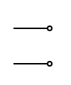

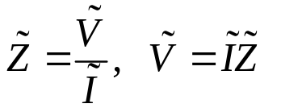


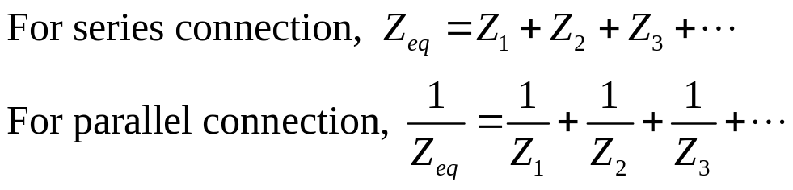
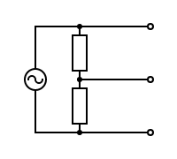


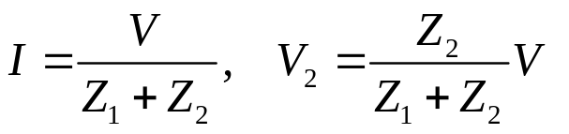


3. Complex impedance
The complex impedance of a two-terminal linear passive network is defined as
(We then drop off the tildes.)
We observe that Kirchhoff’s law (and consequently Thevenin’s theorem) still works for an AC circuit, if we use complex voltage, complex current, and complex reactances.
For example, in a series connection, I is common, V=V₁+V₂, which gives Z=V/I=Z₁+Z_{2.}
Impedance combinations:
Example: voltage divider

Slide 13

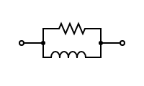
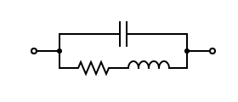
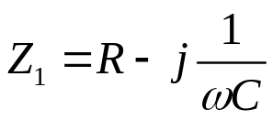
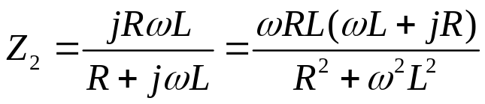
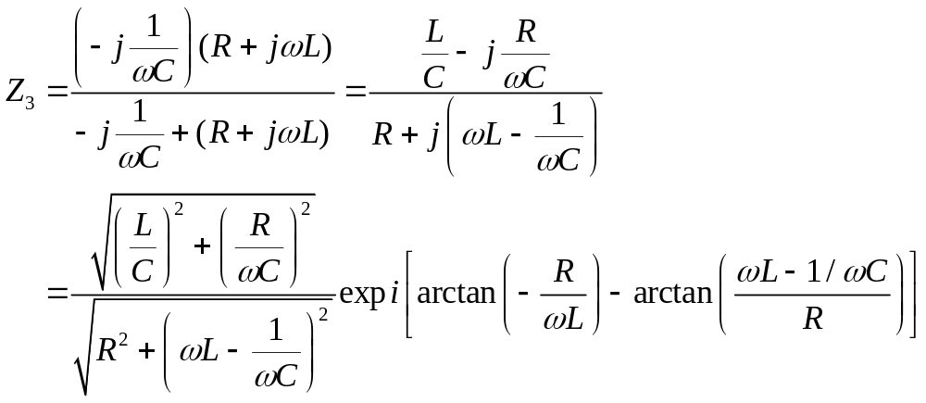
Examples of complex impedances:
R
C
R
C
L
R
L

Slide 14




R₁
L
R₂
C
It is often useful to simplify the complex impedance into the form of .

Slide 15
Homework:
Ch2: 5,6

Slide 16



Lecture 7: RC filters
A filter passes certain frequencies of signals while rejecting others.
There are four basic kinds of filters: low-pass, high-pass, bandpass, and notch filters. They can be realized by combining R, C, and L in special ways.
1. RC low-pass filter
Assuming a load resistance R_{L} = ∞. The complex transfer function (amplification, attenuation) is
R
V_{in}
C
V_{out}

Slide 17

Decibel: Decibel (Δ, in dB) measures the levels of a signal.
Power: Each 3 dB increase (or decrease) makes the power doubled (or halved).
Voltage: Each 6 dB increase (or decrease) makes the voltage doubled (or halved).

Slide 18




f_{C}
f
-3 dB
Attenuation (dB)
f_{C}
f
Phase (°)
-45°

Slide 19


2. RC High-pass filter
Assuming a load resistance R_{L} = ∞. The complex transfer function is
C
V_{in}
R
V_{out}

Slide 20




f_{C}
f
-3 dB
Attenuation (dB)
45°
Phase (°)
f_{C}
f

Slide 21
Homework:
Ch2: 7

Slide 22



Lecture 8: RLC circuits
1. RLC series resonant circuit
The current in the circuit is:
R
V_{s}
L
C
Resonance frequency is the natural frequency at which a system vibrates at its highest amplitude.
At the resonance frequency, the reactances of the capacitor and the inductor cancels each other.

Slide 23





Current as a function of frequency:
|V_{s}|=10 V
L=100 μH
C=62.5 nF
Δ f
R = 2 Ω (Q = 20)
R = 5 Ω (Q = 8)
R = 10 Ω (Q = 4)
Current |I| (A)
f₀=63.7 kHz
Frequency (Hz)
Quality factor (Q) measures the ratio between the stored energy and dissipated energy in a system.
Bandwidth (Δω, Δf) is the width of the resonance peak. It is measured down to 1/2 for power, but 1/$\sqrt{2}$ for voltage and current.

Slide 24



2. RLC band pass filter
A bandpass filter passes a narrow range of frequencies while attenuating others.
Assuming a load resistance R_{L} = ∞. The complex transfer function is
L
C
V_{in}
R
V_{out}
Since |H| ∝|I|, the frequency dependence of |H| follows the current in an RLC series resonant circuit. Especially

Slide 25
Homework:
Ch2: 8,9,10

Slide 26








Lecture 9: Damped oscillator
1. RLC damped harmonic oscillator
R
The RLC series circuit without a source acts as a damped harmonic oscillator. It’s an analog of many other phenomena in physics.
Assume at t = 0 the capacitor is charged to a voltage of V₀, and the switch is closed. We now find the current I.
Kirchhoff’s law gives
+
C
L
I
This is a linear second order homogeneous differential equation. Guess , then
The general solution is
At t =0, I=0, and .
These initial conditions give us

Slide 27











Depending on whether is positive, 0, or negative, the current may have quite different characters.
1) Overdamped oscillator:
In this case . The current is the difference between a slowly decaying term
and a rapidly decaying term .
In the limit of , we have
2) Critically damped oscillator:
In this case we notice
This gives

Slide 28




3) Underdamped oscillator:
In the limit of
R= 200 Ω
R= 100 Ω
R= 20 Ω
V₀= 10 V
L= 5 mH
C= 2 μF
Current (mA)
Time (ms)

Slide 29
Homework:
Ch2: 11,12

