Slide 1
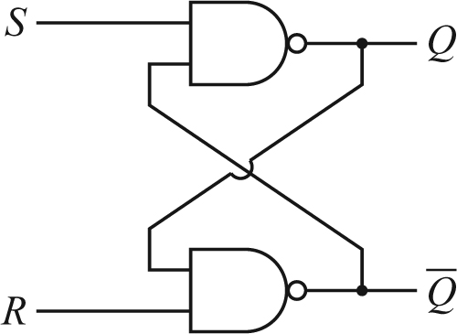
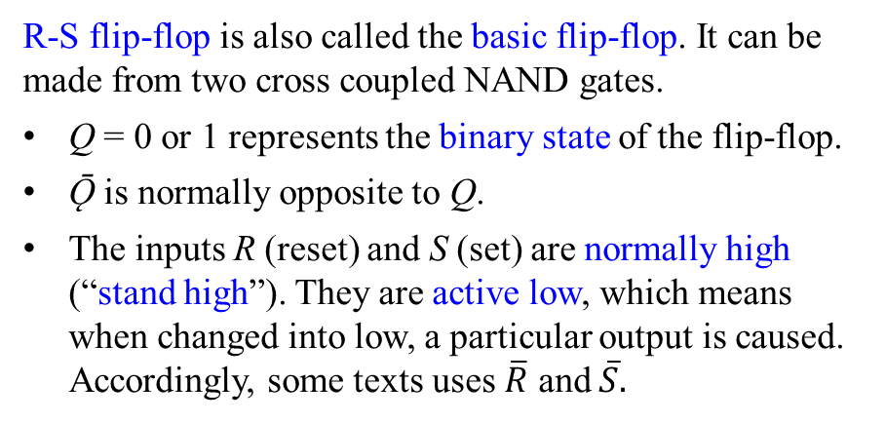
Lecture 20: Flip-flops I
1. R-S flip-flop
A flip-flop is also known as a bistable multivibrator. It is the fundamental building block in digital electronics used to store and read binary data.
It has two stable states. Its output depends on both current and past inputs.
Circuits containing flip-flops are called sequential logic circuits (in contrast to combinational logic circuits). A truth table is not enough. A timing diagram is needed in describing the operation of a sequential logic circuit.
R-S flip-flop is also called the basic flip-flop. It can be made from two cross coupled NAND gates.
Q = 0 or 1 represents the binary state of the flip-flop.
Ǭ is normally opposite to Q.
The inputs R (reset) and S (set) are normally high (“stand high”). They are active low, which means when changed into low, a particular output is caused. Accordingly, some texts uses $\overline{R}$ and $\overline{S}.$

Slide 2
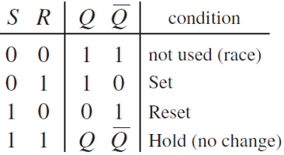
When S = R = 1 (they are normally high), the state of the flip-flop is bistable:
either Q = 0, Ǭ =1 or Q = 1, Ǭ =0. The flip-flop holds the state.
Suppose currently S = R = 1, we now apply a low pulse (“negative pulse”) to S.
If Q = 0, Ǭ =1, then the flip-flop “flips” to Q = 1, Ǭ =0.
If Q = 1, Ǭ =0 already, then it has no change.
We say “A negative pulse on S sets the flip-flop to 1”.
By symmetry, a negative pulse on R causes Q = 0, Ǭ =1.
We say “A negative pulse on R resets the flip-flop to 0”.
S = R = 0 is not used. We don’t set and reset at the same time.
The R-S flip-flop remembers which input (R or S) was low last, i.e., it saves the state of R and S.

Slide 3
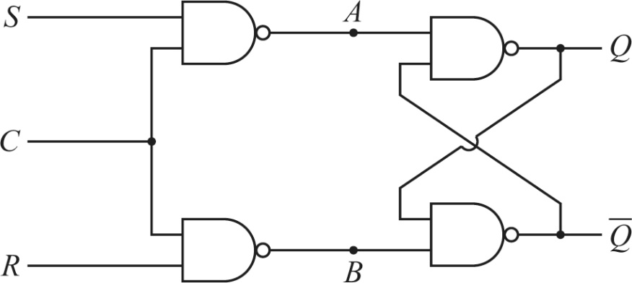

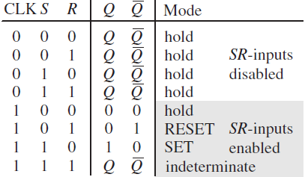
2. Clocked flip-flop
While the R-S flip-flop remembers which input (R or S) was low last, this memory is erased when R or S changes the next time.
A clocked flip-flop, or gated R-S flip-flop, uses a clock input to control whether or not the flip-flop is active.
When the clock input C = 0, S and R cannot go trough. A and B stand high, which keeps the state of Q. We say Q is latched. The flip-flop is inactive, or disabled.
When the clock input C = 1, S and R are passed. The circuit functions like a basic flip-flop.
S and R are now normally low (“stand low”) and active high, because the leftmost two NAND gates now works as inverters to S and R.
Because the clocked flip-flop is enabled whenever C=1, it is a level-triggered flip-flop.

Slide 4
Homework:
Ch8: 7

Slide 5
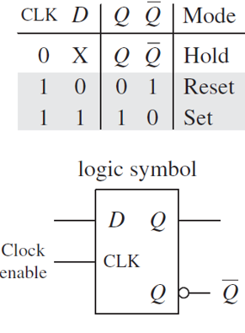
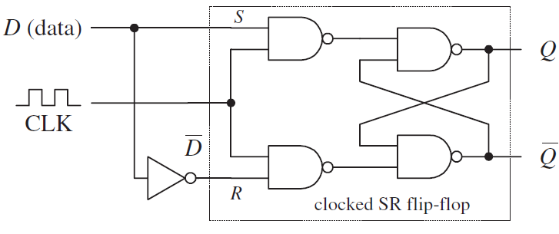
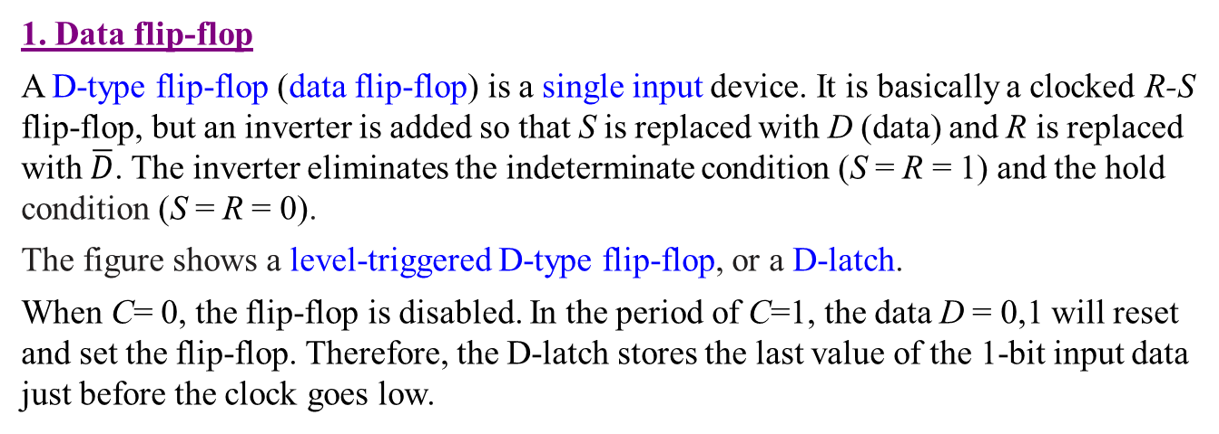
Lecture 21: Flip-flops II
1. Data flip-flop
A D-type flip-flop (data flip-flop) is a single input device. It is basically a clocked R-S flip-flop, but an inverter is added so that S is replaced with D (data) and R is replaced with $\overline{D}$. The inverter eliminates the indeterminate condition (S = R = 1) and the hold condition (S = R = 0).
The figure shows a level-triggered D-type flip-flop, or a D-latch.
When C= 0, the flip-flop is disabled. In the period of C=1, the data D = 0,1 will reset and set the flip-flop. Therefore, the D-latch stores the last value of the 1-bit input data just before the clock goes low.

Slide 6
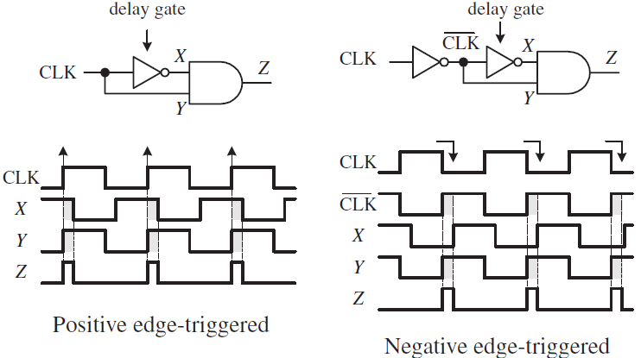
2. Edge-triggering
In a level triggered flip-flop, the output may keep changing during the valid clock level, which is undesirable if we are interested in only the data at a particular moment.
An edge-triggered flip-flop reads the inputs only at either a positive or a negative clock edge. They are known as positive (rising) edge triggering and negative (falling) edge triggering. This is achieved by introducing a positive or negative edge-triggered pulse generator into a level-triggered flip-flop.
In these pulse generators, the clock signal is delayed through an inverter. The very brief pulse generated at Z is used as the new clock.

Slide 7
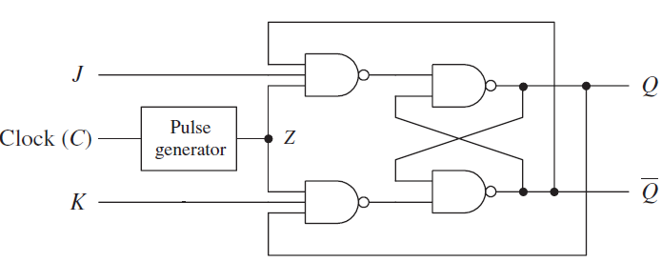
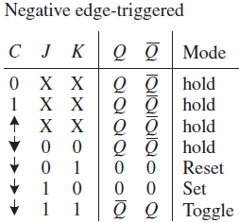
3. J-K flip-flop
The clocked flip-flop has an indeterminate mode when R=S=1, so not all input possibilities are utilized.
A J-K flip-flop is a modified clocked flip-flop, where two cross-coupled feedback lines are added between the output and input. Unlike the clocked flip-flop, when R=S=1, the J-K flip-flop has a toggle mode, where at each active clock edge Q and Ǭ switch to their opposite.
The figure shows a negative edge-triggered J-K flip-flop.
The J-K flip-flop is a versatile counting unit. It can be controlled by the J and K inputs while the signal to be counted is input through the clock.

Slide 8
Homework:
Ch8: 8

Slide 9
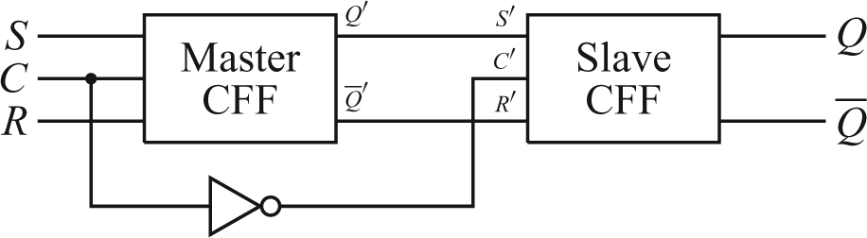
Lecture 22: Counters
1. Master-slave flip-flop
The clocked flip-flop is enabled when C=1. During this time period, if there are multiple changes of S and R, the output of the flip-flop will change continuously. This is undesirable in some applications
The master-slave flip-flop is constructed by two clocked flip-flops (CFFs) connected in series, but clocked in a complementary fashion.
When C= 0, the master CFF is disabled, and the slave CFF is enabled. Q and Ǭ reflects the current state if Q′ and Ǭ ′.
When C=1, the master CFF is enabled, and the slave CFF is disabled. Changes in S and R are reflected in the master outputs Q′ and Ǭ ′.
When C changes back from 1 to 0, the state of S and R just before the instant (which one was high last) will be read by the slave CFF.
Therefore, a master-slave flip-flop reads and saves only the last state of S and R in the period of C=1.

Slide 10
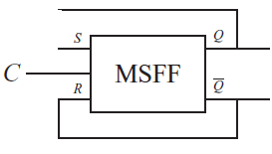
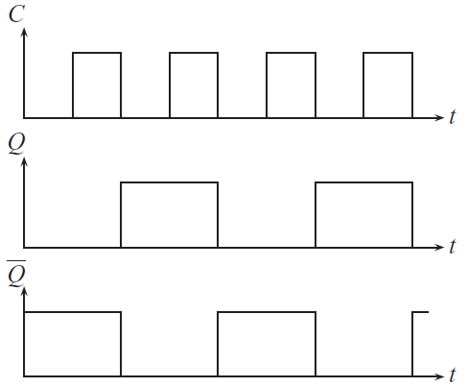
2. Toggle flip-flop
A toggle flip-flop can be made from a master-slave flip-flop by adding two cross-coupled feedback lines between the output and input, as shown.
The states of Q and Ǭ switch or toggle at the negative transition edge of C. A toggle flip-flop is sometimes called a divide-by-two.
A toggle flip-flop can also be made from a J-K flip-flop by setting J =K=1.

Slide 11
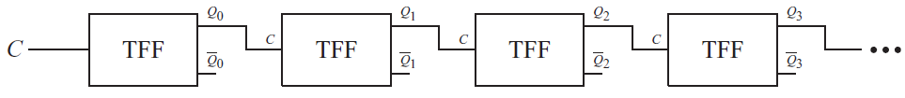
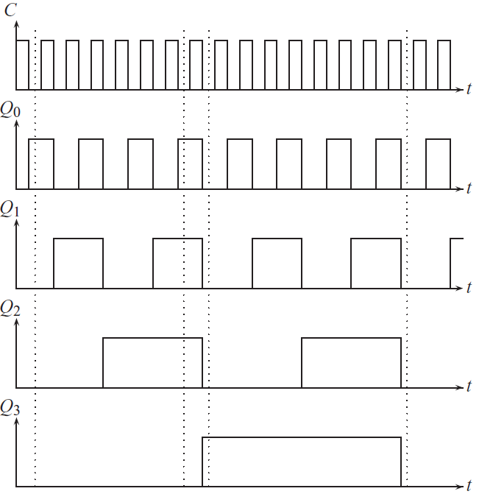
3. Binary counters
A binary counter can be constructed by connecting several toggle flip-flops (TFF) in series, where the output Q of one TFF is used as the clock for the next TFF. The output of each TFF changes state when its particular clock undergoes a high-low transition.
The counter can be extended to use any number n of TFFs. It resets to zero after 2^{n} clock pulses.
Binary counters are available as ICs. They may have useful features such as reset (clear), preset, counting up and counting down.
A binary-coded decimal (BCD) counter is realized by connecting Q₂ and Q₄ to a master reset NAND gate, which resets the counter to 0 when it reaches 1010₂=10.

Slide 12
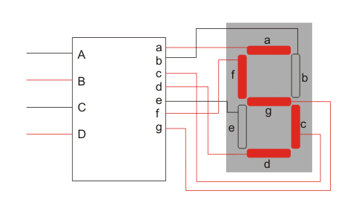
4. Decoders
A BCD to 7-segment decoder is a circuit that reads the four outputs of a BCD counter and lights up the appropriate segments of a seven-segment display.
This is a combinational logic circuit and can be done by using normal digital logic gates. It is a good practice of using Karnaugh maps.
IC 7447 converts BCD inputs into signals that drive 7-segment displays.

