Slide 1
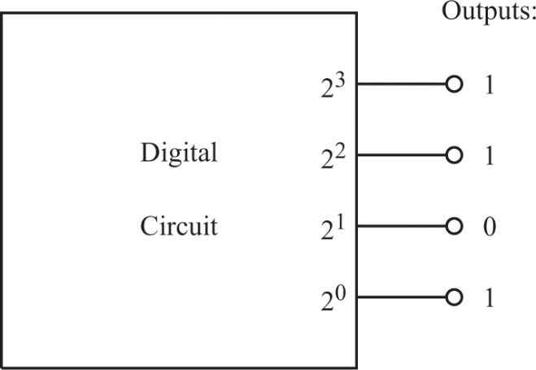
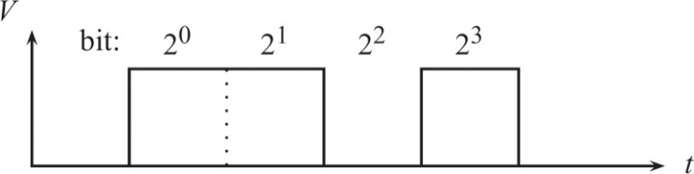
Lecture 16: Digital logic gates
1. Binary numbers
In analog electronics, voltage is a continuous variable, which can represent a continuous physical quantity, e.g., temperature, pressure, and light intensity.
In contrast, digital electronics, has only two distinguishable voltages. These two states are called high/low, 1/0, on/off, or true/false.
In TTL (transistor-transistor-logic) circuits, a high state corresponds to a voltage above 2.0 V, while a low state corresponds to a voltage below 0.8 V. This ensures noise immunity.
The “high/low” nomenclature directly characterizes voltages, but the other names rely on convention, e.g., we can define high=1, low=0, or the opposite.
In digital electronics, signal levels are expressed by base-2 numbers, or binary numbers. There are two ways to represent a binary number:
Parallel representation
Serial representation

Slide 2
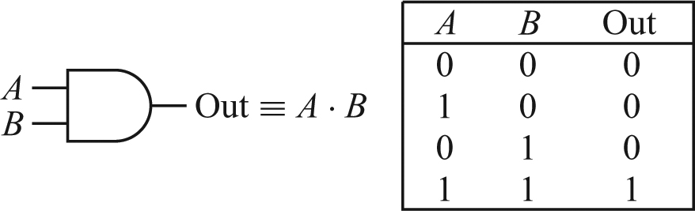
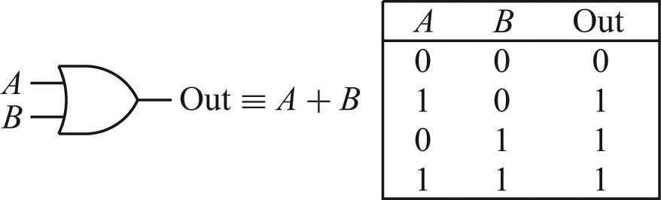
2. Logic gates
A logic gate performs a certain logical operation on its input signals, and generates an output state.
The logical operation of the gate is defined by its truth table, which gives the output state for all possible combinations of the inputs. For n inputs, there are 2^{n} different combinations.
There are six basic logic gates: AND, OR, XOR, NAND, NOR, and NOT (invertor). These gates are sufficient to implement all logic functions.
AND:
OR:

Slide 3
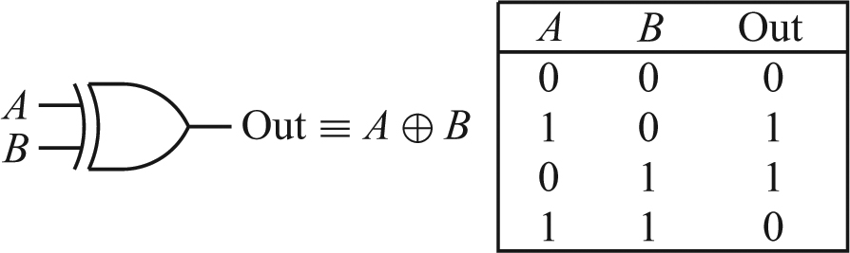
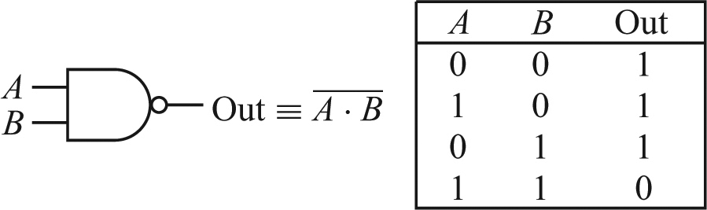
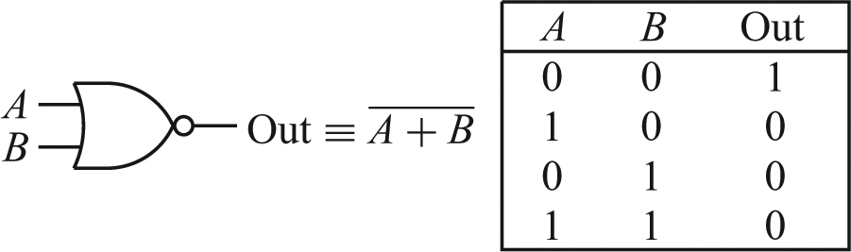
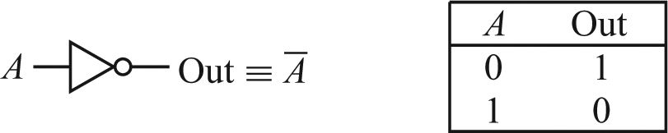
XOR:
NAND:
NOR:
NOT (inverter):

Slide 4
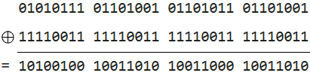

The AND, OR, XOR, NAND and NOR gates may have more than two inputs.
The NAND and NOR gates are negated version or AND and OR:
NAND = NOT AND, NOR = NOT OR.
The NAND gate is the simplest logic gate to construct from discrete components (except the inverter). It was thus the most commonly used gate.
XOR encryption: Note that A ⊕ K can be either A or Ā, depending on K = 0 or 1. but (A ⊕ K ) ⊕ K is always equal to A, regardless of the value of K.
In XOR encryption, a key is XORed with the plaintext to produce ciphertext. The same key is then XORed with the ciphertext to recover the original plaintext.
Example:

Slide 5
Homework:
Ch8: 1

Slide 6
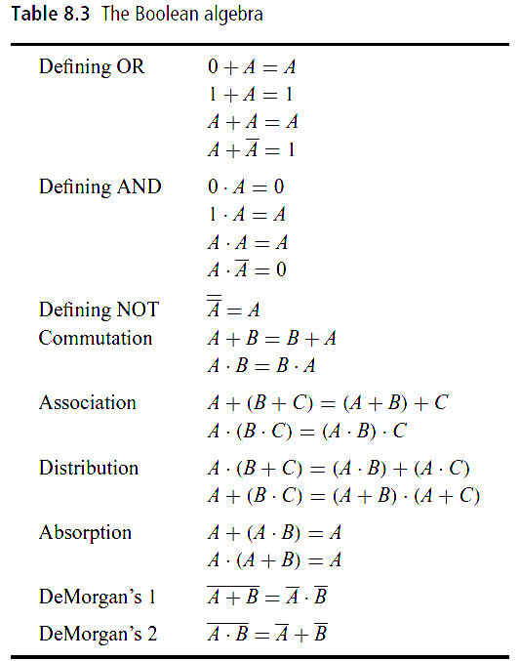
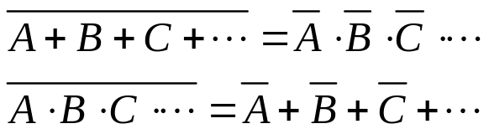
Lecture 17: Boolean algebra
1. Boolean algebra
Boolean algebra is the algebra for logical operations. Common Boolean algebra is summarized in Table 8.3 of the text.
A, B, and C are logical variables that can take values of 0 or 1.
These rules can be proved by brute force by considering all the possible cases, or by using already proved rules.
Examples:
A·(A+B) = A, no matter B is 0 or 1.
(A + B)·(A + C) = A ·(A+B+C) + B·C
=A + B·C.
DeMorgan’s theorems:

Slide 7
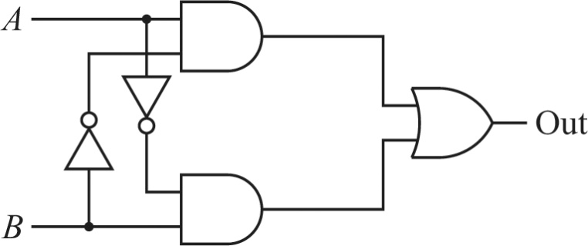

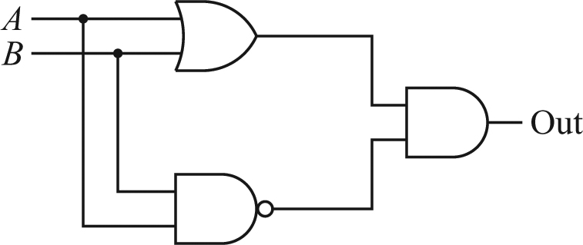
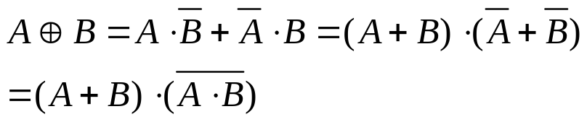
2. Boolean algebra applications
Boolean algebra can be used to
Simplify logical functions, so we can reduce the number of gates needed.
Find alternative ways of expressing logical functions, so we are not bothered by not having certain gates.
Example: the XOR function
A ⊕ B =1 only if i) A=1 and B =0, or ii) A=0 and B =1. Therefore
A simplified expression

Slide 8
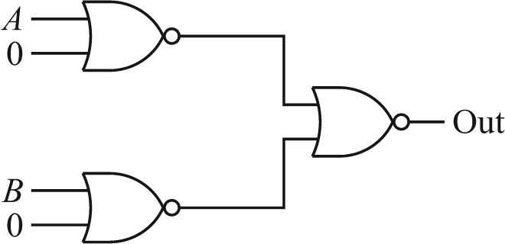
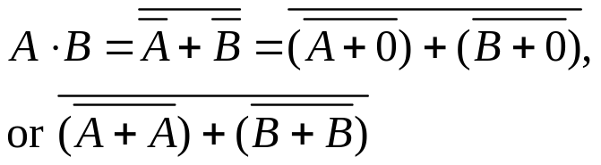
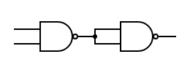
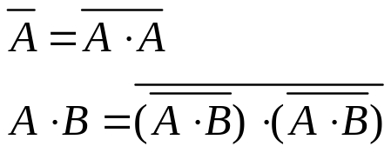
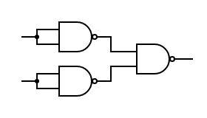

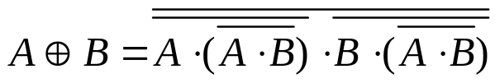
Theorem: any logic function can be constructed from NOR gates alone, or from NAND gates alone. They are called the universal gates.
Example: AND gate from NOR gate
Example: AND gate from NAND gate. Note the second half is a NOT gate:
Example: OR gate from NAND gate
Example: XOR gate from NAND gate

Slide 9
Homework:
Ch8: 2,3

Slide 10
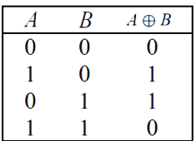
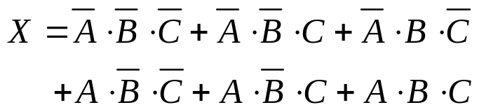
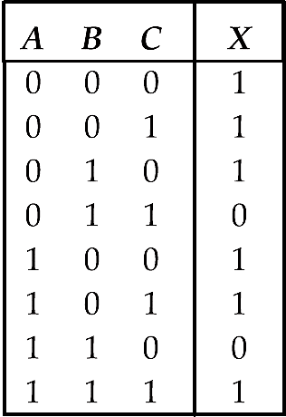
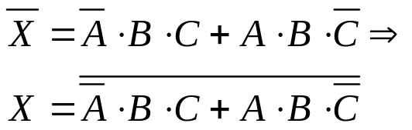
Lecture 18: Karnaugh maps
1. Truth table to SOP
Any truth table can be converted into a Boolean expression which is a sum of products (SOP). Each product (called a minterm) corresponds to a row in the truth table which yields the output of one. This expression is usually not the simplest.
Example 1:
A ⊕ B =1 only if i) A=1 and B =0, or
ii) A=0 and B =1. Therefore
Example 2:
When we have fewer zeros in the output, consider x̄:

Slide 11
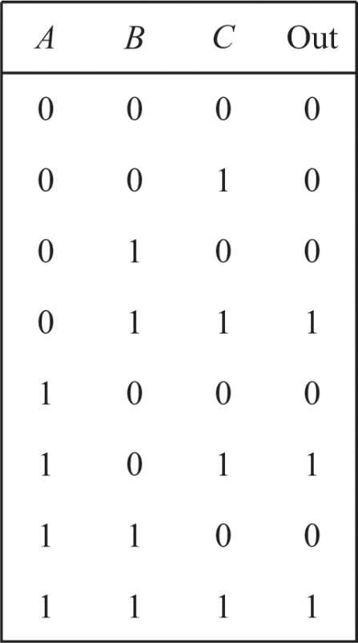
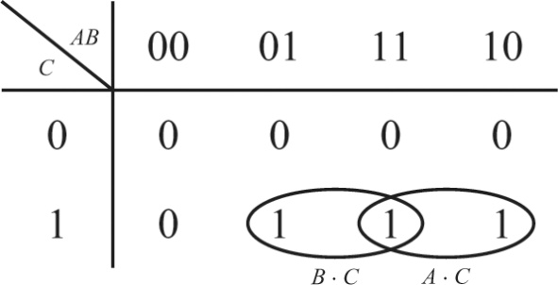

2. Karnaugh maps
Karnau mapping is a graphical method to find the simplest Boolean expression for a given truth table. It works best for logic circuits with three or four inputs.
Karnaugh mapping includes the following 3 steps:
1) Construct a Karnaugh map from the truth table.
For three inputs, list AB along the top and C along the left (or the opposite).
For four inputs, list AB along the top and CD along the left (or the opposite).
For AB or CD combinations, change only one digit at a time (00, 01, 11, 10).

Slide 12


2) Encircle groups of ones on the truth table.
They are horizontal or vertical groups of 1, 2, 4, 8, or 16.
Groups should be as large as possible.
Every 1 must be in at least one group.
Group overlapping is allowed.
The edges of the map connect (wrapping).
3) Determine the expression for each group.
The expression for each group is given by the product of the inputs that has a constant value (either 1 or 0) in that group.
The overall Boolean expression is the SOP of all group expressions.

Slide 13
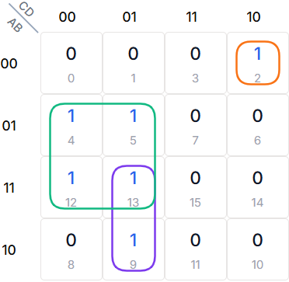
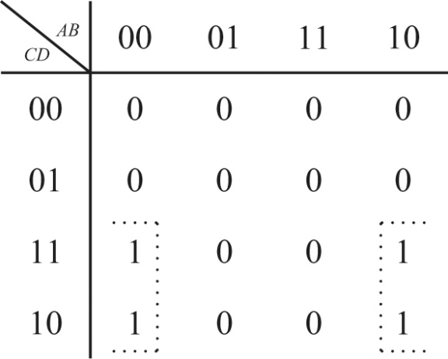


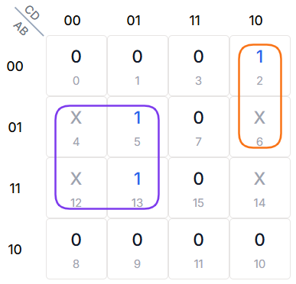

Examples:
Karnaugh maps can also deal with don't care conditions (“undetermined values”) where the output doesn't matter for certain input combinations.

Slide 14
Homework:
Ch8: 4,5

Slide 15
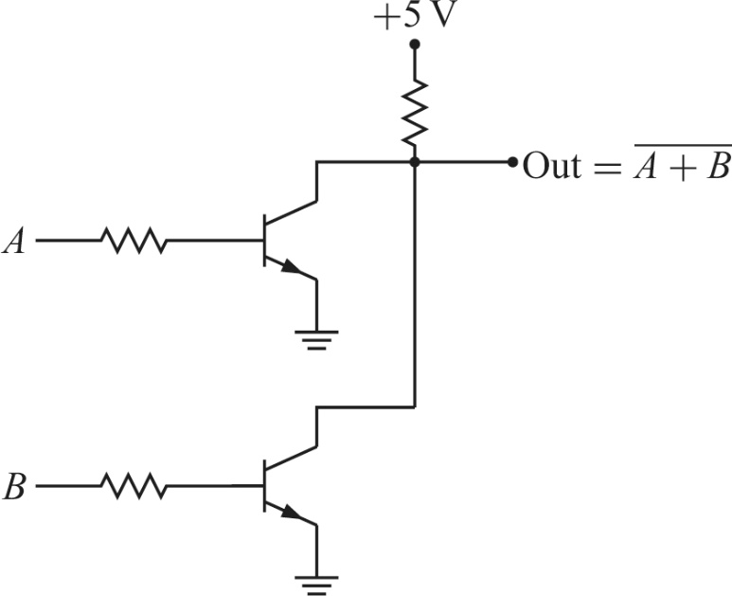
Lecture 19: Digital gate circuits
1. Making logic gates
One common type of semiconductor logic gates is the transistor-transistor logic (TTL) family, which uses bipolar transistors. Another common type is the complementary metal oxide semiconductor (CMOS) family, which uses field-effect transistors. TTL is fast and cheap, while CMOS has low power consumption.
We show here a TTL NOR gate made with two bipolar transistors.
If either A or B is high, its transistor is saturated, making the collector-emitter voltage small and the gate output low.
If neither A nor B is high, both transistors are in the cutoff region, so there is no voltage drop across R_{c} and the output is high.

Slide 16
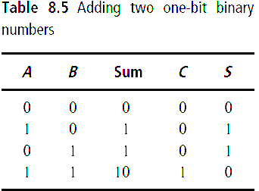
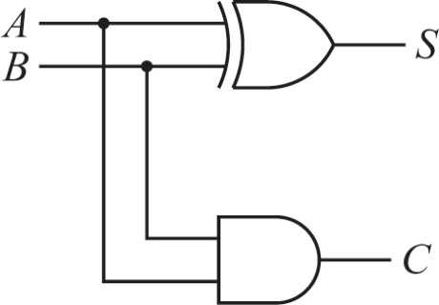
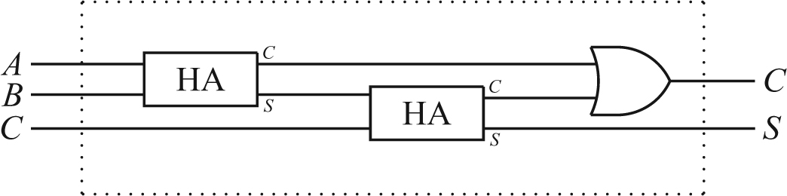
2. Binary adders
Adding two binary numbers can be expressed by logic functions and realized by logic gates.
1) Half-adder
When adding two 1-bit binary numbers, the functions are
S (sum) = A ⊕ B
C (carry) = A · B
The circuit is called a half-adder (HA).
2) Full-adder
In actual addition, we need to accommodate the possible carry from the digits to the right.
A full-adder (FA) uses two half-adders and an OR gate to achieve this.

Slide 17
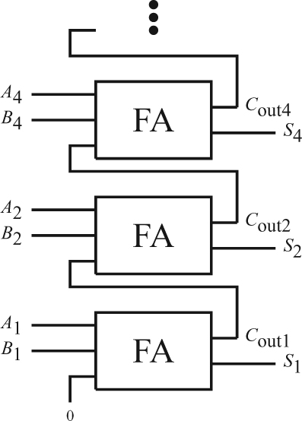
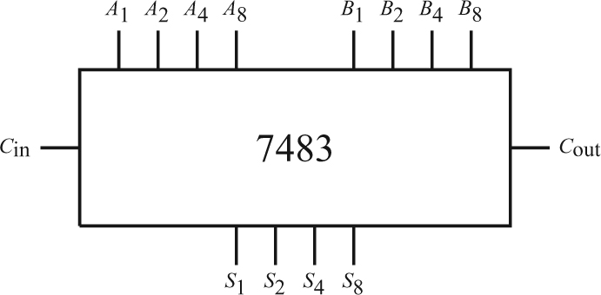
3) n-bit binary adder
The carry out of one full adder is connected to the carry in of the next.
Four-bit full adder is available as an integrated circuit (e.g., 74LS83).

Slide 18
3. Signed binary numbers
Sign bit: A sign bit is placed at the leftmost of a signed binary number.
If the sign bit is 0, the number is positive or 0, and is expressed in the normal way.
If the sign bit is 1, the number is negative. It can be read by taking into account the sign value -2^{n-1}. Example: 1010= 1×(-2³) + 0×(2²) + 1×(2¹) + 0×(2⁰)= – 6.
n-bit signed number ranges from -2^{n-1} to 2^{n}-1. Example: 4-bit signed numbers are from -8 (1000) to 7 (0111).
Representing a negative number (–Y ) by the 2’s complement method:
1) Write down Y in binary mode, including the sign bit. (e.g., 6 = 0 110₂)
2) Invert each bit. (0110 → 1001).
3) Add 1, and ignore any overflow. This yields the 2’s complement of Y, which is –Y.
(– 6 =1001+1=1010)
The 2’s complement method generates the opposite of a binary number (Y→ –Y, –Y→ Y), no matter it is positive or negative.

Slide 19
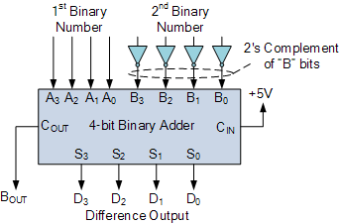
4. Binary subtractors
Subtracting two binary numbers, X – Y, can be done by the 2’s complement method:
X –Y = X + (2’s complement of Y )

Slide 20
Homework:
Ch8: 6

