Slide 1
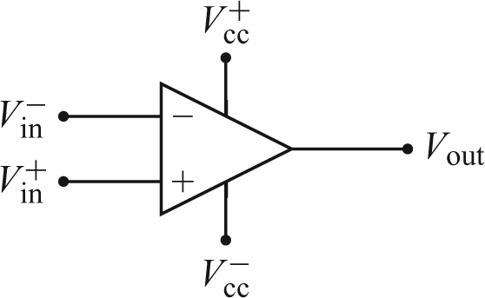



Lecture 14: Op-amps I
1. Op-amps
Op-amps are the short name for operational amplifiers. They are based on differential amplifiers constructed from normal transistors. This differential amplifier amplifies the voltage difference between the two inputs with a very large voltage gain.
An op-amp is usually packaged as an integrated circuit with multiple pins. We will treat the device as a black box, and learn some basic rules for its application.
An op-amp has two power supply voltages, V_{cc}⁺ and V_{cc}⁻. These two voltage sources are often omitted in a circuit diagram.
There are two signal inputs: the inverting input (-), and the non-inverting input (+). The two signs do not specify the polarity of voltages.
The basic operation of the op-amp is:
A_{OL} is the open-loop voltage gain, which is usually huge (10⁴-10⁹). Therefore, V_{out} may be quickly saturated. In reality V_{out} can only be within a range set by two saturation voltages:
Here

Slide 2
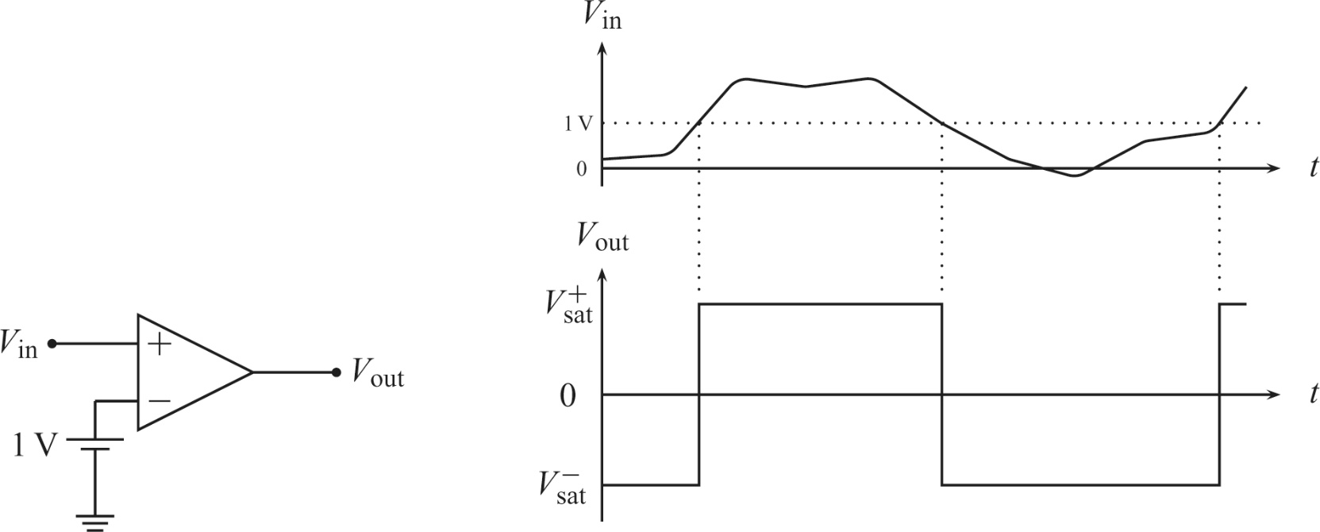
2. Non-linear application: comparator
Because A_{OL} is large, any small difference between the op-amp inputs will cause the output to saturate. For example, for A_{OL} = 200k, at ±15 V power supplies, only a 70 μV difference between the two inputs makes the output saturate.
In the comparator circuit below,
When V_{in} is above 1V (reference voltage), the output swings to its positive saturation limit.
When V_{in} is below 1V, the output falls to its negative saturation limit.

Slide 3
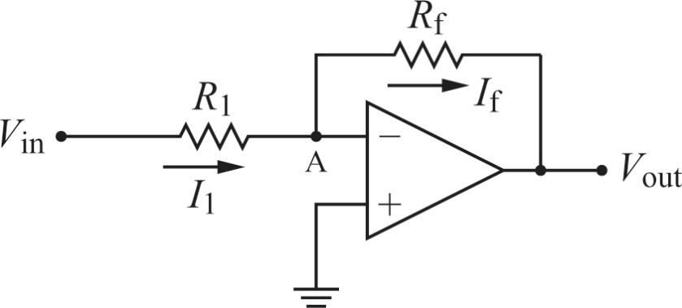
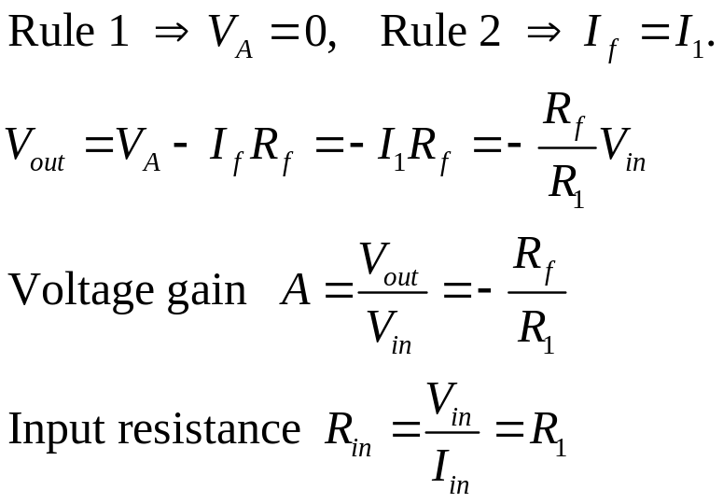
3. Golden rules of ideal linear op-amp operation
In linear applications, the circuits are characterized by a feedback connection from the output to the inverting input of the op-amp.
The circuits can be analyzed by applying two approximate rules called the golden rules of ideal linear op-amp operation.
Rule #1: The output will do whatever is necessary to make the voltage difference between the inputs zero.
Rule #2: No current flows into the inputs.
3. Inverting amplifier
→ Op amps are much easier than transistors in application.

Slide 4
Homework:
Ch6: 1,2,5

Slide 5
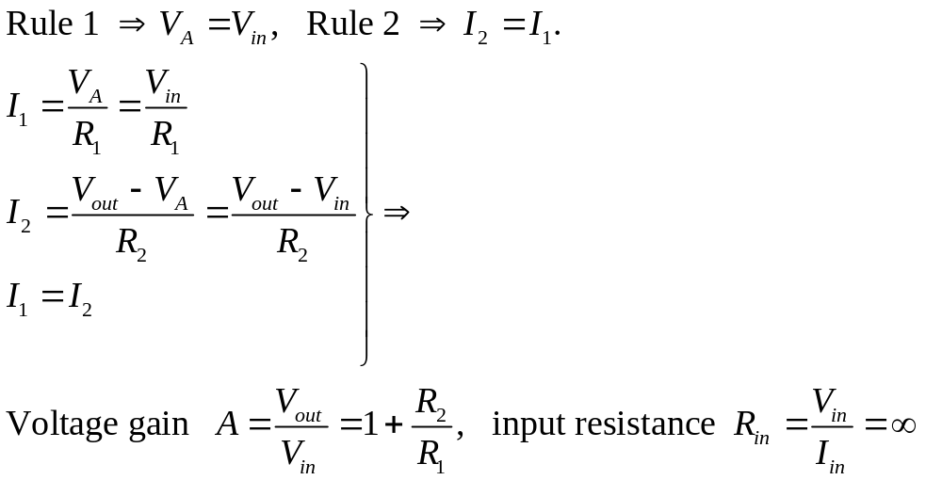
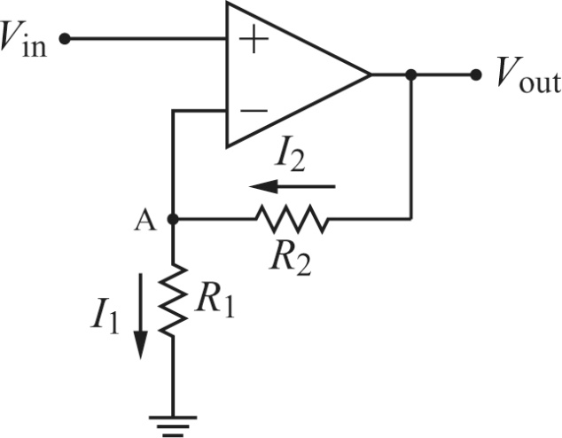
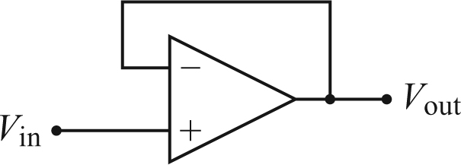
Lecture 15: Op-amps II
1. Non-inverting amplifier
2. Buffer (voltage follower)
This can be used between a high impedance voltage source and a low impedance load to alleviate loading due to the voltage divider effect.

Slide 6
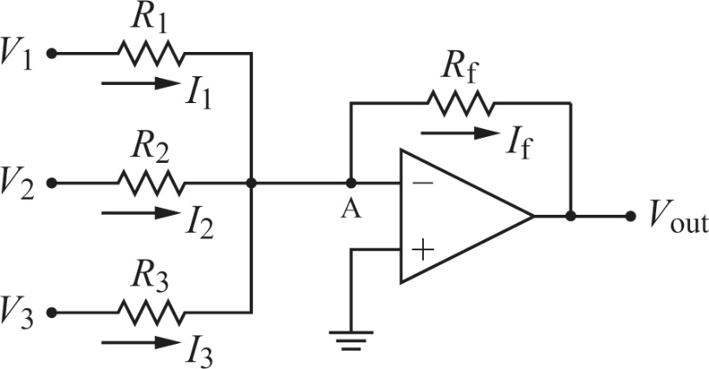
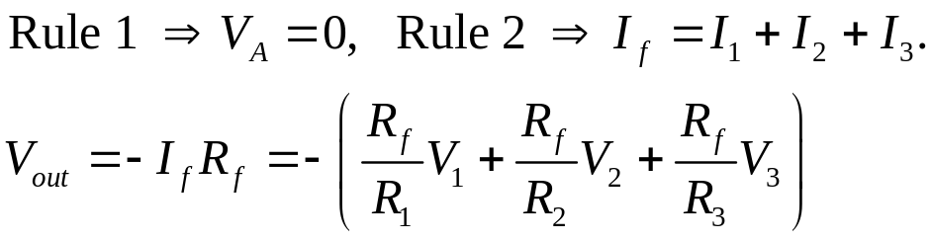
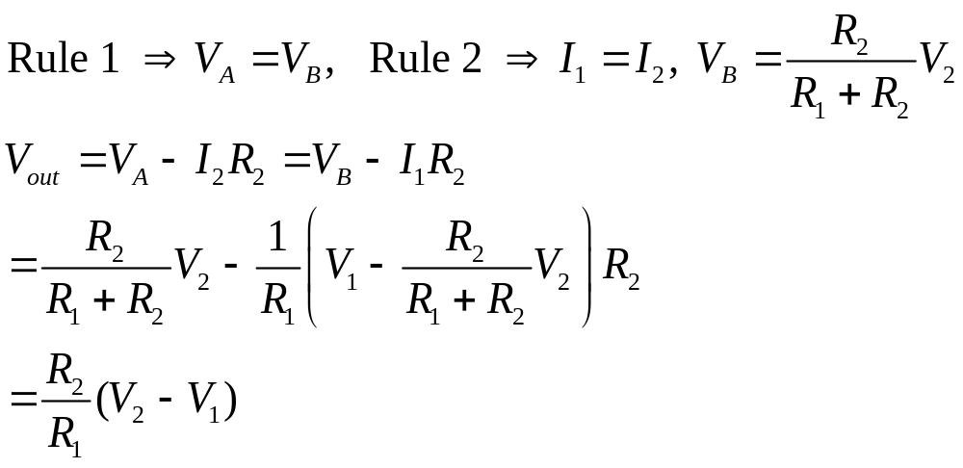
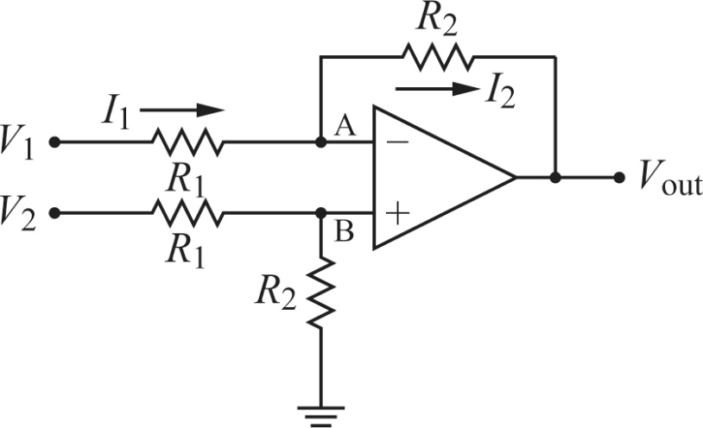
3. Adder
4. Differential amplifier

Slide 7
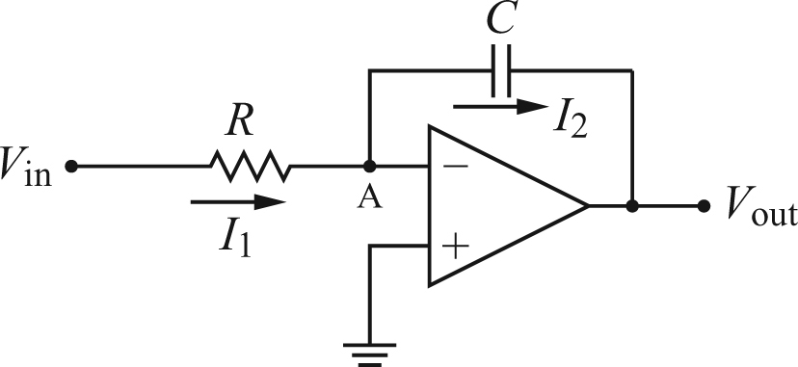
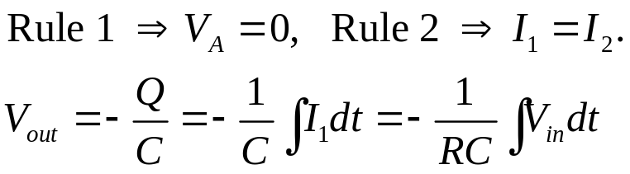
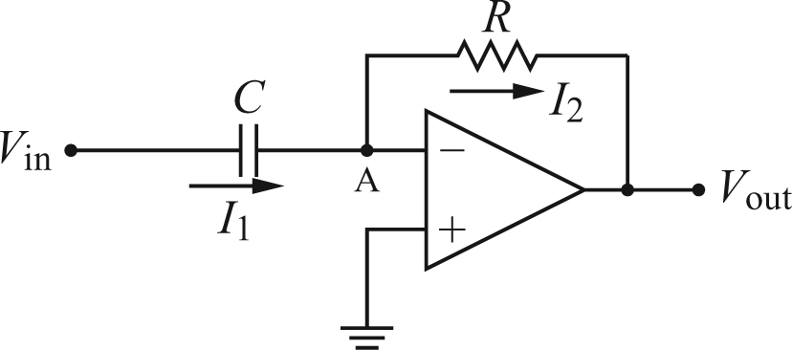
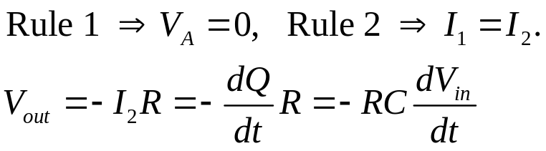
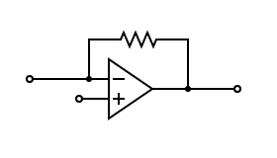

5. Integrator
6. Differentiator
7. Current-to-voltage converter
R
I_{in}
→
V_{out}
V_{R}

Slide 8
Homework:
Ch6: 6,7,8,9

