Slide 1
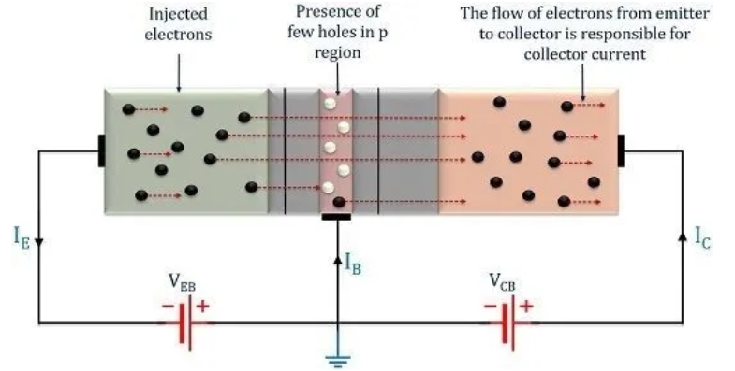
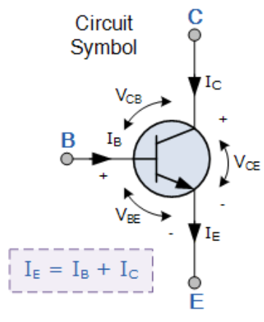
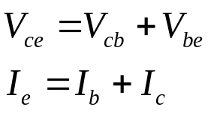
Lecture 11: Transistors
1. Bipolar junction transistor
Bipolar junction transistors can be of either NPN or PNP type. They are used for amplification or switching.
In an NPN transistor, the base (B) and the collector (C) are lightly doped. The emitter (E) is heavily doped. The base is thin. The main charge carriers are the electrons.
The E-B junction is forward-biased, while the B-C junction is reverse-biased.
Electrons are injected from the emitter lead. Most electrons (99%) get into the collector. Only few electrons (1%) exit from the base lead.
E
N
P
N
C
B

Slide 2
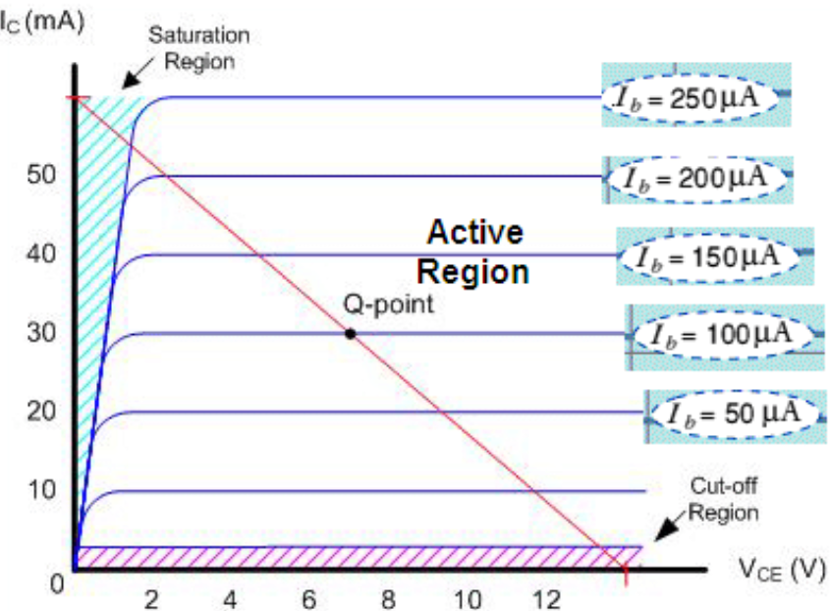
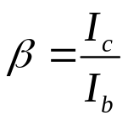
2. Characteristic curves of a transistor
A typical characteristic curve for a bipolar transistor shows the collector current I_{c} versus collector-emitter voltage V_{ce} , with the base current I_{b} as a parameter.
In an amplification application, a transistor is specified by its current gain
It is also known as h_{FE}, and is almost a constant. Usually 10 < β < 500.
Three regions on the characteristic curve:
Linear active region: I_{c} = β I_{b} , used for amplification.
Saturation region: reduced I_{c} increasement at larger I_{b}’s.
Cutoff region: I_{c} falls to zero because I_{b} is small.

Slide 3
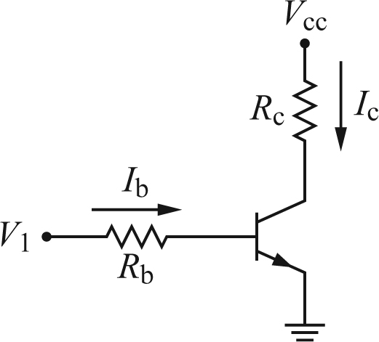
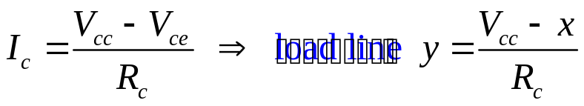
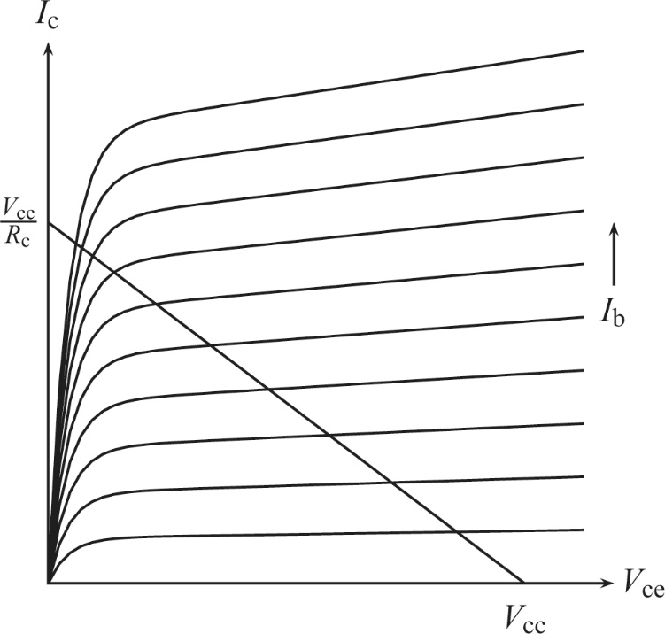
3. Transistor switch
This load line is drawn on the transistor characteristic curve to analyze the circuit.
Transistor cutoff and saturation can be used as a switch.
If V₁= 0 then I_{b} = 0. The solution on the load line shows I_{c} = 0 and V_{ce}= V_{cc}.
A high V₁ (e.g., V₁= 5 V) makes I_{b} large. The solution shows I_{c} is large (≈ V_{cc} /R_{c}) and V_{ce} is small.
This switch is an voltage inverter: a high (low) voltage input at the base causes a low (high) voltage output at the collector.
V_{out}

Slide 4
Homework:
Ch4: 1

Slide 5
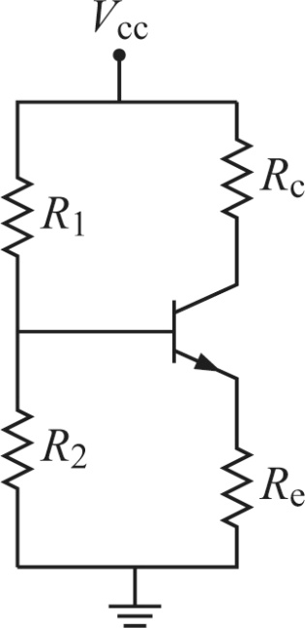
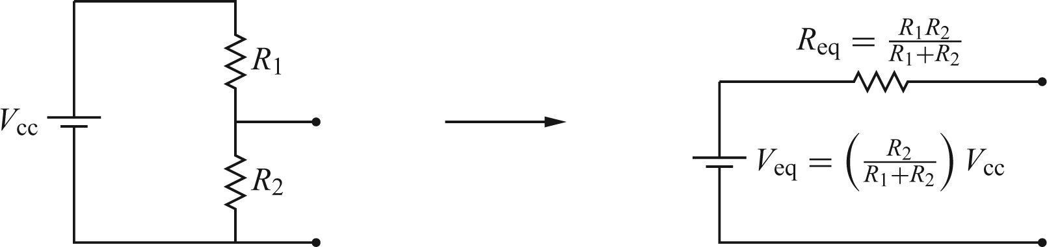
Lecture 12: Transistor amplifiers I
1. Universal DC bias circuit
Before discussing AC amplifiers, we first keep the transistor operating in the middle of the linear active region. This is the universal DC bias circuit. It sets the DC operating conditions for an amplifier.
Other bias circuits can be derived from the universal one by setting a resistor value to zero or infinity.
We first replace the left half of the circuit by its Thevenin equivalent:

Slide 6
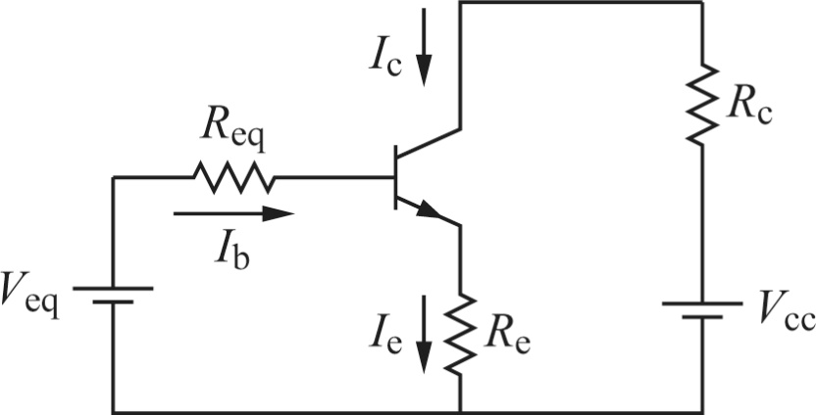
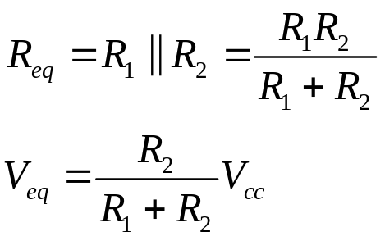
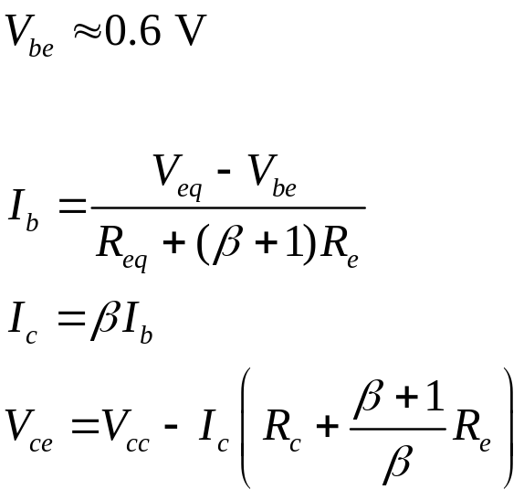
The universal DC bias circuit is now redrawn.
Our goal is to determine I_{b} , I_{c} and V_{ce} . They work together to define the operating point (also called the quiescent point or Q point) of the transistor. The operating point is usually on the middle of the load line.

Slide 7
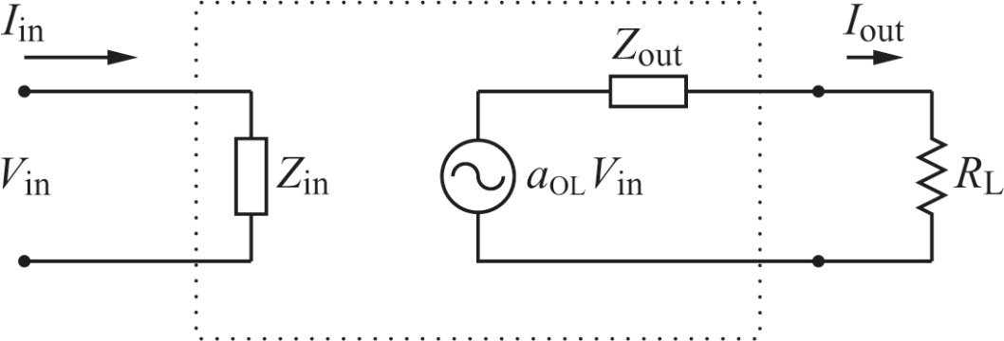
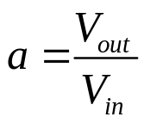
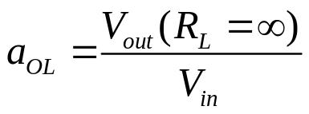


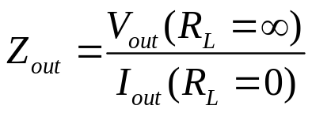
2. Black box model of an amplifier
A general amplifier can be represented by a black box.
Four black box parameters that specify the amplifier:
V_{out}
1) Voltage gain . (Open-loop voltage gain )
2) Current gain
3) Input impedance
4) Output impedance
Z_{in} is the impedance seen when looking into the input of a circuit. It gives us an idea of how much current can be drawn into the input of a device.
Z_{out} refers to the impedance looking back into the output of a device. The output of a circuit is equivalent to a Z_{out} in series with a voltage source.
When transmitting a signal, Z_{in} of a device should be much higher than Z_{out}.

Slide 8
Homework:
Ch4: 2

Slide 9
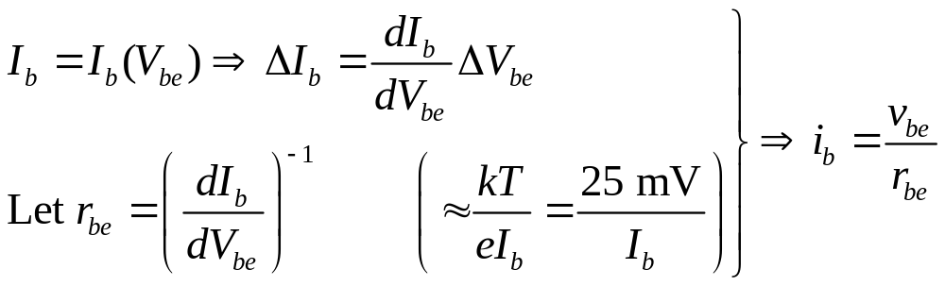
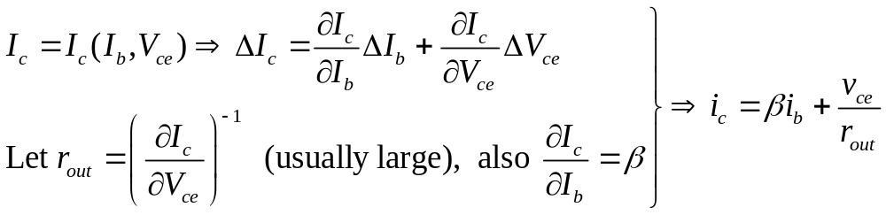
Lecture 13: Transistor amplifiers II
1. AC equivalent circuit for transistors
We now model a transistor’s response to an AC input around a given DC operating point. We use lower-case letters for AC currents and voltages, so
1) For the B-E junction,
2) For the C-E part,

Slide 10
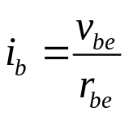
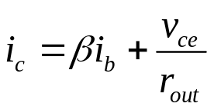
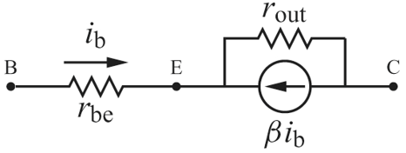
Based on and , the AC equivalent circuit for the transistor
is now

Slide 11
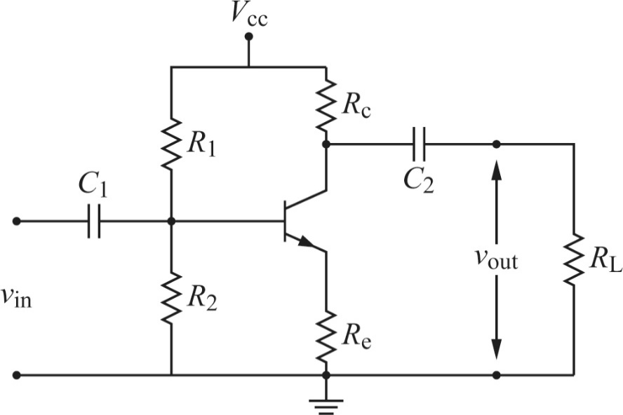
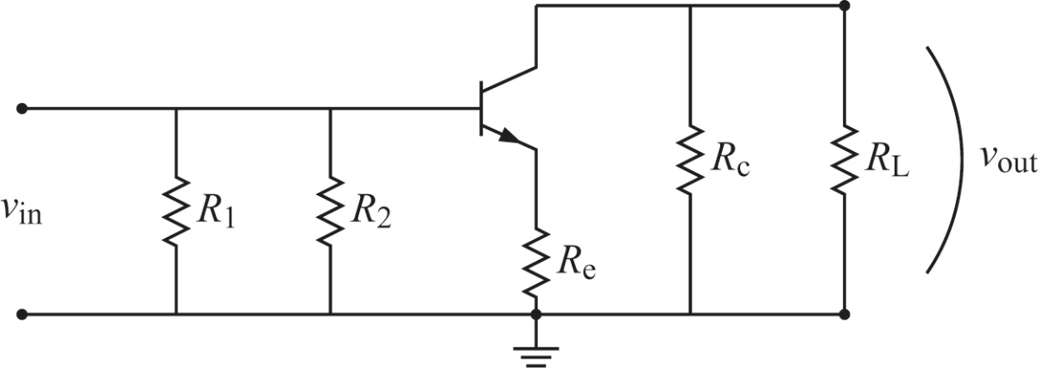
2. Common-emitter amplifier
A common-emitter amplifier provides a voltage gain for the input signal.
The central part of this circuit is the universal DC bias circuit, which sets the DC operating point (Q point) for the circuit.
AC signals are added through C₁ and extracted through C₂.
AC analysis of an amplifier can be broken down into 3 steps. They are good mental stamina tests for physicists. Redraw the circuit when proceeding.
1) Treat the coupling capacitors as shorts. Treat the DC power supply as ground.

Slide 12
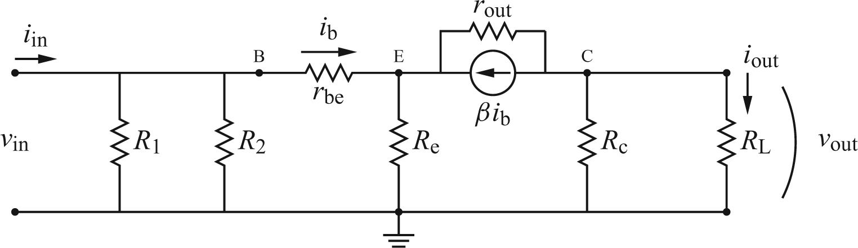
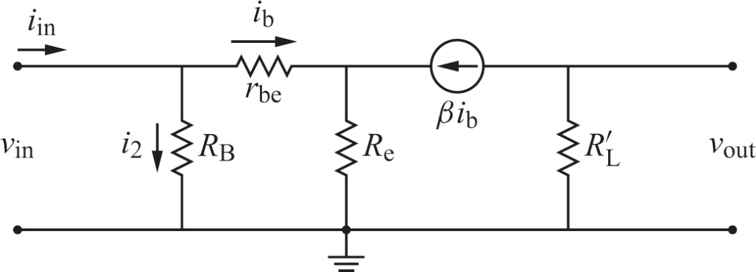
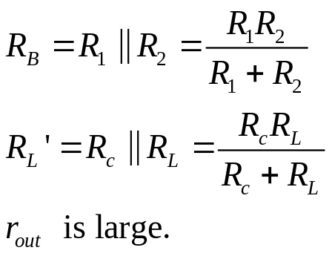
2) Insert the AC equivalent circuit for the transistor. Simplify the circuit.

Slide 13
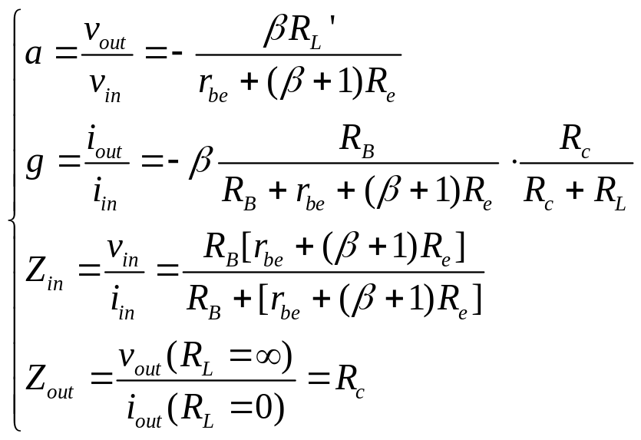
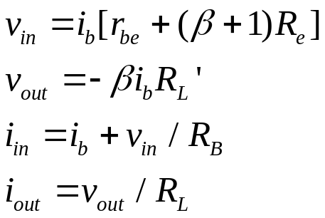
3) Write v_{in}, v_{out}, i_{in}, and i_{out} in terms of i_{b}. Compute a, g, Z_{in} and Z_{out}.

Slide 14
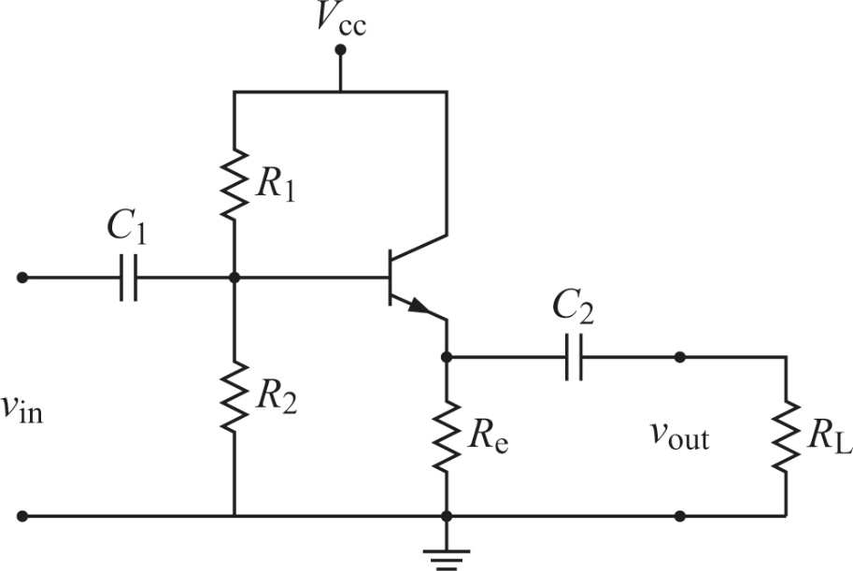
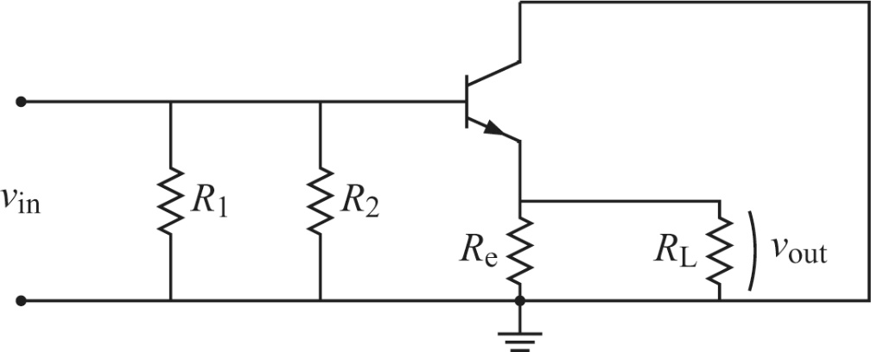
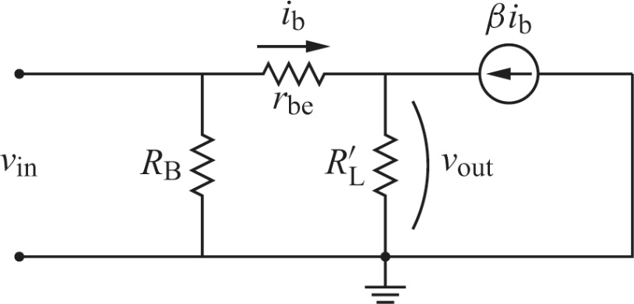
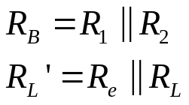
3. Common-collector amplifier
A common-collector amplifier is also called an emitter follower, in which v_{out} follows v_{in}. It has a high input impedance, and a low output impedance. It thus provides a current gain. The circuit requires less power from a signal source to drive a load, compared to the case when the load is directly powered by the source.
AC analysis step 1:
Step 2:

Slide 15
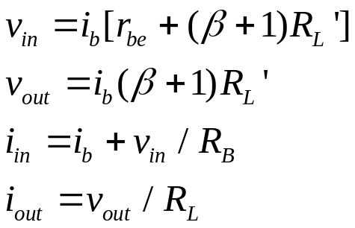
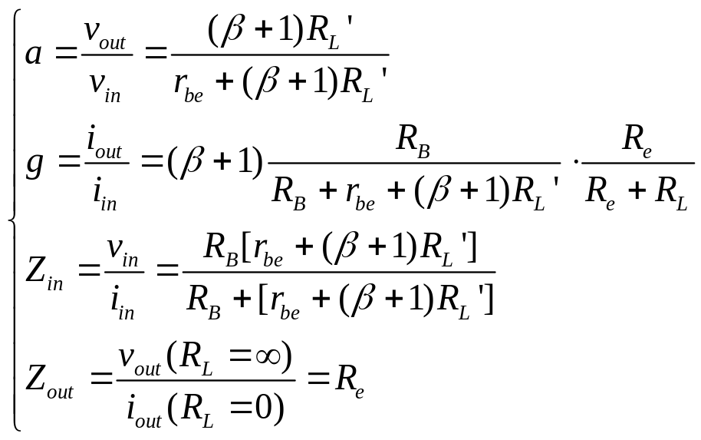
Step 3:

Slide 16
Homework:
Ch4: 5,7,9

