Slide 1
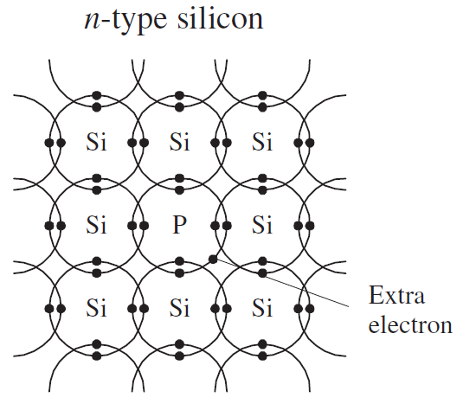
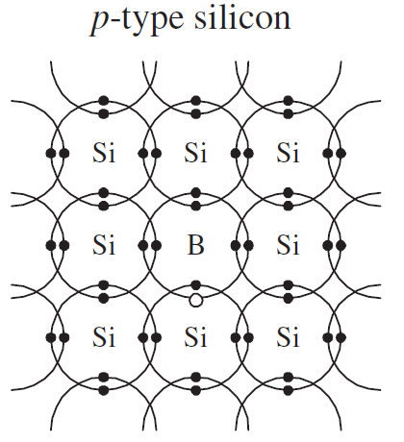
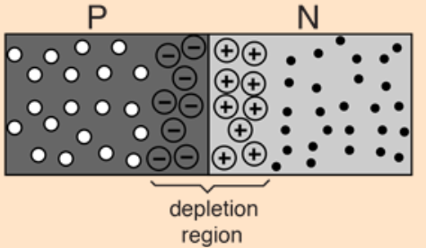
Lecture 10: Diodes
1. p-n junction
The conductivity of a semiconductor (silicon) is enhanced by doping.
Doping with a donor material (phosphorus) creates an n-type semiconductor, which has negative charge carriers (the extra electrons).
Doping with an accepter material (boron) creates a p-type semiconductor, which has positive charge carriers (the holes).
A p-n junction is made when a crystal has both types of doping. It is called a diode.
Nature diffusion of the electrons creates a depletion region in the p-n junction. Space charges are created in this region, which produce an internal electric field pointing from N to P.
The internal electric field prevents further diffusion. It produces a potential barrier for the electrons.
At 25 °C, the potential barrier in Si junction is about 0.6 V. It is about 0.3 V in Ge.
E

Slide 2
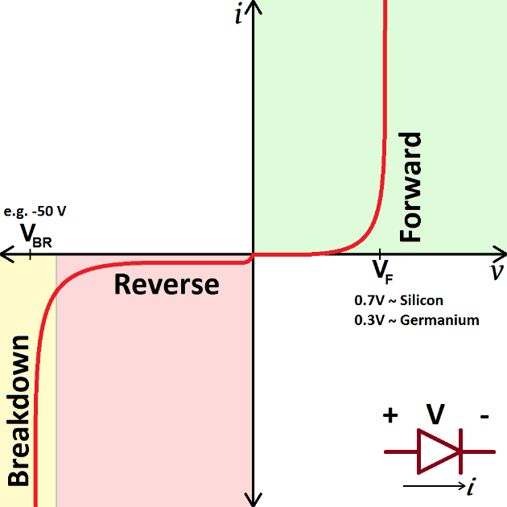


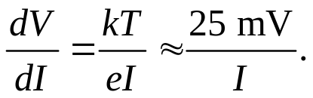

2. I-V curve of a diode
Like all other electronic components, a diode is characterized by its I-V curve.
When the diode is forward-biased, the internal potential barrier is reduced, which allows electrons to flow.
When the diode is reverse-biased, the internal potential barrier is enhanced, which prevents electrons to flow.
At normal forward-biased use, Si diode has about 0.6 V drop across it. Ge diode has about 0.3 V.
÷50
×100
Without breakdown, the current I flowing through the diode can be approximated by an exponential function:
I₀: Reverse saturation current
e: Charge of electron
V: Applied voltage
k: Boltzmann constant
T: Temperature
Further approximations:
1) When V > 100 mV,
Dynamic resistance
2) When V < -100 mV,

Slide 3
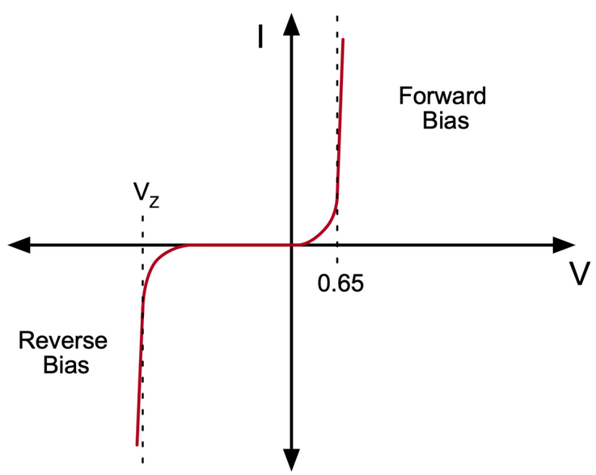
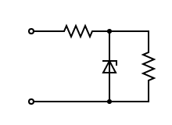
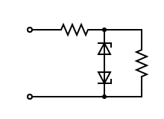
3. Zener diodes
Zener diodes are manufactured with controlled reverse breakdown properties. They are designed to operate at or about their reverse breakdown voltage (Zener voltage, V_{Z}), typically 2 V to 200 V.
Example 1: Simple Zener diode voltage regulator
The circuit is working at the reverse breakdown of the Zener diode. Even though V_{in} may vary somehow, the load voltage on R_{L} is stabilized at V_{Z}. Zener diodes can be used in series to obtain desired V_{Z} .
R
V_{in}
R_{L}
R
Example 2: The diode clipper
In the circuit the input voltage varies in both polarities. The output voltage on R_{L} is clipped to the range of –V_{Z2} <V_{out}< V_{Z1}.
Z₁
R_{L}
V_{in}
Z₂

Slide 4
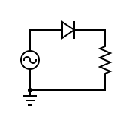
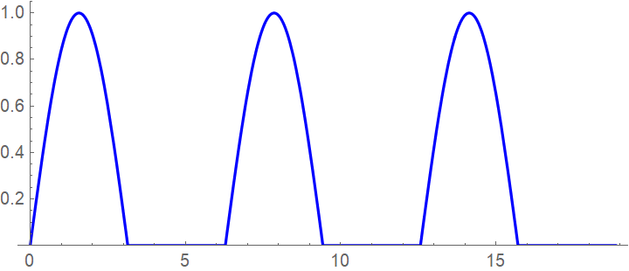
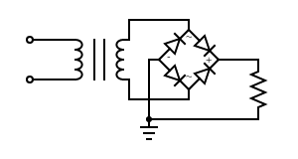
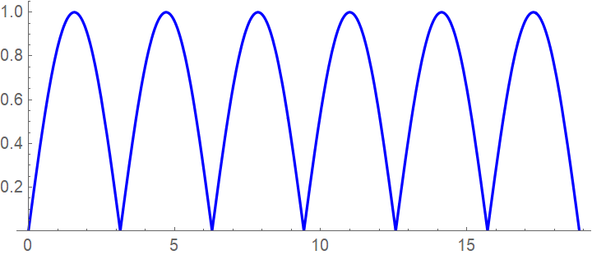
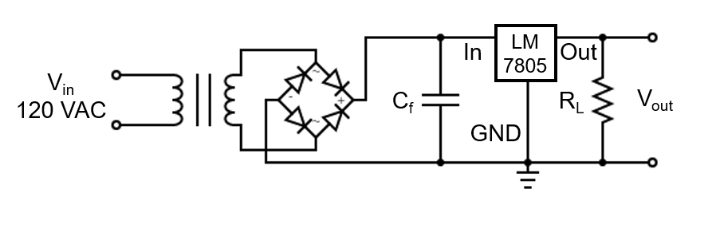
4. Rectification and power supply
1) Half-wave rectifier
The input is an alternating sinusoidal voltage. The diode only passes the positive voltages.
2) Full-wave rectifier
A bridge rectifier is used to rectify the secondary voltage of a transformer. The output is a positive full wave.
R_{L}
R_{L}
3) Power supplies
Filter capacitors and IC voltage regulators are used to provide a stable DC voltage.

Slide 5
Homework:
Ch3: 3,5

