Slide 1


Lecture 1: Current, voltage, and resistance
1. Electric charges and field
Particles may have an intrinsic property called the electric charge. Charges can be positive or negative.
The SI unit of charge is the coulomb (C).
The charge on the electron is
The charge on the proton is
Conductors transmit charges easily.
Insulators do not transmit charge.
Semiconductors are intermediate. They are important materials in electronics.
Electric charges produce electric field E around the charged bodies. The electric field exerts electric force F = q E on a charge.
The SI unit of E is newton/coulomb, or N/C.
Electric field can also be produced by time-varying magnetic field.

Slide 2
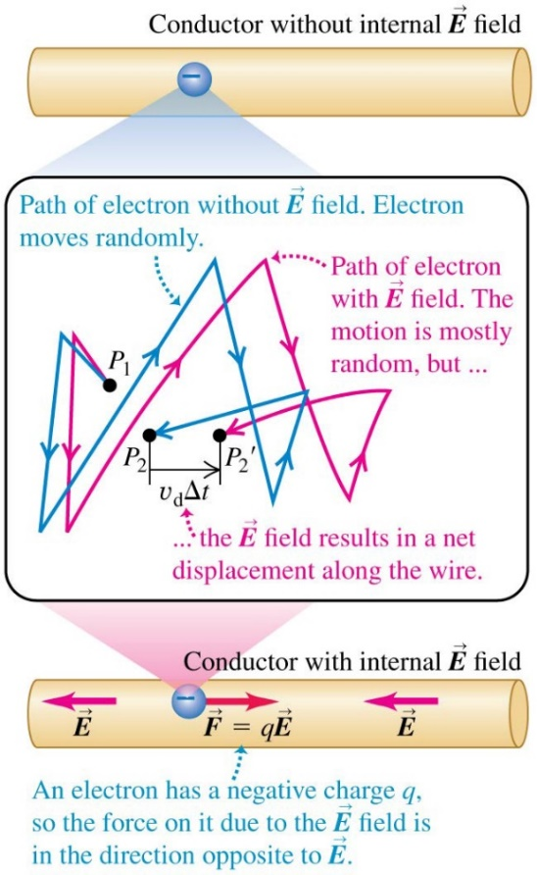
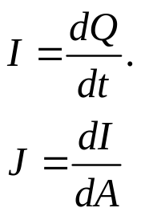
2. Electric current
An electric current is a motion of charges.
In physics, the current direction is described by conventional current direction :
If the charged particles are positive, the direction of the
current is the same as the moving direction of the particle. If the charged particles are negative, especially electrons in conductors, the current is in the opposite direction to the actual motion of the particles.
In some engineering books the current direction of electrons are defined oppositely.
Current through a cross section area A is defined as the net charge flowing through the area per unit time:
The unit of current is ampere, 1 A = 1 C/s.
Current density is the electric current through a unit area perpendicular to the current direction; it is a vector. Current density is needed more in theoretical work.

Slide 3

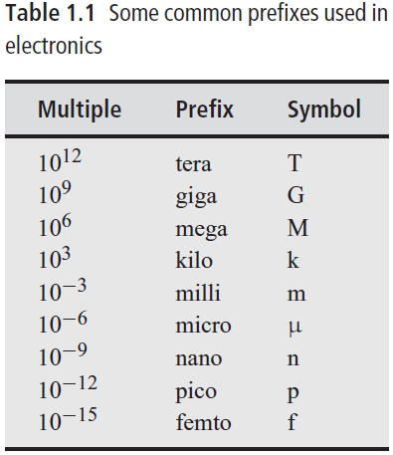
3. Voltage
Charges in a conservative electric field have electric potential energy.
The electric potential is the electric potential energy of a unit charge.
Voltage is the difference between the electric potentials at two spatial points:
The SI unit of voltage (and electric potential) is the volt, or V: 1 V= 1 J/C.
We should distinguish V (a variable) and V (its unit).
Prefixes and nomenclature:

Slide 4
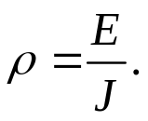
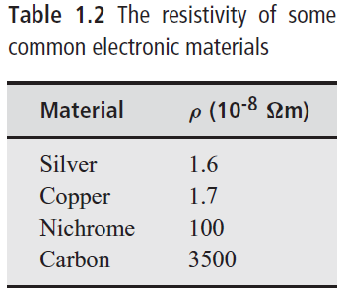
4. Ohm’s law and resistance
The current density J in a conductor depends on the electric field E and the properties of the material. For some materials, J is nearly proportional to E. This relationship is called the Ohm’s law, and these materials are said to be ohmic.
Resistivity of a material is defined as:
Its unit is V·m/A, or Ω·m.
The reciprocal of resistivity is called the conductivity (σ ).

Slide 5
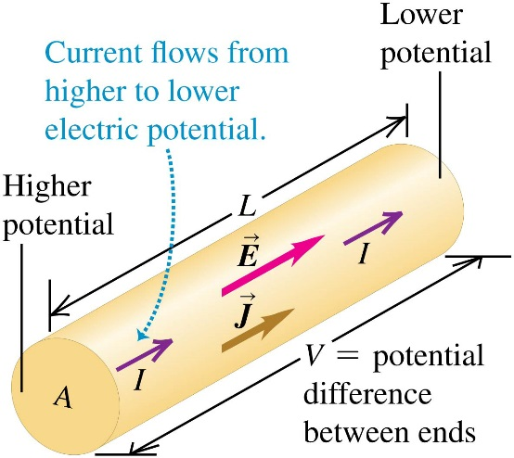
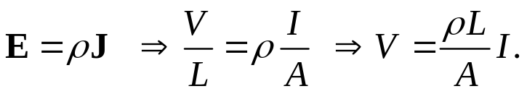
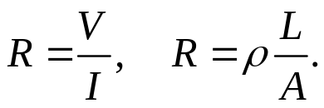
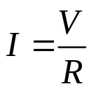

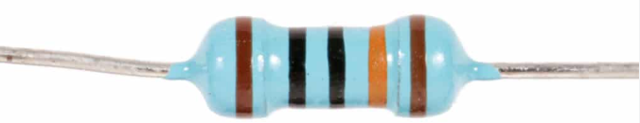
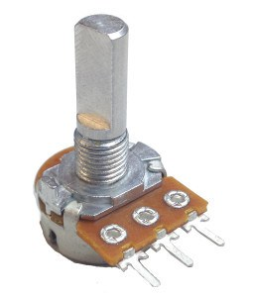
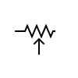
When a conductor obeys Ohm’s law, we have
The resistance of a conductor is its voltage to current ratio:
The cause-effect form of Ohm’s law is:
The unit of resistance is ohm, 1 Ω = 1 V/A.
The reciprocal of resistance is called the conductance G:
G = 1/R, measured in 1/Ω, also called a siemens or mho.
When using a resistor, it is important to know its power rating. Typical values are 1/8, ¼, ½, 1, and 2 W.
Rheostats are 2-leads variable resistors.
Potentiometers are 3-leads variable resistors, also called “pots”.

Slide 6
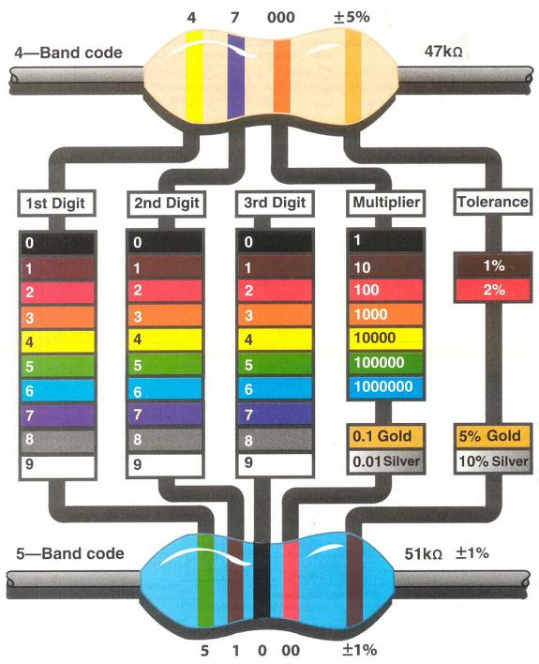


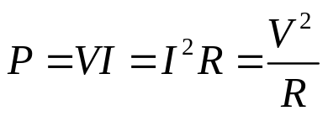
The electronic color code is used to indicate the values of electronic components, commonly for resistors.
A mnemonic trick:
Boys (black) better (brown) remember our young girls become (blue) very good wives.
5. Power
The power absorbed or delivered by an electric component (resistors, capacitors, inductors, batteries, diodes, …) . is
For a resistor, it is
I
+
-

Slide 7
Homework:
Ch1: 1,2,3

Slide 8
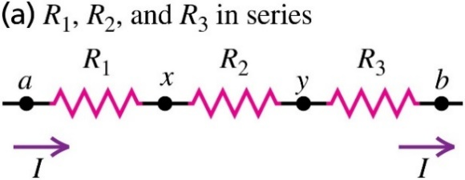


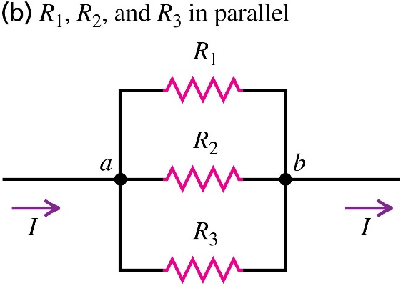
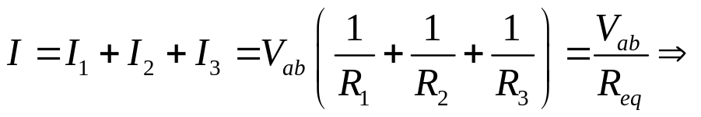
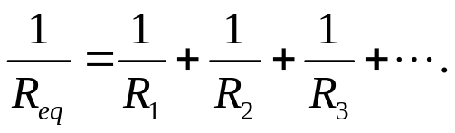
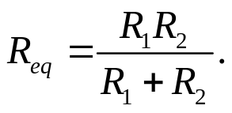
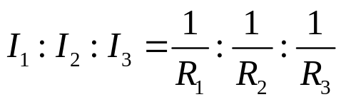
Lecture 2: Kirchhoff’s laws
1. Resistor combinations
1) Resistors in series:
In this case, the current is the same in each of the resistors, while the total voltage is shared:
It follows that , the larger resistor has more voltage.
2) Resistors in parallel:
Now the voltage is the same across each resistor, while the total current is shared:
For 2 resistors,
It follows that , the smaller resistor carries more current.

Slide 9


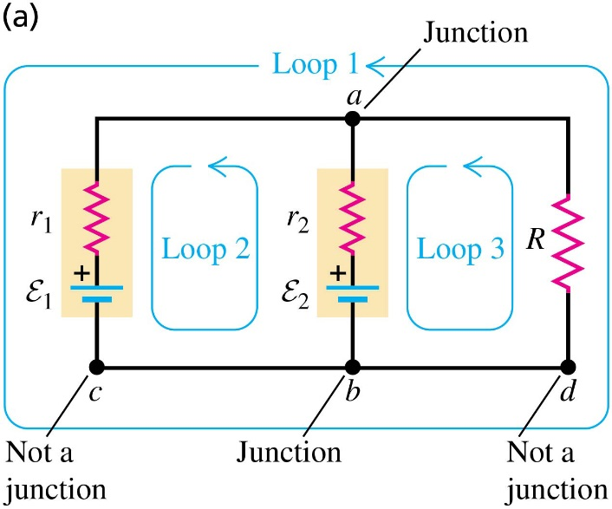
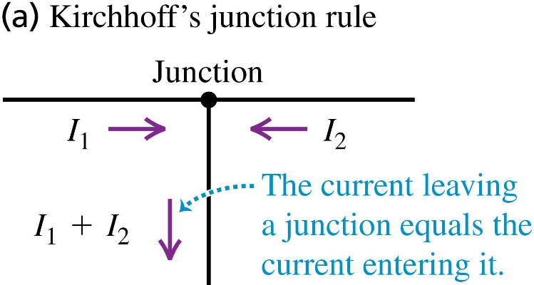
2. Kirchhoff’s laws
Many circuits cannot be reduced to simple series or parallel combinations. For analyzing complicated networks, we need Kirchhoff’s laws.
A junction in a circuit is a point where three or more conductors meet.
A loop in a circuit is any closed conducting path.
Kirchhoff’s junction rule:
The sum of the currents into any junction equals zero.
Kirchhoff’s loop rule:
The sum of the potential changes around any loop equals zero.

Slide 10
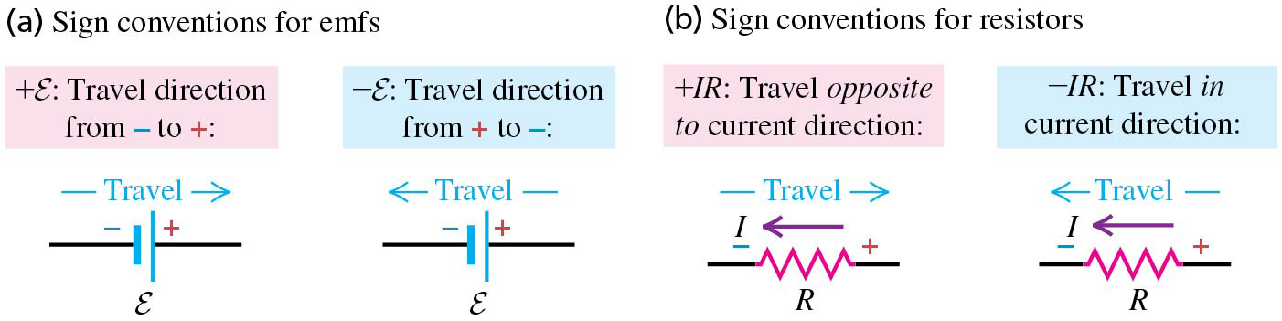
Sign convention of Kirchhoff’s junction rule:
The current is positive when flowing into a junction, and negative when flowing out of a junction.
Sign convention of Kirchhoff’s loop rule:
First assume a current direction, and assume a polarity of a battery in the loop, if they are not given. Don’t worry that your assumptions may be wrong. Then travel around the loop, using the following sign convention for the potential changes through each element.
Note: Not all loops generate independent equations.
If Loop 1 ± Loop 2 = Loop3, one of the three loops are redundant, and you only need to keep two of them.

Slide 11
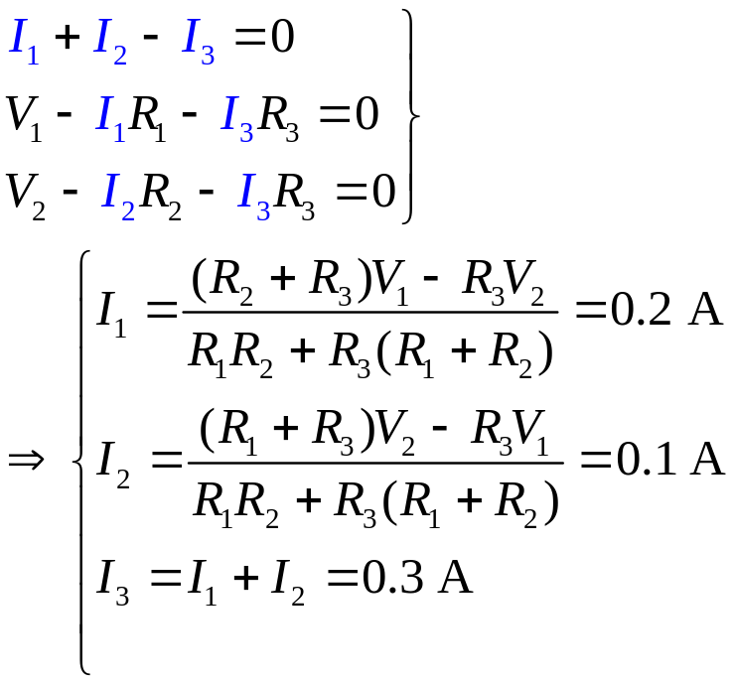
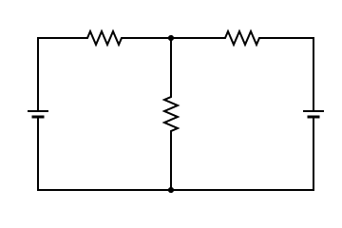
Example of Kirchhoff’s laws:
Question: Find the currents through each resistor.
Step 1: Define I₁, I₂, and I₃, and assume their directions, as shown.
Step 2: Choose two independent loops, which can be of either senses, as shown.
Step 3: Write down Kirchhoff’s current equations.
Step 4: Write down Kirchhoff’s voltage equations.
Step 5: Check the number of unknowns = the number of equations.
Step 6: Solve the simultaneous linear equations.
R₁= 30 Ω
R₂= 10 Ω
I₁
I₂
V₁= 15 V
I₃
R₃= 30 Ω
V₂= 10 V
L₁
L₂

Slide 12
Homework:
Ch1: 4,6,7,9,10,11

Slide 13
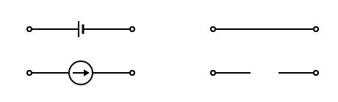
Lecture 3: Thevenin’s theorem
1. Superposition theorem
Superposition theorem of linear active networks:
The current in a branch of a linear circuit is the sum of the partial currents produced by each source, with all other sources set to zero.
Proof: By Kirchhoff’s law, the solution of the current of each branch is a linear sum of all power sources (Cramer’s method).
How to set a source to zero:
1) For a voltage source, replace it with a piece of wire.
2) For a current source, remove it.
a
b
a
b
a
b
a
b

Slide 14

Example of the superposition theorem:
Step 1: Short V₂, and find the partial currents
I₁₁= 0.4 A, I₂₁= 0.3 A, I₃₁= 0.1 A.
Step 2: Short V₁, and find the partial currents
I₁₂= 0.2 A, I₂₂= 0.4 A, I₃₂= 0.2 A.
Step 3: Sum up the partial currents. Pay attention to their directions.
I₁= 0.2 A, I₂= 0.1 A, I₃= 0.3 A.
R₁= 30 Ω
R₂= 10 Ω
I₁
I₂
V₁= 15 V
I₃
R₃= 30 Ω
V₂= 10 V
R₁= 30 Ω
R₂= 10 Ω
R₁= 30 Ω
R₂= 10 Ω
I₁₁
I₂₁
I₁₂
I₂₂
V₁= 15 V
I₃₁
R₃= 30 Ω
V₂= 10 V
V₁= 15 V
I₃₂
R₃= 03 Ω
V₂= 10 V

Slide 15
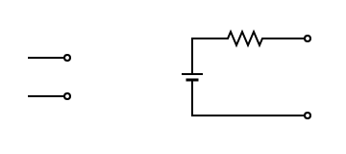
2. Thevenin’s theorem
Thevenin’s theorem: Any two-terminal linear active network (a black box) can be replaced by a Thevenin equivalent circuit, consisting of a voltage source V_{th} and a resistance R_{th} connected in series.
How to find the Thevenin voltage and the Thevenin resistance of a black box:
1) V_{th} is the open-circuit voltage.
2) R_{th} is obtained by replacing all voltage sources by shorts, and all current sources by open-circuits.
R_{th}
Lear active network
a
a
=
V_{th}
b
b
Proof of Thevenin’s theorem: For the linear active network, between terminals a and b, add an external backward V_{th} source in series with an arbitray R_{Load}, so that the current through R_{Load} is now 0. Switch on the internal and external source alternatively. According to the superposition theorem, we then find I = V_{th}/(R_{th}+ R_{Load}) by the internal source alone.

Slide 16
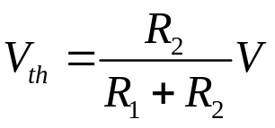
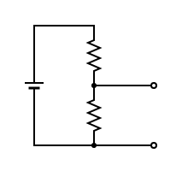
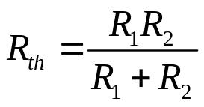
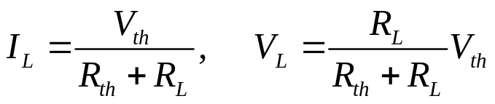
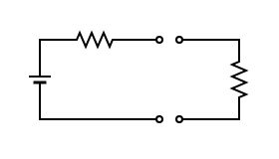
Example of Thevenin’s theorem: Voltage divider
Step 1: Find V_{th}.
Step 2: Find R_{th}.
Step 3: Replace the black box with the equivalent circuit.
The current and voltage on the load is necessarily
R₁
V
R₂
R_{th}
V_{th}
R_{L}

Slide 17
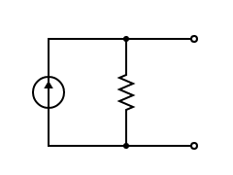
3. Norton’s theorem:
Norton’s theorem: Any two-terminal linear active network can be replaced by a Norton’s equivalent circuit, consisting of a current source I_{nor} and a resistance R_{nor} connected in parallel.
How to find the Norton current and the Norton resistance of a black box:
1) I_{nor} = I_{sc} is the short-cut current, which satisfies I_{nor} = V_{th} / R_{th}.
2) R_{nor} = R_{th}.
R_{th}
a
a
Lear active network
a
=
=
I_{nor}
R_{nor}
V_{th}
b
b
b
Proof of Norton’s theorem: For a linear active network, construct its Thevenin’s equivalent circuit and Norton’s equivalent circuit. Add the same but arbitrary R_{Load} to each circuit. It is easy to prove that the current through R_{Load} is the same in the two equivalent circuits.

Slide 18
Homework:
Ch1: 12,13,14,15

