Slide 1
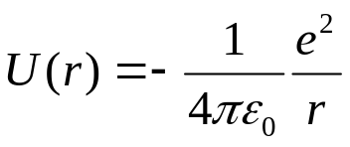
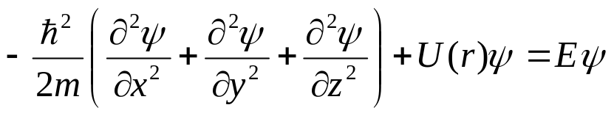
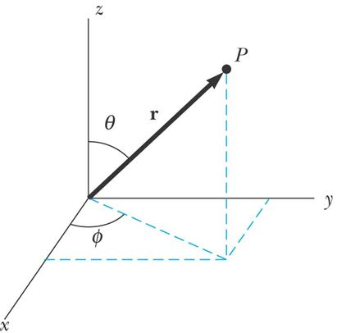
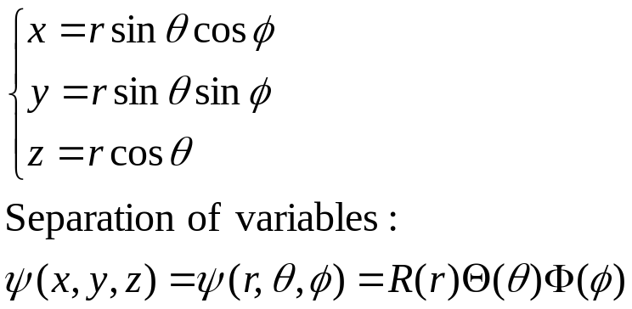
Chapter 41 Atomic Structure
April 21, 23 Hydrogen atom
41.3 The hydrogen atom
Schrödinger equation for the hydrogen atom:
r
-e
+e
The potential energy :
The time-independent Schrödinger equation:
It is easier to solve this equation if the rectangular coordinates are converted into the spherical polar coordinates:

Slide 2
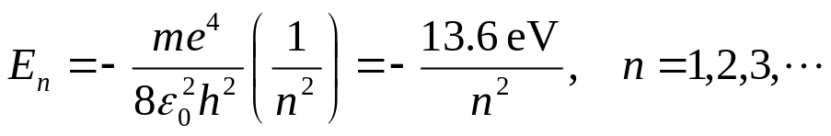


Quantum numbers for the hydrogen atom:
When boundary conditions are applied, we get three different quantum numbers for each allowed state. The three quantum numbers are restricted to integer values. They correspond to three degrees of freedom.
1) Principal quantum number n:
It is associated with the energy of the allowed sates:
2) Orbital quantum number l:
It is associated with the orbital angular momentum of the electron. An atom in a state with principle quantum number n can take the following discrete orbital angular momentum:
L can equal 0 when l = 0, where the wave functions are spherically symmetric.
3) Magnetic quantum number m_{l}:
The orbital magnetic quantum number m_{l} specifies the allowed values of the z component of the orbital angular momentum:
Agrees exactly with Bohr’s theory!

Slide 3
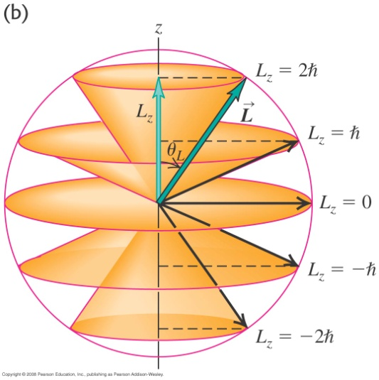
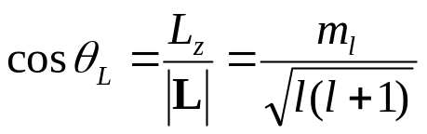
Vector model of the possible orientations of L:
| L_{z} |< |L| (unless both are 0). This is required by the uncertainty principle.
L lies anywhere on the surface of a cone that makes an angle θ_{L} with the z axis:
Notation of quantum numbers, shells and subshells:
1) All states having the same principle quantum number n are said to form a shell.
Shells of n =1, 2, 3, 4, … are identified by letters K, L, M, N, …
2) All states having the same values of n and l are said to form a subshell.
Subshells of l = 0, 1, 2, 3, 4, … are designated by letters s, p, d, f, g, …
3) All states having the same values of n, l and m_{l} are said to form a spatial orbital.

Slide 4
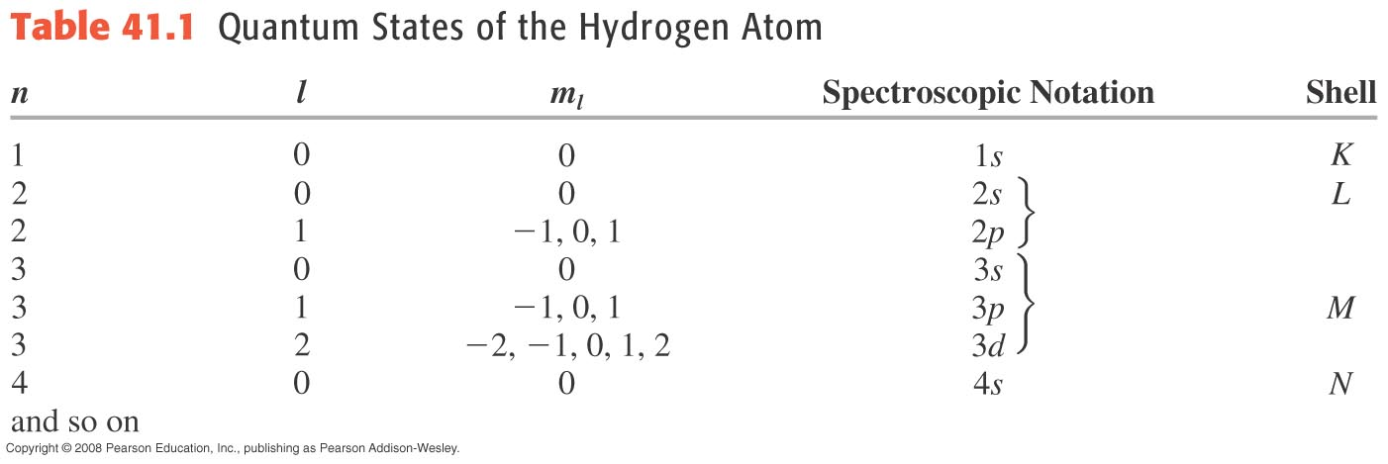
Example 41.2: Counting hydrogen states
Example 41.3: Angular momentum of an hydrogen atom

Slide 5


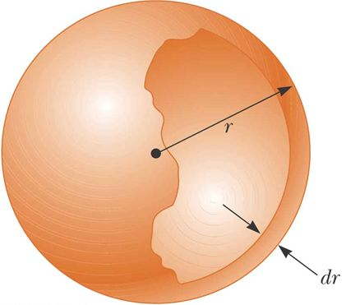
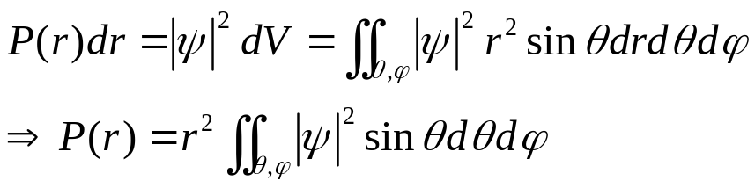
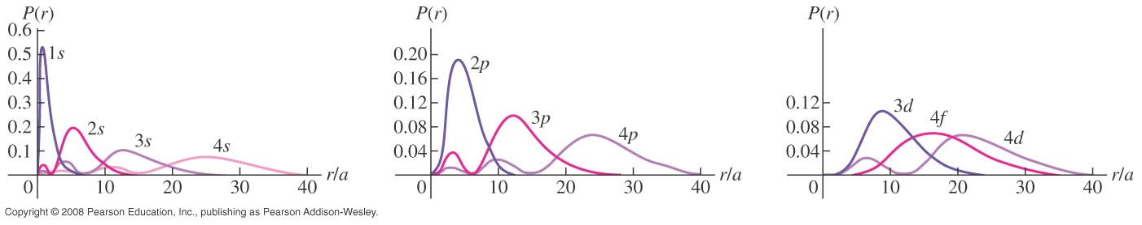
Electron probability distributions:
The wave function gives us the probability density function , which is usually not easy to visualize.
Radial probability density function P(r):
The probability per unit radial length of finding the electron in a spherical shell at radius r (regardless of its angular position):
P(r) for several hydrogen-atom wave functions. For states with the largest l of each n (1s, 2p, 3d, 4f, …), P(r) has a single maximum at r = n²a, which is the same as predicted by the Bohr model.

Slide 6

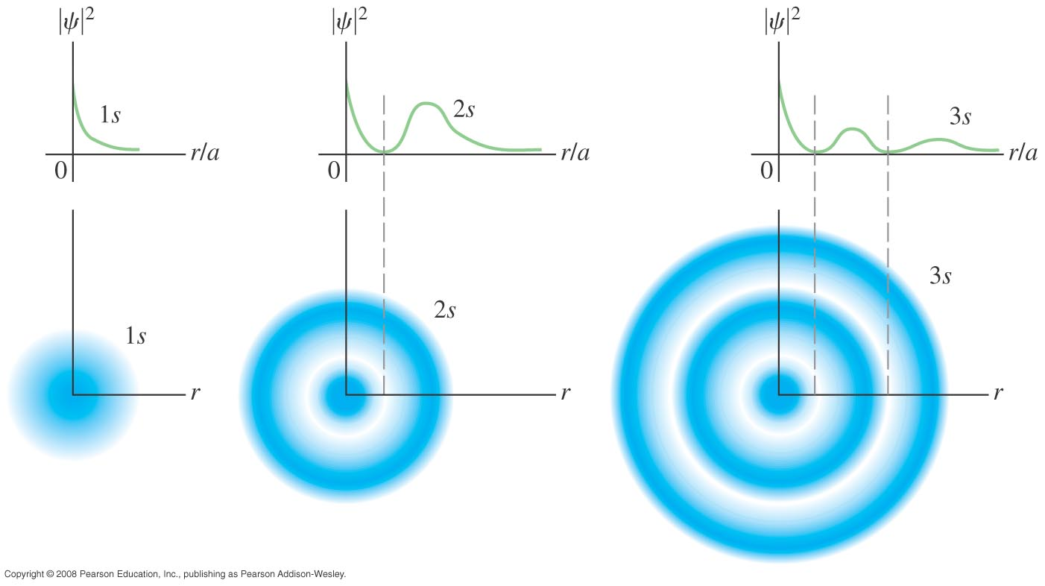
Three-dimensional probability density function :
For all s states, is spherically symmetric.

Slide 7
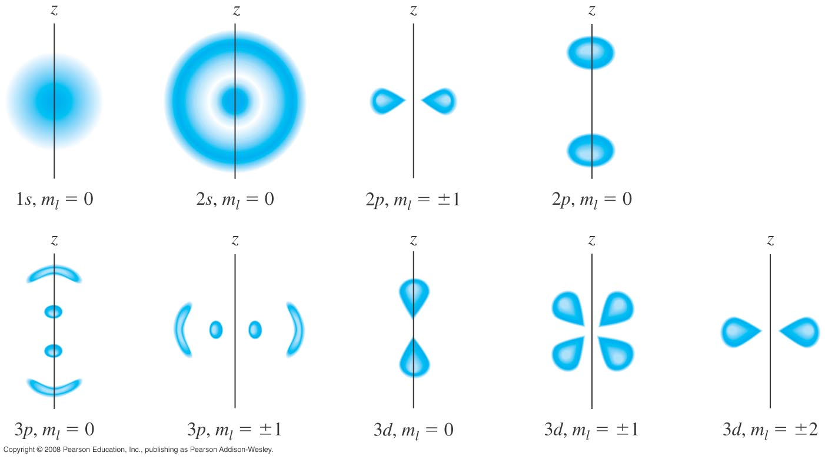
For all stationary states, is independent of φ.
Example 41.4: A hydrogen wave function.

Slide 8
Read: Ch41: 3
Homework: Ch41: 12,16,18,19
Due: May 2

Slide 9
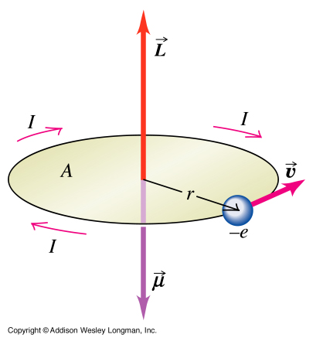
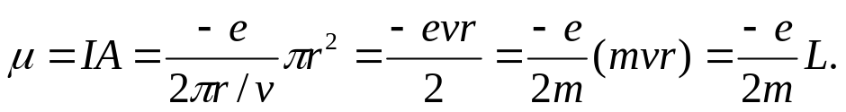
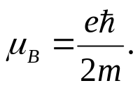
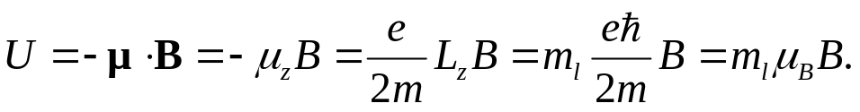
April 25 Zeeman effect
41.4 The Zeeman effect
Zeeman effect refers to the splitting of atomic energy levels and spectral lines when the atoms are placed in a magnetic field.
Magnetic moment: μ = Ι A
For an orbiting charge -e,
A magnetic moment μ exists due to the orbital angular momentum L.
Bohr magneton: A nature unit for magnetic moment,
Suppose an external magnetic field is set along the z-axis. The magnetic interaction between the atom and the magnetic field causes a potential energy:
The interaction energy U depends on the value of m_{l}, which is thus called the magnetic quantum number.

Slide 10
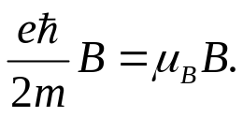
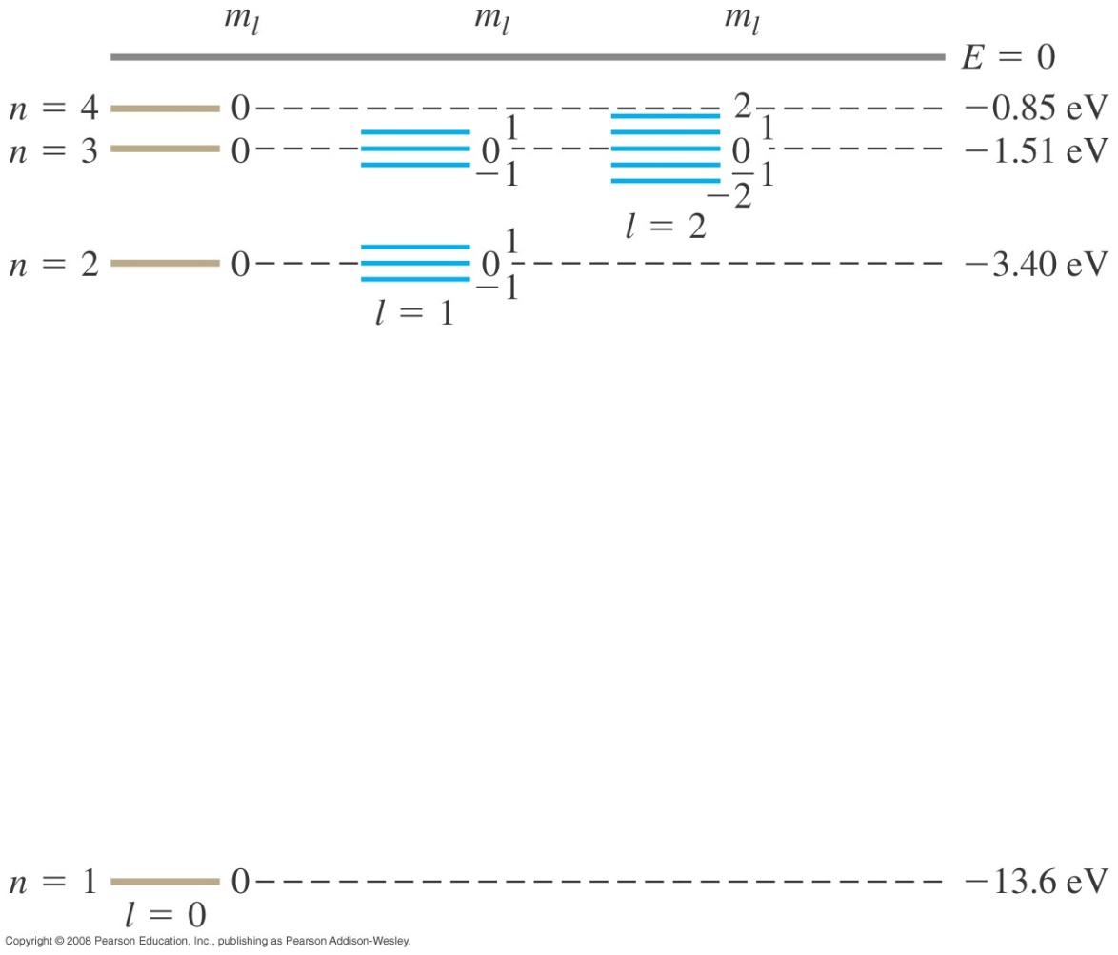
Split of the energy levels:
In a magnetic field, the energy level with a particular orbital quantum number l will be split into 2l+1 distinct sublevels, each can be labeled by their magnetic quantum number
m_{l}. The energy difference between adjacent sublevels is
Example 41.5.

Slide 11


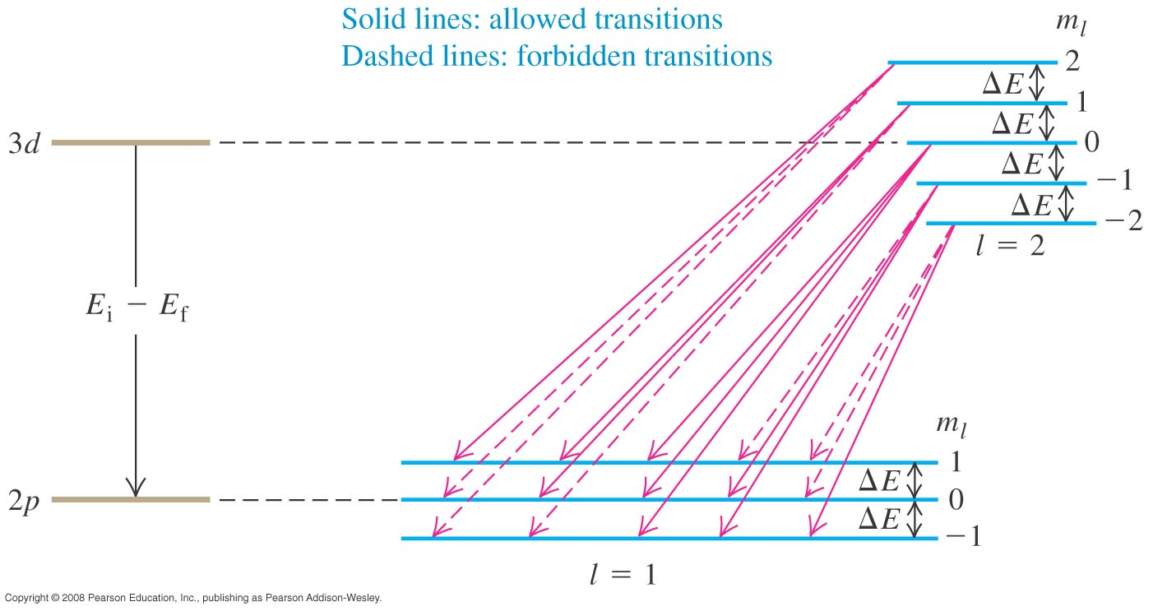
Selection rules:
In an electronic transition the photon carries away one of angular momentum. Because of the conservation of angular momentum, the only allowed transitions are
As a result, in a magnetic field, due to Zeeman effect, a single spectral line is split into 3 spectral lines.

Slide 12
Read: Ch41: 4
Homework: Ch41: 21,22
Due: May 2

Slide 13
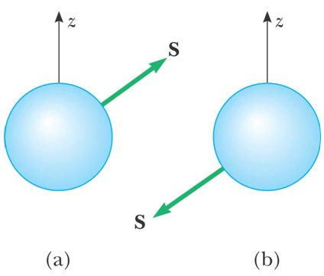
April 28 Electron spin
41.5 Electron spin
Anomalous Zeeman effect: An atomic spectral line can split into other than 3, and unevenly spaced lines in an external magnetic field.
Stern-Gerlach experiment (1922): A beam of silver atoms is split into two by a nonuniform magnetic field.
Electron spin:
Only two directions exist for electron spins. The electron can have spin up (a) or spin down (b).
In the presence of a magnetic field, the energy of the electron is slightly different for the two spin directions. This produces doublets in the spectra of some gases.
The electron cannot be considered to be actually spinning. The experimental evidence supports that the electron has some intrinsic angular momentum.
Dirac showed the electron spin from the relativistic properties of the electron.

Slide 14
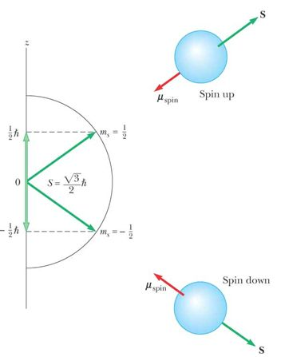
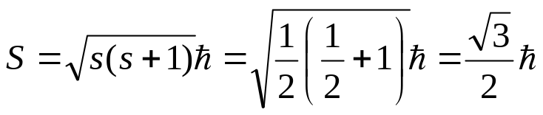
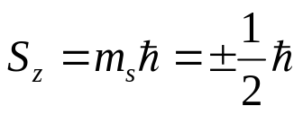
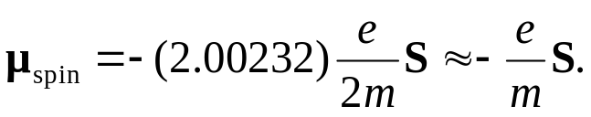
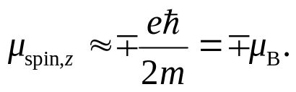
Spin angular momentum:
Electron spin can be described by a spin quantum number s, whose value can only be s = 1/2. The magnitude of the spin angular momentum S is
The spin angular momentum can have two orientations relative to the z axis, specified by the spin magnetic quantum number m_{s} = ± 1/2:
m_{s} = + 1/2 corresponds to the spin up case;
m_{s} = − 1/2 corresponds to the spin down case.
The z component of spin angular momentum is
The spin magnetic moment:
The z component of the spin magnetic moment:

Slide 15
Spin-orbit coupling:
The spin magnetic moment causes the splitting of energy levels even when there is no external field. The interaction energy of spin-orbit coupling is proportional to L·S.
Example: Sodium lamp, 589.0 nm (²P_{3/2}), 589.6 nm (²P_{1/2}).
Example 41.6 Energy of electron spin in a magnetic field.
Example 41.7 An effective magnetic field

Slide 16
Read: Ch41: 5
Homework (optional): Ch41: 27,28

Slide 17
April 30 Exclusion principle and the periodic table
41.6 Many-electron atoms and the exclusion principle
Central field approximation: Up to date there exists no exact solutions for the Schrödinger equations of many-electron atoms.
We may think each individual electron moves in the field due to the nucleus and the averaged spherical field from all other electrons. Under this approximation, the four quantum numbers n, l, m_{l}, m_{s} can still be used to describe all the electronic states of an atom regardless of the number of electrons in its structure, but in general the energy of the state depends on both n and l.
Question: How many electrons can be in a particular quantum state?
Pauli’s exclusion principle:
No two electrons can ever be located in the same quantum state. Therefore, no two electrons in the same atom can have the same set of quantum numbers.
Orbital: The atomic state characterized by the quantum numbers n, l and m_{l}. It is also called a spatial orbital. In contrast, a quantum state characterized by all four quantum numbers n, l, m_{l} and m_{s} is called a spin orbital.
→ From the exclusion principle, at the most only two electrons can be present in an orbital. One electron will have spin up and the other spin down.

Slide 18
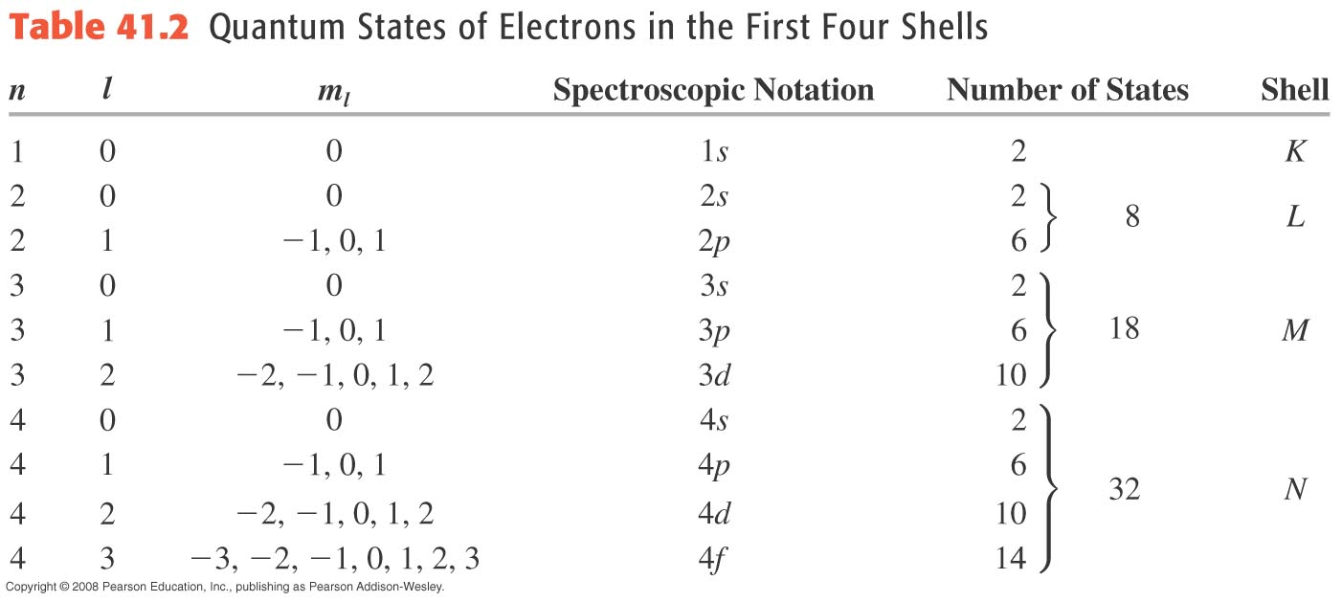

Slide 19
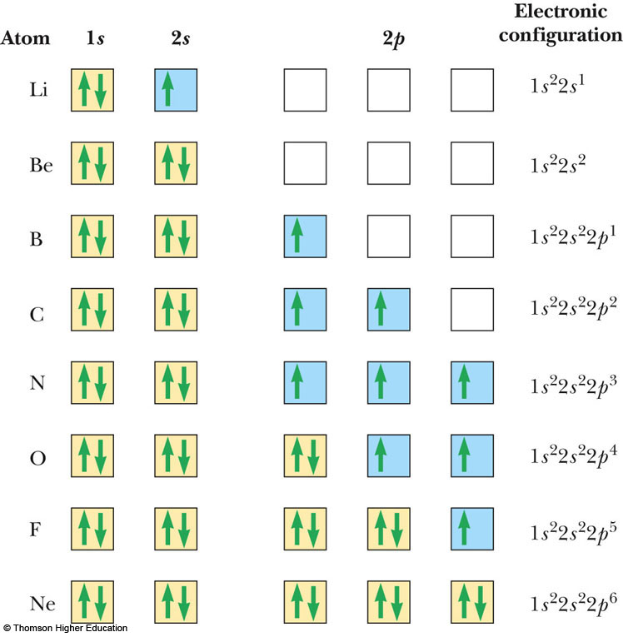
Question: How are the electrons aligned in an orbital?
Hund’s rule: When an atom has orbitals of equal energy, the order in which they are filled by electrons is such that a maximum number of electrons have unpaired spins. (Exceptions may exist).
Electronic configuration:
The filling of the electronic states must obey both Pauli’s exclusion principle and Hund’s rule.
The periodic table:
An arrangement of the atomic elements according to their atomic masses and chemical similarities. The chemical behavior of an element depends on the outermost shell that contains electrons.

Slide 20
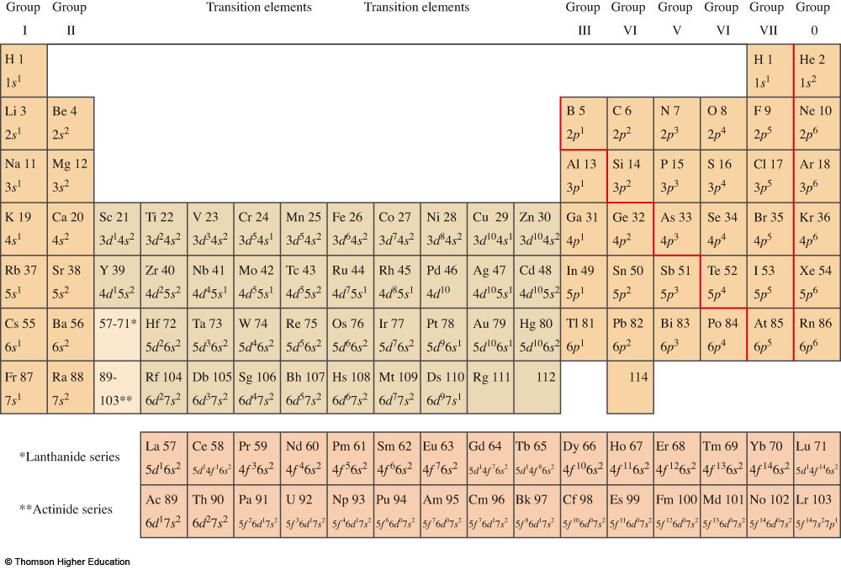

Slide 21
Read: Ch41: 6
Homework (optional): Ch41: 29,30

