Slide 1


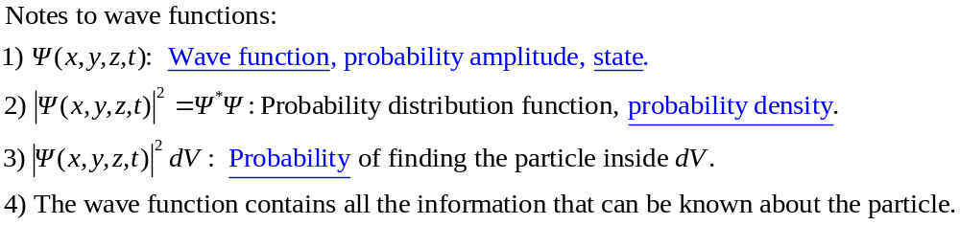
Chapter 40 Quantum Mechanics I: Wave Functions
March 31, April 2 Wave functions and Schrödinger equation
40.1 Wave functions and the one-dimensional Schrödinger equation
Quantum mechanics: Physical science studying the behavior of matter on the scale of atomic and subatomic levels.
A photon described by an electromagnetic wave:
Probability per unit volume of finding the photon in a given region of space at an instant of time ∝ Square of the amplitude of the electromagnetic wave.
Interpretation of the wave function of a particle:
Wave function: A wave function describes the distribution of a particle in space. The quantity is the probability that the particle can be found within the volume dV around the point (x, y, z) at time t.

Slide 2
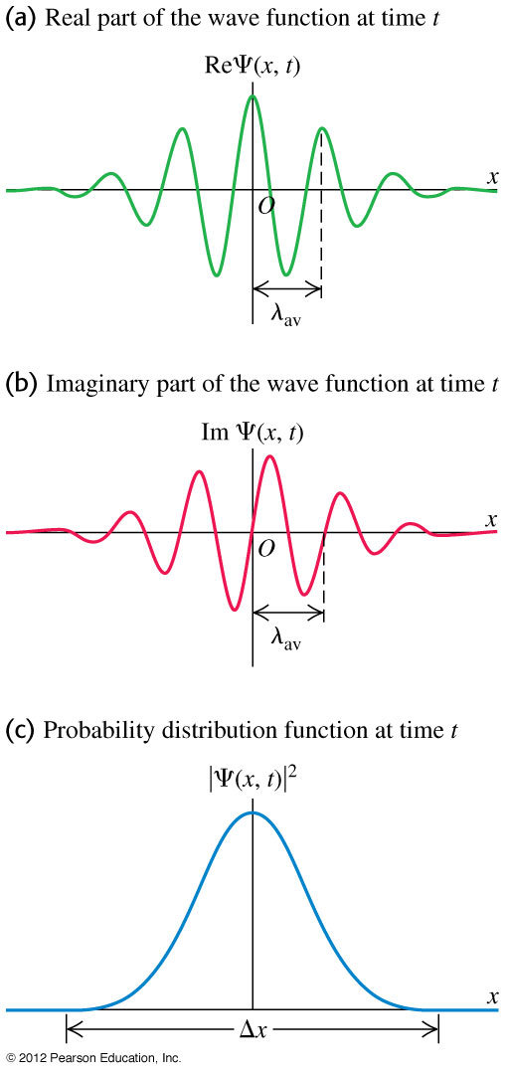
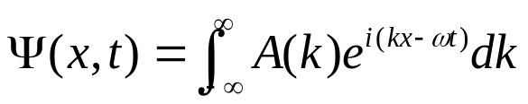
Wave packet: A wave packet is a wave that has a narrow distribution in space, so that it exhibits properties of a particle. A wave packet can be constructed by the sum of a large number of waves with a continuous distribution of similar wavelengths:
A wave packet has both the characteristics of a wave and of a particle.

Slide 3

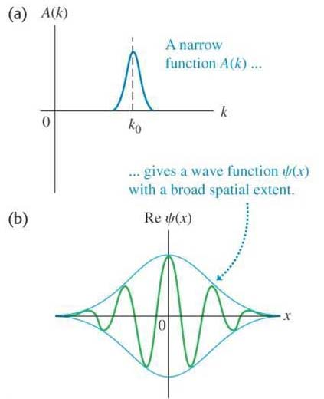
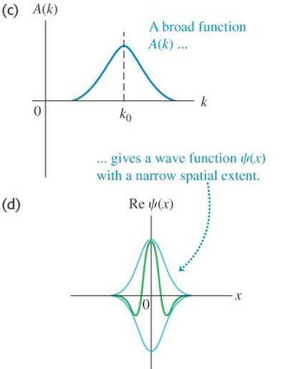
The uncertainty principle:
A broad distribution of A(k) results in a narrower wave packet.
A short laser pulse must be white.

Slide 4
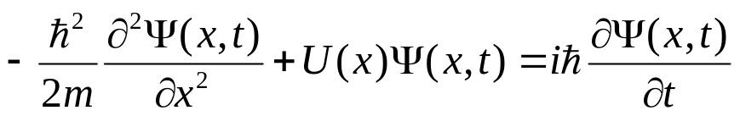
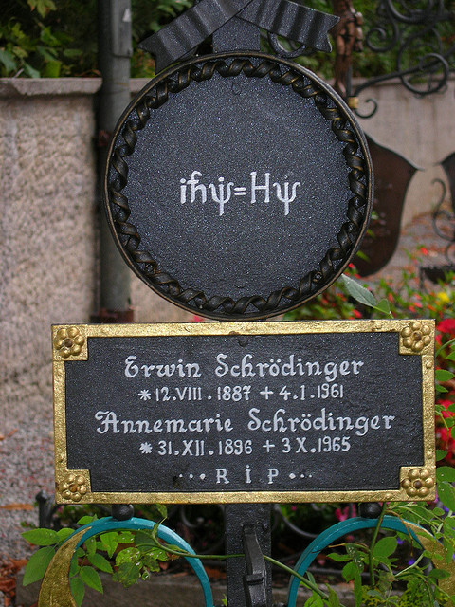
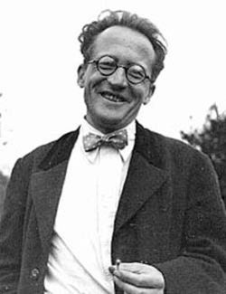
One dimensional Schrödinger equation:
Erwin Schrödinger: (1887-1961)
Austrian physicist.
Famous for his contributions to quantum mechanics, especially the Schrödinger equation.
Nobel Prize in 1933.
A particle of mass m is confined to move along the x axis and interact with its environment through a potential energy function U(x). The wave function Ψ (x, t) satisfies

Slide 5

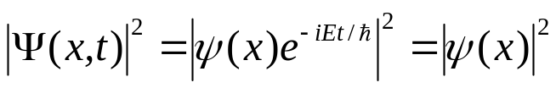
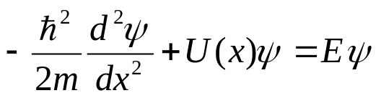
Stationary states:
Stationary state: A stationary state of a particle is a state that has a definite energy.
The wave function of a stationary state can be written as a product of a time-independent wave function ψ (x) and a simple function of time:
Notes to stationary states:
Stationary states are of essential importance in quantum mechanics.
A system in general can be in a state that is different from a stationary state and thus does not have a definite energy. However, a wave function can always be decomposed into a combination of stationary wave functions.
At a stationary state the probability density function does not depend on time:
Time-independent Schrödinger equation:
A particle of mass m is confined to move along the x axis and interact with its environment through a potential energy function U(x). The total energy of the system is E, and the wave function of the system is ψ (x), then

Slide 6
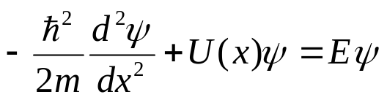
More about the time-independent Schrödinger equation:
The first term in the Schrödinger equation represents the kinetic energy K of the particle multiplied by ψ , therefore K + U = E.
If U(x) is known, one can solve the equation for ψ (x) and E for the allowed states. Some restrictions:
1) ψ (x) must be continuous,
2) ψ (x) → 0 when x → ±∞ (normalization condition),
3) dψ/dx must be continuous for finite values of U(x).
Solutions of the Schrödinger equation may be very difficult.
The Schrödinger equation has been extremely successful in explaining the behavior of atomic and nuclear systems.
When quantum mechanics is applied to macroscopic objects, the results agree with classical physics.

Slide 7
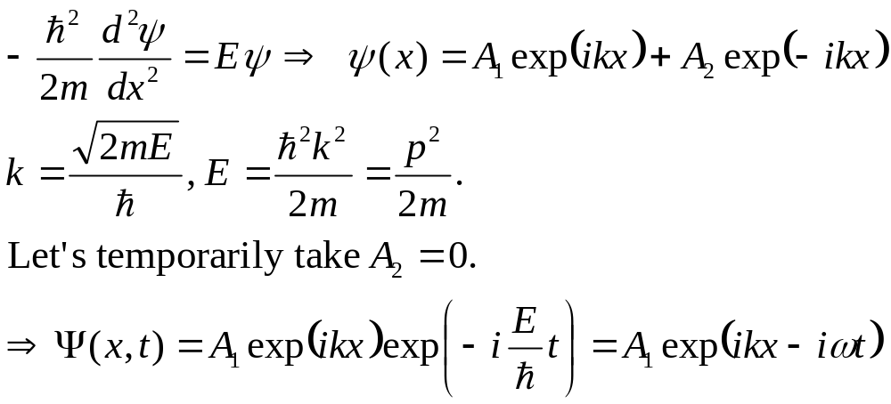
Wave function for a free particle:
Example 40.1
Example 40.2
Test 40.1

Slide 8
Read: Ch40:1
Homework: Ch40: 4,5,6
Due: April 11

Slide 9
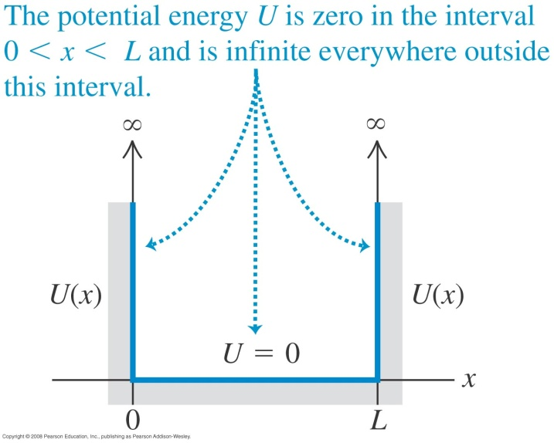
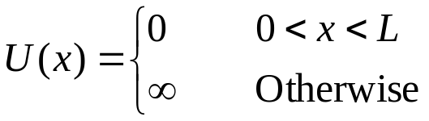
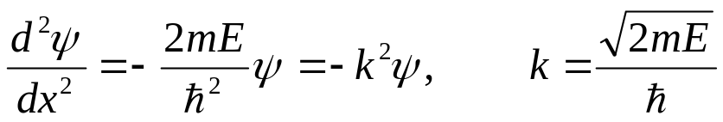
April 4 Particle in a box
40.2 Particle in a box
Potential well: An upward-facing region of a potential energy diagram. (opp. barrier).
Potential energy of a box:
Schrödinger equation:
In the region x< 0 and x > L, where U = ∞, ψ (x)=0.
In the region 0 < x < L, where U = 0, the Schrödinger equation is
The general solution to this equation is

Slide 10

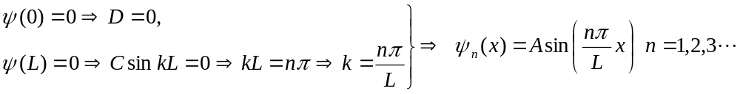
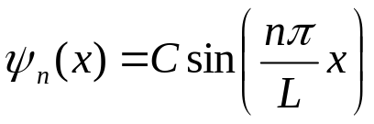
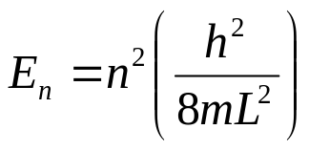
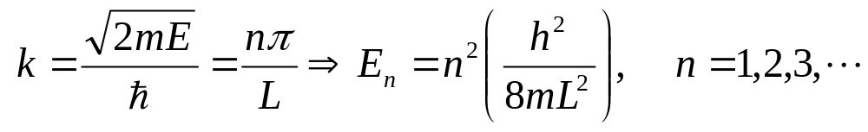
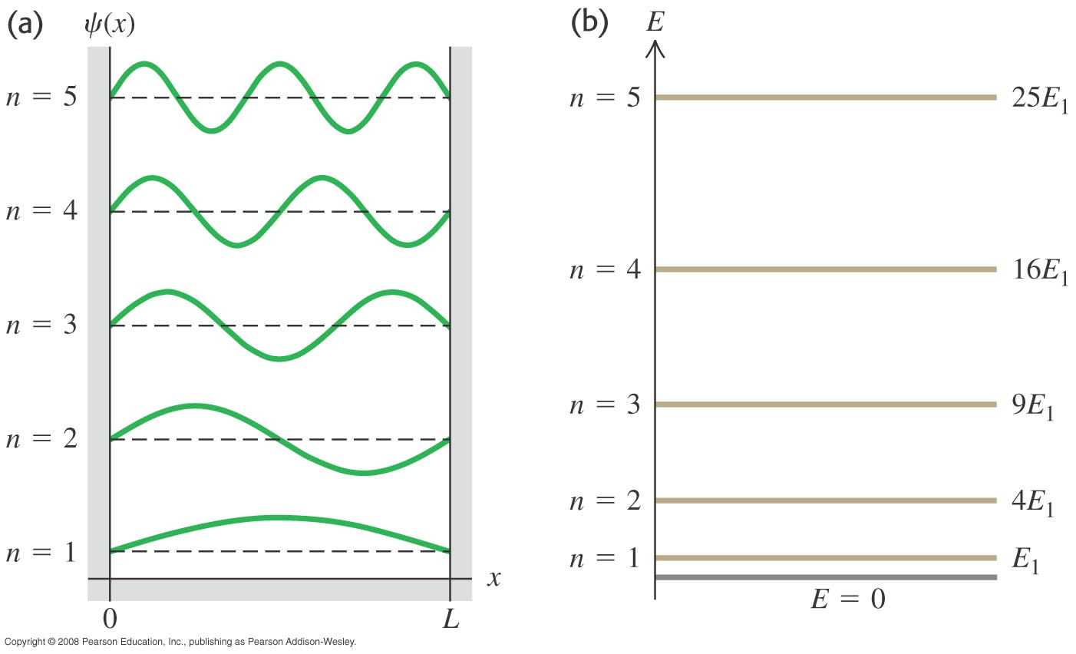
Applying boundary conditions to the general solution
Energy levels:

Slide 11
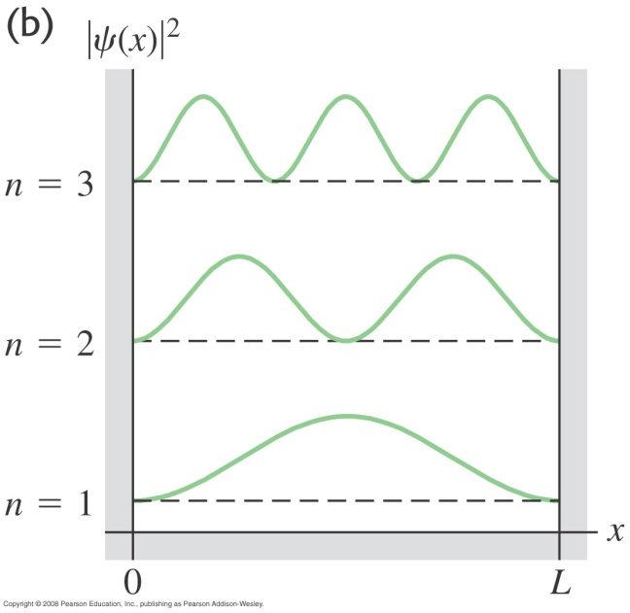
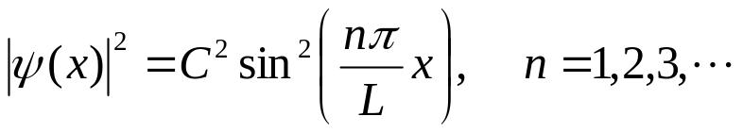
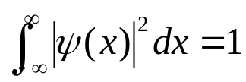
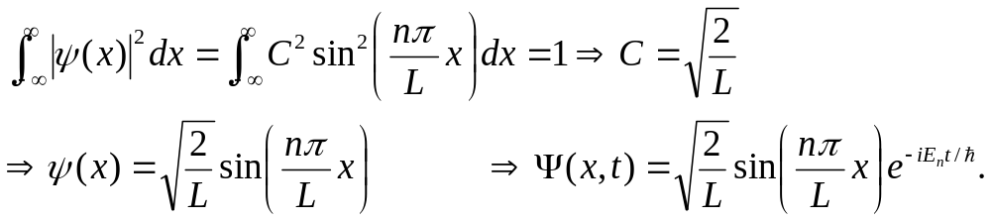
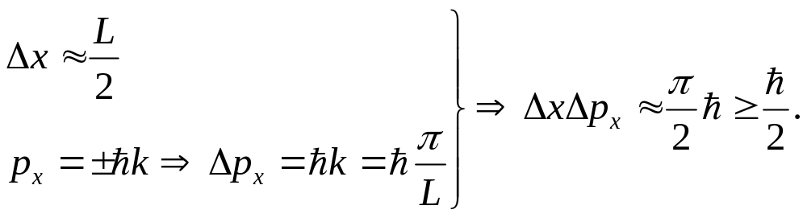
Probability density:
Normalization: The total probability of finding the particle somewhere in the universe must be 1.
Uncertainty principle: For the state n =1,
Example 40.3
Example 40.4
Test 40.2

Slide 12
Read: Ch40: 2
Homework: Ch40: 10,11,14,18,20
Due: April 11

Slide 13
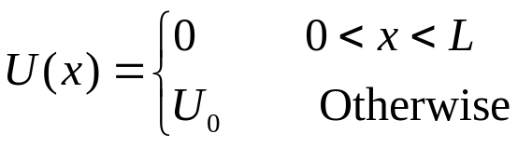
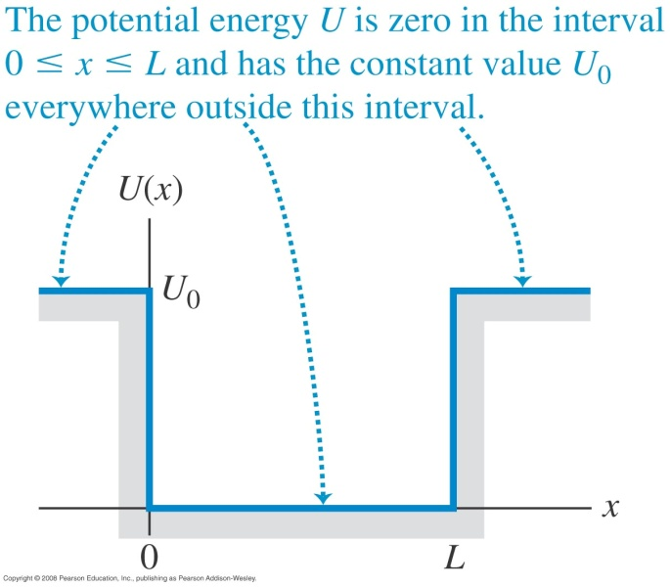
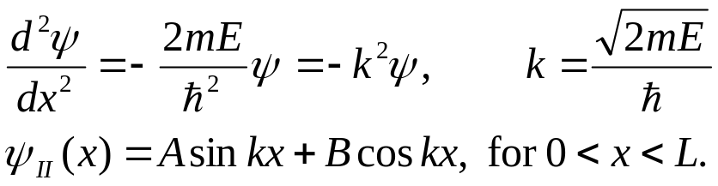
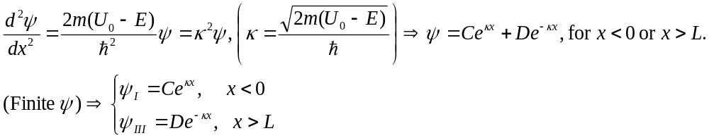
April 7 Particle in a well
40.3 Potential wells
A particle in a well of finite height (square-well potential):
Schrödinger equation:
Bound states: When E<U₀, the particle is more localized in the well.
1) Region II
I
II
III
2) Region I and III

Slide 14
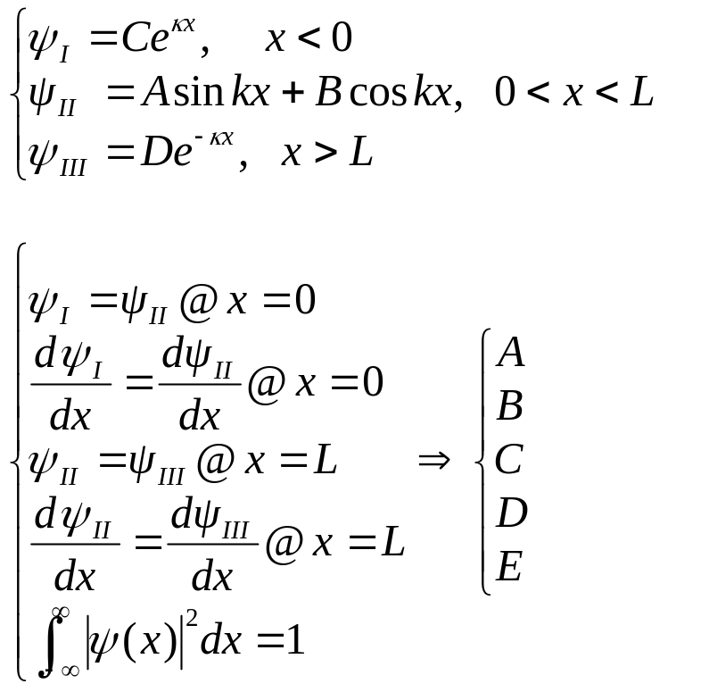
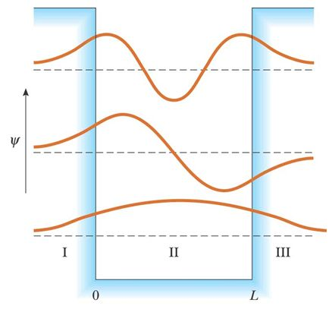
Determining the constants in the equations by the boundary conditions and the normalization condition:
Matching the functions at the boundary points is possible only for specific values of E, which are the possible energy levels of the system.

Slide 15
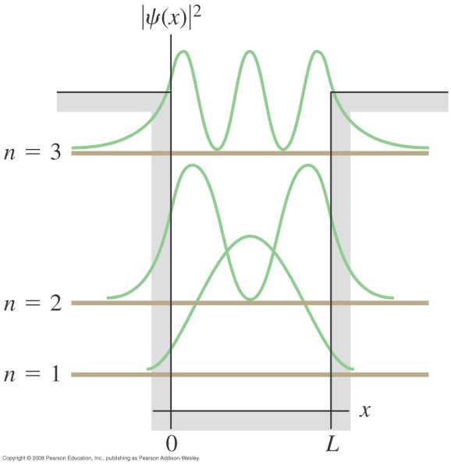
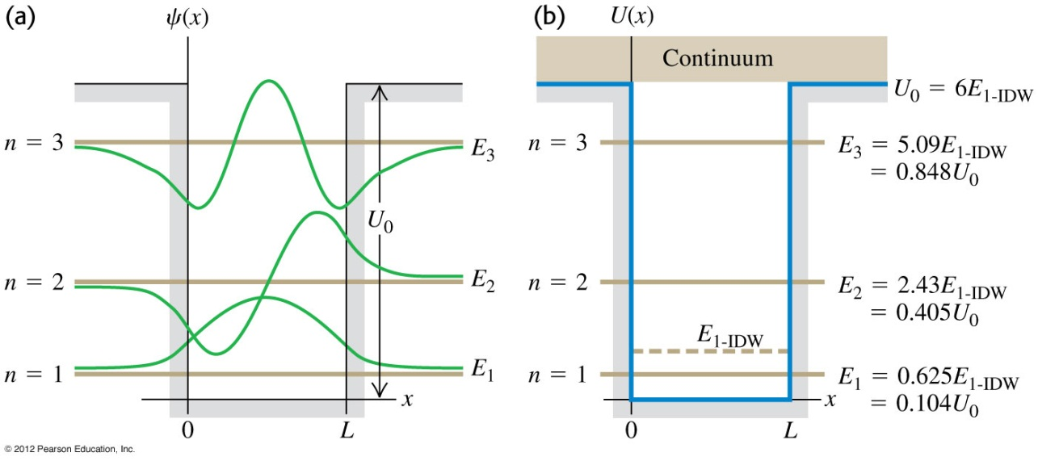
Wave functions and energies of a particle in a well :
Outside the potential well, classical physics forbids the presence of the particle, while quantum mechanics shows the wave function decays exponentially to approach zero.
The functions are smooth at the boundaries.
Each energy level for a finite well is lower than for an infinitely deep well of the same width.
Applications:
Nanotechnology: The design and application of devices having dimensions ranging from 1 to 100 nm. Using the idea of trapping particles in potential wells.
Quantum dot: A small region that is grown in a silicon crystal, acting as a potential well.
Storage of binary information.
Example 40.6.

Slide 16
Read: Ch40: 3
Homework: Ch40: 22,23,26
Due: April 18

Slide 17
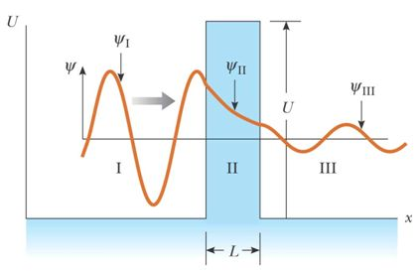
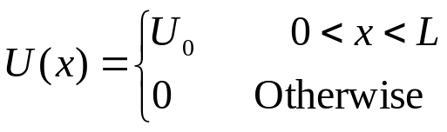
April 14 Potential barriers and tunneling
40.4 Potential barriers and tunneling
Potential barrier: A place where the potential
energy diagram has a maximum.
0
Square barrier:
U₀ is the barrier height.
0
L
Classically, if E < U₀, the particle incident from the left is reflected by the barrier. Regions II and III are forbidden. In quantum mechanics, all regions are accessible to the particle.
The probability of the particle being in a classically forbidden region is low, but not zero.
The curve in the diagram represents a full solution to the Schrödinger equation. Movement of the particle to the far side of the barrier is called tunneling or barrier penetration.
The probability of tunneling can be described by a transmission coefficient T.

Slide 18
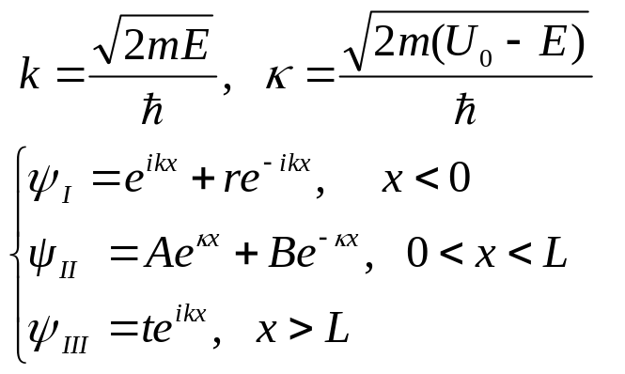
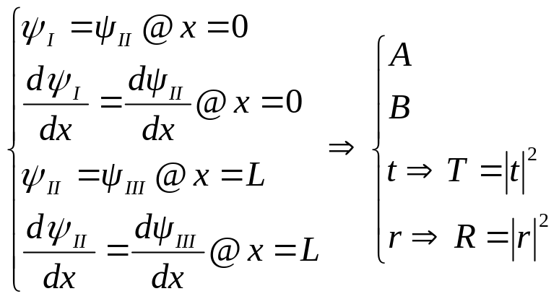
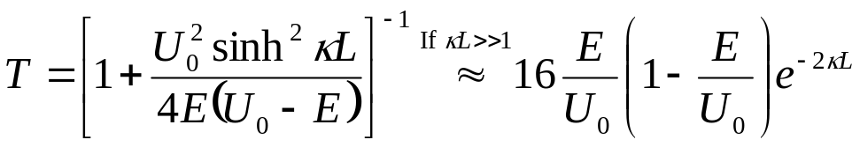
0
0
L
Transmission coefficient (T): The probability for the particle to penetrate the barrier.
Reflection coefficient (R): The probability for the particle to be reflected by the barrier.
T + R = 1
Example 40.7
Test 40.4

Slide 19
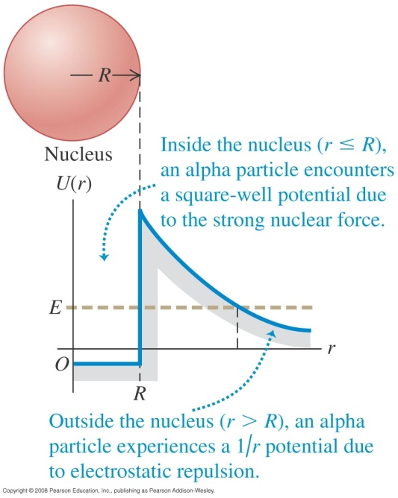
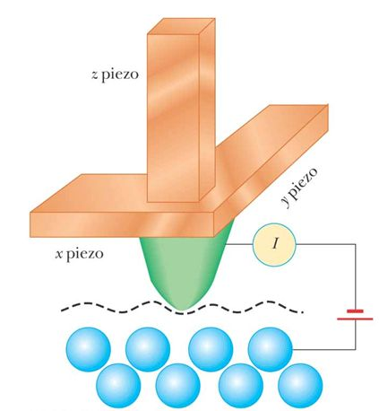
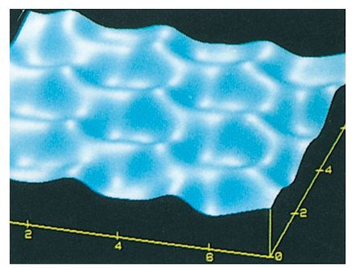
Applications of tunneling:
Alpha decay:
In order for the alpha particle to escape from the nucleus, it must penetrate a barrier whose energy is several times greater than the energy of the nucleus-alpha particle system.
Nuclear fusion:
Protons can tunnel through the barrier caused by their mutual electrostatic repulsion.
Scanning tunneling microscope:
The empty space between the tip and the sample surface forms the “barrier”.
The STM allows highly detailed images of surfaces with resolutions comparable to the size of a single atom: 0.2 nm lateral, 0.001nm vertical.

Slide 20
Read: Ch40: 4
Homework: Ch40: 29,30,31
Due: April 25

Slide 21
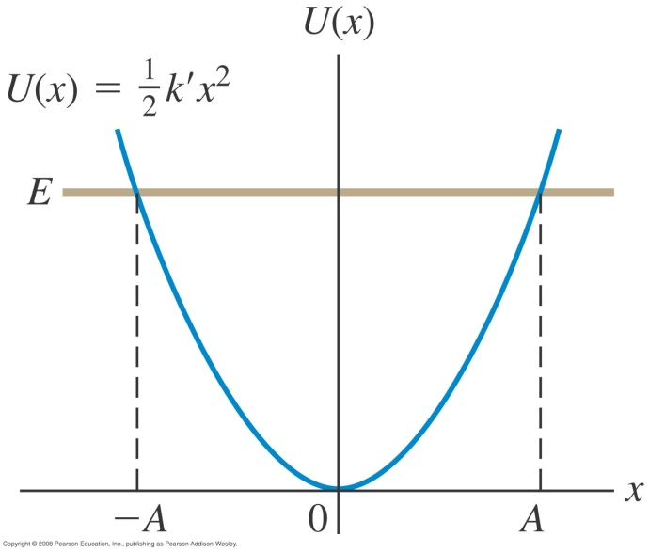
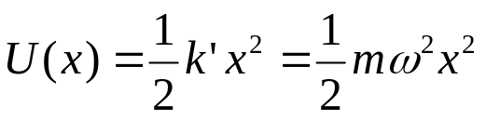
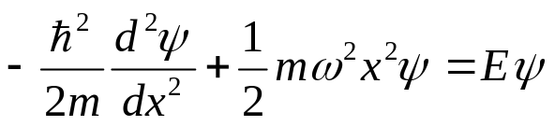
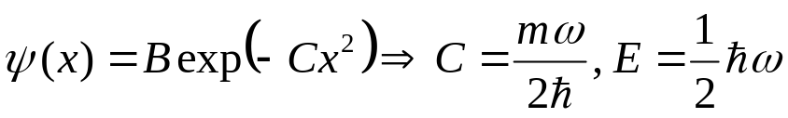
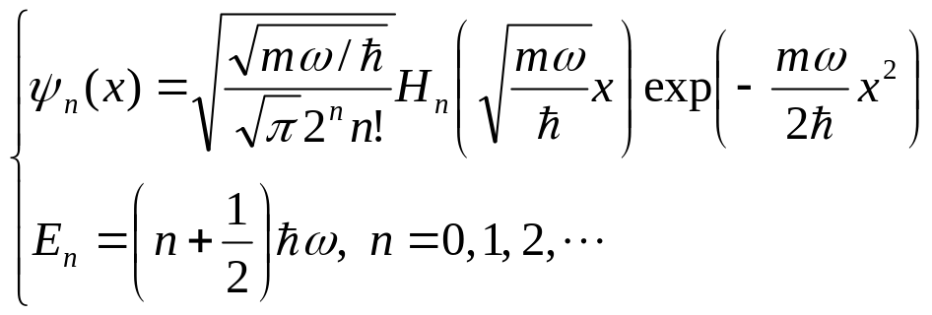
April 18 Harmonic oscillator
40.5 The harmonic oscillator
The potential energy:
The Schrödinger equation:
Let us guess:
This is actually the ground state.
The actual solution:
Hermite polynomials

Slide 22
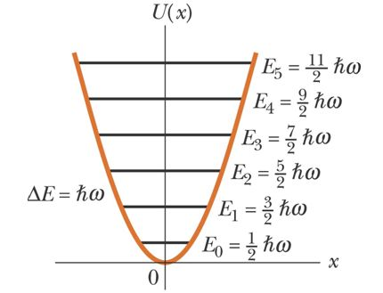
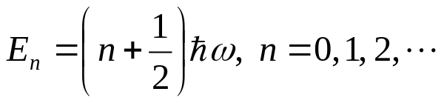

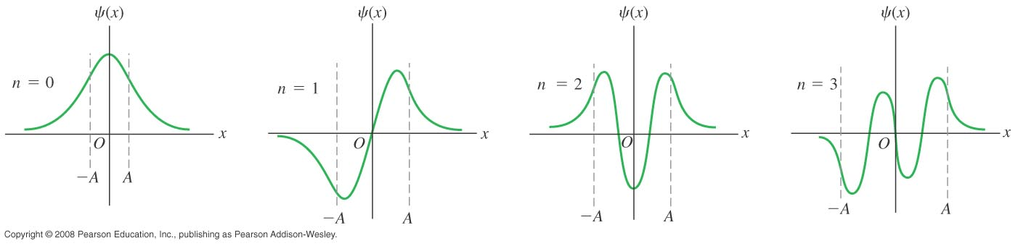
Energy levels:
Ground state
Example 40.8
Wave functions:

Slide 23
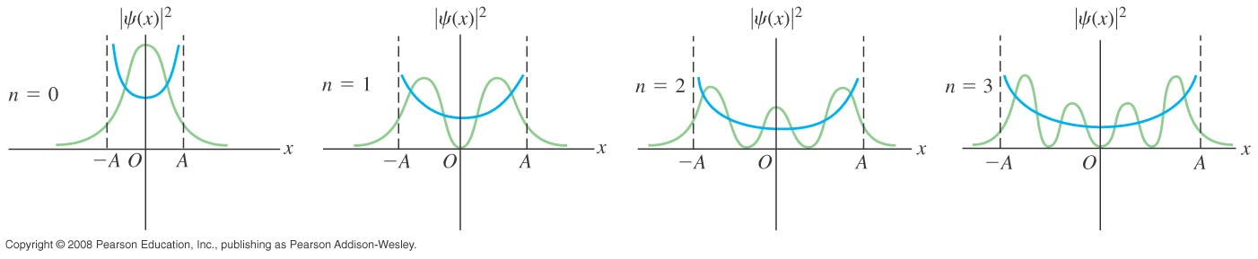
Probability density and comparison to Newtonian oscillators:
The green curves represent probability densities for the first four states.
The blue curves represent the classical probability densities corresponding to the same energies.
As n increases, the agreement between the classical and the quantum-mechanical results improves.
Test 40.5

Slide 24
Read: Ch40: 4
Homework: Ch40: 35,36,37
Due: April 5

