Slide 1
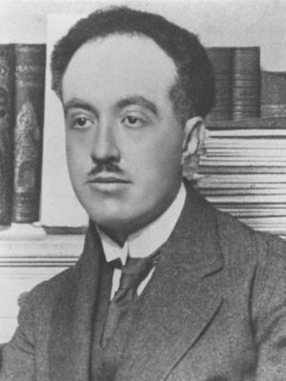
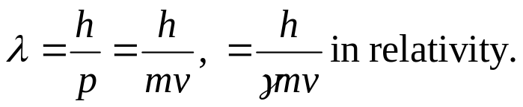
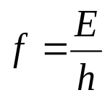
Chapter 39 Particles Behaving as Waves
March 17 De Broglie waves
39.1 Electron waves
Louis de Broglie (1892 –1987):
French physicist.
Nobel Prize in Physics (1929) for his prediction of the wave nature of electrons.
Originally studied history.
Broglie hypothesis:
All forms of matter have both wave and particle characteristics.
The de Broglie wavelength of a particle is .
The frequency of a particle is .
Note: Some photon equations, especially f = c/λ, may not apply to particles with mass.

Slide 2
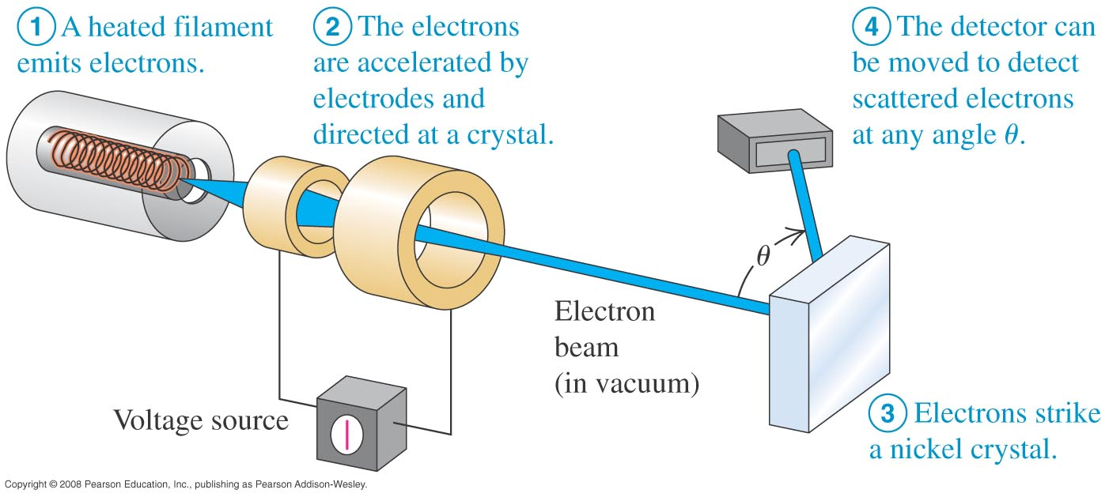
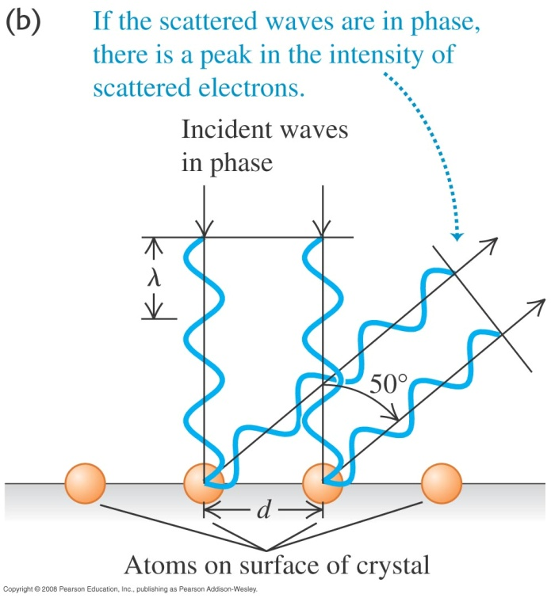

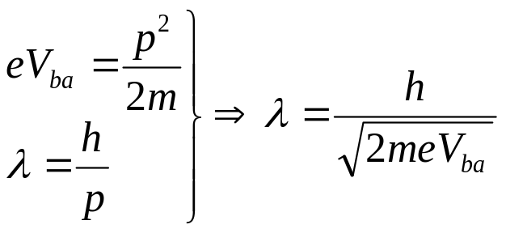
Electron diffraction
Davisson-Germer experiment (1926):
Scattering of low-energy electrons from a nickel target exhibited maxima and minima at specific angles.
They measured the wavelength of the electrons and confirmed de Broglie relationship: p = h /λ.
Electron diffraction:
Like a diffraction grating, strong reflection occur at
De Broglie wavelength of a nonrelativistic electron:

Slide 3
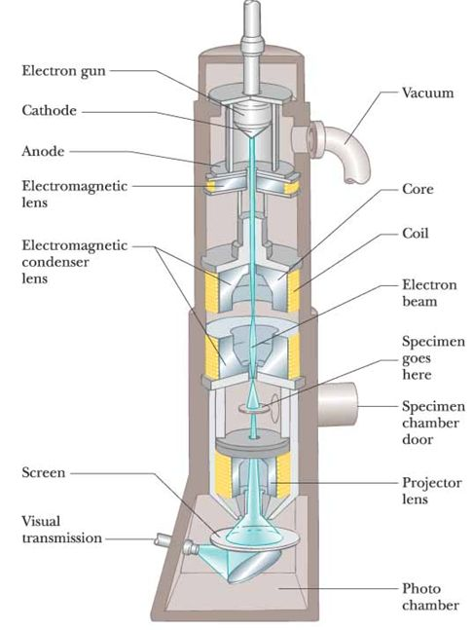
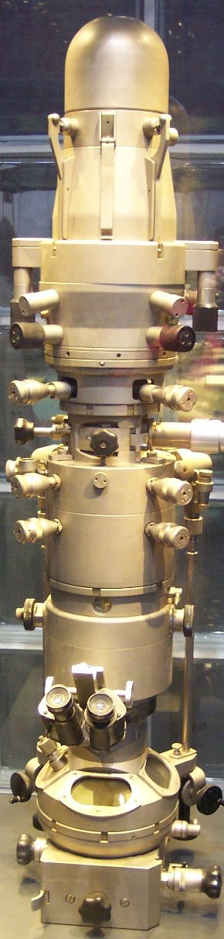
The electron microscope
The electron microscope depends on the wave characteristics of electrons.
The electron microscope has a high resolving power because the electrons have a very short wavelength:
λ_{electron} ~ (1/ 100) λ_{photon}.
Example 39.1,2,3
Test 39.1

Slide 4
Read: Ch39: 1
Homework: Ch39: 3,6,11,14
Due: March 28

Slide 5
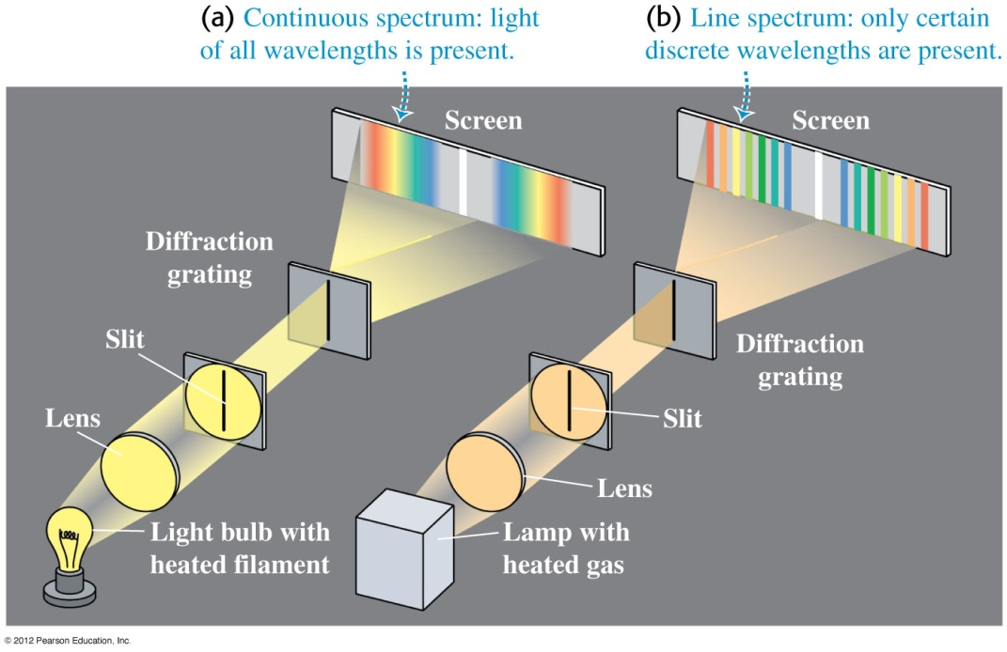
March 19 The nuclear atom
39.2 The nuclear atom and atomic spectra
Atomic line spectra:
A discrete line emission spectrum is observed when a low-pressure gas sample is subjected to an electric discharge.
An absorption spectrum is obtained by passing a white light from a continuous source through a cool gas sample.
Observation and analysis of these spectral lines is called spectroscopy.
No two elements have the same line spectrum. → Spectroscopy provides a practical and sensitive technique for identifying the elements existing in unknown samples.

Slide 6
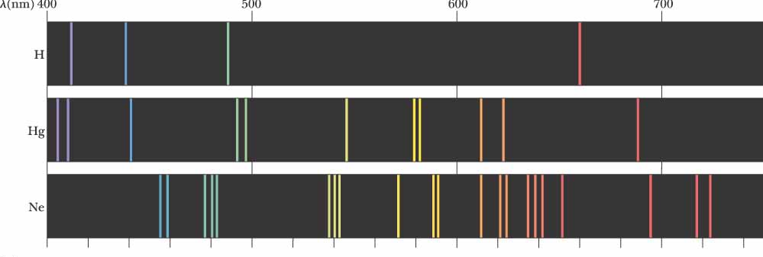
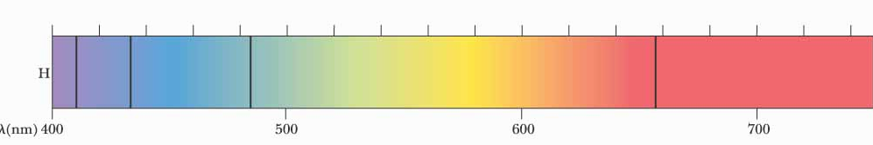
Emission spectra:
Absorption spectra:

Slide 7
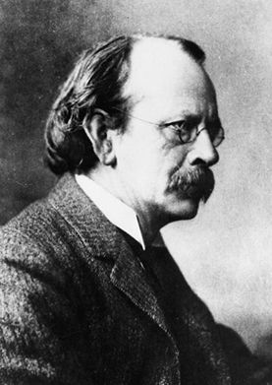

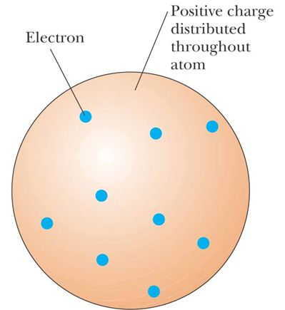
Joseph John Thomson (1856-1940):
British scientist.
Nobel Prize in physics (1906).
The discoverer of the electron.
Thomson’s model of the atom:
Electrons embedded throughout a volume of positive charge.

Slide 8
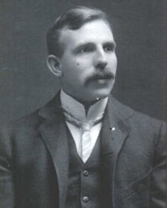
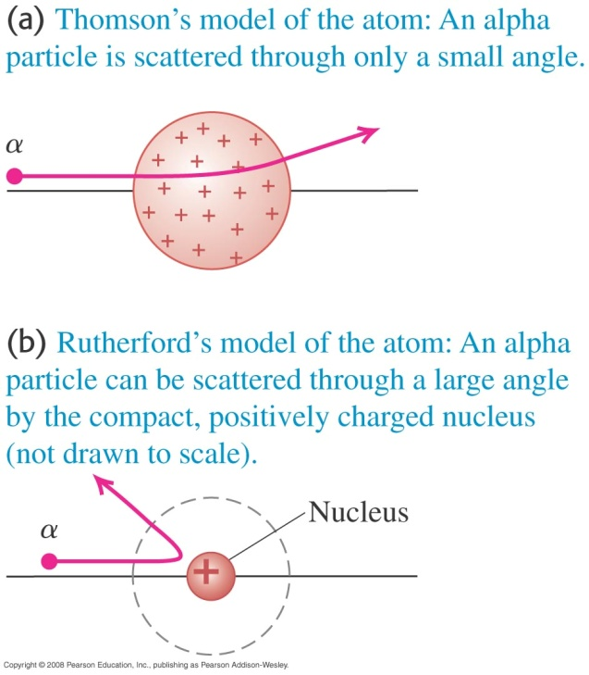
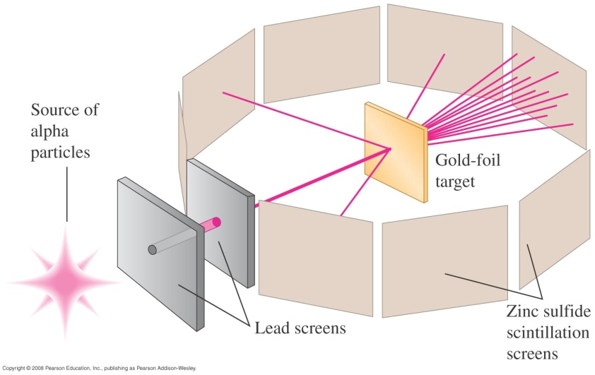
Rutherford’s thin foil experiment (1911):
A beam of positively charged alpha particles hit a thin gold foil target and are scattered.
Most of the particles passed through the foil. Many particles were scattered at large angles. Some particles were deflected backward.
The large deflections could not be explained by Thomson’s model.

Slide 9
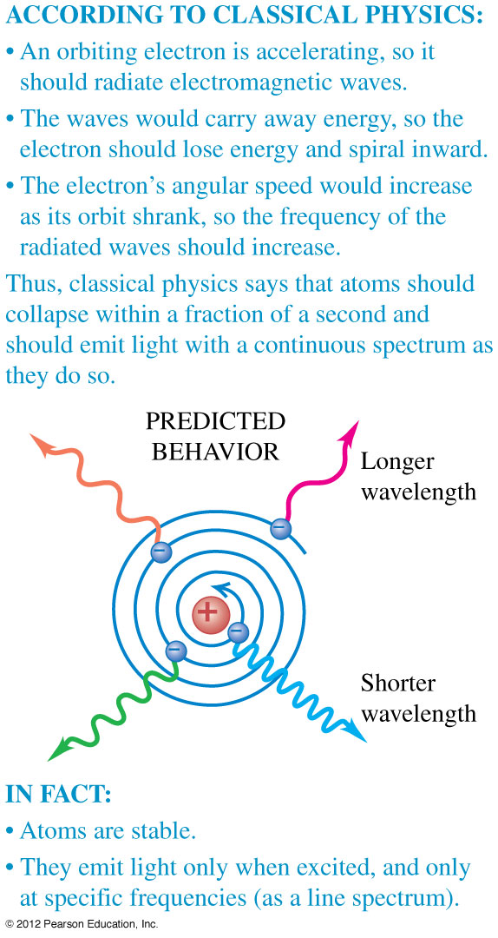
Rutherford’s model of the atom:
Positive charge is concentrated in the center of the atom, called the nucleus.
Electrons orbit the nucleus like planets orbit the sun.
Difficulties with the Rutherford model: Failure of classical physics
Rutherford model is unable to explain that atoms are stable and emit certain discrete characteristic frequencies of electromagnetic radiation.
Rutherford’s electrons are undergoing a centripetal acceleration. It should radiate electromagnetic waves of the same frequency. The radius should steadily decrease and the electron should eventually spiral into the nucleus.
Example 39.4
Test 39.2

Slide 10
Read: Ch39: 2
Homework: Ch39: 17 Due: March 28

Slide 11
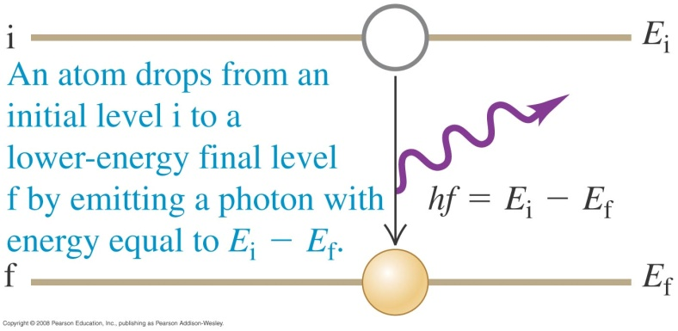
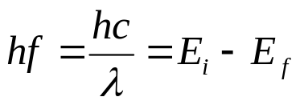
March 21, 24 Bohr’s model of the atom
39.3 Energy levels and the Bohr model of the atom
Bohr’s hypothesis about energy levels:
Each atom has a set of energy levels. The line spectrum of an element results from the emission or absorption of photons when the atom makes a transition between different energy levels.
Example 39.5
Frank-Hertz experiment (1914):
When the electrons moving in mercury vapor have kinetic energy of 4.9 eV or more, the vapor emits ultraviolet light with wavelength at 250 nm.

Slide 12
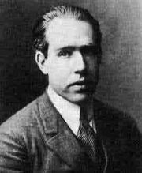
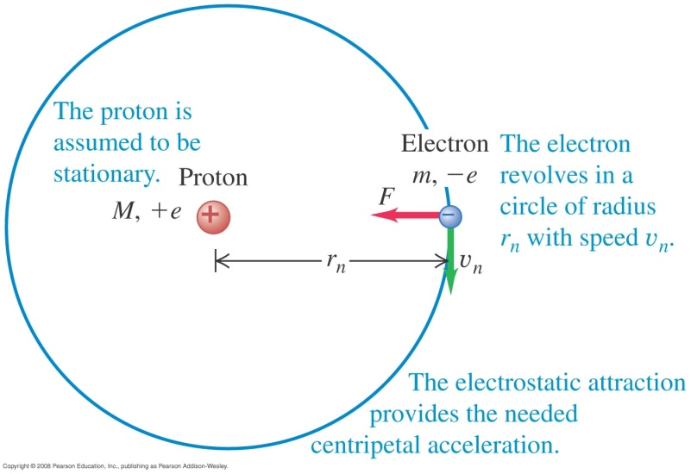
Electron waves and Bohr model of hydrogen
Niels Bohr (1885-1962)
Danish physicist.
Fundamental contributions to atomic structure and quantum mechanics.
Nobel Prize in Physics in 1922.
Taking part in the Manhattan Project.
Bohr’s theory of hydrogen (1913):
An obsolete theory which has been replaced by quantum mechanics.
The model can still be used to develop ideas of energy and angular momentum quantization in atomic-sized systems.
Assumption 1: The electron moves in circular orbits around the proton under the electric force.
Assumption 2: Only certain electron orbits are stable. The atom does not emit energy in these stationary states.

Slide 13
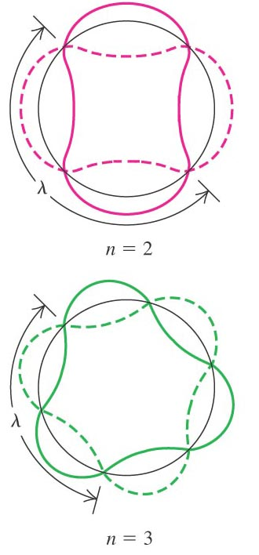
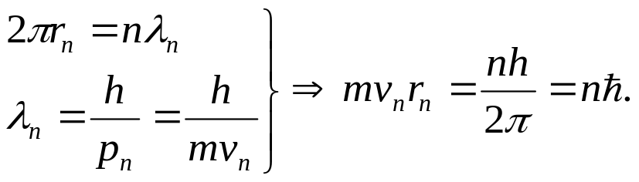
Assumption 3: Radiation is emitted by the atom when the electron makes a transition from an initial state to a lower-energy orbit. The frequency of the emitted radiation is given by E_{i} – E_{f} = hƒ, which is independent of frequency of the electron’s orbital motion.
Assumption 4: The allowed orbits are those for which the electron’s orbital angular momentum about the nucleus is quantized and equal to an integral multiple of h/2π:
  L_{n}=mv_{n}r_{n} = n ħ, n = 1, 2, 3,…
The de Broglie wave and the Bohr model:
Fitting a standing wave around a circle:
The circumference of the circle must include integer number of wavelengths.

Slide 14
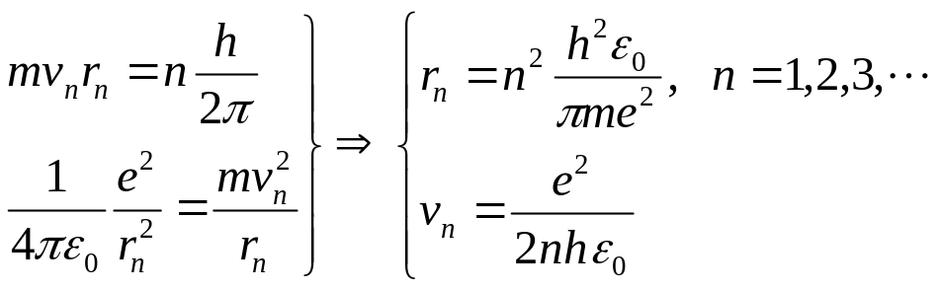
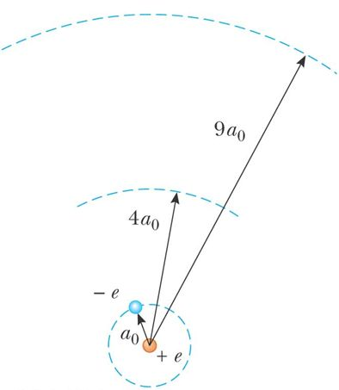
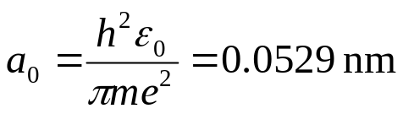

Bohr orbitals:
Angular momentum:
Coulomb force =
Centripetal force:
Bohr radius (r_{n} for n =1):
Radius of an orbit:

Slide 15
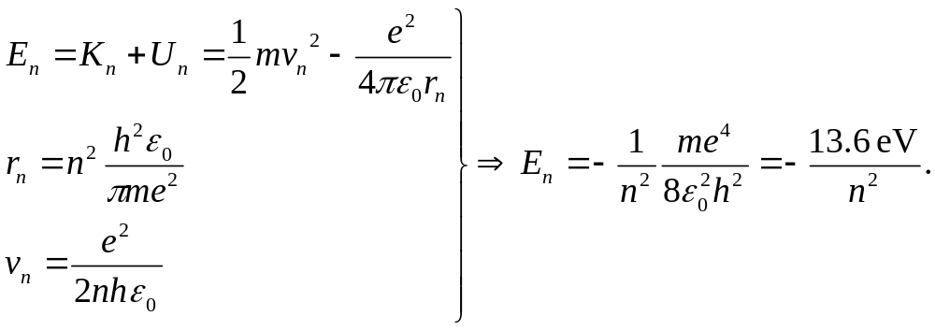
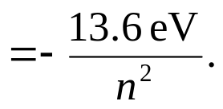
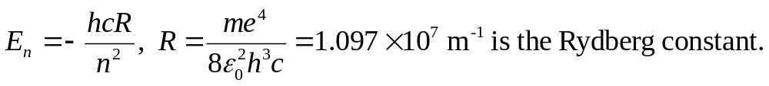
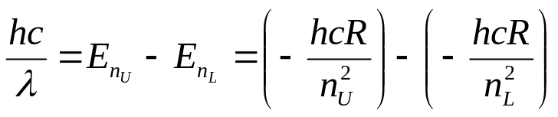
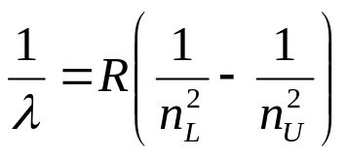
Bohr energy levels:
Rydberg Constant:
This theoretical prediction agrees with experimental observation very well.

Slide 16
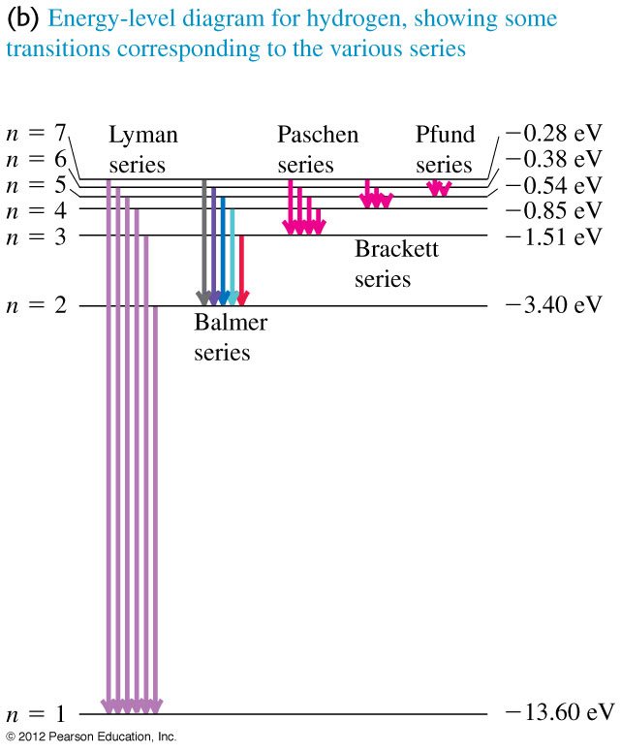
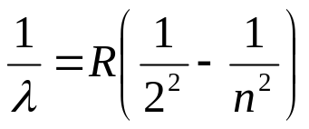
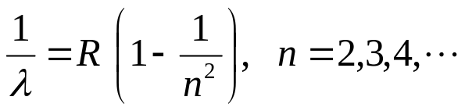
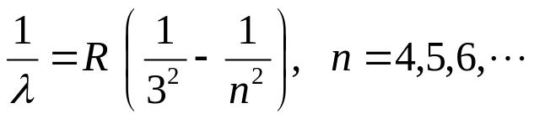
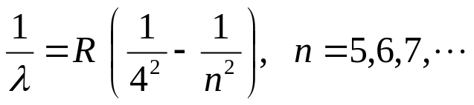
Spectra of the hydrogen atom:
Balmer series:
Johann Balmer (1885): Empirical equation for the four visible emission lines of hydrogen:
  H_{α} , λ = 656.3 nm,
  H_{β} , λ = 486.1 nm,
  H_{γ} , λ = 434.1 nm,
  H_{δ} , λ = 410.2 nm.
Other series:
Lyman series:
Paschen series:
Brackett series:
Energy level diagram:
Ground level, excited levels, ionization energy, transitions.

Slide 17
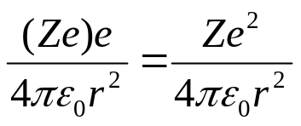
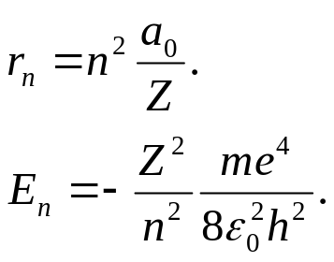
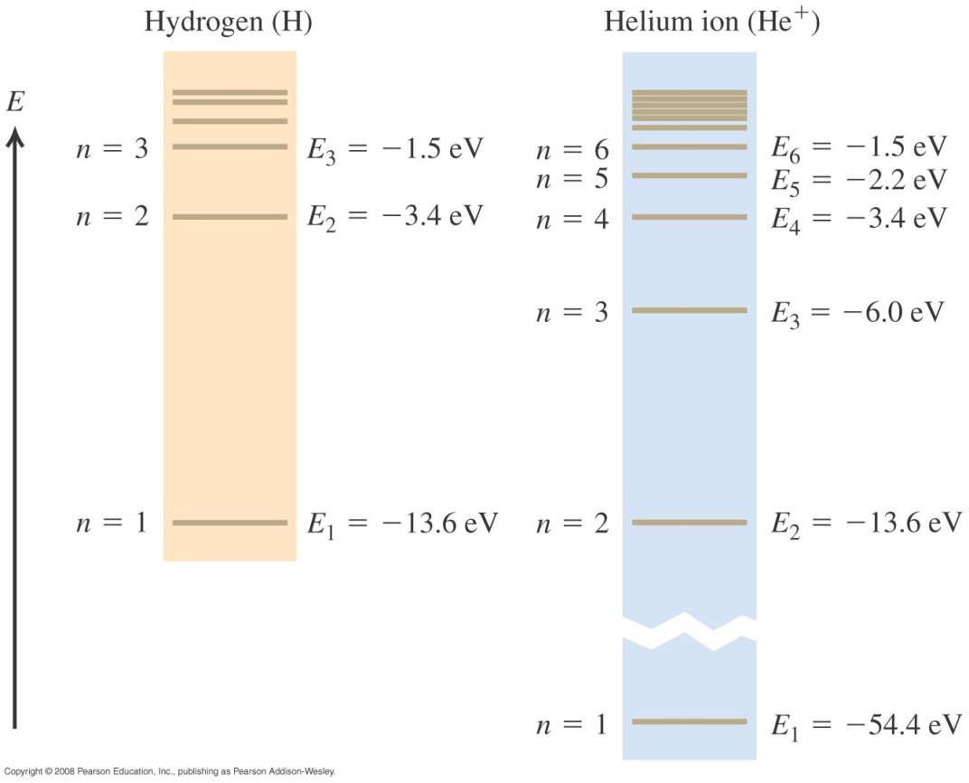
Extension to H-like atoms:
Coulomb force:
-e
+Ze
Z is the atomic number of the element.
Example 39.6
Test 39.3

Slide 18
Read: Ch39: 3
Homework: Ch39: 20,21,29,30
Due: March 28

Slide 19
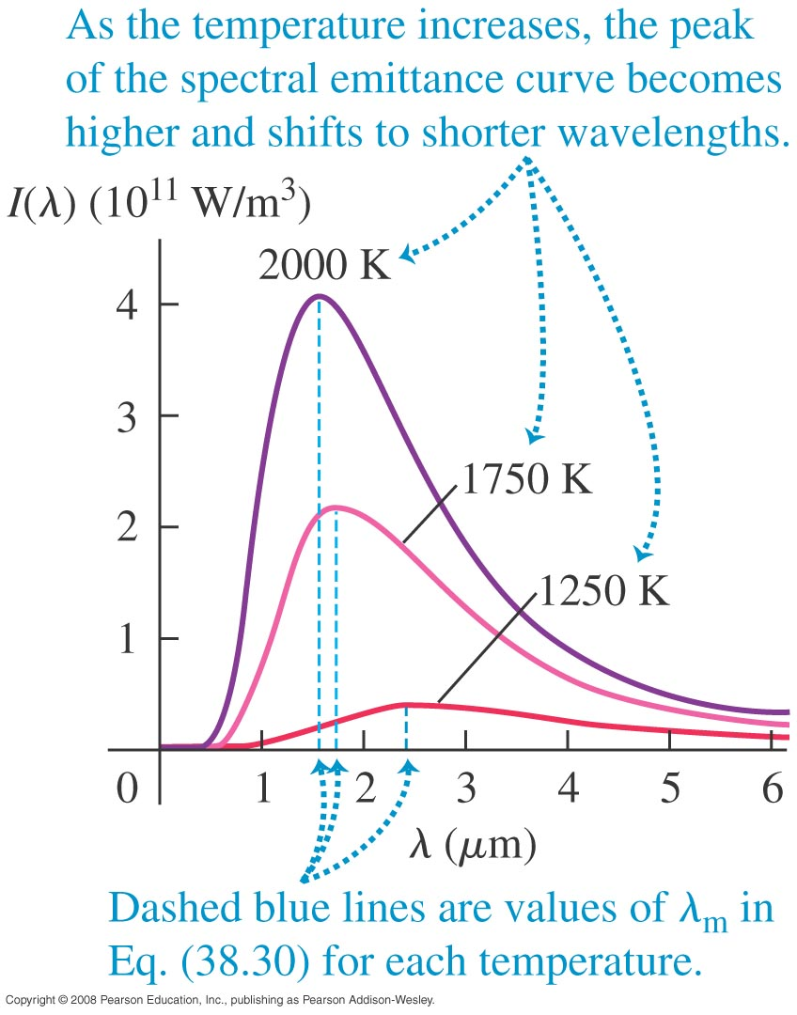
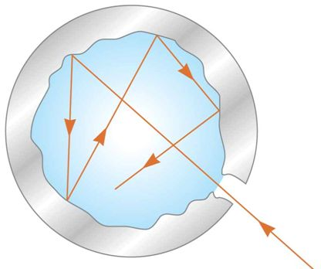
March 26, 28 Blackbody radiation
39.5 Continuous spectra
Thermal radiation: The electromagnetic emission from an object.
Covers all the spectrum.
At room temperature, the wavelengths of the radiation are mainly in the infrared. As the surface temperature increases, the wavelength shifts to red and then white.
Classical physics could not describe the observed distribution of the radiation emitted by a blackbody.
Blackbody: An ideal system that absorbs all radiation incident on it.
Blackbody radiation: The electromagnetic radiation emitted by a blackbody.

Slide 20

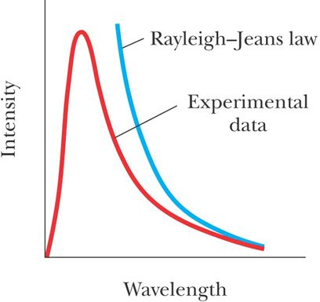
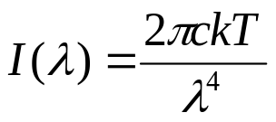
Two significant experimental results:
1) The total power of the emitted radiation increases with temperature.
Stefan-Boltzmann law (Chapter 17):
I: intensity of radiation.
σ: constant, = 5.67×10⁻⁸ W/m²·K⁴.
T: surface temperature.
2) The peak of the wavelength distribution shifts to shorter wavelengths as the temperature increases.
Wien’s displacement law:
λ_{m}T = 2.90 × 10⁻³ m·K
An early classical attempt to explain blackbody radiation:
Rayleigh-Jeans law:
Ultraviolet catastrophe:
At short wavelengths, there was a major disagreement between the Rayleigh-Jeans law and the experiment.

Slide 21
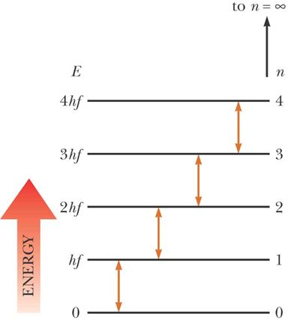
Max Planck and the quantum hypothesis: Planck (1900) assumed that the cavity radiation came from atomic oscillations in the cavity walls. He made two assumptions about the nature of the oscillators:
1) The energy of an oscillator can have only certain discrete values:
E_{n} = n h ƒ
i) The energy is quantized.
ii) Each energy value corresponds
to a quantum state.
Quantum number
Frequency of oscillation
Planck’s constant, h = 6.626×10⁻³⁴ J·s
2) The oscillators emit or absorb energy when making a transition from one quantum state to another, E = h f.
Allowed transitions
Energy levels

Slide 22
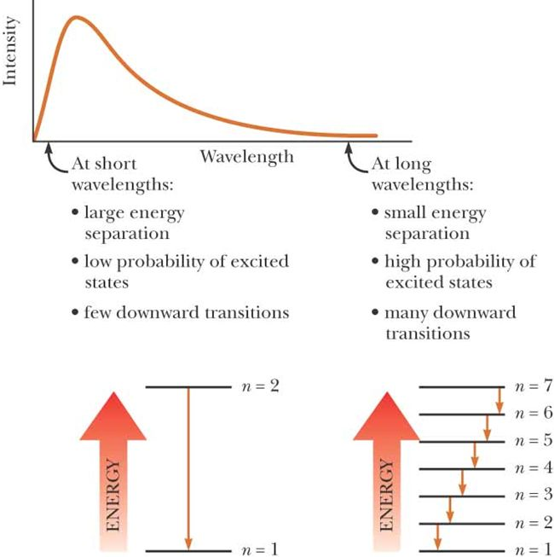
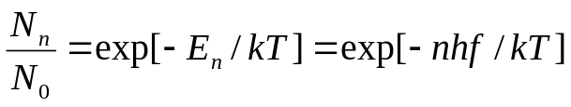
Energy-level diagram:
A diagram that shows the quantized energy levels and the allowed transitions.
The energy levels are populated according to the Boltzmann distribution law:
The average energy of a wave is the energy difference between levels of the oscillator, weighted by the probability of the wave being emitted [~ Σ_{n} exp(-E_{n} /kT)].

Slide 23
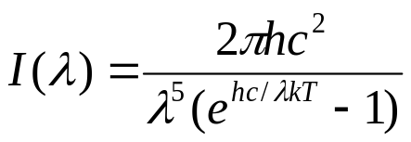
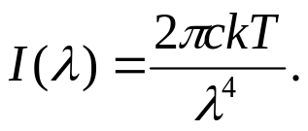
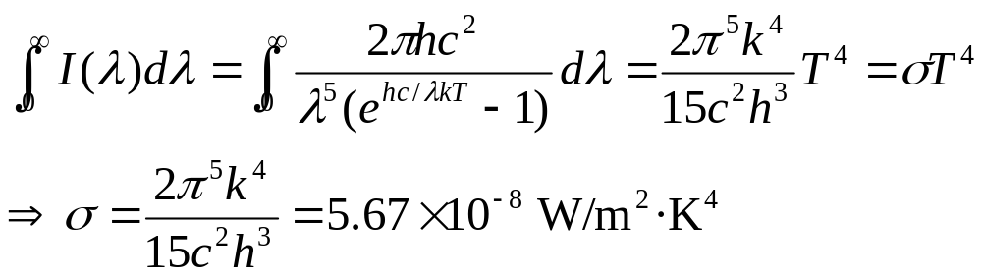
Planck’s radiation law: Planck generated a theoretical expression for the intensity distribution of blackbody radiation:
Derivation can be found at, e.g., Silfvast, Laser fundamentals, 2nd edition, Cambridge University Press, 2004, p. 214.
Conclusions from Planck’s equation:
1) At long wavelengths, Planck’s equation reduces to the Rayleigh-Jeans law
(using e^{x}~1+x):
2) At short wavelengths, it predicts an exponential decrease in intensity with decreasing wavelength. This is in agreement with experimental results.
3) Total power radiated :
Stefan-Boltzmann law

Slide 24
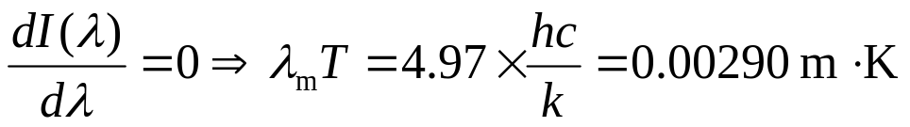
4) Peak of the distribution (“most probable” wavelength):
Wien’s displacement law
Question:
λ_{m} at room temperature.
f_{peak}=c/λ_{peak}?
Example 39.7,8
Test 39.5

Slide 25
Read: Ch39: 5
Homework: Ch39: 38,41,42,59
Due: April 4

