Slide 1
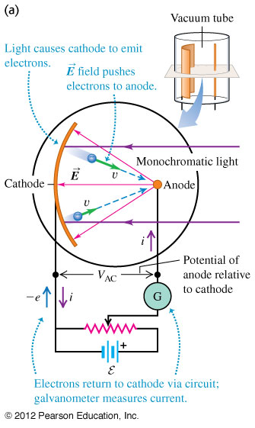
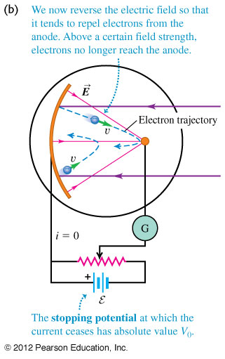
Chapter 38 Photons: Light Waves Behaving as Particles
February 21 Photoelectric effect
38.1 Light absorbed as photons: the photoelectric effect
Photoelectric effect: When light is incident on certain metallic surfaces, electrons are emitted.
Apparatus: Photoelectrons are emitted from the negative plate and are collected at the positive electrode. The current is measured by an ammeter.

Slide 2
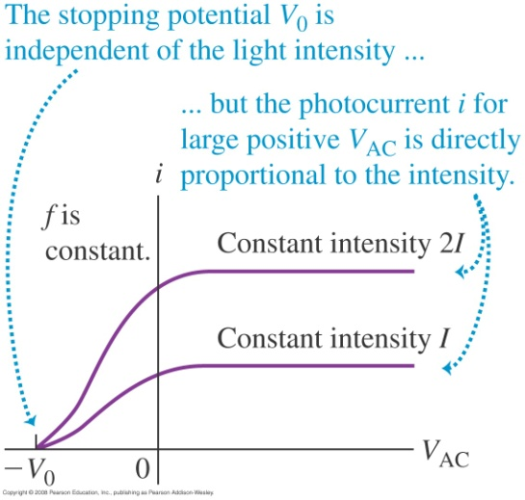
Phenomena:
At large positive V_{AC}, the current reaches a maximum.
The maximum current increases as the intensity of the incident light increases.
When V_{AC} is negative, the current drops.
When V_{AC} is equal to or more negative than −V₀, the current is zero. V₀ is the stopping potential.
The maximum kinetic energy of the photoelectrons is: K_{max} = eV₀.
Experimental results:
1) The maximum kinetic energy is independent of light intensity.
Electrons are emitted almost instantaneously, even at very low light intensities.
No electrons are emitted if the incident light falls below some threshold frequency (cutoff frequency) ƒ_{c}, regardless of the light intensity.
The maximum kinetic energy of the photoelectrons increases with increasing light frequency.

Slide 3
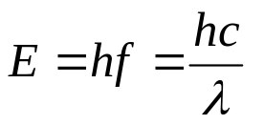
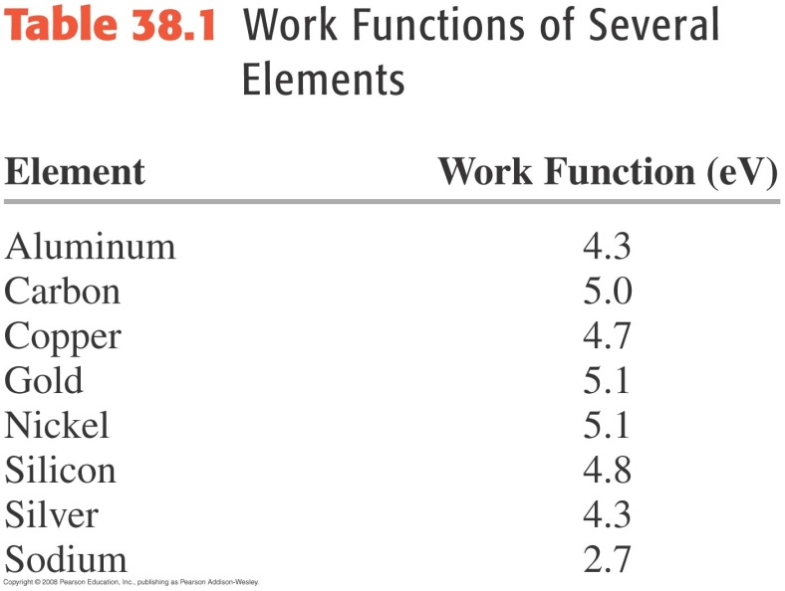
Einstein’s photon model (1905):
All electromagnetic radiation can be considered as a stream of quanta (photons). Each photon has an energy of
A photon of incident light gives all its energy hf to a single electron in the metal.
Electrons ejected from the surface of the metal without collision with other metal atoms before escaping have the maximum kinetic energy K_{max}:
Planck’s constant h = 6.626 × 10⁻³⁴ J·s is a fundamental constant of nature.
1 eV energy corresponds to an infrared photon of wavelength 1240 nm.
K_{max} =eV₀= hƒ – φ
Work function (φ):
The minimum energy with which an electron is bound in the metal. It is on the order of a few electron volts.

Slide 4
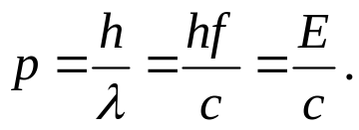
Photon model explanation of the photoelectric effect:
1) K_{max} depends on the light frequency and the work function, and is independent of the light intensity.
Each photon may have enough energy to eject an electron immediately.
There are no photoelectrons ejected below a certain cutoff light frequency, regardless of the light intensity.
As the frequency increases, the kinetic energy will increase linearly once the photon energy exceeds the work function.
Photon momentum:
From the relativistic energy-momentum relation, a photon has a momentum of
Example 38.1 Laser pointer photons
Example 38.2 A photoelectric-effect experiment

Slide 5
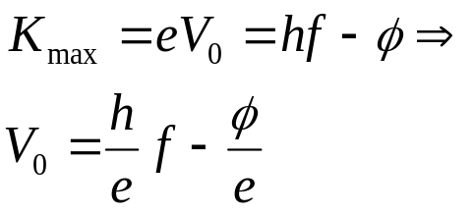
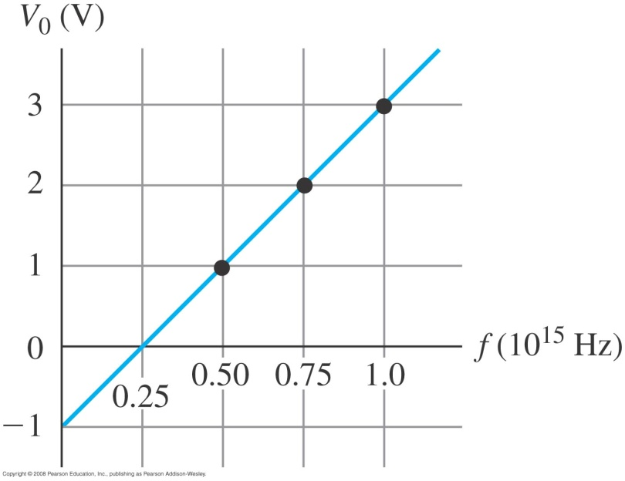
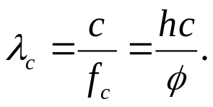
Measurement of the cutoff frequency f_{c}, the Planck’s constant h, and the work function φ:
The intersect on the x axis: f_{c}
The intersect on the y axis: −φ/e.
The slope: h/e.
Cutoff wavelength:
Example 38.3 Determining φ and h experimentally
Test 38.1

Slide 6
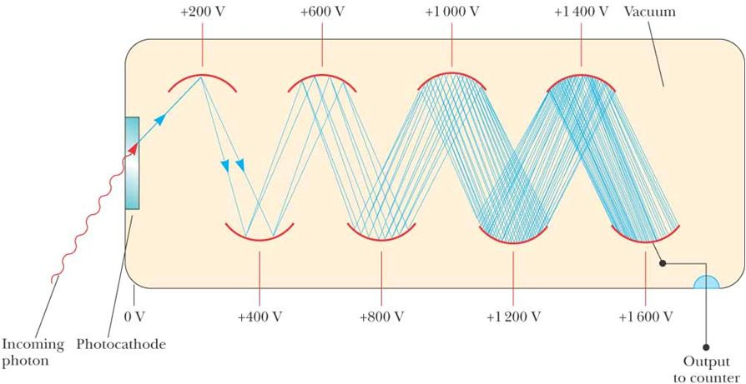
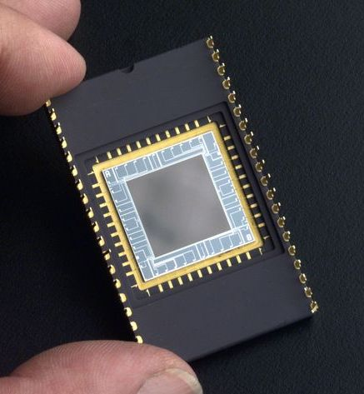
Applications of the photoelectric effect:
Photomultiplier tube
CCD Camera

Slide 7
Read: Ch38: 1-2
No homework

Slide 8
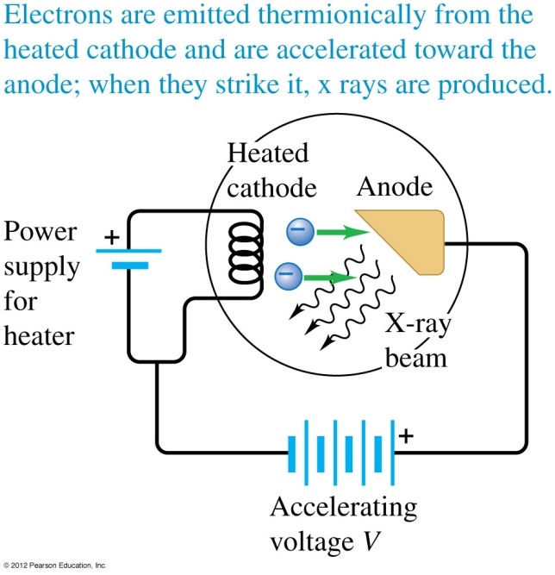
February 24 X-ray production
38.2 Light emitted as photons: x-ray production
X-ray: Electromagnetic radiation in the wavelength range of about 0.01-10 nm, or photon energies of about 100 eV -100 keV.
Roentgen’s 1895 apparatus:
Electrons are released from the cathode by thermionic emission.
The electrons are then accelerated toward the anode by a potential difference.
The electrons are decelerated by the anode. Electromagnetic waves are produced, which is called bremsstrahlung (braking radiation).

Slide 9
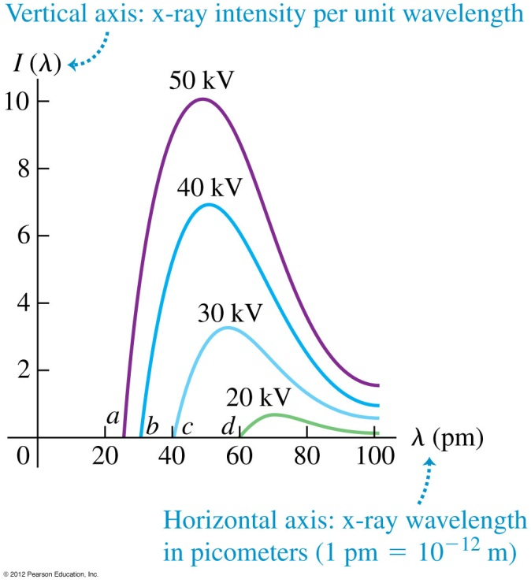
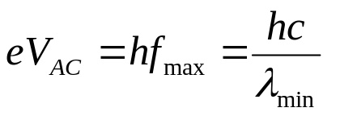
Roentgen’s 1895 apparatus:
Part or all of the kinetic energy of the electron can be used to produce an x-ray photon. The most energetic photon is given by
Here λ_{min} is the minimum wavelength of the generated x-ray.
Applications of x-rays:
Medicine and industry imaging. Particularly broken bones.
CT (computer tomography).
Example 38.4 Producing x rays
Test 38.2

Slide 10
Read: Ch38: 1-2
Homework: Ch38: 1,6,7,10,12
Due: March 7

Slide 11
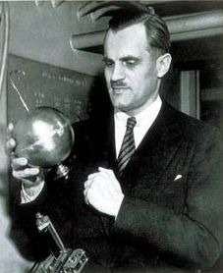
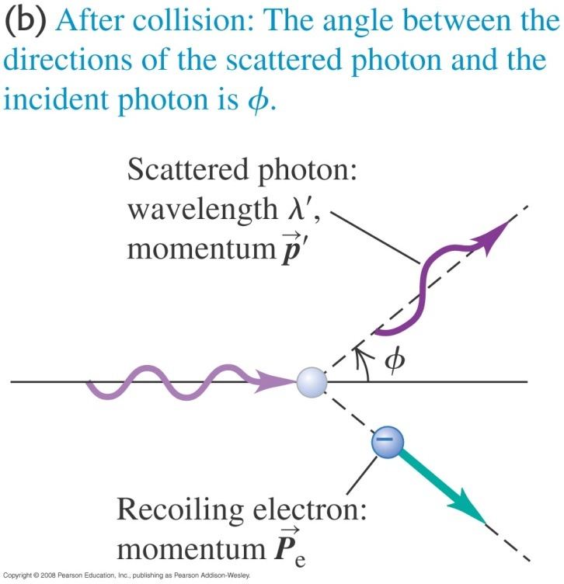
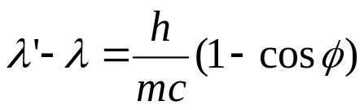
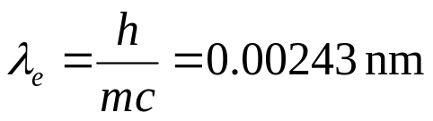
March 3 Compton scattering
38.3 Light scattered as photons: Compton scattering and pair production
Arthur Holly Compton (1892 –1962):
Nobel Prize in Physics (1927) for the discovery of the Compton effect.
Met Lab at the University of Chicago.
Chancellor of Washington University at St. Louis (1946-1953).
Compton effect: The decrease in energy (increase in wavelength) of an x-ray or gamma ray photon when scattered from matter.
Experimental results:
At a given angle φ , only one frequency of radiation (besides the incident frequency) is observed.
Compton shift equation:
λ
Compton wavelength of the electron:

Slide 12
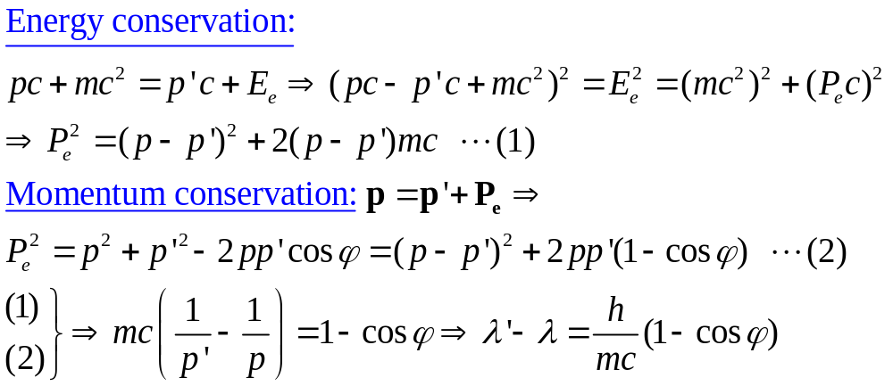
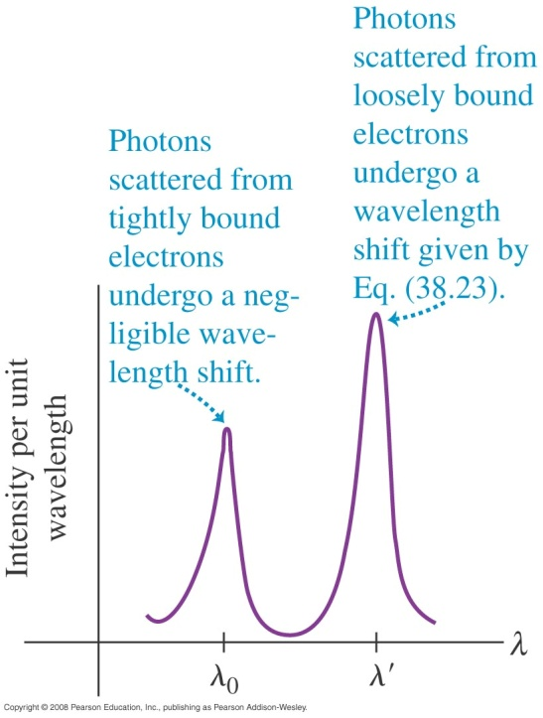
Compton’s explanation:
The photons can be thought as point-like particles having energy hƒ and momentum h/λ.
The total energy and momentum of the isolated system of the colliding photon-electron pair are conserved.
Questions:
1) Can Δλ be negative?
2) What is the largest possible Δλ?
Example 38.5 Compton scattering

Slide 13
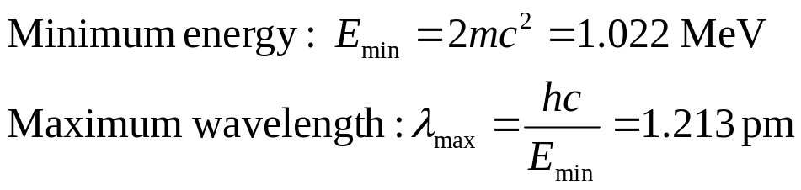
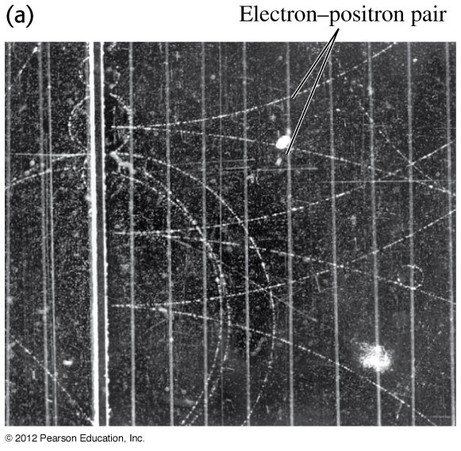
Pair production:
When a gamma-ray photon with sufficient short wavelength hits a target, it may disappear and produces an electron and a positron.
Electron-positron pair annihilation:
When a positron and an electron collide, they disappear and two (or three) photons are produced.
Decay into a single photon is not possible because of momentum conservation.
Example 38.6 Pair annihilation
Test 38.3

Slide 14
Read: Ch38: 3
Homework: Ch38: 13,15,16,17,20
Due: March 21

Slide 15
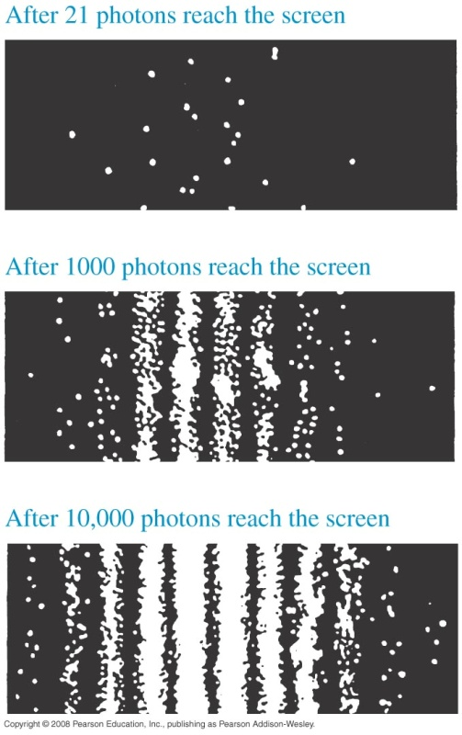
March 7 The uncertainty principle
38.4 Wave-particle duality, probability and uncertainty
Photons and electromagnetic waves:
Depending on the phenomenon being observed, some experiments are best explained by the photon model, while others are best explained by the wave model.
Principle of complementarity: The wave and particle models of matters complement each other. Neither model can be used exclusively to describe matter or radiation adequately.
Double-slit interference pattern
Diffraction and interference in the photon picture:
The wave description explains the interference and diffraction patterns, while the particle description explains the single photon measurement of the patterns.

Slide 16
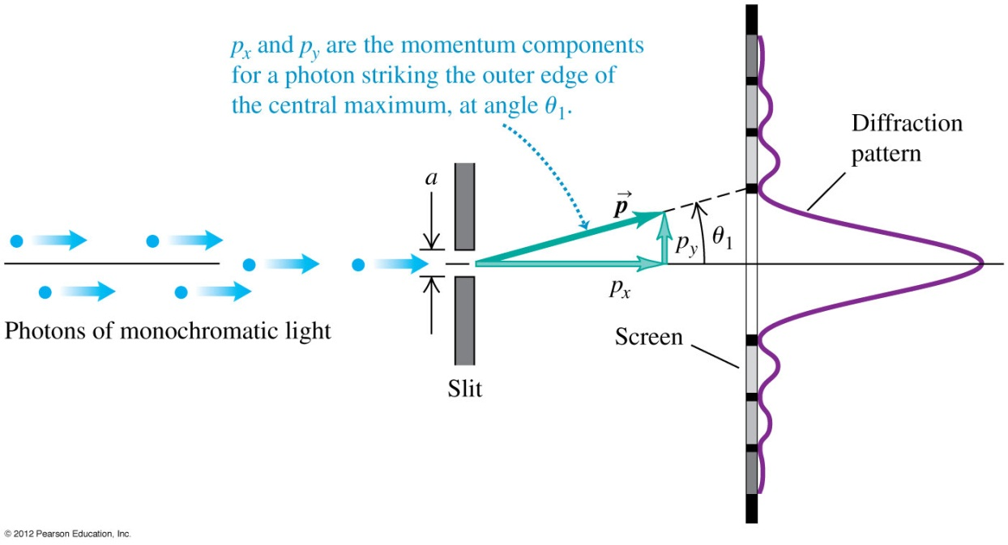
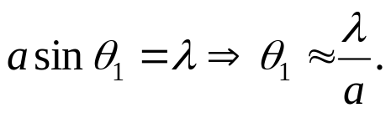
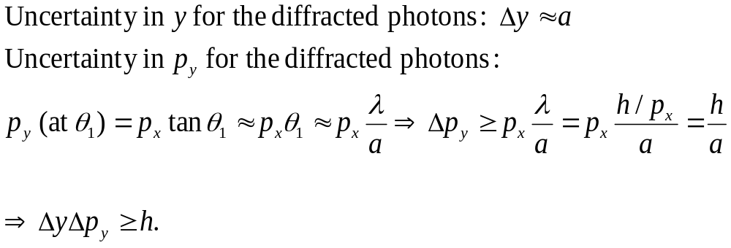
Probability and uncertainty:
Single-slit diffraction of light
The angular position of the
first minimum:
The uncertainties in the position and momentum of an individual photon on the y-axis:

Slide 17
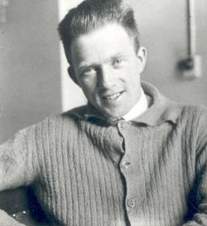

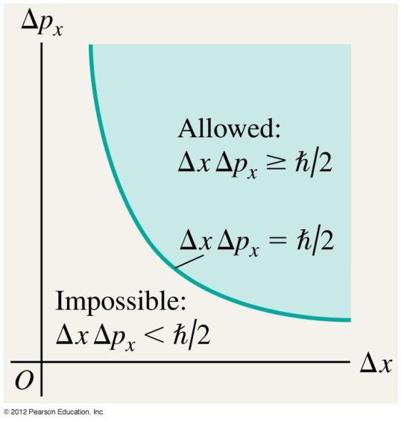
Heisenberg uncertainty principle:
More generally the uncertainty of a quantity is described by its standard deviation. The standard-deviation uncertainties are related by the following principle:
If a measurement of the position of a particle has an uncertainty Δx, and a simultaneous measurement of its momentum has an uncertainty Δp_{x}, then
The uncertainties arise from the intrinsic nature of matters, rather than instrumental reasons.
Werner Heisenberg
(1901-1976)
Nobel Prize in Physics (1932) for the creation of quantum mechanics.
University of Munich.

Slide 18
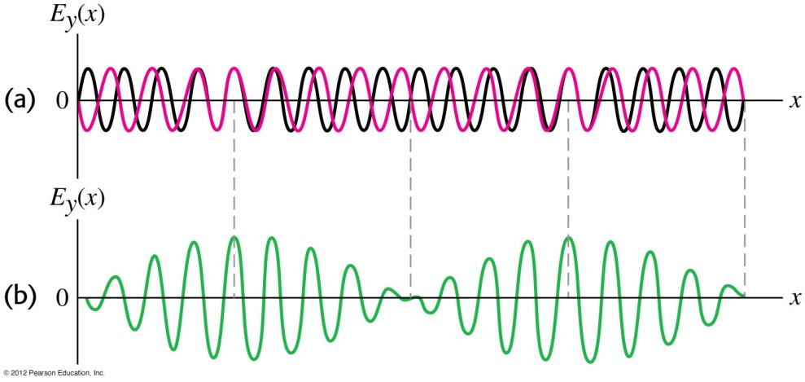
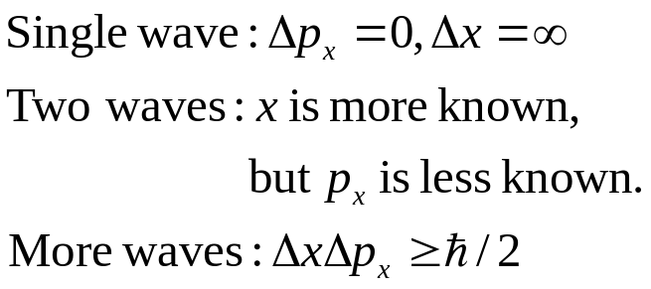

Waves and uncertainty:
The uncertainty principle can be illustrated by the superposition of electromagnetic waves.
Uncertainty principle in energy and time:
The uncertainty in energy of a system depends on the time interval during which the system remains in a given state:
Example 38.7 Ultrashort laser pulses and the uncertainty principle
Test 38.4

Slide 19
Read: Ch38: 4
Homework: Ch38: 21,22,23
Due: March 21

