Slide 1
Chapter 37 Relativity
January 13 Galilean coordinate transformation
Introduction to this course:
1. Syllabus
2. Modern physics: Relativity and quantum mechanics
3. Methods of studying Modern Physics:
Conceptions.
Principles.
Exercises.

Slide 2
37.1 Invariance of physical laws
Two basic problems occurring in Newtonian mechanics:
Describing the motion of the objects whose speeds approach that of light.
E.g., accelerating an electron beam.
Measuring the speed of light. It is constant according to Maxwell’s equations. It is varying according to Newtonian mechanics.
Frame of reference:
The space (and time) system that are used by an observer to discuss the state of motion of objects. As a convention, the observer considers that himself and the space he uses for reference are not moving.
E.g., “My car is running at 60 mph northward” implies a frame of reference using the earth.
Compare to: Coordinate systems.
Inertial frame of reference:
A reference frame in which objects subjected to no forces will experience no acceleration.
Any system moving at constant velocity with respect to an inertial reference frame must also form an inertial reference frame.
There is no absolute inertial frame of reference.

Slide 3
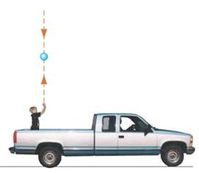
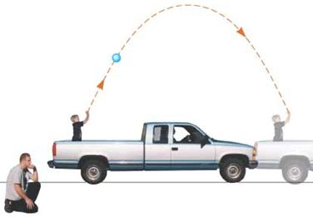
Principle of Galilean relativity:
The laws of mechanics are the same in all inertial frames of reference.
Example: A child on a truck throws a ball straight up. The trajectories of the ball are different according to different observers, but they use the same physics textbook to explain equally well what they have seen .
In reality, there are no pure mechanical phenomena. This requires that if the laws of mechanics are the same, then all physics laws should be the same in all inertial frames of reference.
Event: A physical occurrence that happens in space and time, and can be described by its space-time coordinates (x, y, z, t).
E.g., sparking, meeting, colliding, hitting, exploding, dying, etc ...
The space-time coordinates of an event depend on the observer. E.g., “When v reaches 3 m/s” is not a well-defined event, unless the observer is specified.

Slide 4
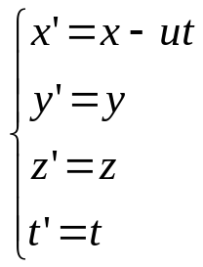
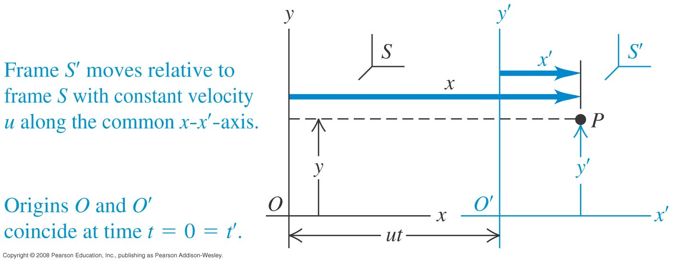
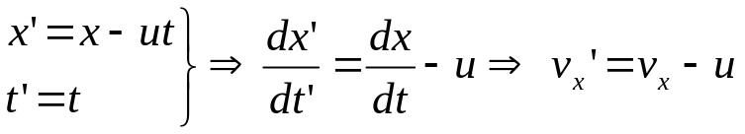

Galilean space-time transformation:
Suppose an inertial reference frame S' moves relative to another inertia reference frame S with a constant velocity u along the x and x' axes. The origins of S and S' coincide at t =t'= 0. If the observers in S and S' describe a certain event with (x, y, z, t) and (x', y', z', t'), respectively, then
The time is the same in both inertia frames.
This is the standard convention in choosing the coordinate systems in special relativity.
Galilean velocity transformation:
v is for the velocity of the object and u is for the relative velocity between the reference frames.

Slide 5
Read: Ch37: 1
Homework:
This is the most typical problem in elastic collision. Please review p. 249 of the textbook for help. Please plan to use several hours on solving this problem. A full answer is about 2-3 pages. Hints are given on the next page.
Two balls with mass m₁ and m₂ are moving in a straight line with velocity v₁ and v₂ with respect to the ground. They then collide elastically with each other. That is, the total momentum and the total kinetic energy of the two balls are conserved in the collision.
Please find the final velocities, v₁' and v₂', of the two balls.
If you are driving a car with a velocity u in the direction of the moving of the balls, please prove that under Galilean relativity in your observation the total momentum and the total kinetic energy of the two balls are still conserved, regardless of your velocity u.
Due: January 24

Slide 6
Hints for HW1:
Here are some hints for the problem.
1) This problem has two equations (momentum conservation and kinetic energy conservation) and two unknowns (v1', v2'). It is perfectly solvable. Please understand in your answer (v1', v2') is expressed by (m1, m2,v1,v2). If you cannot do it by your hands, here is the code in Mathematica:
Solve[m1 v1 + m2 v2 == m1 v1' + m2 v2' && m1 v1^2 + m2 v2^2 == m1 v1'^2 + m2 v2'^2, {v1', v2'}]
Please ask our department about which computers have Mathematica installed. Please let me know if you still do not have access to Mathematica.
2) You are asked to prove that if all v and v's are shifted by u, the momentum and kinetic energy are still conserved in the collision. It is unnecessary to plug in the explicit expressions of v1' and v2' from the above to prove this statement.

Slide 7
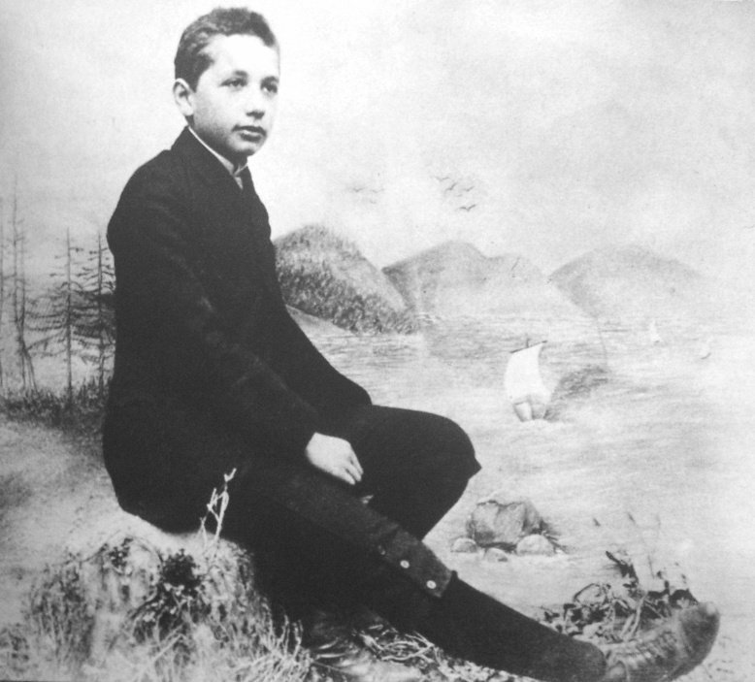
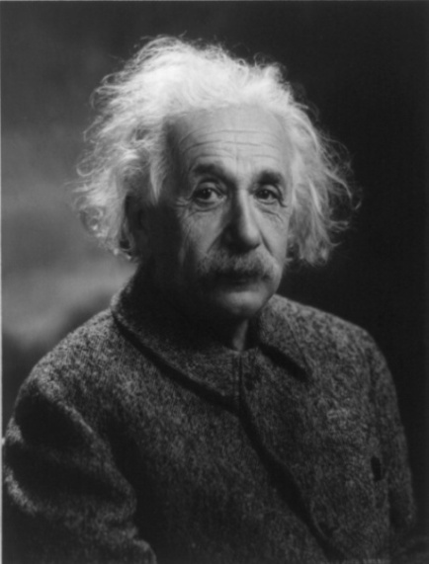
January 15, 17 Einstein’s principle of relativity
37.1 Invariance of physical laws
Albert Einstein (1879-1955)
A German-born theoretical physicist.
One of the greatest physicists of all time.
Best known for the theory of relativity.
Contributed to quantum theory and unified field theory.
1921 Nobel Prize in Physics for the photoelectric effect.
Now "Einstein" = Great intelligence and genius.
Young Einstein in Munich. 1893

Slide 8
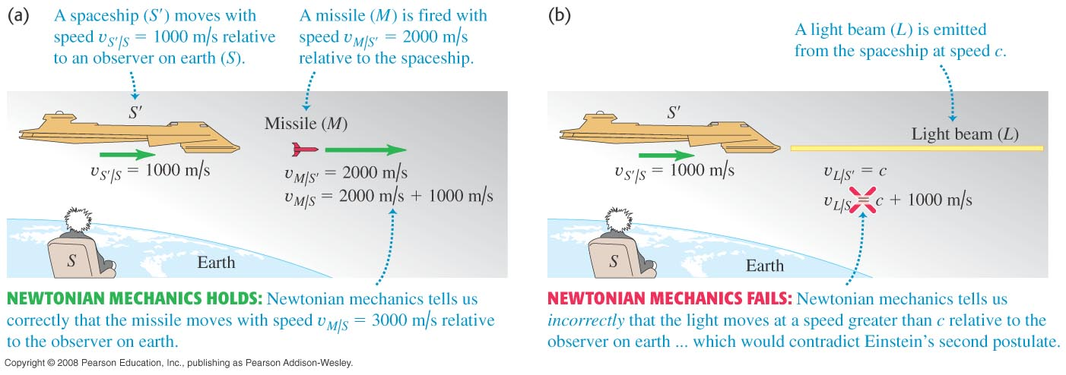
Newtonian mechanics applied to speed of light:
Newtonian mechanics makes correct predictions on slow-moving objects. It makes incorrect predictions on the behavior of light. The speed of light is constant according to Maxwell’s equations, but it is varying according to Newtonian mechanics using Galilean relativity. (Figure 37.2.)

Slide 9
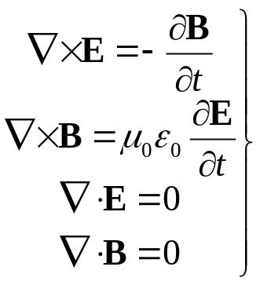
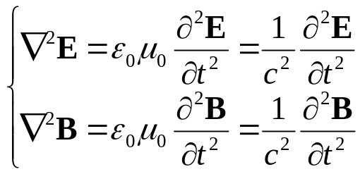

Light in an ether wind?
Maxwell’s equations imply that the speed of light in vacuum has a fixed value in all inertial reference frames:
Physicists in the late 1800s thought that light might move through a medium called the ether. The speed of light would be c only in an absolute frame that is at rest with respect to the ether.

Slide 10
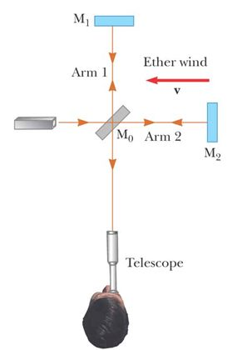

Michelson-Morley experiment:
The experiment was designed to determine the velocity of the earth relative to the hypothetical ether by detecting small changes in the speed of light, as indicated by the shift of the interference pattern.
In the Michelson interferometer, Arm 2 is aligned along the direction of the earth’s motion through space.
The speed of light in the earth frame should be
c – v as the light approaches M₂, and c + v as the light is reflected from M₂. It is when light is in arm 1.
The interference fringes should shift while the interferometer was rotated through 90°. The shift is calculated to be measurable (~ 0.44 fringe).
Measurements failed to show any change in the fringe pattern.
Ether hypothesis is wrong.
Light is an electromagnetic wave requiring no medium for its propagation.

Slide 11
Einstein’s principle of relativity:
Resolves the contradiction between Galilean relativity and the fact that the speed of light is the same for all observers.
Einstein’s two postulates:
1. Principle of relativity:
The laws of physics must be the same in all inertial reference frames.
2. Constancy of the speed of light:
The speed of light in a vacuum has the same value c = 299,792,458 m/s in all inertial reference frames, regardless of the velocity of the observer or the velocity of the source emitting the light.
Einstein’s principle of (special) relativity is a generalization of the principle of Galilean relativity. The results of any kind of experiment (mechanics, electricity, magnetism, optics, thermodynamics, …) performed in a laboratory at rest must be the same as when performed in a laboratory moving at a constant speed.
The constancy of the speed of light is required by the first postulate. It also explains the null result of the Michelson-Morley experiment. Relative motion is unimportant when measuring the speed of light.
Test 37.1

Slide 12



The ultimate speed limit:
It is impossible for an inertial observer to travel at or more than c, the speed of light in vacuum.
Consequences of the special theory of relativity:
We must alter our common-sense notions of space and time, and be ready to see some surprising results from Einstein’s principle of relativity.
Description of an event:
Observers in S and S' describe a certain event using (x, y, z, t) and (x', y', z', t').
Things quite different in relativistic mechanics compared to Newtonian mechanics:
(to be proved soon).
1) Simultaneity: Events occurring simultaneously in one frame are generally not observed to be simultaneous in another frame.
2) Time intervals: There is no absolute time intervals.
3) Lengths: There is no absolute lengths.
4) Newton’s second law of motion and the definitions of momentum and kinetic energy have to be modified.

Slide 13
Read: Ch37: 1
No homework

Slide 14
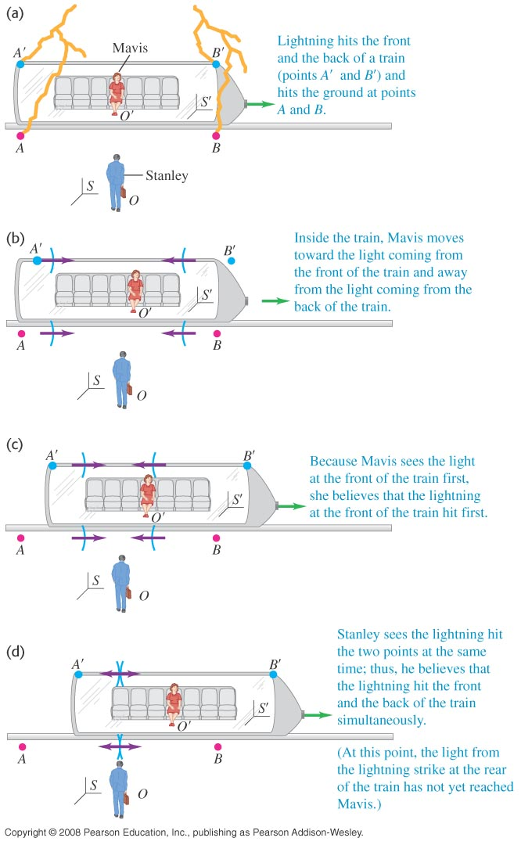
January 22 Simultaneity
37.2 Relativity of simultaneity
A thought experiment:
A boxcar moves with uniform velocity.
Events: Two lightning bolts strike the car and leave marks A' and B' on the car, and A and B on the ground. Light signals were sent out at the strikes.
Observer in S (Stanley) is on the ground, midway between A and B. The light reaches him at the same time. He concludes that the lightning bolts struck A and B simultaneously.
Observer in S' (Mavis) is in the boxcar, midway between A' and B'. By the time the light reached O, O' has moved. The signal from B' has already passed O', but the signal from A' has not yet reached her. Observer at O' concludes that the lightning struck B' before it struck A'.

Slide 15
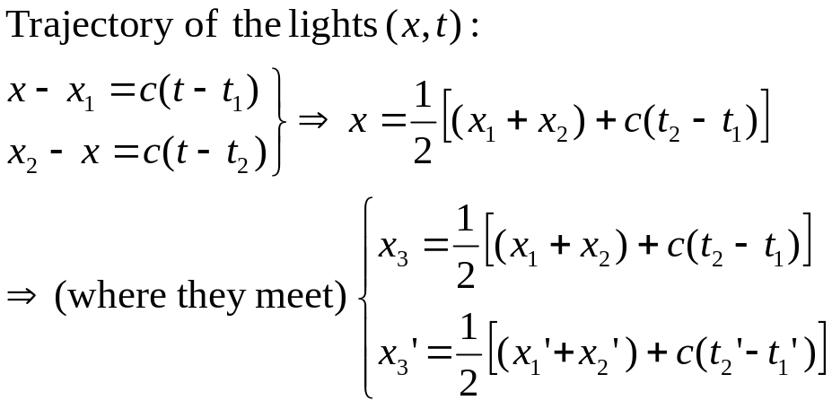
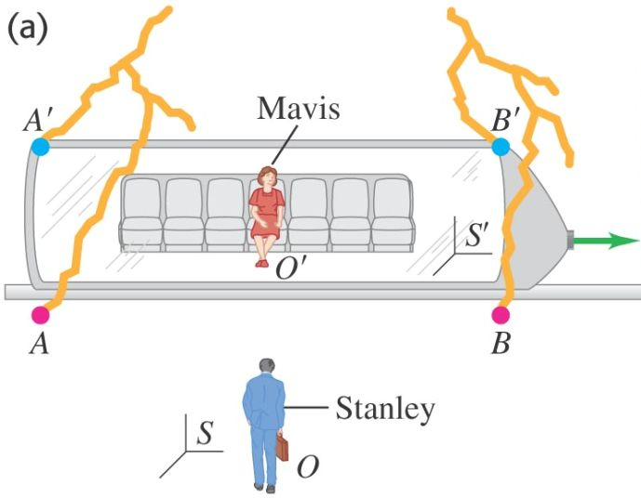

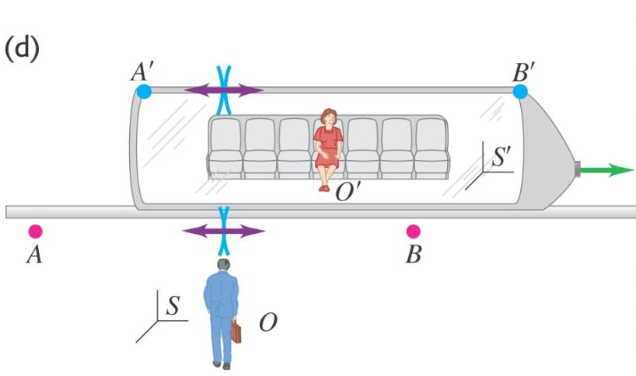



Reading: The thought experiment details
Events: Observer in S Observer in S '
Event 1: A and A' sparks. (x₁, t₁) (x₁', t₁')
Event 2: B and B' sparks. (x₂, t₂) (x₂', t₂')
(Event 3:) The two spark pulses meet. (x₃, t₃) (x₃ ', t₃ ')
Facts:
Observer in S: Sees
Observer in S ' : Sees
Conclusions:
Observer in S: They sparked simultaneously.
Observer in S ': B' and B sparked first.

Slide 16
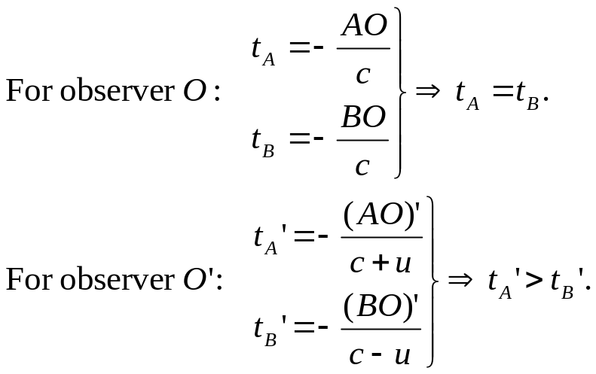
Conclusion: Two events that are simultaneous in one reference frame are in general not simultaneous in another reference frame. Simultaneity is not an absolute concept. It depends on the state of motion of the observer.
A simplified version: We do not really need A' and B'. Let observers O and O' both set their clock to 0 when event 3 (two light pulses meet at O) occurs. Also it does not matter where O and O' stand. What really matters is which frame they use.
O'
A
O
B
O'
A
O
B
A more simplified version: A boxcar AB is moving at speed u rightward. A spherical light wave is emitted from the middle point of the car. The light pulse then hits A and B.
The car observer: The light hits A and B simultaneously.
The ground observer: The light hits A first and B later.
Test 37.2

Slide 17
Read: Ch37: 2
Homework: Ch37: 1
Due: January 31

Slide 18
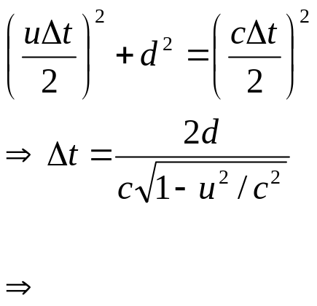
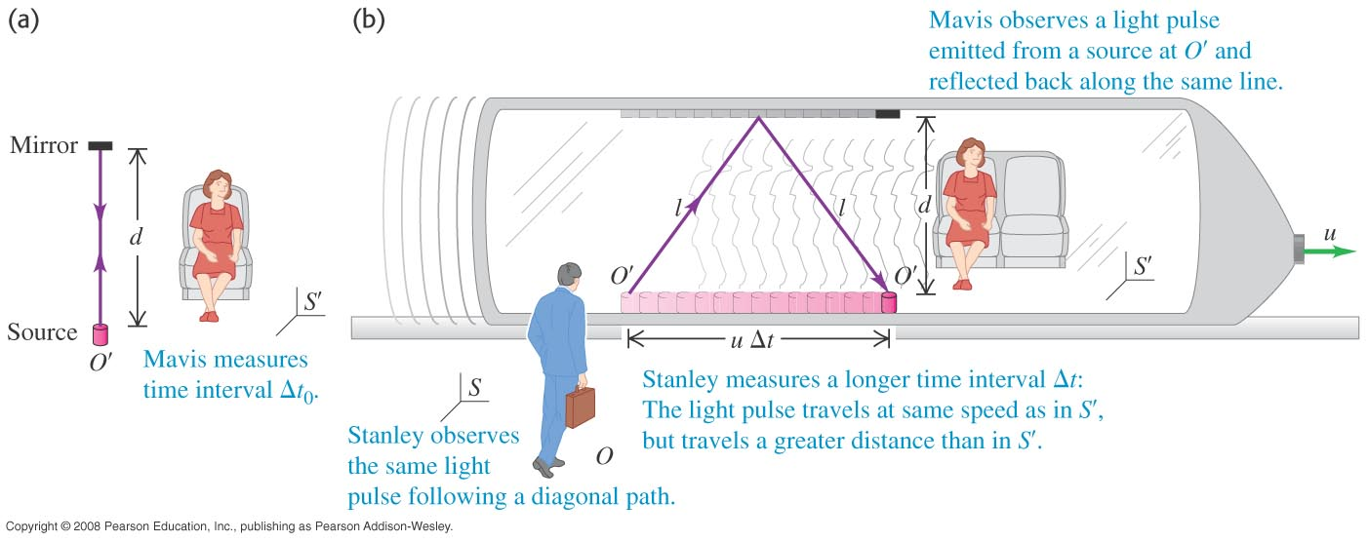
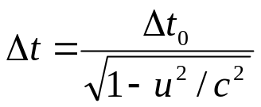
January 24 Time dilation
37.3 Relativity of time intervals
A thought experiment:
A mirror is fixed on the ceiling of a vehicle moving with speed u. Observer in S ' (Mavis) is at rest in the vehicle. A flashlight is at O', which is a distance d below the mirror.
Event 1: The flashlight emits a pulse of light directed at the mirror.
Event 2: The pulse returns back at O' after being reflected.
Observer in S ' (Mavis) carries a clock and she measures the time interval between the events as Δt₀ = 2d/c.
Observer in S (Stanley) is stationary on the earth. He observes that the light travels farther than Mavis sees. He measures the time interval between the events as

Slide 19
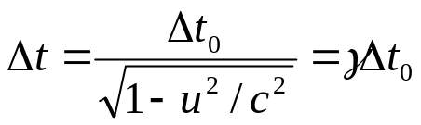
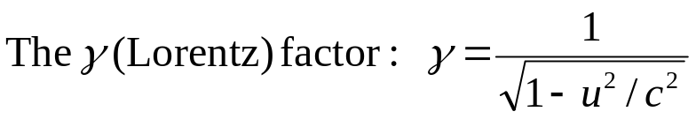

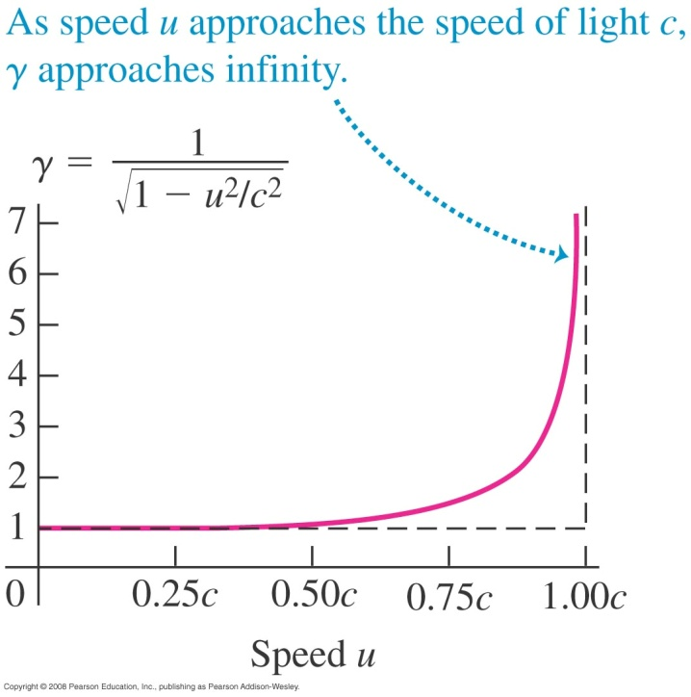
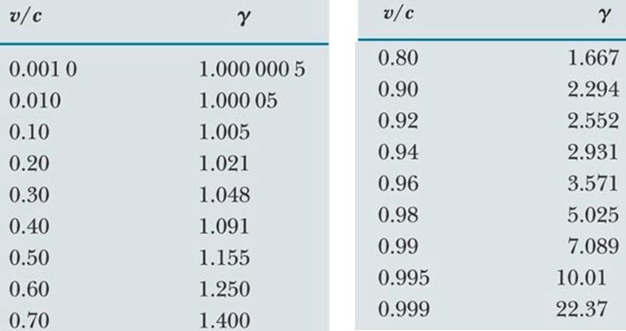
Time dilation: The time interval Δt between two events measured by any other observer is longer than the time interval Δt₀ between the same two events measured by a particular observer who measures the two events occur at the same point in space.
Relativistic speed: γ is appreciably greater than 1.
Nonrelativistic speed:
u
u
Think why.

Slide 20
Proper time interval t₀: The time interval between two events as measured by an observer who measures the events occur at the same point in space. (Eigenzeit → own time)
Generalization of time dilation:
The time interval Δt between two ticks of a moving clock measured by you is longer than the time interval Δt₀ between the same two ticks measured by an particular observer who is stationary with respect to the clock and thus measures the two ticks occur at the same point in space.
That is, the time interval between ticks of the moving clock measured by you is longer than that of an identical clock in your reference frame.
→ A moving clock ticks slower.
→All physical processes are measured to slow down when these processes occur in a frame moving with respect to the observer.

Slide 21
Read: Ch37: 3
Homework: Ch37: 2,3,4,5
Due: January 31

Slide 22
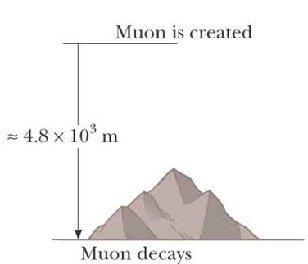
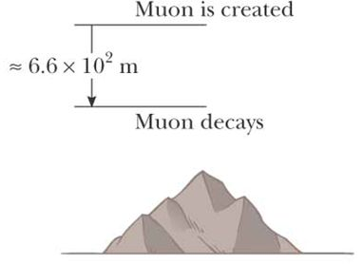
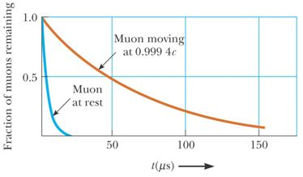

January 27 Time dilation: Applications
Time dilation is a real phenomenon that has been verified experimentally.
Airplane flights:
In 1972 time intervals measured with four macroscopic cesium clocks in jet flight were compared to time intervals measured by earth-based reference clocks. Flying clocks were found to lose time (~ tens of ns), and the results were in good agreement with the predictions of the special theory of relativity. →You save life time while flying!
Example 37.1: Decay of muons:
Muon: particles with q =e, m = 207m_{e}, half-life time Δt₀ = 2.2 µs measured in a reference frame at rest with respect to the muons.
Relative to an observer on the earth, flying muons should have a lifetime of γΔt₀.
This explains why a large number of muons reach the surface of the earth.
v = 0.99c
Experiments
at CERN

Slide 23
Example 37.2: Airliner
Example 37.3: When is it proper?
The twin paradox :
Situation: Astrid, one of the twins, travels at v =0.95c to Planet X 20 light years from the earth. After she reaches there she immediately returns to the earth at the same speed. When Astrid returns, she has aged 13 years, but her sister Eartha on earth has aged 42 years.
Paradox: Astrid thinks that she was at rest, while Eartha and the earth raced away from her and then headed back toward her. Therefore, Eartha should have aged less.
Question: Whose hair has turned white?
Answer:
Theory of special relativity only applies to reference frames moving at uniform speeds.
Astrid must experience a series of accelerations during the journey. Therefore she is not in an inertial frame and cannot apply the theories of special relativity.
Eartha can apply the time dilation formula. She finds that Astrid has aged 13 years.
Test 37.3.

Slide 24
Read: Ch37: 3
Homework: Ch37: 6,7
Note (disambiguation):
37.6 (a) asks for your measurement of the racer’s clock.
37.6 (c) asks for the racer’s measurement of your clock.
Due: February 7

Slide 25
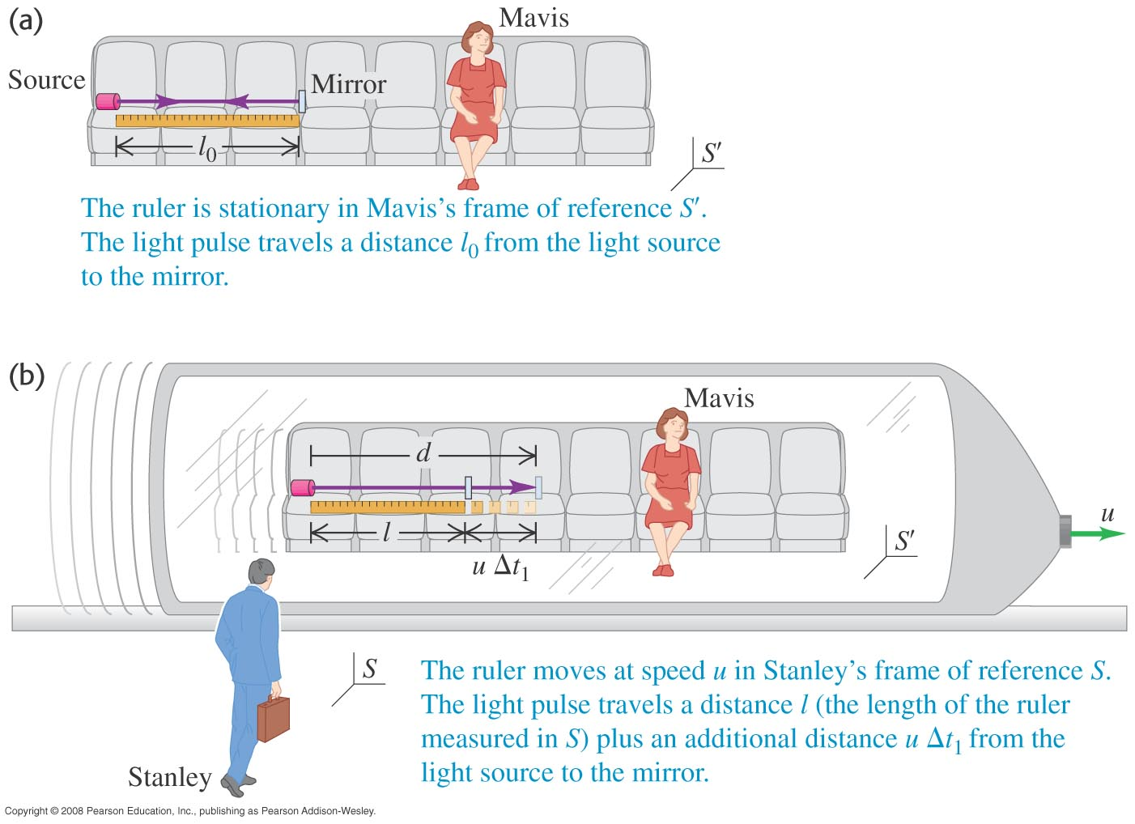
January 29 Length contraction
37.4 Relativity of length
Measuring the length of a running car: The position of the head and tail should be measured at the same time.
A thought experiment:
A ruler is at rest in Mavis’ frame S', with one end equipped with a flashlight and the other end with a mirror.
Event 1: The flashlight emits a pulse of light directed at the mirror.
Event 2: The pulse returns back at the flashlight after being reflected.
Observer in S ' (Mavis): Measures the length of the ruler as l₀, and the time interval between the two events as their proper time Δt₀ =2l₀/c.
Observer in S (Stanley): Measures the length of the ruler as l, and the time interval between the two events as Δt=γ Δt₀.
What is the relation between l and l₀?

Slide 26
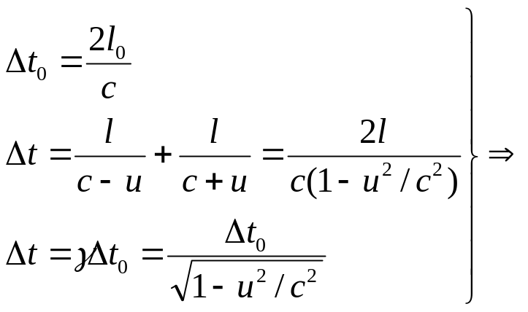
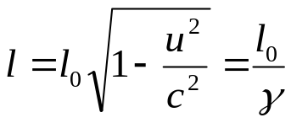
An equivalent simpler thought experiment:
A spacecraft is traveling with a speed u.
Event 1: The spacecraft leaves star A.
Event 2: The space craft reaches star B.
Observer on the earth: Measures the distance between the stars as l₀. The time interval for finishing the voyage is Δt =l₀/u.
Observer in the spacecraft: Measures the proper time interval for the voyage because the two events occur at the same position for him. Δt₀ = Δt /γ. He concludes that the distance between the two stars is l = u Δt₀=u Δt /γ =l₀ /γ .

Slide 27
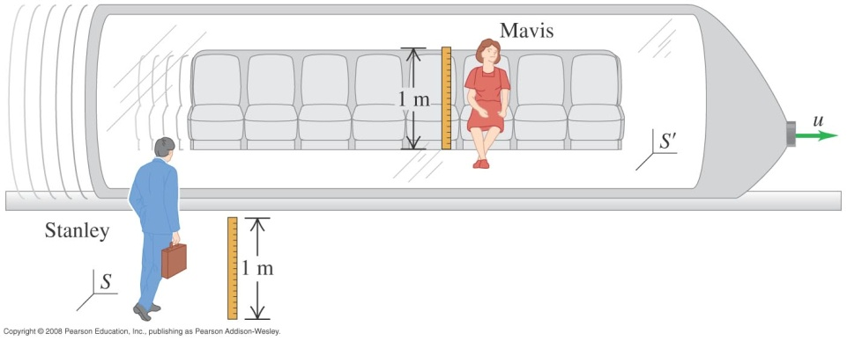
Proper length l₀ : The proper length of an object is the length of the object measured by someone who is at rest relative to the object.
Length contraction:
The length of an object measured in a reference frame that is moving with respect to the object is always less than the proper length: l =l₀ /γ.
→A moving ruler shrinks.
Lengths perpendicular to the relative motion:
Length contraction takes place only along the direction of motion. Lengths that are perpendicular to the direction of motion are not contracted.
A thought experiment:
Two identical meter sticks stand vertically, with one end at O and O ', respectively.
When the two sticks meet, Stanley marks the point on Mavis’ stick that coincide with his 50 cm line.
If the mark is below the 50cm line of Mavis’ stick, then Stanley will conclude that a moving stick becomes longer. However, Mavis will conclude that a moving stick becomes shorter.

Slide 28
Read: Ch37: 4
Homework: Ch37: 9,10
Due: February 7

Slide 29
January 31 Length contraction: Applications
Proper length and proper time:
The proper length is measured by an observer for whom the end points of the object remain fixed in space. The proper time interval is measured by someone for whom the two events take place at the same position in space.
is true only when Δt₀ is the proper time between the two events.
is true only when l₀ is the proper length of the object.
Example 37.4: How long is the spaceship?
Example 37.5: How far apart are the observers?
Example: Moving with a muon
The observer on the earth: Measures the proper travel distance, but the lifetime is longer because of time dilation.
The observer on the muon: Measures the proper lifetime, but the travel distance is shorter because of length contraction.
The outcome of the experiment is the same for both observers. Length contraction and time dilation are consistent with each other.
Test 37.4.

Slide 30
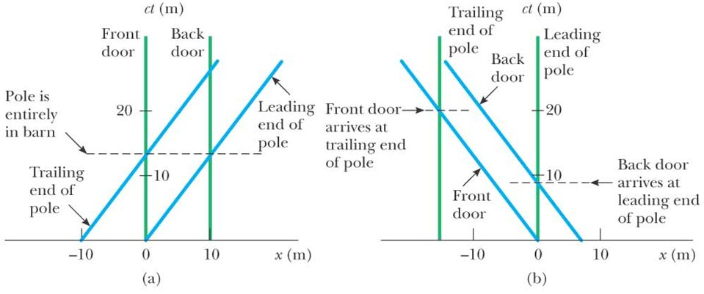
Example: The pole-in-the-barn paradox:
A runner carrying a horizontal pole with 15 m proper length is moving at 0.75 c toward a barn that is 10 m long. When the runner is inside the barn, a ground observer instantly and simultaneously closes and then opens the two doors of the barn.
Question: Can the runner safely pass the barn?
The relativity of simultaneity.
Space-time graphs:
For a certain reference frame, ct is the ordinate and position x is the abscissa.
A path (trajectory) of an object through space-time is called a world-line.

Slide 31
Read: Ch37: 4
Homework: Ch37: 12,13
Due: February 7

Slide 32
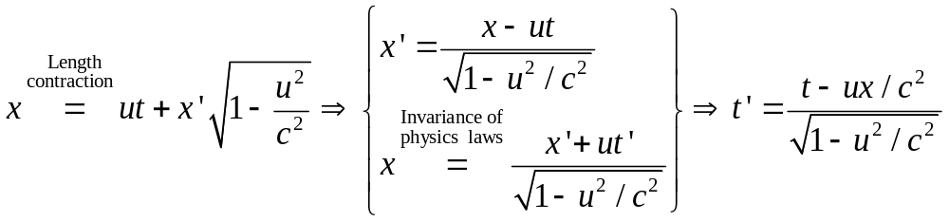
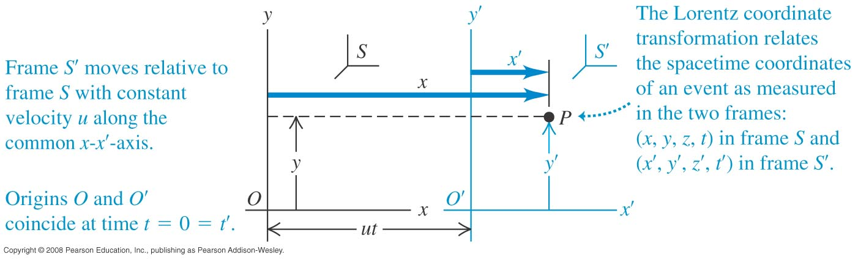
February 3 Lorentz transformation
37.5 The Lorentz transformations
Suppose O and O' coincide at (x=x'= 0, y= y'= 0, z =z'= 0, t =t'=0).
Event: A spark occurs at point P.
Observer in frame S describes the event with the space-time coordinates (x, y, z, t).
Observer in frame S ' describes the same event with the space-time coordinates (x', y', z', t').
Question: What are the relations between the two sets of space-time coordinates?

Slide 33
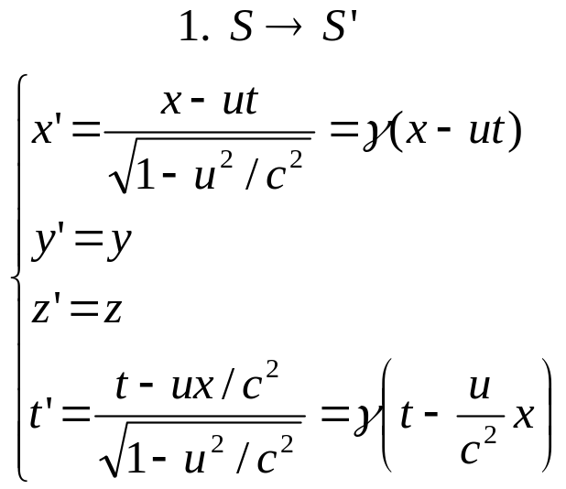
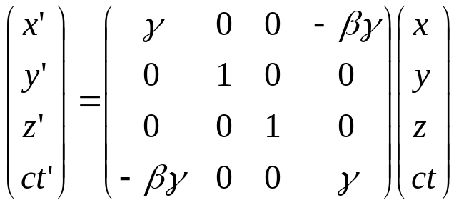
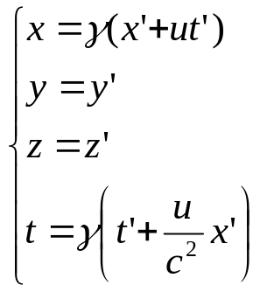
Lorentz coordinate transformation equations:
Lorentz coordinate transformation equations relate the space-time coordinates of the same event measured in two reference frames:
2. Matrix form
3. S' →S
In relativity, space and time are not separate concepts but rather closely interwoven with each other.
When u <<c, Lorentz transformation reduces to Galilean transformation.

Slide 34
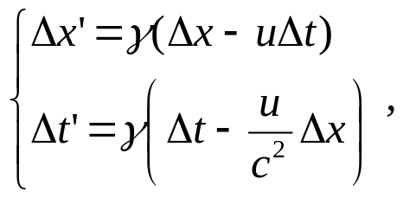
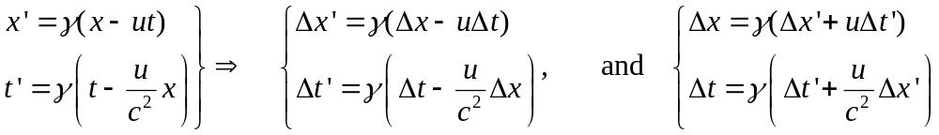
For a pair of events: Lorentz transformation equations in difference form:
Observer in S: (x₁, y₁, z₁, t₁) and (x₂, y₂, z₂, t₂);
Observer in S': (x'₁, y'₁, z'₁, t'₁) and (x'₂, y'₂, z'₂, t'₂).

Slide 35
Read: Ch37: 5
Homework: Ch37: 16
Due: February 14

Slide 36
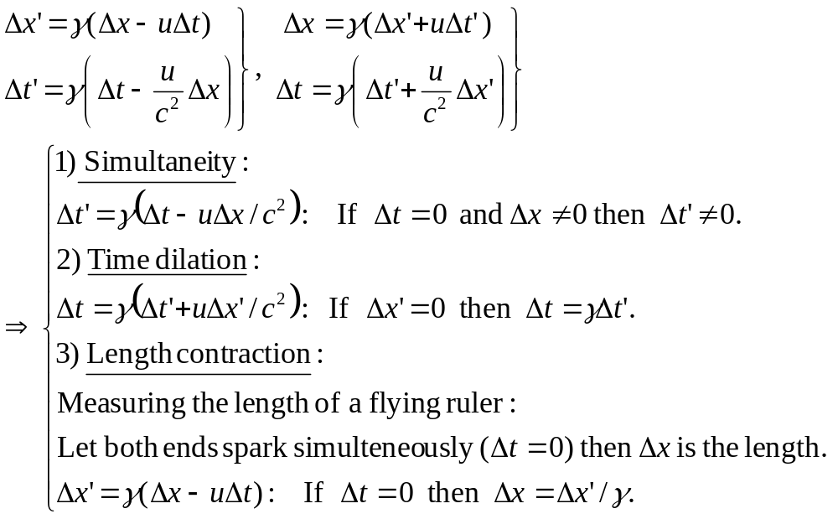
February 5 Lorentz transformation: Applications
Simultaneity, time dilation and length contraction revisited:
Note: In a general case, neither of the two observers may measure the proper time or proper length. The persons that measure the proper time or proper length are rather particular observers.

Slide 37
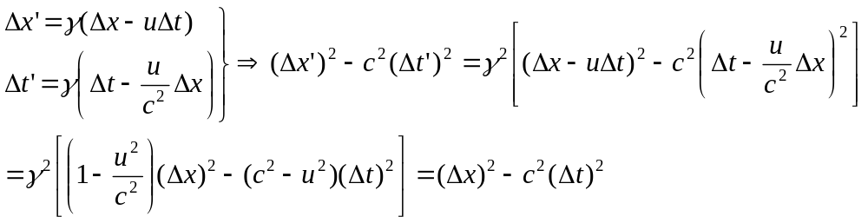

Space-time interval:
In general,
→The space-time interval is invariant in all inertial reference frames.
Example 37.6: Was it received before it was sent?
According to Stanley, how far is Mavis from the finish line when the hooray message is sent?

Slide 38
Read: Ch37: 5
No homework

Slide 39
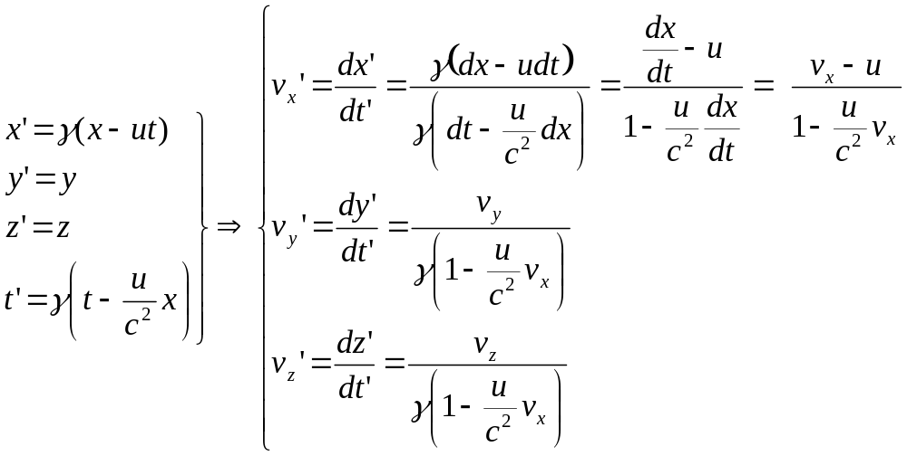
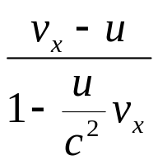

February 7,10 Lorentz velocity transformation
37.5 The Lorentz transformations
An object moves with a velocity of v= (v_{x}, v_{y}, v_{z}) in the S frame.
Question: What is the velocity of the object measured in the S' frame?
v (v')
u
S
S'
If u << c, then v_{x}’ v_{x}–u, Lorentz transformation reduces to Galilean transformation.
If v_{x}=c, then v_{x}'=c. The speed of light does not depend on the motion of the reference frame, which is exactly Einstein’s second postulate.

Slide 40
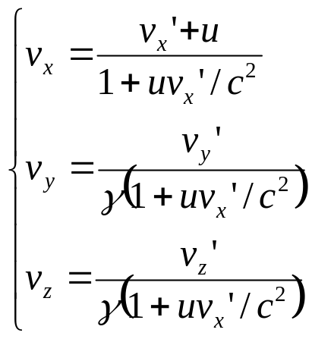
−u
v (v')
S ' →S:
S
S'
The two observers do not agree on (things related to space and time):
The time interval between events that take place at the same position in one of the reference frames.
The distance between two points that remain fixed in one of the frames.
The velocity components of a moving object.
Whether or not two events occurring at different places are simultaneous.
The two observers agree on:
Their relative speed u with respect to each other.
The speed c of any ray of light.
The simultaneity of two events take place at the same position and the same time.

Slide 41
Example 37.7: Relative velocities.
Example: Two space crafts
Two spacecrafts A and B are moving in opposite directions. An earth observer measures the speed of A is 0.75c and that of B is 0.85c. Find the velocity of spacecraft B as observed by the crew on spacecraft A.
1) Identify the observers and the object being observed.
2) What is the velocity of spacecraft A as observed by the crew on spacecraft B?
3) What is the relative velocity between A and B as observed by us?
Test 37.5.
A
B
S

Slide 42
Read: Ch37: 5
Homework: Ch37:17,18,19,20
Due: February 21

Slide 43
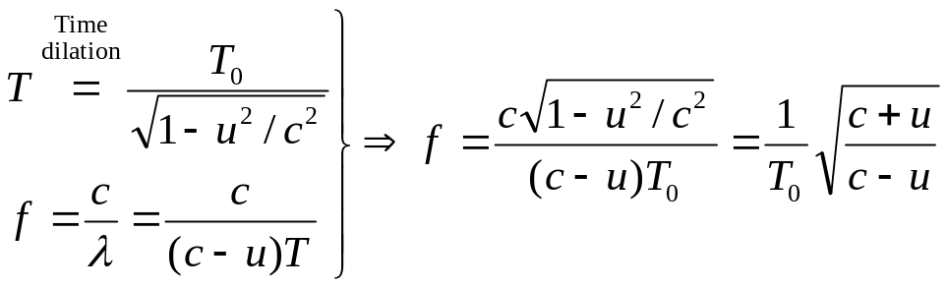
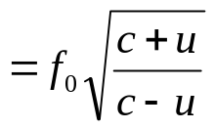
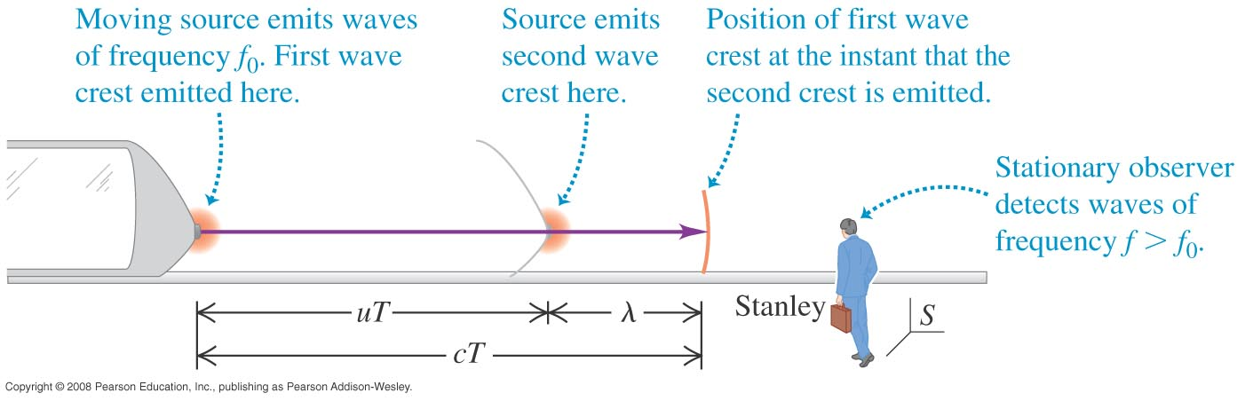
February 14 Relativistic Doppler effect
37.6 The Doppler effect for electromagnetic waves
A light source on a train emits light with frequency f₀, wavelength λ₀ and period T₀, as observed by Mavis.
Events: Two wave crests are emitted.
Question: What is the frequency of the light f as observed by Stanley?
Stanley took pictures of the two events as they happen.

Slide 44
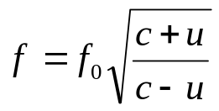
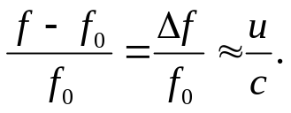
Relativistic Doppler effect: The frequency shifts for light emitted by atoms when the light source is moving. A consequence of time dilation.
If a light source and an observer approach each other with a relative speed u, the frequency measured by the observer is
1) Things moving toward us appear more blue, while things moving away from us appear more red.
2) When u/c<<1,
Example: Red shift (from XUV) of galaxies.
→ Most galaxies are moving away from us.
Example 37.8: Jet from a black hole.
Example: Fines on speeding and on running through a red signal (650 nm →520nm).

Slide 45
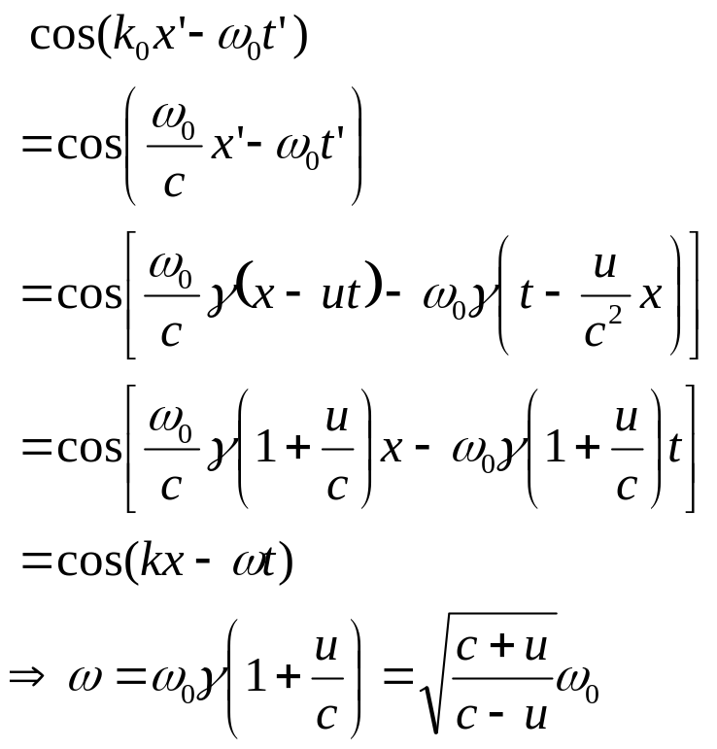
Reading : Relativistic Doppler effect revisited by Lorentz transformation
Suppose the light source is fixed on the S' frame, which is moving toward us with speed u.
u
S'
S

Slide 46
Read: Ch37: 6
Homework: Ch37: 22,23,24
Due: February 21

Slide 47
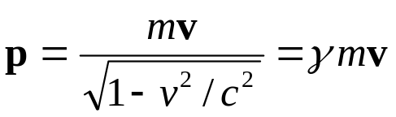
February 17 Relativistic momentum
37.7 Relativistic momentum
Classical momentum: p_{classical} = mv.
Problem:
Suppose we observe a collision experiment. The classical momentum of the system is conserved in the reference frame S. If we change to the S' reference frame using Galilean transformation, the classical momentum of the system is again conserved.
However, if we change to the S' reference frame using Lorentz transformation, the classical momentum will not be conserved.
To achieve momentum conservation in all inertial frames, the definition of momentum must be modified. The new definition must satisfy two conditions:
1) The momentum of an isolated system must be conserved in all collisions.
2) The relativistic linear momentum p of a particle must approach the classical value mv when v approaches zero.
Solution:
In relativity the relativistic momentum of a particle is defined as:
This generalized definition of momentum satisfies the above two conditions.

Slide 48



The relativistic momentum as a function of v:
The relativistic momentum is approximately mv at low velocity. It becomes infinite as v approaches c.
Relativistic mass:
Newton’s second law of motion:
The generalized Newton’s second law of motion is

Slide 49


Acceleration:
1) When F is along the direction of v:
The acceleration caused by a constant force continuously decreases at high velocity. It approaches zero when v approaches c.
→It is impossible to accelerate a particle from rest to a speed of u ≥ c.
→ The speed of light is the speed limit of the universe.
It is the maximum possible speed for energy and information to transfer.
2) When F is perpendicular to the direction of v:
3) In a general case, F needs to be decomposed into components parallel and perpendicular to v. The net force and the acceleration will generally not be in the same direction.
Example 37.9: Relativistic dynamics of an electron.
Test 37.7

Slide 50
Read: Ch37: 7
Homework: Ch37: 27,29
Due: February 28

Slide 51



February 19 Relativistic energy
37.8 Relativistic work and energy
Redefinition of momentum → Generalization of Newton’s second law
→Redefinition of kinetic energy.
Work done by force F on a particle along its moving direction (through dγ):
→Relativistic kinetic energy:
1) When v << c,
2) When v approaches c, the kinetic energy approaches infinity.

Slide 52


Total energy, rest energy, and kinetic energy:
Total energy = Kinetic energy + Rest energy
Mass is a form of energy.
A particle has energy by virtue of its mass alone.
A small mass corresponds to an enormous amount of energy.
Evidence of the existence of rest energy: The decay of a pion produces electromagnetic radiation with energy m_{π} c².
Principle of the conservation of mass and energy:
In an isolated system,
Change of the rest masses × c² + Change of the kinetic energy = 0
→ Conservation of the relativistic total energy
Example: Nuclear power plants.

Slide 53



The relativistic energy-momentum relation:
E
pc
mc²
Example: For a photon,
Example 37.10: Energetic electrons.
Example 37.11: Relativistic collision.
Test 37.8

Slide 54
Read: Ch37: 8
Homework: Ch37: 31,33,35,39 Due: February 28

