Slide 1
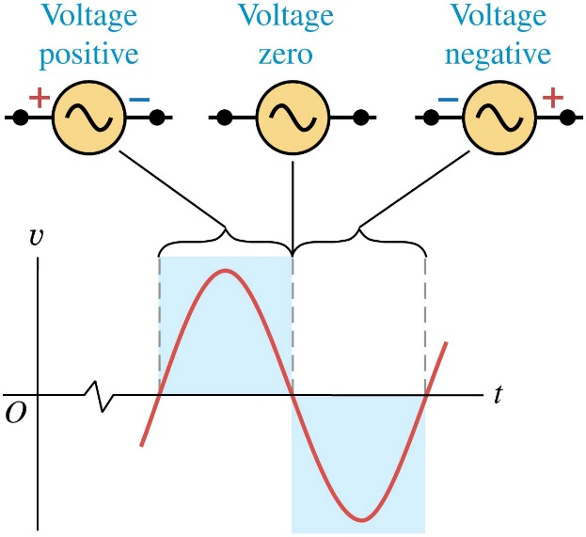
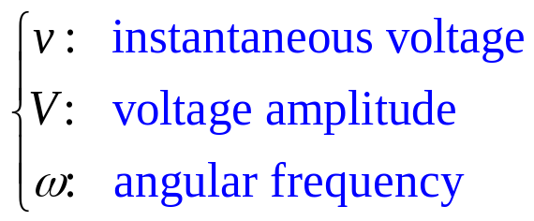


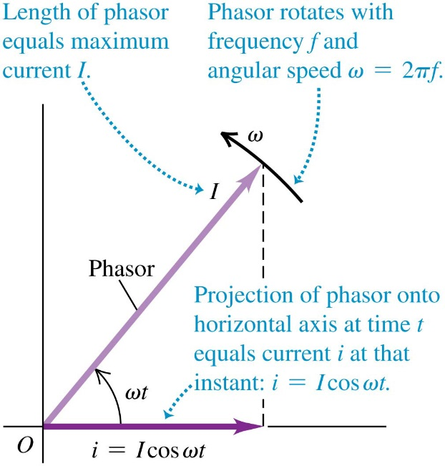
Chapter 31 Alternating Current
December 4 Phasors
31.1 Phasors and alternating currents
An AC source is a device that supplies a sinusoidally varying voltage or current. An AC voltage can be described by
A similar expression holds for AC current:
Phasor diagrams:
An AC current (or voltage) can be visually represented by a phasor. In the figure, a vector (phasor) with length I is rotating counterclockwise at an angular velocity ω, starting from the x-axis. The projection of the phasor on
the x-axis is the instantaneous current
Phasors are useful when we need to add several voltages or currents together.

Slide 2
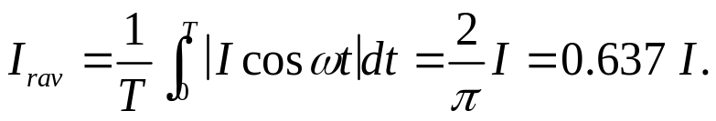
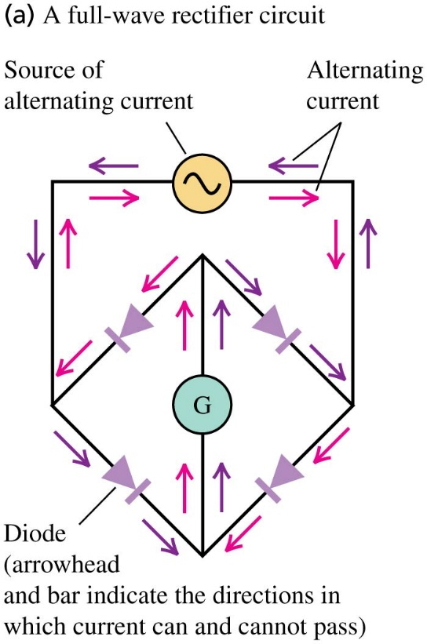
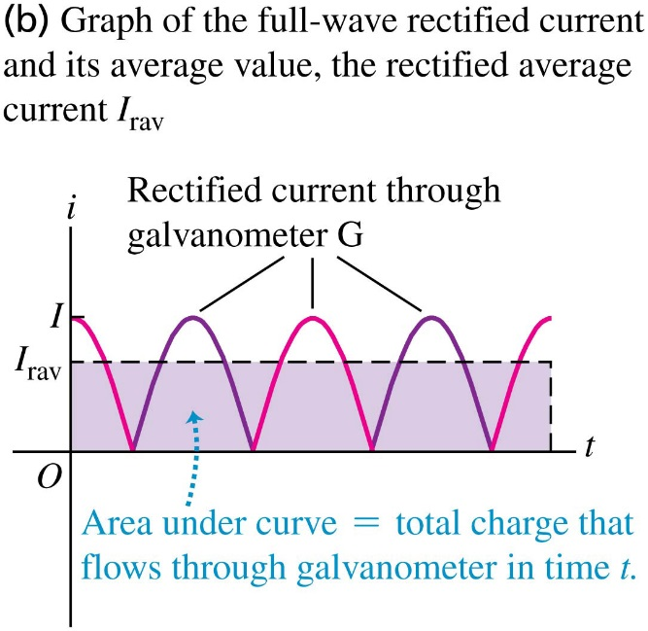
Rectified AC current:
A full-wave rectifier circuit can make the current going in one direction in an appliance. To measure an AC current, we can use its rectified average current.

Slide 3
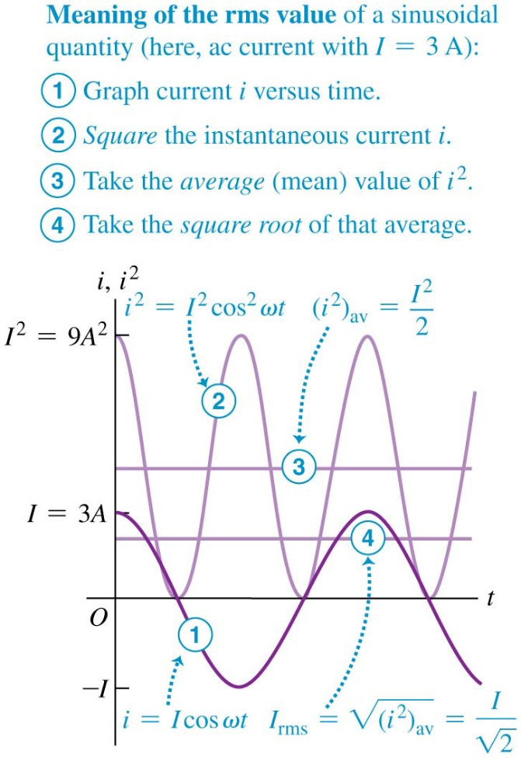
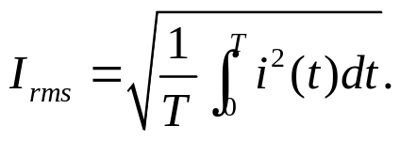
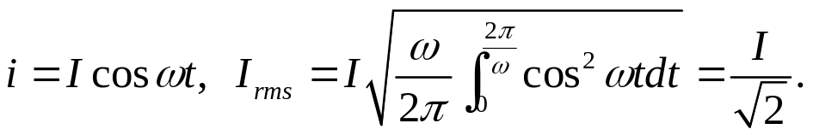
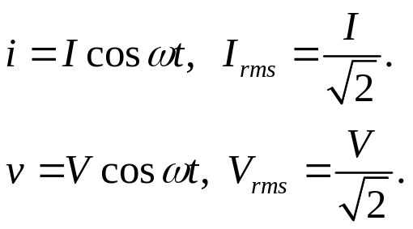
Root-mean-square values:
The root-mean-square current of an AC current is
defined as
It is “the root of the mean of the square” of the current.
For
Example 31.1 Current in a personal computer
Test 31.1

Slide 4
Read: Ch31: 1
Homework: Ch31: 1,2
Due: December 12

Slide 5
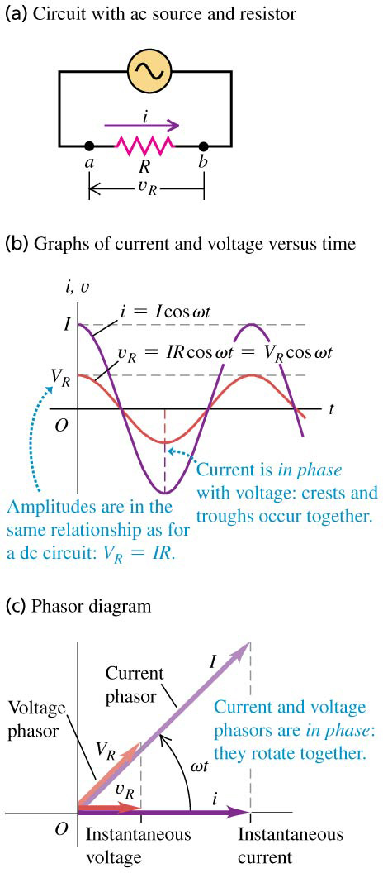



December 5 Reactance
31.2 Resistance and reactance
We derive the voltage–current relationships for resistors, inductors, and capacitors carrying a sinusoidal current.
Resistor in an AC circuit:
In the circuit suppose , then ohm’s law gives
For a resistor, the current and voltage amplitudes, as well as their instantaneous values, are related in the same way as in a DC circuit.
The current is in phase with the voltage. The current and voltage phasors are parallel at any moment.

Slide 6
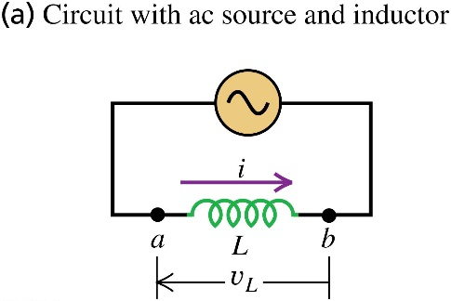
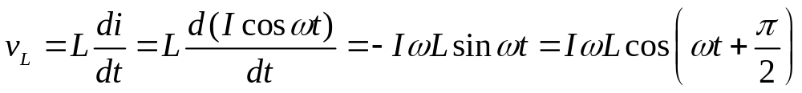
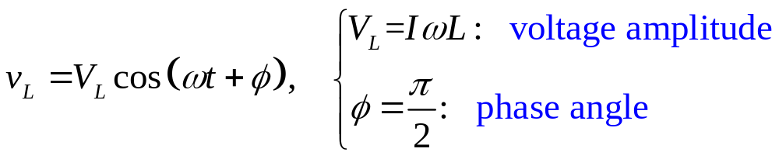
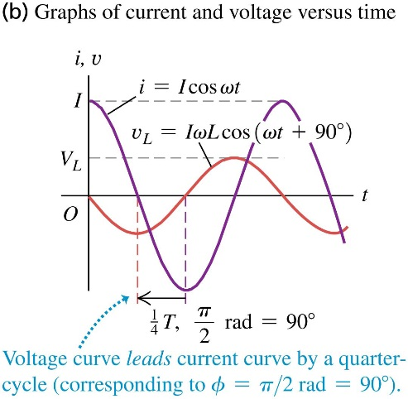


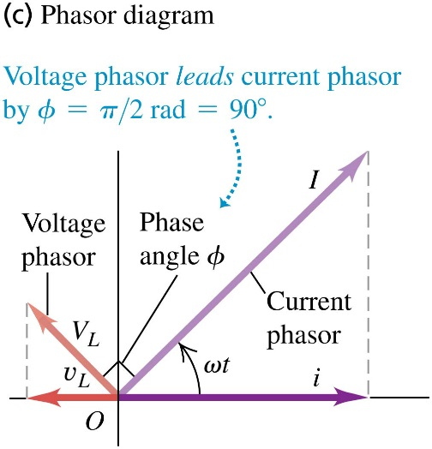
Inductor in an AC circuit:
In the circuit suppose , then
The voltage phasor leads the current phasor by 90°.
Define inductive reactance , then
The inductive reactance X_{L} describes the ability of an inductor to oppose the flow of an AC current at a given V_{L}.
X_{L} is proportional to frequency. Inductors are used to block high frequency current while permitting lower frequency or DC current to pass through.

Slide 7
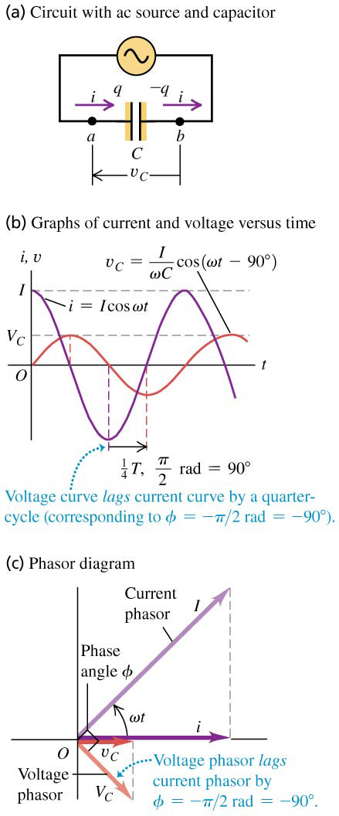
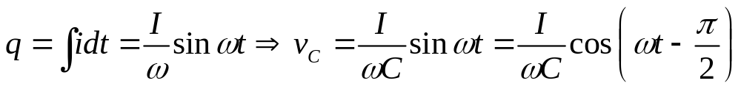
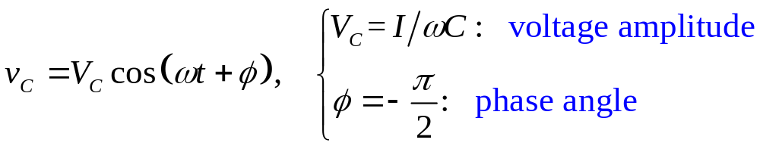


Capacitor an AC circuit:
In the circuit suppose , then
The voltage phasor lags the current phasor by 90°.
Define capacitive reactance , then
The capacitive reactance X_{C} describes the ability of an capacitor to oppose the flow of an AC current at a given V_{C}.
X_{C} is inversely proportional to frequency. Capacitors tend to pass high-frequency current and to block low-frequency current and DC, which is the opposite of inductors. .

Slide 8
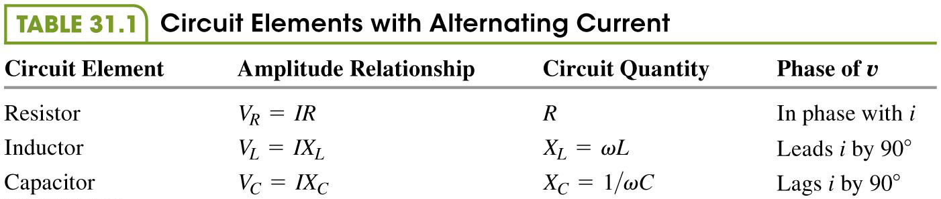
Example 31.2 An inductor in an AC circuit
Example 31.3 A resistor and a capacitor in an AC circuit
Test 31.2

Slide 9
Read: Ch31: 2
Homework: Ch31: 6,8,10
Due: December 12

Slide 10
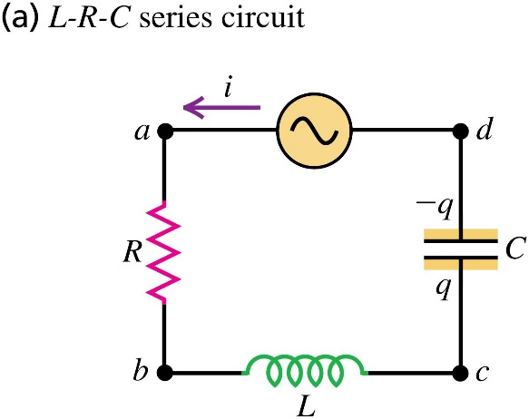
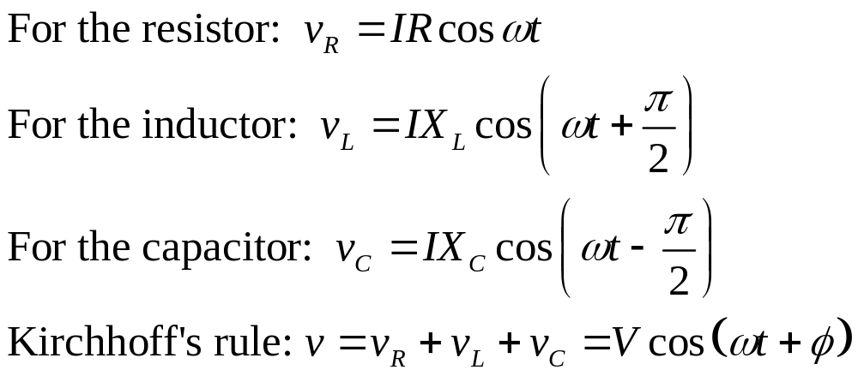
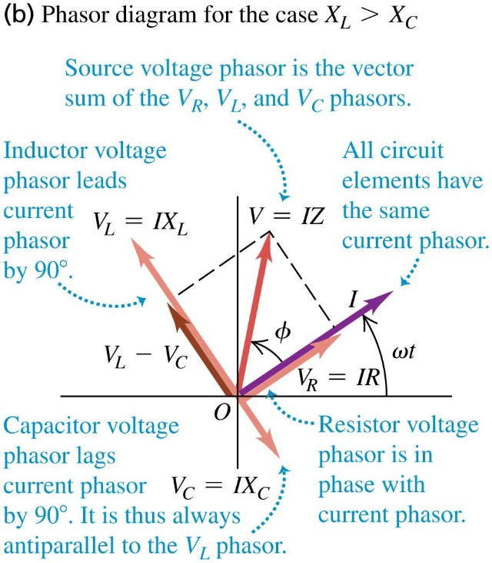


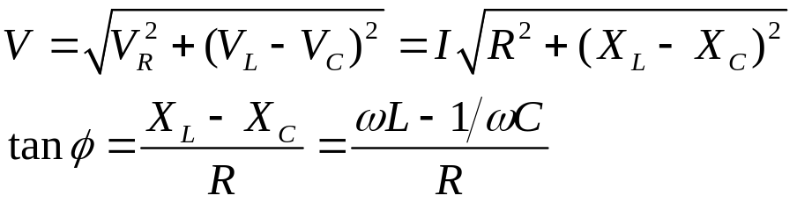
December 8 L-R-C Circuit
31.3 The L-R-C series circuit
In the L-R-C series circuit, suppose the source current is
. Our goal is to find the source voltage and the voltage on each element.
When the instantaneous voltages follow algebraic sum, their phasors follow a vector sum:
The amplitude V and phase φ are given from the phasor diagram:

Slide 11
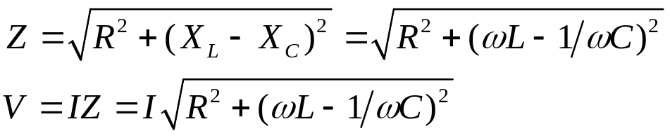


The impedance Z of an AC circuit is defined as the ratio of its voltage amplitude to its current amplitude. The impedance measures the ability of the circuit to oppose the flow of an AC current. The unit of impedance is ohm. For the L-R-C series circuit,
Because the rms quantities are of their amplitudes, V=I Z also works as
Example 31.4 An L-R-C series circuit I
Example 31.5 An L-R-C series circuit II
Test 31.3

Slide 12
Read: Ch31: 3
Homework: Ch31: 12,13,15

Slide 13
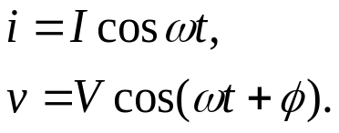
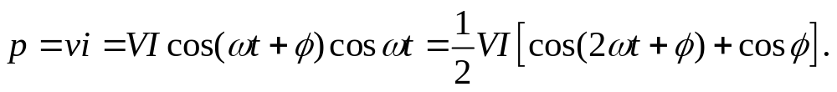
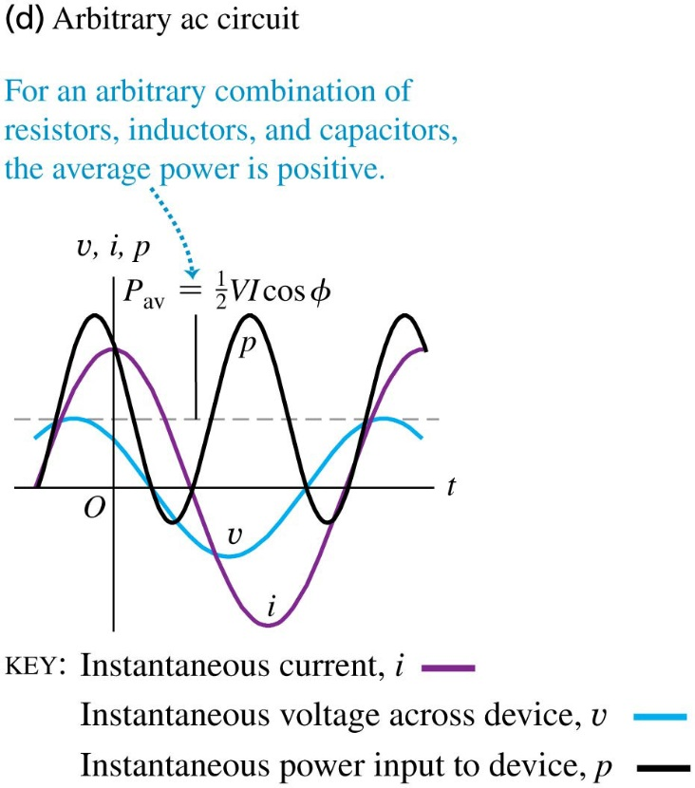
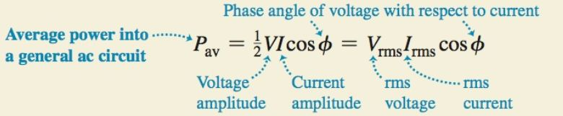
December 10 Power in AC Circuit
31.4 Power in alternating-current circuit
Suppose in an AC circuit consisting of a single or a combination of resistors, capacitors, and inductors, the instantaneous current i and voltage v are given by
The instantaneous power p of the circuit is
The average power is
The factor cosφ is called the power factor. For a given V_{rms} and a desired power P_{av}, the power factor need to be high enough so that the i²R loss is minimized.

Slide 14
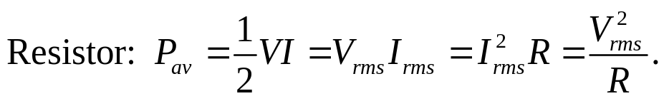


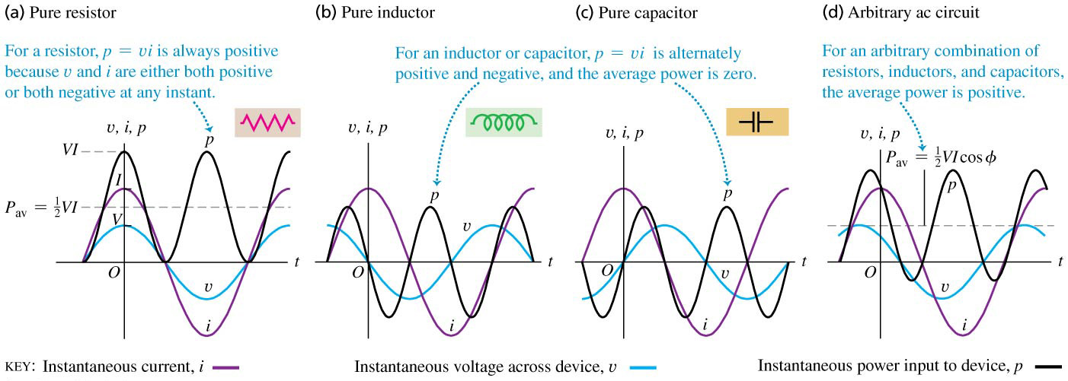
Power in a resistor: Because the phase angle φ =0, the average power is
Power in an inductor: Because the phase angle φ =π/2, the average power is
Power in a capacitor: Because the phase angle φ = -π/2, the average power is

Slide 15
Example 31.6 Power in a hair dryer
Example 31.7 Power in an L-R-C series circuit
Test 31.4

Slide 16
Read: Ch31: 4
Homework: Ch31: 18,20,23

Slide 17
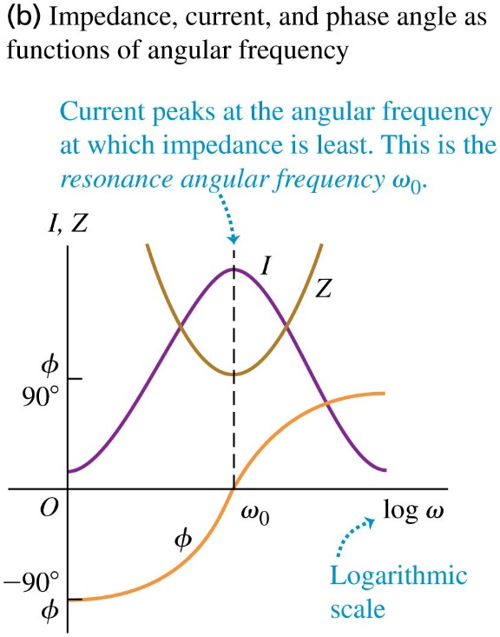
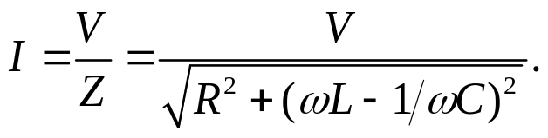
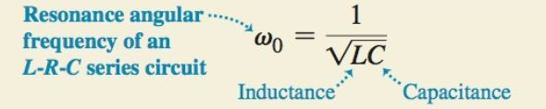
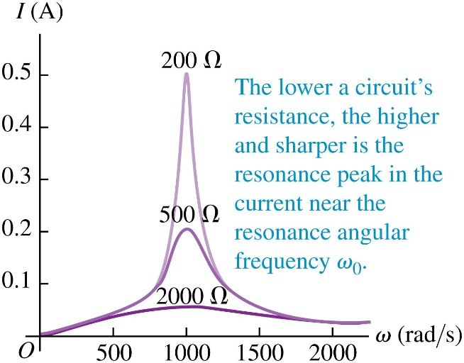
December 11 Transformers
31.5 Resonance in AC circuits
When a source voltage with a certain amplitude V is applied on an L-R-C series circuit, the resulting current amplitude is
The current amplitude varies with the angular frequency ω.
The maximum value of I occurs at the resonance angular frequency ω₀, where X_{L}=X_{C}:
Near the resonance frequency ω = ω₀, the response curve I (ω) is higher and sharper for smaller R, and is lower and broader for larger R.

Slide 18
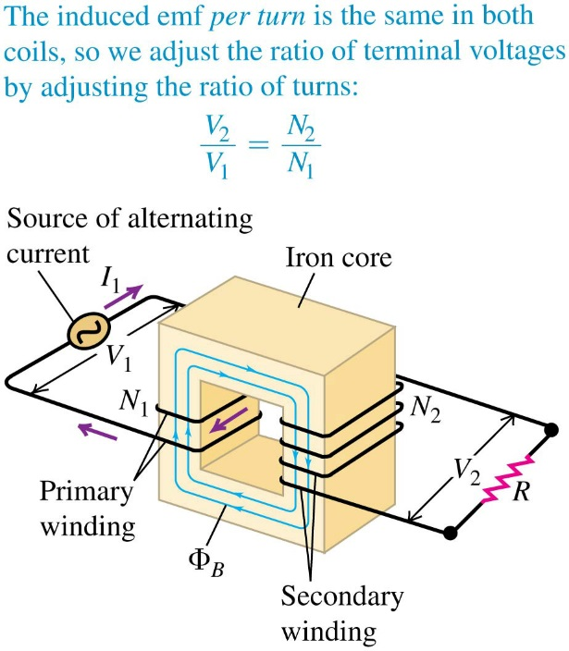
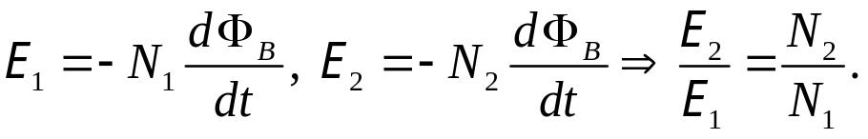
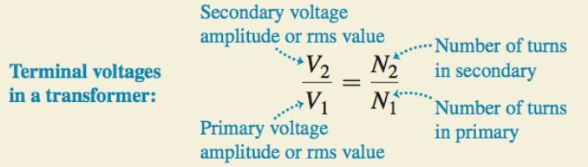
31.6 Transformers
A transformer consists of two coils (windings) wound on the same core. The winding to which power is supplied is called the primary; the winding from which power is delivered is called the secondary.
Let N₁ and N₂ be the number of turns of the primary and secondary windings. Φ_{B} be the magnetic flux in each turn of the windings. The induced emfs are
If the windings have no resistance, then the terminal voltages satisfy

Slide 19
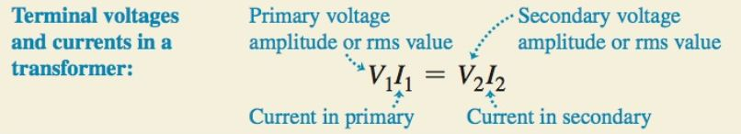
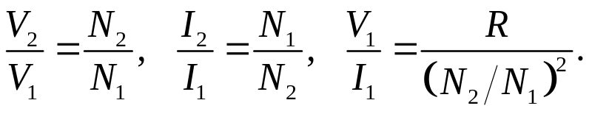
Energy considerations for transformers:
From energy considerations, the power delivered to the primary equals that taken out of the secondary.
This generates
This means that the transformer transforms not only voltages, but also currents and impedances.
Example 31.8 Tuning a radio
Test 31.5
Example 31.9 “Wake up and smell the transformer!”
Test 31.6

Slide 20
Read: Ch31: 5
Homework: Ch31: 27,33,35,36

