Slide 1
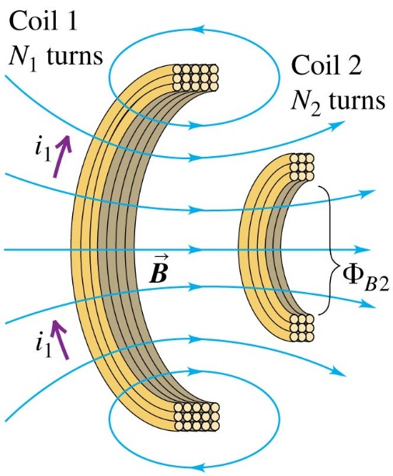
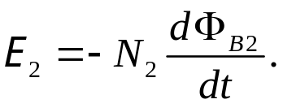

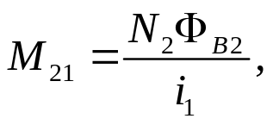
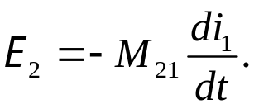
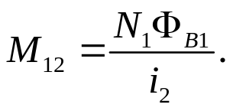
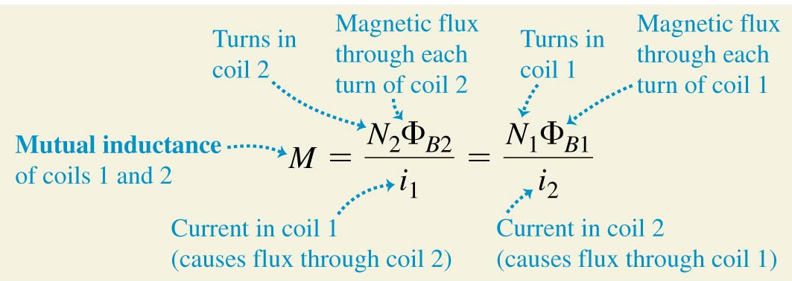
Chapter 30 Inductance
November 17 Mutual Inductance
30.1 Mutual inductance
In the two neighboring coils shown, the changing of i₁ induces an emf in coil 2, and vice versa. Supposing no current changes in coil 2, then Faraday’s law gives
is proportional to i₁, introducing
mutual inductance then
Similarly we have
It turns out that M₁₂ always equals M₂₁, even though the two coils may not be identical and the flux through them may not be the same. We then define the mutual inductance
The SI unit of mutual inductance is the henry (H), 1 H = 1Wb/A.

Slide 2
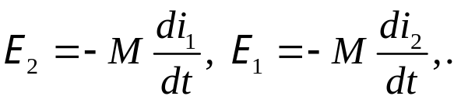
Now the mutually induced emf in the two coils is
Example 30.1 Calculating mutual inductance
Example 30.2 Emf due to mutual inductance
Test 30.1

Slide 3
Read: Ch30: 1
Homework: Ch30: 1,3,4
Due: December 5

Slide 4
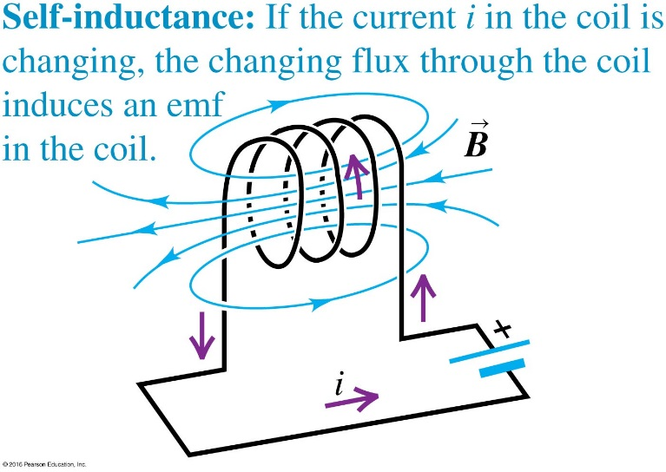

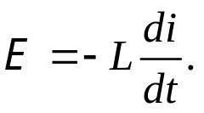
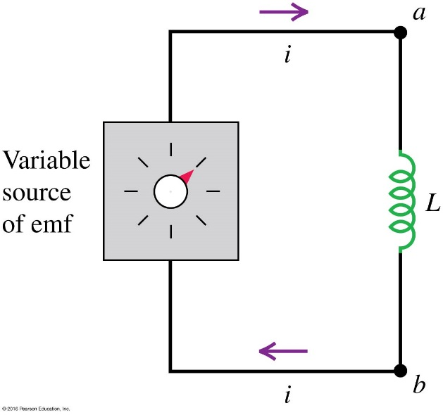
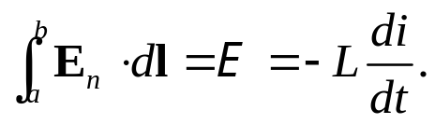

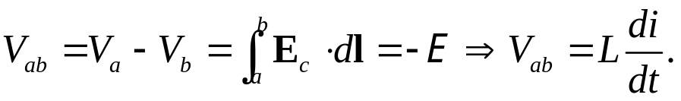
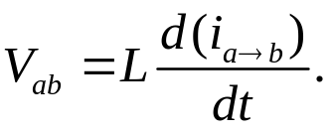
November 19 Self-inductance
30.2 Self-inductance and inductors
In the figure, a circuit with a coil that carries a varying current has a self-induced emf.
The self-inductance L of the circuit is defined as
From Faraday’s law the self-induced emf is then
The negative sign here means that if i is increasing then E is opposite to i.
Inductors as circuit elements:
When an inductor with negligible resistance is in a circuit, the non-conservative E-field E_{n} in the inductor satisfies
The total field . Therefore,

Slide 5
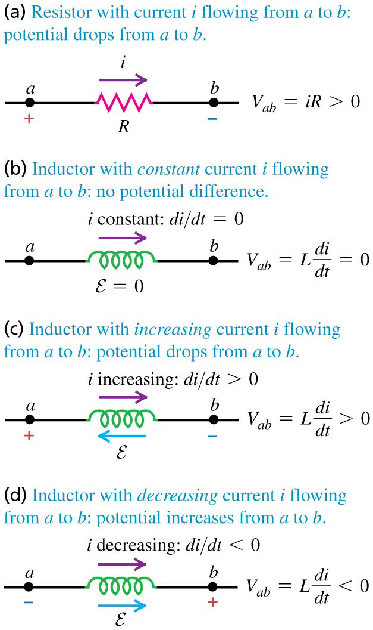
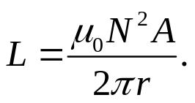
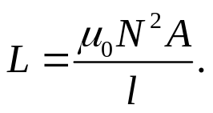
Potential across an inductor:
Example 30.3 Calculating self-inductance
The inductance of a toroidal solenoid is
The inductance of a straight solenoid is approximately (upper limit)
Example 30.4 Calculating self-induced emf
Test 30.2

Slide 6
Read: Ch30: 2
Homework: Ch30: 6,9,11
Due: December 5

Slide 7
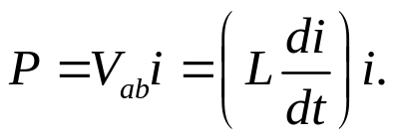

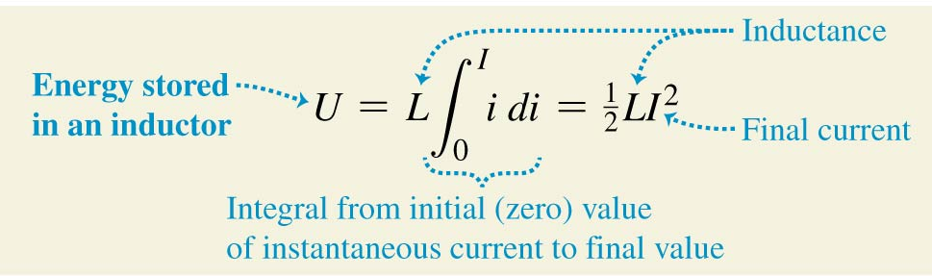
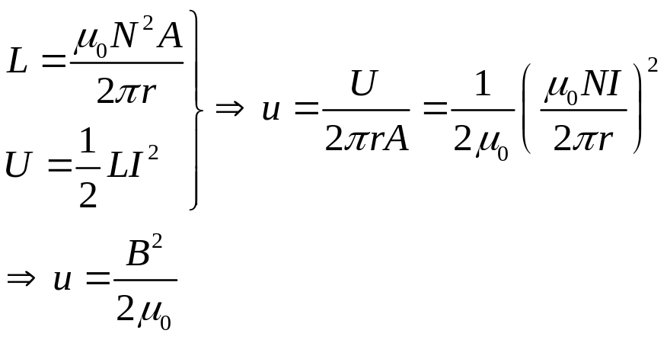
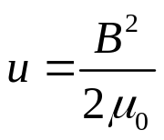
November 21 Magnetic-field Energy
30.3 Magnetic-field energy
Energy stored in an inductor:
We calculate the total energy needed to establish a final current in an inductor. The rate P at which energy is being delivered to the inductor is
The energy supplied in time interval dt is
The total energy input U needed to establish a final current I is
Magnetic energy density:
The energy in an inductor is stored in the magnetic field of the coil, just as the energy of a capacitor is stored in the electric field between its plates. Use a toroidal solenoid as an example.

Slide 8
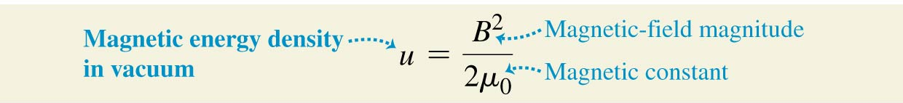
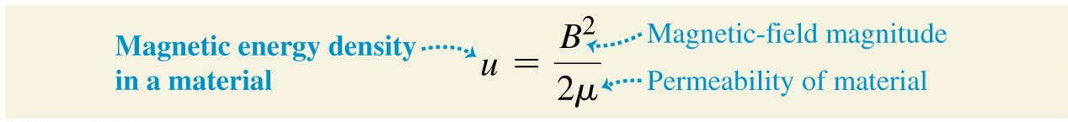
In vacuum, the magnetic energy density is
When the magnetic field is in a material with constant magnetic permeability μ,
Example 30.5 Storing energy in an inductor
Test 30.3

Slide 9
Read: Ch30: 3
Homework: Ch30: 16,17,19
Due: December 5

Slide 10
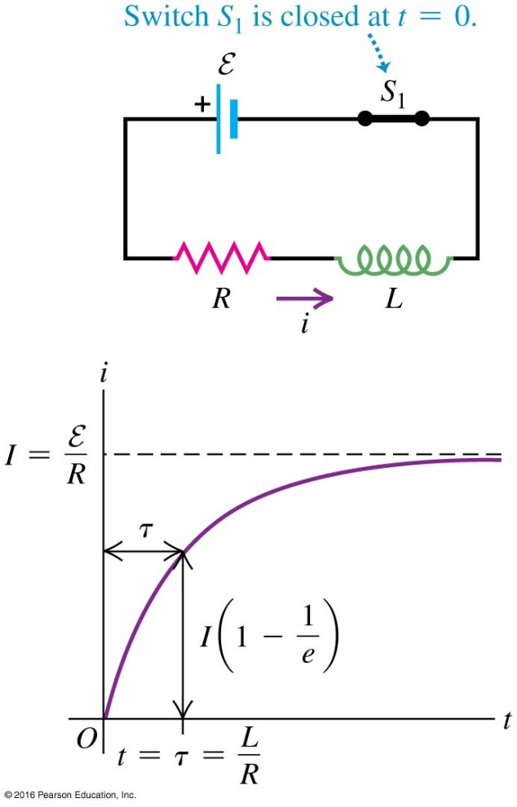
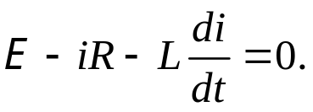
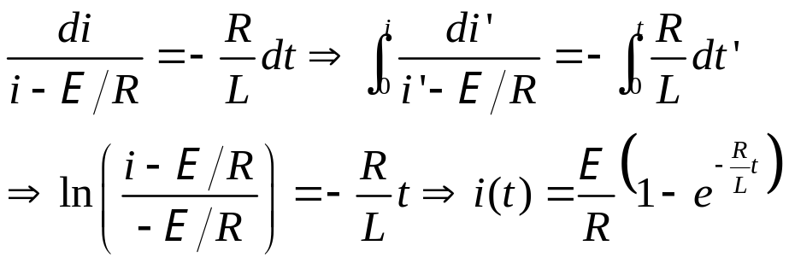
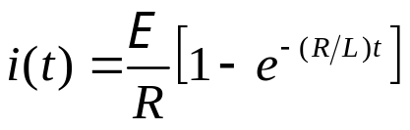
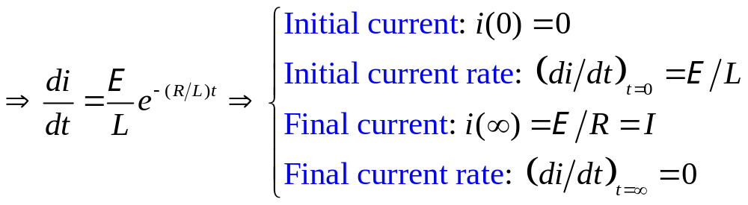
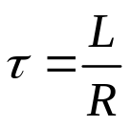
December 1 R-L Circuit
30.4 The R-L circuit
Current growth in an R-L circuit:
At t = 0 the switch is closed. Applying Kirchhoff’s rule to
the counterclockwise loop,
Solving for i(t),
Time-constant τ , where
i(τ) is 1/e to the full I :

Slide 11
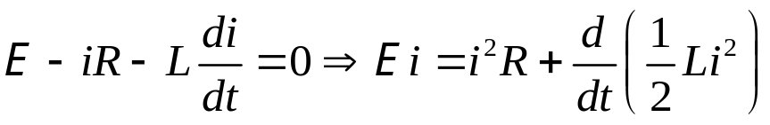
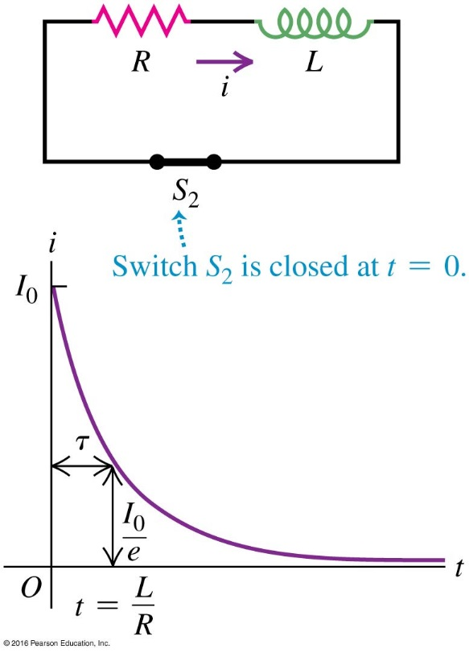
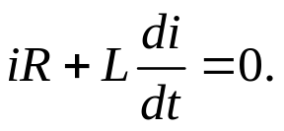

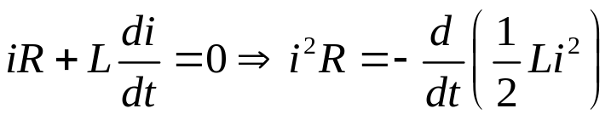
Energy consideration in the current growth in an R-L circuit:
Current decay in an R-L circuit:
Suppose there is an initial current I₀ running through the circuit. At t = 0 the switch is closed. Applying Kirchhoff’s
rule to the counterclockwise loop,
Solving for i(t),
The time constant for the decay of the current is τ = L/R.
Energy consideration in current decay in an R-L circuit:
The energy stored in the magnetic field of the inductor provides the energy dissipated in the resistor.

Slide 12
Example 30.6 Analyzing an R-L circuit
Example 30.7 Energy in an R-L circuit
Test 30.4

Slide 13
Read: Ch30: 4
Homework: Ch30: 21,23,27
Due: December 12

Slide 14
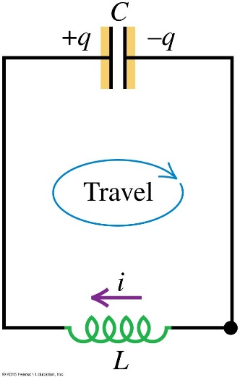
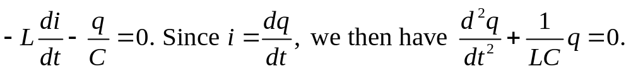
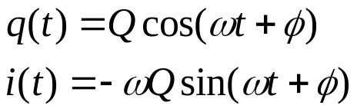
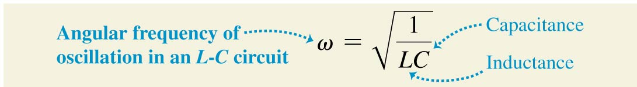
December 3 L-C Circuit
30.5 The L-C circuit
Electric oscillations in an L-C circuit:
We apply Kirchhoff’s loop rule to the circuit shown.
Solving for q(t),
Therefore, the charge and current in an L-C circuit oscillate sinusoidally with time, with an angular frequency determined by L and C.
Here ω is the angular frequency, Q and φ are the amplitude and the initial phase of the charge oscillation, determined by the initial condition. The amplitude of the current is
I =ω Q.
If at t = 0 the left-hand capacitor plate has maximum charge Q, and the current i =0, then φ = 0.

Slide 15
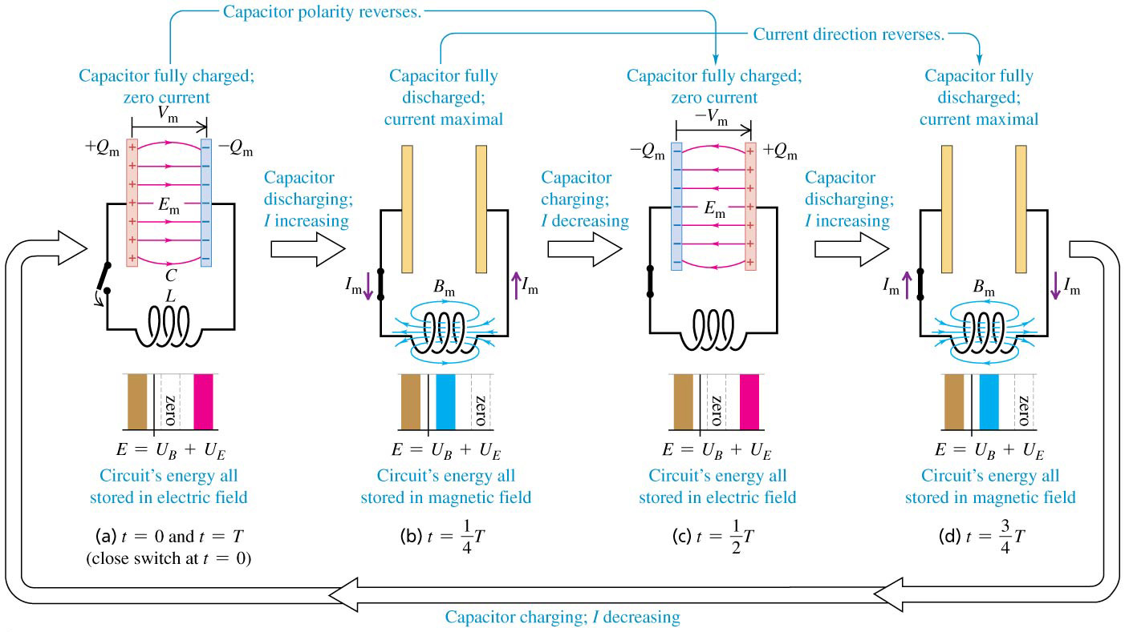
An oscillating L-C circuit

Slide 16
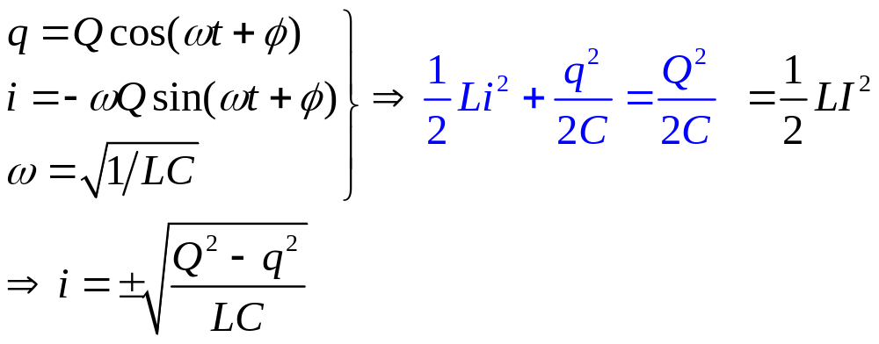
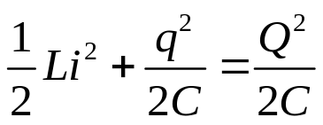
Energy in an L-C circuit:
The total energy in the L-C circuit is a constant; it oscillates between the magnetic and the electric forms.
Example 30.8 An oscillating circuit
Example 30.9 Energy in an oscillating circuit
Test 30.5

Slide 17
Read: Ch30: 5
Homework: Ch30: 32,34,37
Due: December 12

