Slide 1
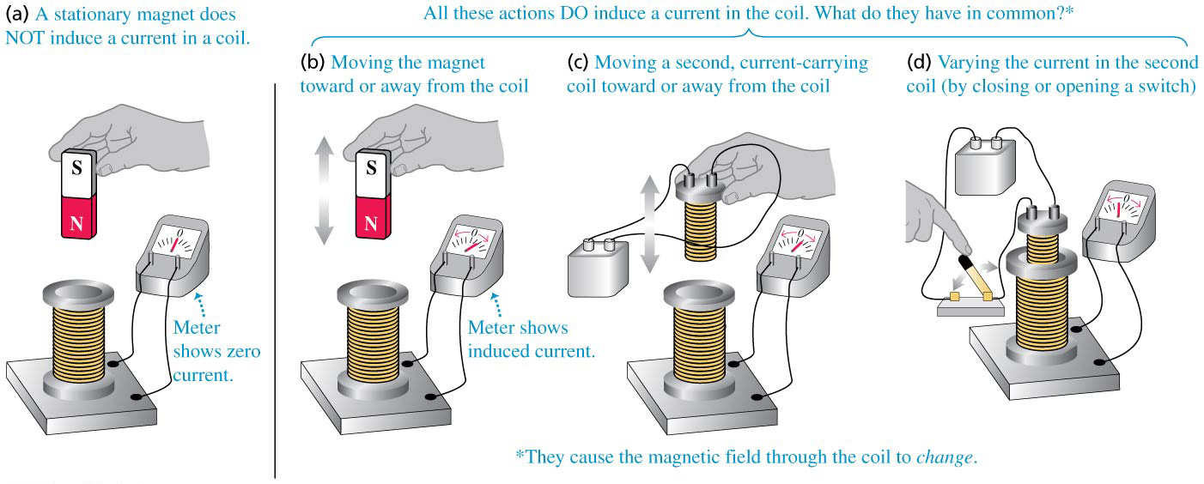
Chapter 29 Electromagnetic Induction
November 5 Faraday’s Law
29.1 Induction experiments
The figure shows various method of inducing a current through a coil of wire connected to a galvanometer.
The common element in these experiments of inducing a current is a changing magnetic flux through the coil. The magnetic flux change can be caused by either a change in the magnetic field, or a motion of the coil.

Slide 2
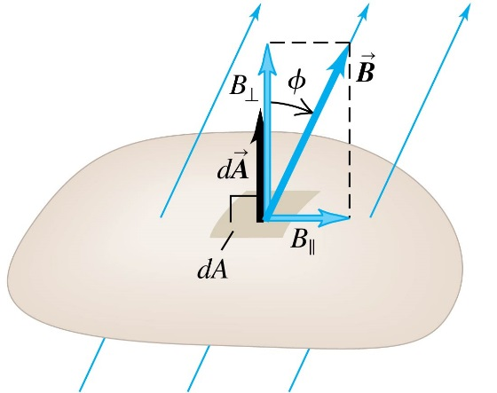
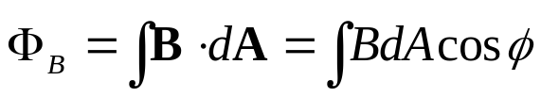
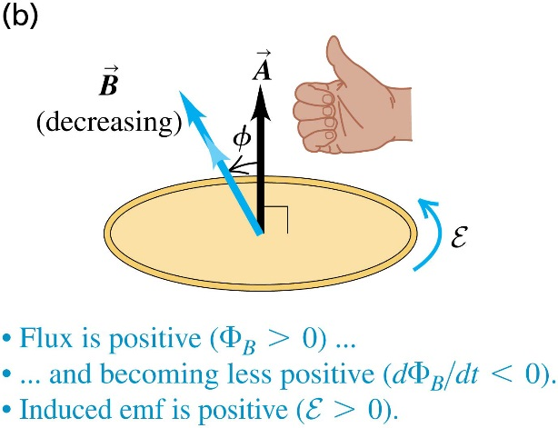

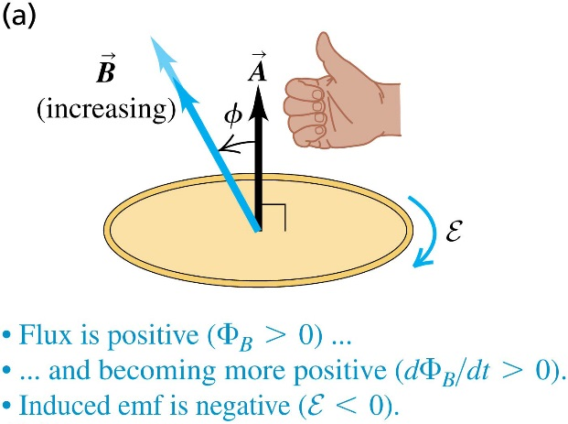
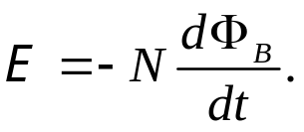
29.2 Faraday’s law
Review of magnetic flux:
The sign of the magnetic flux depends on the direction of the vector area (A) you have chosen. Once you chose it, you have to stick to it.
Faraday’s law of induction:
When the magnetic flux through a single closed loop changes with time, there is an induced emf around the loop:
Sign convention of the induced emf:
When Faraday’s law is applied, a positive E means a counter-clockwise emf when looking against the vector area A (right-hand rule).
Faraday’s law for a coil:

Slide 3
Example 29.1 Emf and current induced in a loop
Note that the emf is determined by Faraday’s law, and it always exists, while the induced current depends on the resistance of the loop.
Example 29.2 Magnitude and direction of an induced emf
Example 29.3 Generator I: a simple alternator
Example 29.4 Generator II: a DC generator and back emf in a motor
Example 29.5 Generator III: the slide-wire generator
Example 29.6 Work and power in the slide-wire generator
Test 29.2

Slide 4
Read: Ch29: 1-2
Homework: Ch29: 5,9,10
Due: November 14

Slide 5
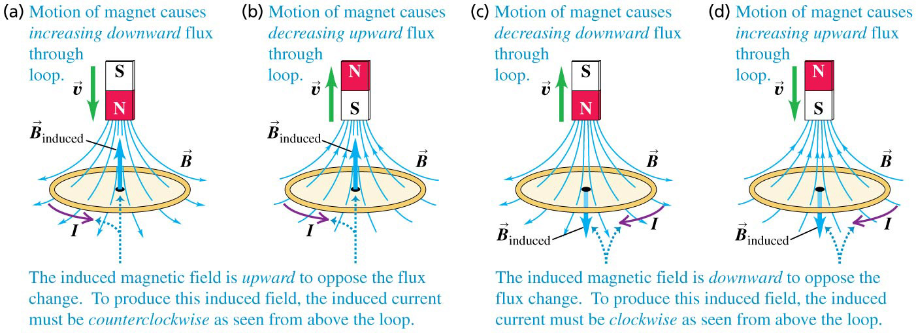
November 6 Lenz’s Law
29.3 Lenz’s law
Faraday’s law is enough to determine the direction of an induced emf.
In practice, Lenz’s law is more convenient: the direction of any magnetic induction effect is such as to oppose the cause of the effect.
1) If the flux through a circuit changes, the induced current will set up a magnetic field of its own, which is always opposing the change in the flux through the circuit.
2) If the flux change is due to the motion of a circuit, the direction of the induced current in the moving conductor is such that the direction of the magnetic-field force on the conductor is always opposing its motion.

Slide 6
Example 29.7 Lenz’s law and the slide-wire generator
Note that the magnetic force on the conductor due to the induced current is opposing the motion of the conductor.
Example 29.8 Lenz’s law and the induced current
Test 29.3

Slide 7
Read: Ch29: 3
Homework: Ch29: 15,17,19,22
Due: November 14

Slide 8
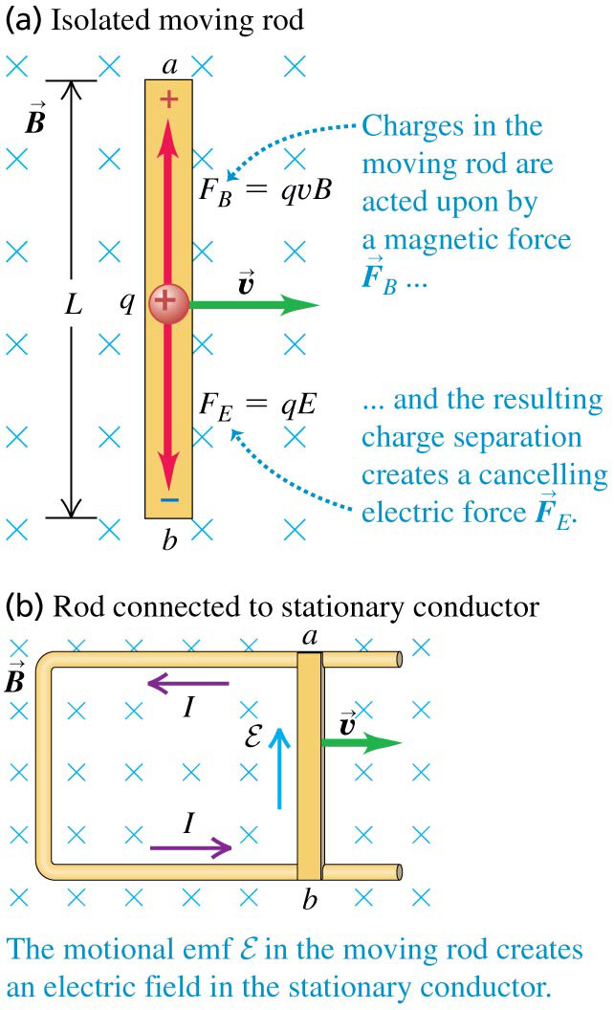
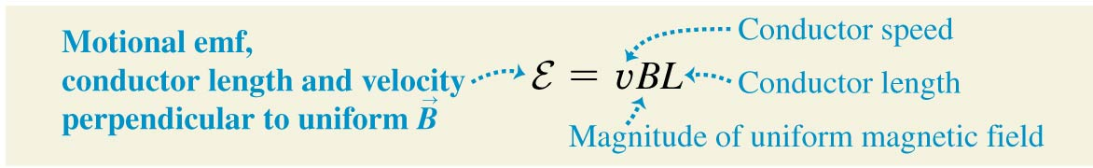
November 7 Motional Emf
29.4 Motional electromotive force
In the figure, a conducting rod is moving in a uniform magnetic field. The magnetic force on the charge in the conductor is F= qvB. This force pushes the charge upward, which causes excessive positive and negative charges to accumulate on the two ends of the rod. These excessive charges produce an electric field, whose force eventually cancels the magnetic force on the charge in the conductor: qE=qvB, V_{ab}=vBL.
If we slide the rod on a U-shape conductor, a current will flow through the circuit. The moving rod is a source of emf, which is called a motional electromotive force. When v, B, and L are mutually perpendicular to each other:
The direction of the emf follows the direction of the magnetic force on a positive charge in the wire.

Slide 9
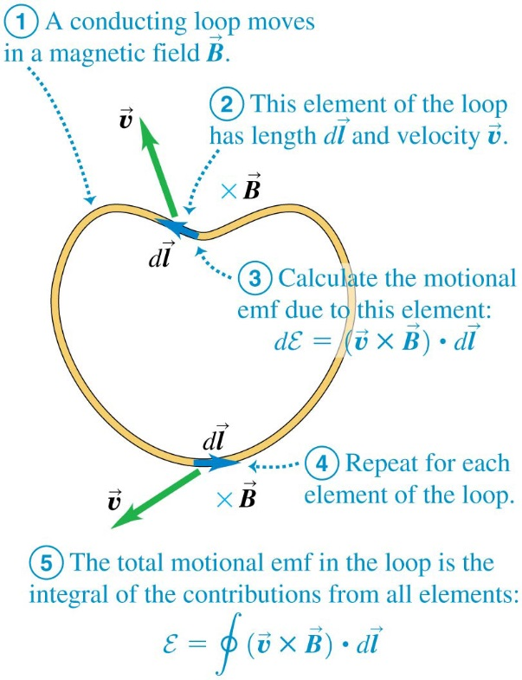

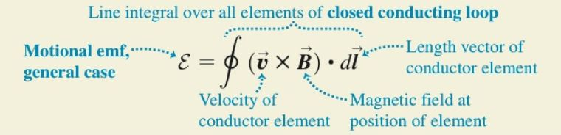
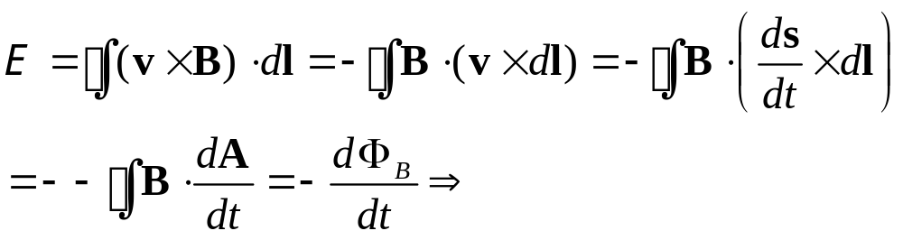
General form of motional emf:
For a line element, the motional emf is
Note that this is the volume enclosed by v, B, and d l.
dE is nonzero only when the wire is cutting the magnetic field lines.
For a closed conducting loop:
Motional emf is a special case of Faraday’s law.
Example 29.9 Motional emf in the slide-wire generator
Example 29.10 The Faraday disk dynamo
Test 29.4

Slide 10
Read: Ch29: 4
Homework: Ch29: 25,26,27,29
Due: November 14

Slide 11
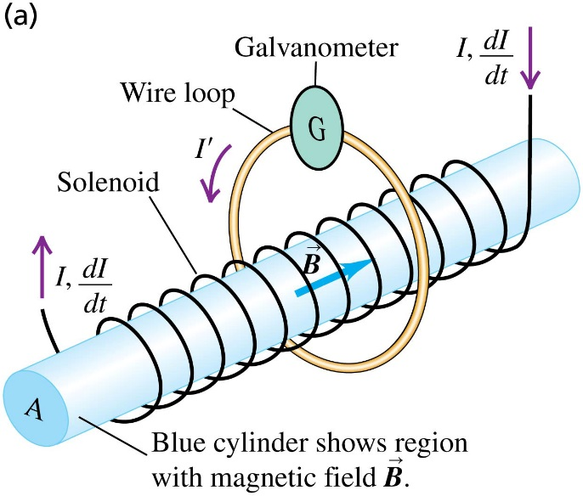
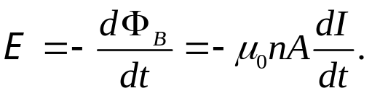
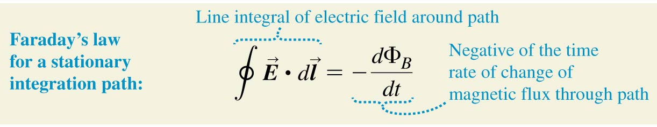
November 10 Induced Electric Fields
29.5 Induced electric fields
In the figure, a long and thin solenoid is encircled by a circular conducting loop. According to Faraday’s law, there is an induced emf in the loop:
This emf causes an induced current in the loop: I'=E /R.
There must be an electric field inside the loop to drive the current. Therefore, a changing magnetic field has caused an induced electric field.

Slide 12
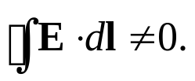
Non-electrostatic electric field:
A time-varying magnetic field causes an induced electric field.
The electric field is induced even when no conductor is present.
It does not require the existence of charges in space.
The induced electric field is non-conservative. The line integral around a closed
path is not zero:
It is called a non-electrostatic electric field.
You cannot define an electric potential for a non-electrostatic electric field.
Example 29.11 Induced electric field
Test 29.5

Slide 13
Read: Ch29: 5-6
Homework: Ch29: 34,35,36
Due: November 21

Slide 14
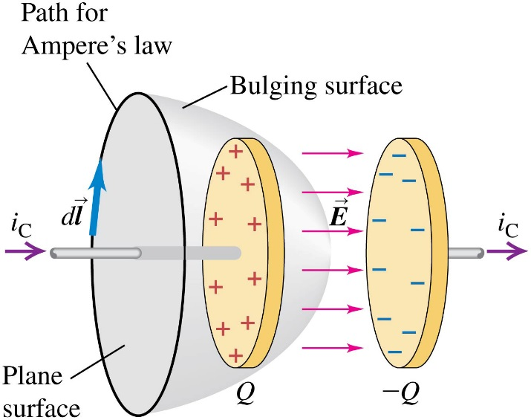
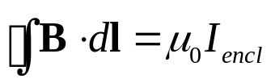
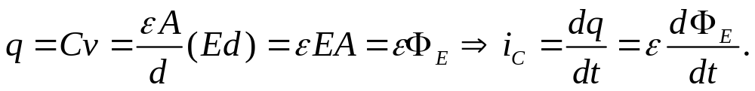

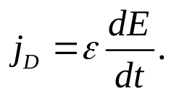
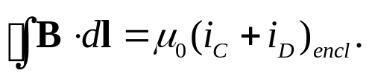
November 12 Maxwell’s Equations
29.7 Displacement current and Maxwell’s equations
Displacement current:
We apply Ampere’s law, , to a charging capacitor. For the plane circular area, I_{encl} is the conduction current i_{C}. The surface that bulges out to the right is bounded by the same circle, but the current through the surface is zero. This leads to a contradiction. When charging the capacitor,
We then define a fictitious displacement current
The consequent displacement current density is
Ampere’s law is now revised to

Slide 15
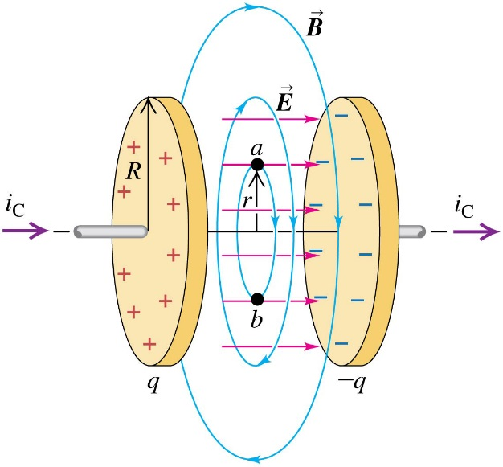
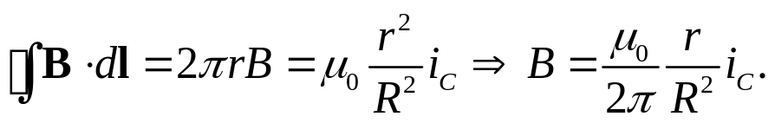
The reality of displacement current:
In reality, a magnetic field is detected inside a charging capacitor, whose magnitude is exactly given by Ampere’s law:
A time-varying electric field produces a displacement current, which is a source of magnetic field.

Slide 16
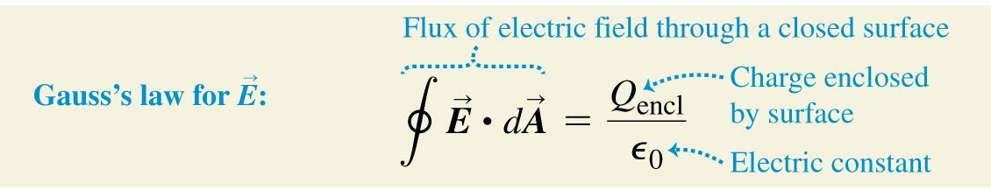
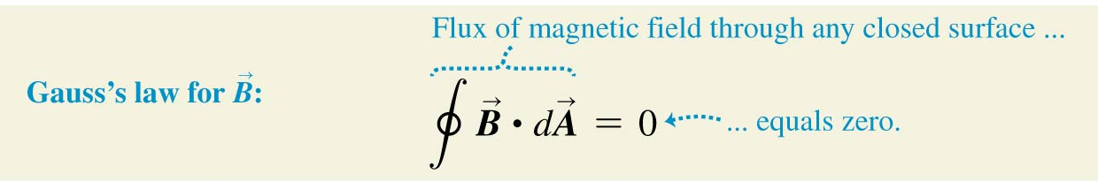
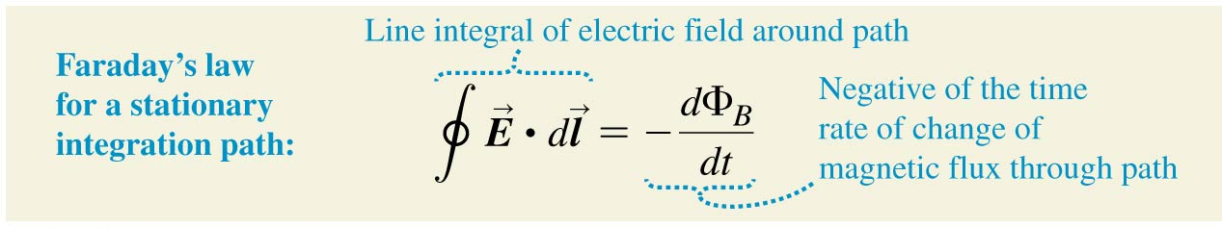
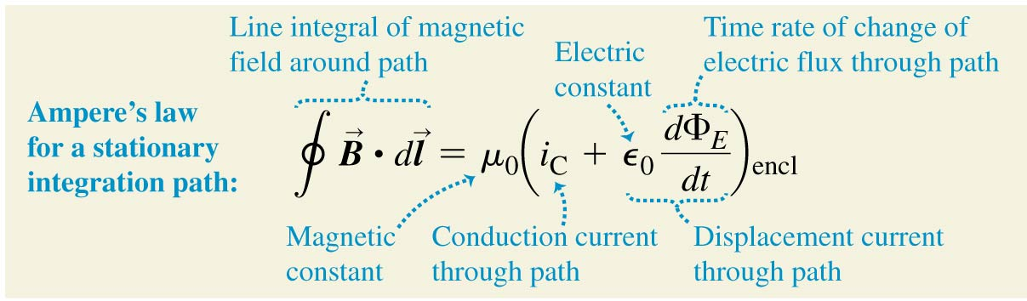
Maxwell’s equations of electromagnetism:
In classical physics, all the relationships between the electric and magnetic fields and their sources are summarized in four equations, called Maxwell’s equations.
1. Gauss’s law for
electric field:
2. Gauss’s law for
magnetic field:
3. Faraday’s law:
4. Ampere’s law:

Slide 17
Read: Ch29: 7
Homework: Ch29: 38,39
Due: November 21

