Slide 1
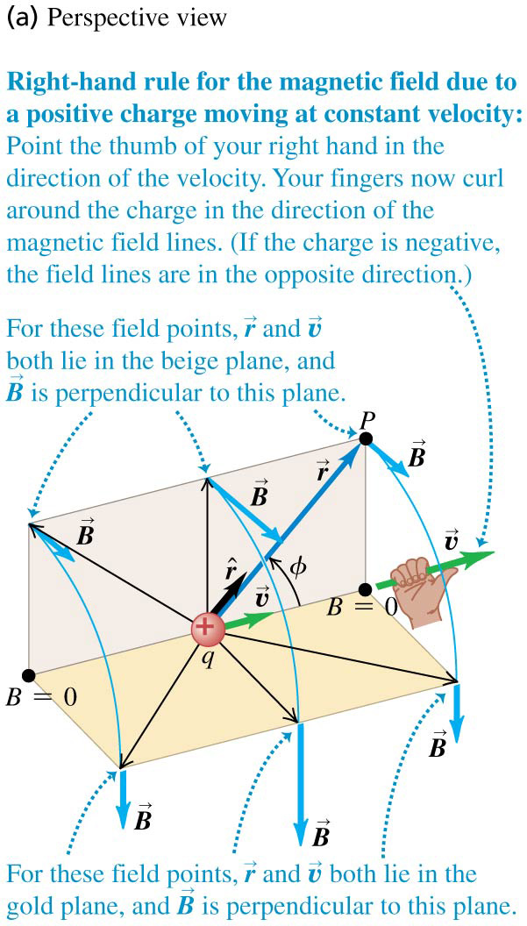
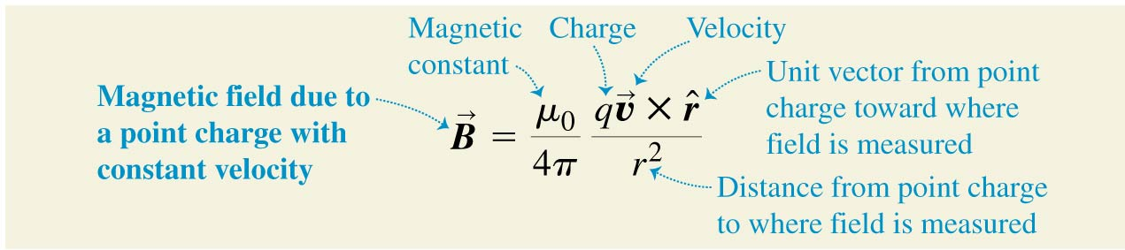

Chapter 28 Sources of Magnetic Field
October 27 Biot-Savart Law
28.1 Magnetic field of a moving charge
Experiment shows that the magnetic field generated by a moving charge at constant velocity is given by.
μ₀=4π × 10⁻⁷ T·m/A is the magnetic constant.
is the unit vector from the source to the field point.
The magnitude of B depends on the direction of r.
The direction of B is determined by the right-hand rule:
Grab the charge by your right hand, and let your thumb point in the direction of the velocity of the charge. Your fingers are now curling in the direction of the magnetic field lines.

Slide 2
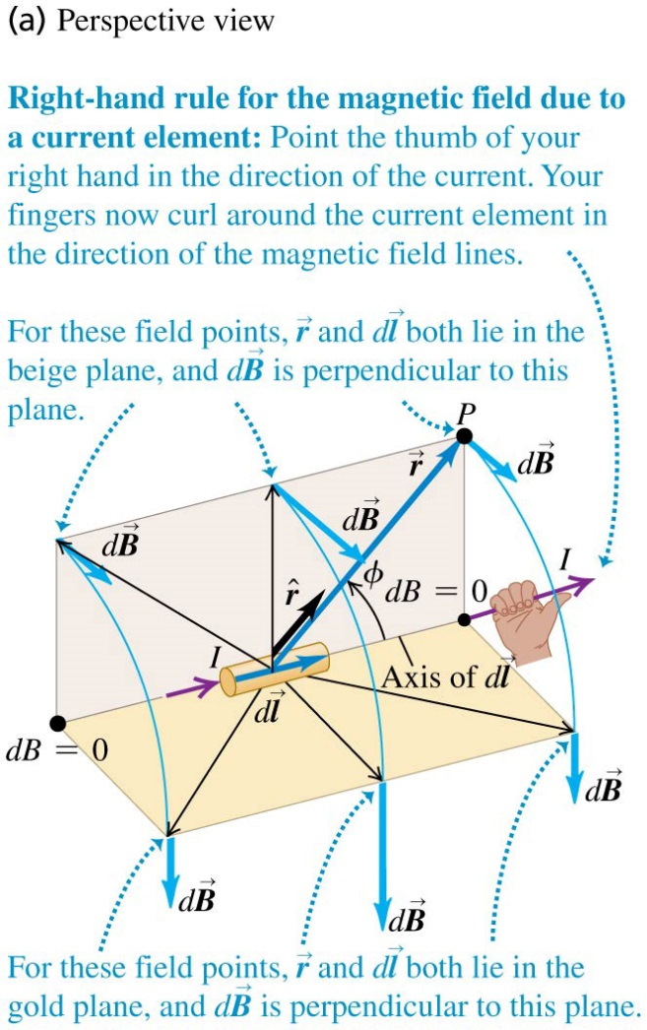
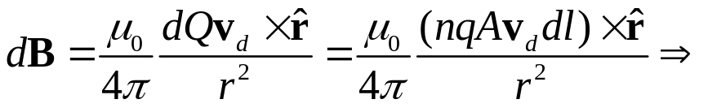
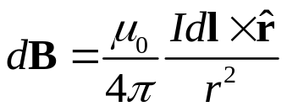
Example 28.1 Forces between two moving protons
Note that the ratio between the magnetic force and the electric force is v²/c².
Test 28.1
28.2 Magnetic field of a current element
Principle of the superposition of magnetic fields: The total magnetic field of several moving charges is the vector sum of each field.
Let d l be a line segment in the current direction. There are dQ= nqAdl charge in the segment. The magnetic field produced by this line element is
Biot-Savart Law:
Id l is the current element.
The direction of B is determined by the right-hand rule.

Slide 3
Example 28.2 Magnetic field of a current segment
Test 28.2

Slide 4
Read: Ch28: 1-2
Homework: Ch28: 4,6,10,13
Due: November 7

Slide 5
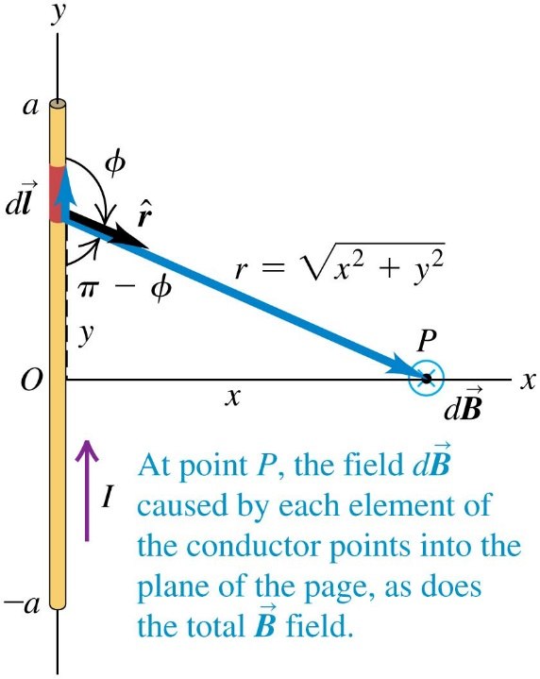
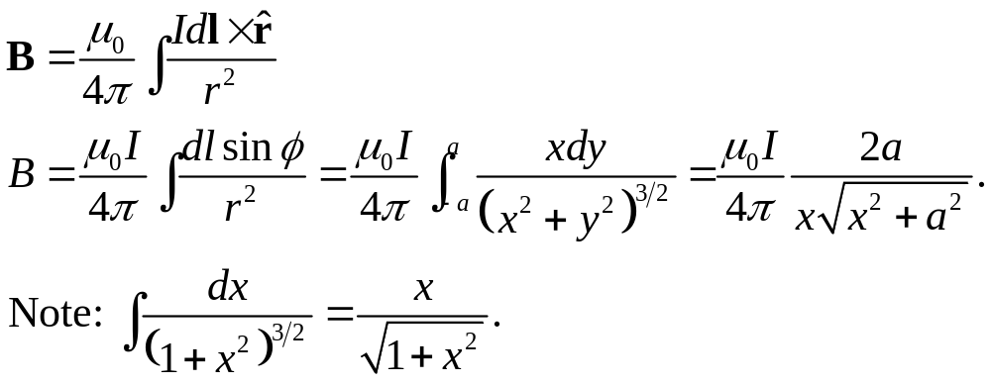
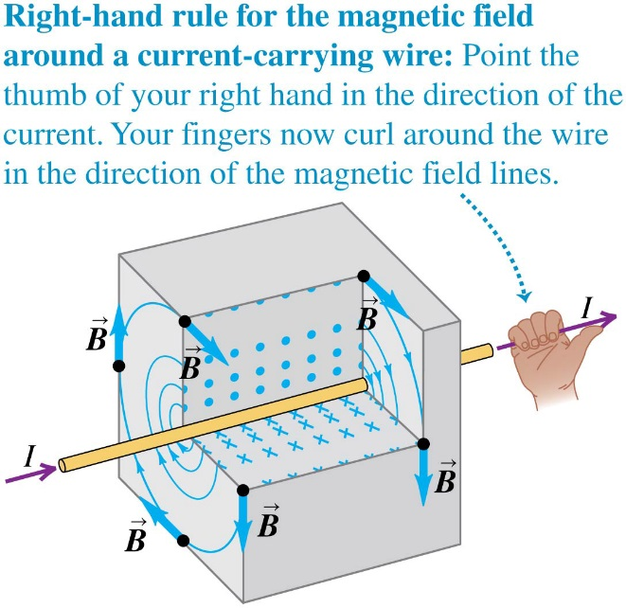
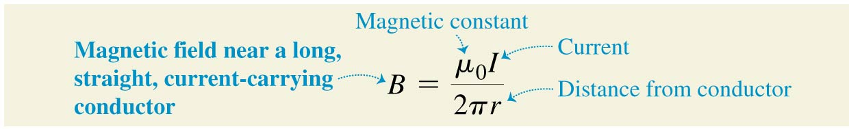
October 29 Straight Current Lines
28.3 Magnetic field of a straight current-carrying conductor
We try to find the magnetic field produced by a straight conductor with length 2a and current I.
When the length of the wire 2a approaches infinity, we have
The magnetic field lines around a long, straight, current-carrying conductor are circles, with directions determined by the right-hand rule.

Slide 6
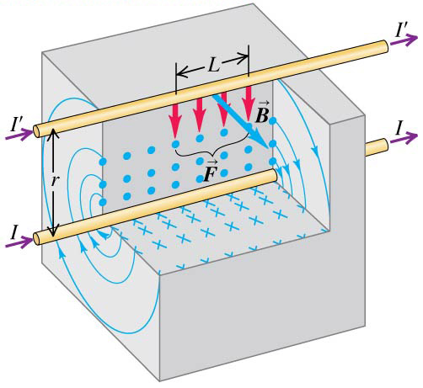
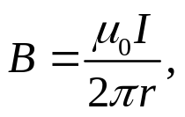
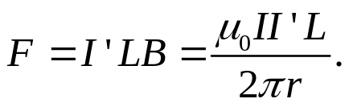
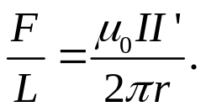
Example 28.3 Magnetic field of a single wire
Example 28.4 Magnetic field of two wires
Test 28.3
28.4 Force between parallel conductors
Let us find the magnetic force between two long and parallel current lines. The magnetic field produced by the lower conductor at the place of the upper conductor is
which exerts a force onto the upper conductor
as
The magnetic force per unit length between the wires is
The force is attractive when the two currents are in the same direction; it is repulsive when they are in the opposite directions.
Newton’s third law applies.

Slide 7
Example 28.5 Forces between parallel wires
Test 28.4

Slide 8
Read: Ch28: 3-4
Homework: Ch28: 18,22,29,30
Due: November 7

Slide 9
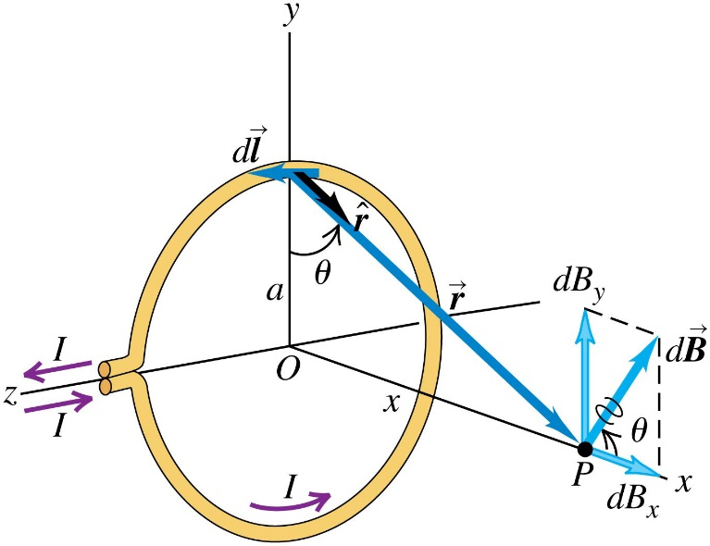
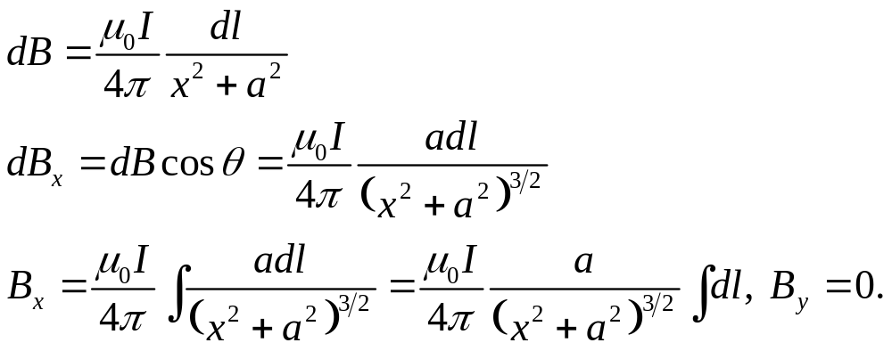
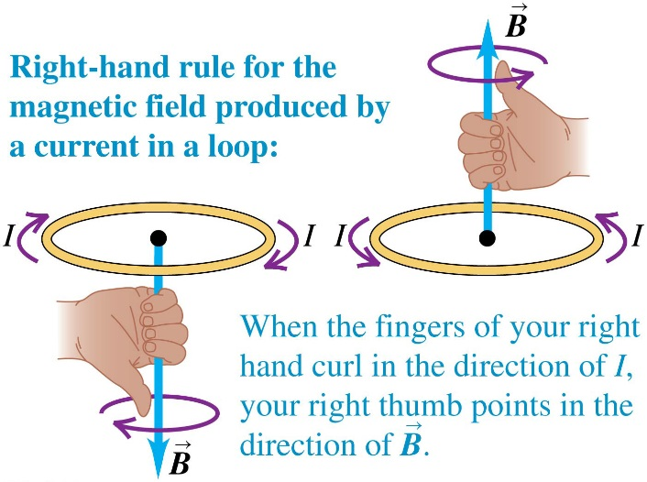
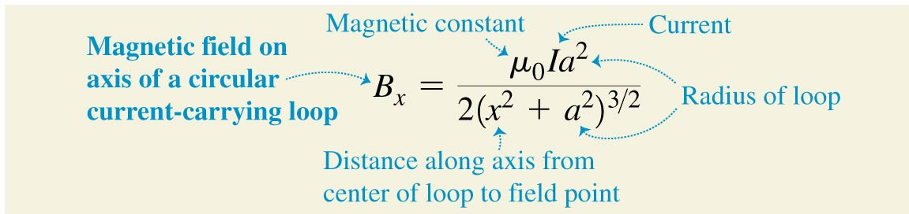
October 31 Circular Current Loop
28.5 Magnetic field of a circular current loop
A circular conductor with radius a carries a counterclockwise current I. Let us calculate the magnetic field on the axis of the loop.
The directions of the magnetic field are determined by the right-hand rule.

Slide 10
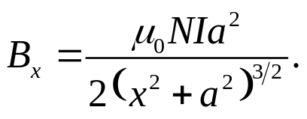
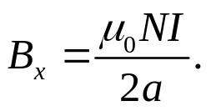

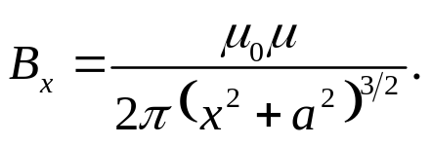
Magnetic field on the axis of a coil:
For a coil consisting of N closely spaced loops with the same radius a, the magnetic field on the axis of the coil is
The maximum field occurs at the center of the coil:
The magnetic dipole of the coil is
A magnetic dipole is a source of magnetic field:
Example 28.6 Magnetic field of a coil
Test 28.5

Slide 11
Read: Ch28: 5
Homework: Ch28: 32,34,36
Due: November 7

Slide 12
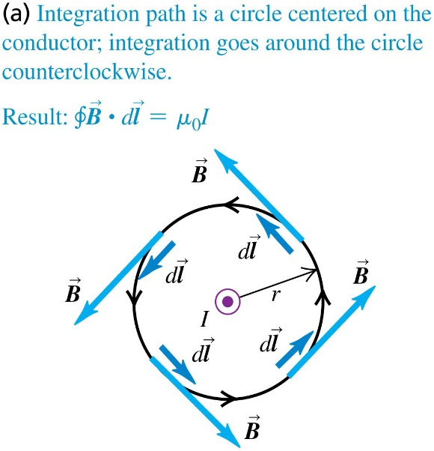
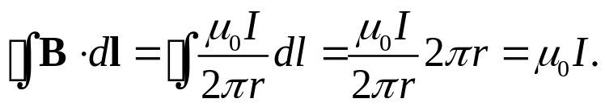
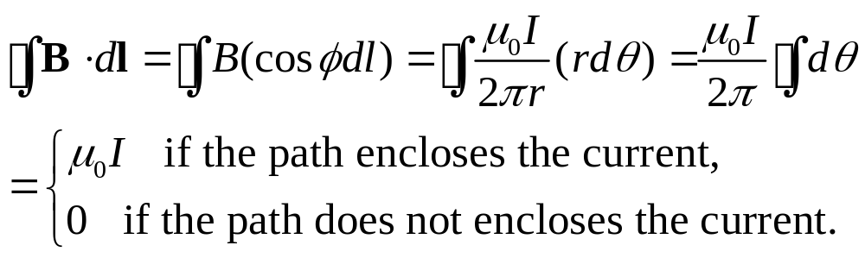
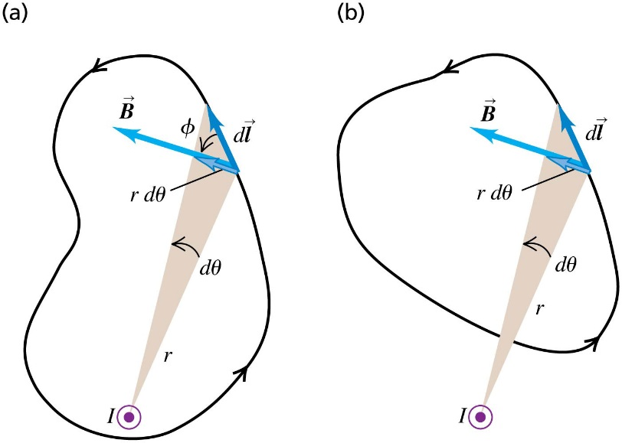
November 3 Ampere’s Law
28.6 Ampere’s law
Ampere’s law for a long, straight conductor:
Let us calculate the line integral of the magnetic field counterclockwise around a closed circle with radius r from a current I :
This result does not depend on the radius of the circle.
We now calculate the line integral along an arbitrary path:

Slide 13
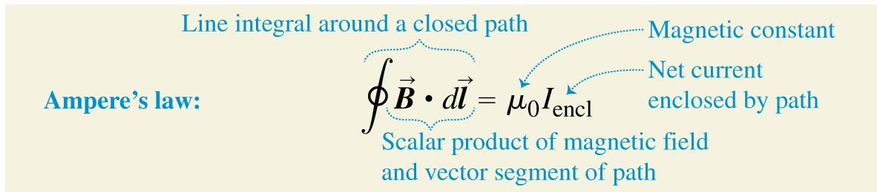

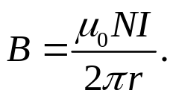
General statement of Ampere’s law:
The line integral of the magnetic field around a closed path is equal to μ₀ times the net current enclosed by the path. The positive direction of the current and the sense of the path follow the right-hand rule.
28.7 Applications of Ampere’s law
Example 28.7 Field of a long, straight, current-carrying conductor
Example 28.8 Field of a long, cylindrical conductor
Example 28.9 Field of a solenoid:
Example 28.10 Field of a toroidal solenoid:
Test 28.6,7

Slide 14
Read: Ch28: 6-7
Homework: Ch28: 38,39,43,44
Due: November 14

