Slide 1
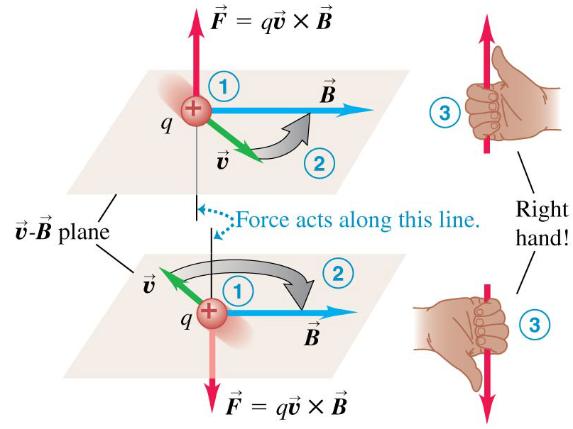

Chapter 27 Magnetic Field and Magnetic Forces
October 17 Magnetic Field
27.2 Magnetic field
The fundamental nature of magnetism is the interaction of moving electric charges. A moving charge creates a magnetic field, which then exerts a force on any other moving charge located in the field. In this chapter we assume the magnetic field is given, and explore what force it exerts on a moving charge or a current. In the next chapter we explore how magnetic fields are created by moving charges and currents.
Magnetic forces on moving charges:
By experiments, the magnetic force on a charge q moving with velocity v is
The direction of F follows the right-hand-rule. F is perpendicular to the plane that contains v and B. F reverses its direction if anyone of q, v, or B is reversed.
The magnitude of F is F = |q|vB sinφ = |q|vB┴. It vanishes when v is parallel to B. It is maximized when v is perpendicular to B.

Slide 2

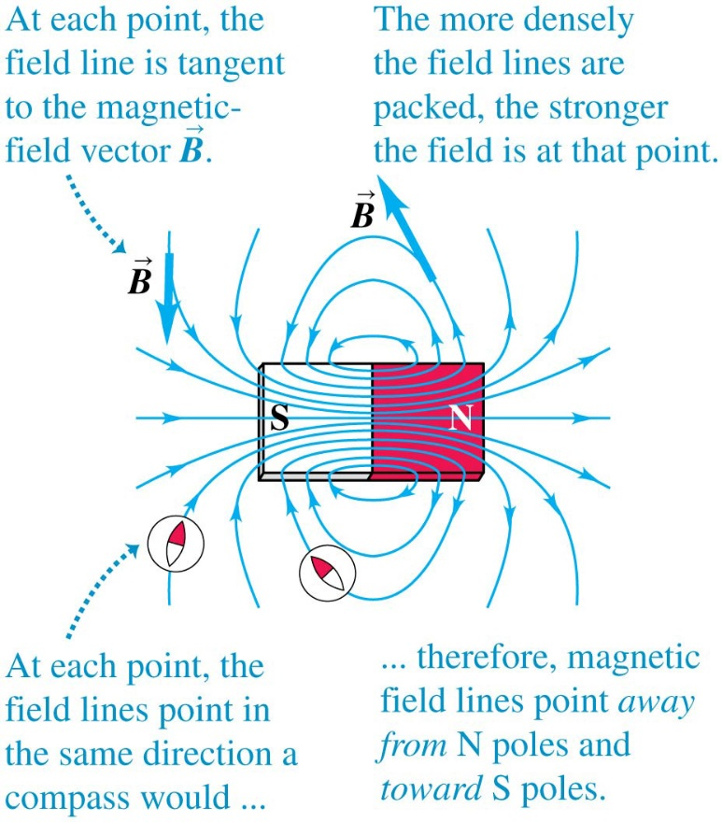
The SI unit of the magnetic field B is tesla (T), 1 T = 1N/A·m.
In practice we also use gauss (G). 1 G =10⁻⁴ T.
It is unfortunate that historically B is given the name “magnetic induction”, and another quantity (H) is given the name “magnetic field”.
When a charged particle moves in a space where both electric and magnetic fields are
present, the total force exerted on the charge is
Example 27.1 Magnetic force on a proton
Test 27.2
27.3 Magnetic field lines and magnetic flux
The magnetic field can be represented by magnetic field lines. On any point of a field line, the line is always tangent to the magnetic field vector at that point.
Outside a magnet, the magnetic field lines point away from the N pole and toward the S pole. Inside a magnet, they point from S to N.
Field lines never intersect.
Magnetic field lines are not lines of magnetic force.

Slide 3
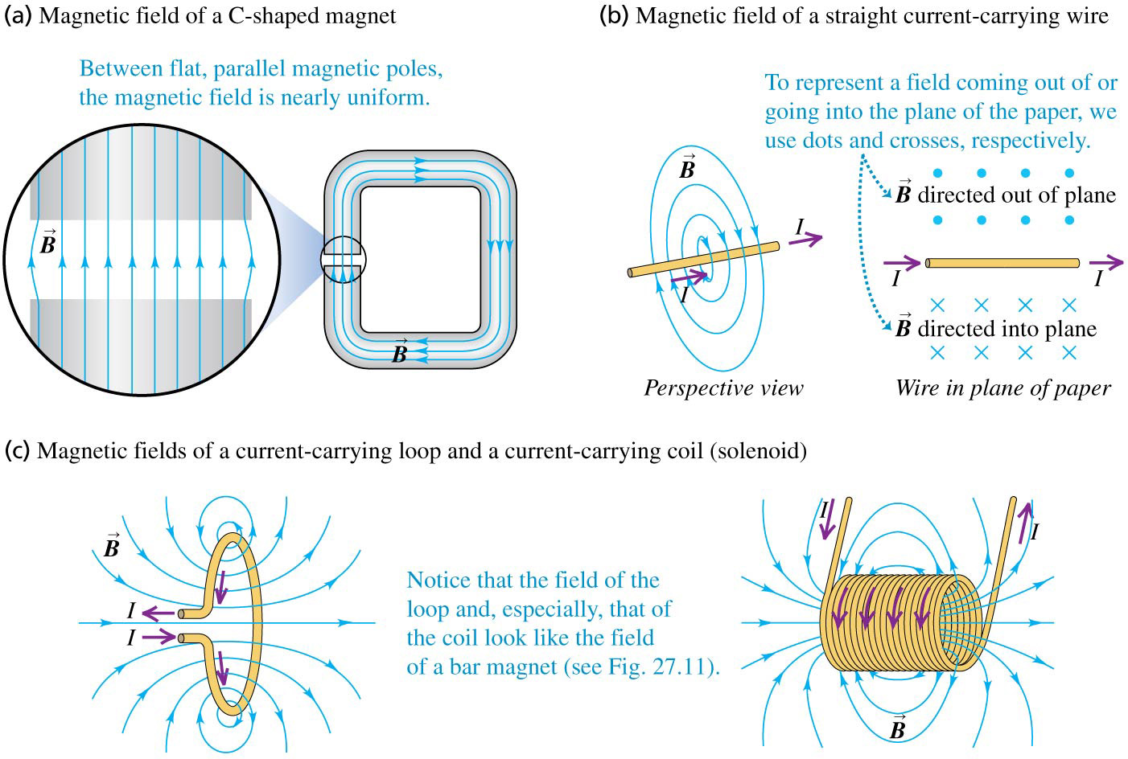
Figure 27.13 Magnetic field lines produced by some common sources of magnetic field.
To represent a field coming out of or going into the plane of the paper, we use dots and crosses.

Slide 4
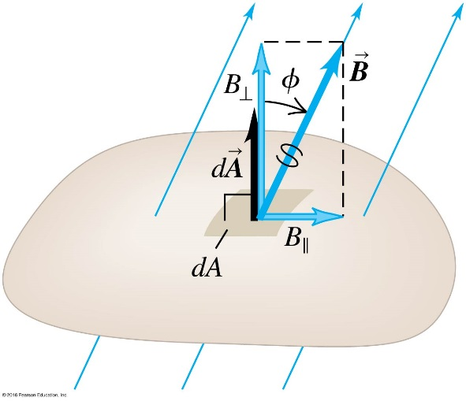
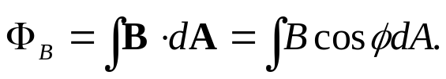
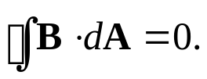
Magnetic flux:
Magnetic flux is defined similarly as we did for electric flux:
The SI unit of the magnetic flux is weber (Wb).
1 Wb = 1 T ∙ m².
No magnetic monopole (magnetic charge) has ever been observed. Every field line that enters a closed surface must also exit from it.
Gauss’s law for magnetism:
The magnetic flux through any closed surface is zero.
Example 27.2 magnetic flux calculations
Test 27.3

Slide 5
Read: Ch27: 1-3
Homework: Ch27: 3,8,9,11
Due: October 24

Slide 6
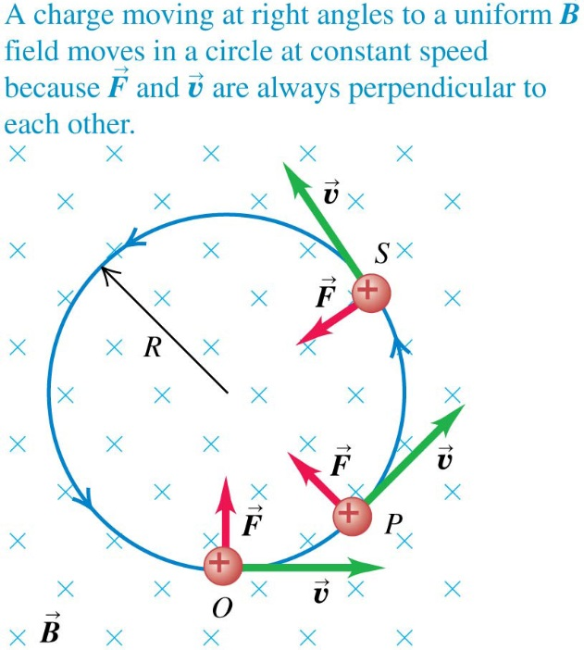
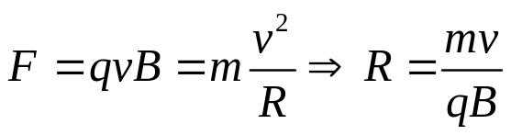
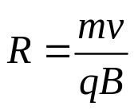
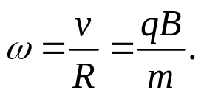
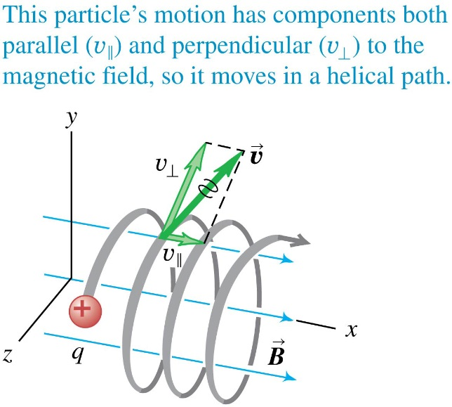
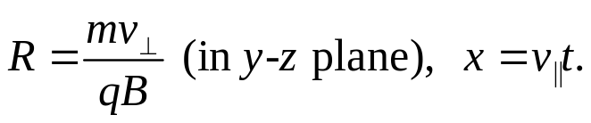
October 20 Particles in Magnetic Field
27.4 Motion of charged particles in a magnetic field
When a charged particle moves in a magnetic field, the magnetic force is always perpendicular to its velocity. Therefore, magnetic force cannot change the speed (the magnitude of velocity) of a particle. Magnetic force won’t do work to a particle.
A charge moving at right angles to a uniform B field moves in a circle at constant speed. The magnetic force acts as the centripetal force.
The angular speed (angular frequency,
cyclotron frequency) of the motion is
If the particle has velocity components parallel the B field, its path is a helix:

Slide 7
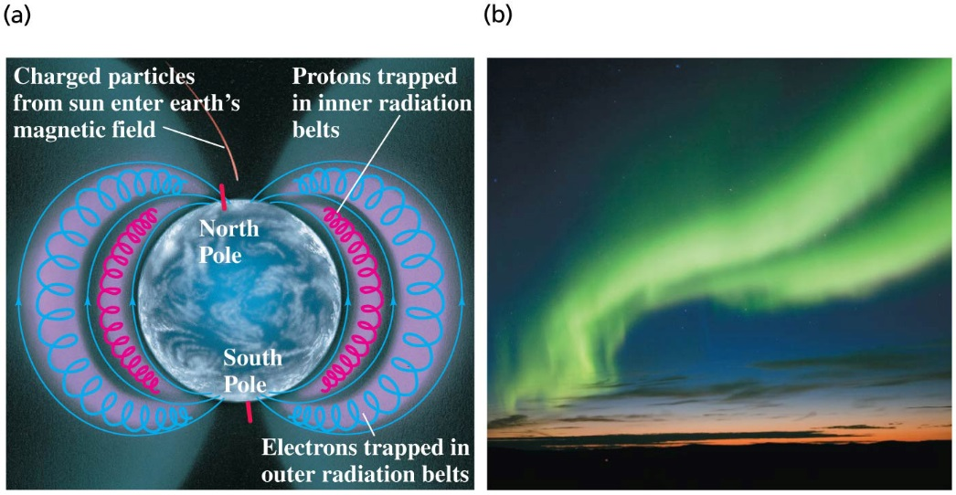
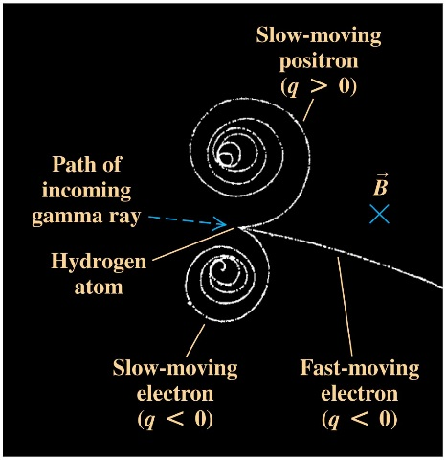
Examples of the motion of charged particles in magnetic field:
Northern lights Electron-positron generation
Example 27.3 Electron motion in a magnetron
Example 27.4 Helical particle motion in a magnetic field
Test 27.4

Slide 8
Read: Ch27: 4
Homework: Ch27: 16,20,22
Due: October 31

Slide 9
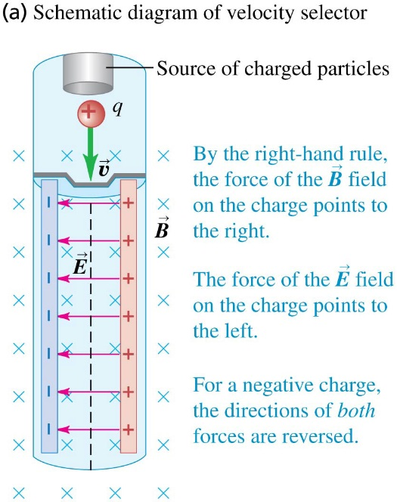
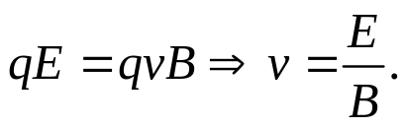
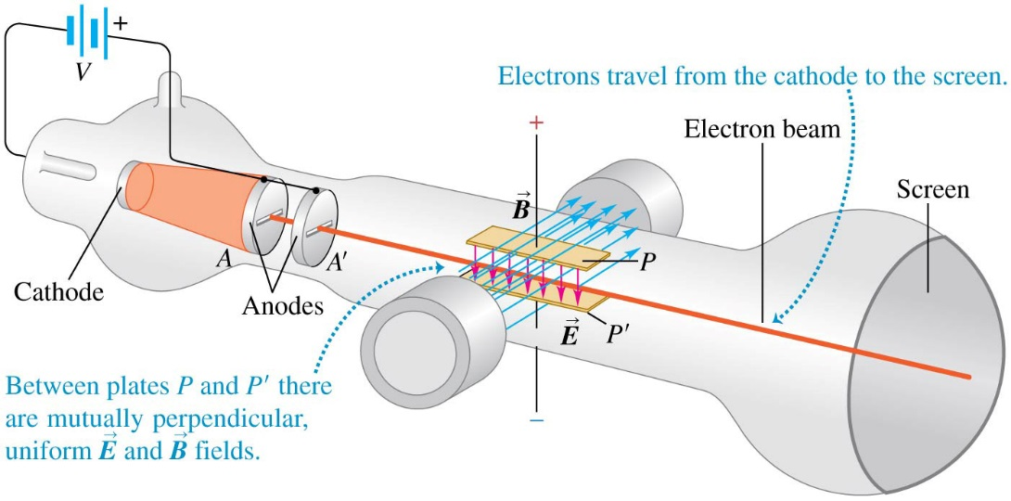
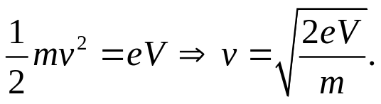
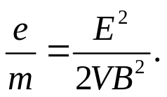
October 22 Applications of Motion of Charged Particles
27.5 Applications of motion of charged particles
Velocity selector:
A velocity selector uses perpendicular electric and magnetic fields to select particles of a specific speed from a beam.
For a particular value of v, the electric force and the magnetic force on the particles can be canceled:
Only these particles are nondeflected in the device.
Thomson’s e/m experiment:
When passing through a potential difference V, the electrons gain velocity
Through a velocity selector we have v=E/B, therefore

Slide 10
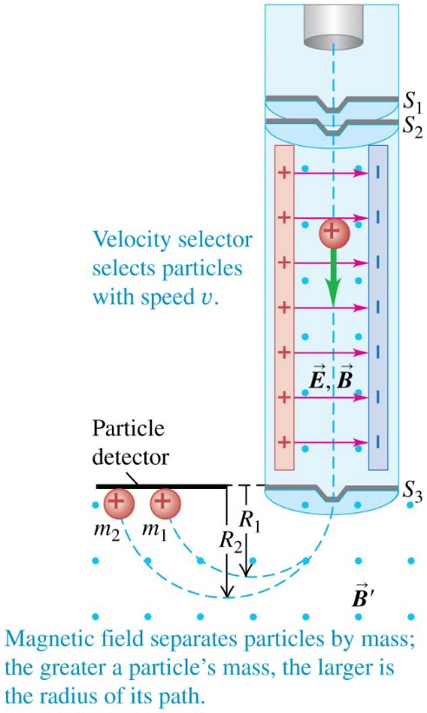
Mass spectrometer:
A velocity selector selects particles with uniform velocity v. In the region with magnetic field B', particles with different masses travels at different radii.
Example 27.5 An e/m demonstration experiment
Example 27.6 Finding leaks in a vacuum system
Test 27.5

Slide 11
Read: Ch27: 5
Homework: Ch27: 24,25,27
Due: October 31

Slide 12
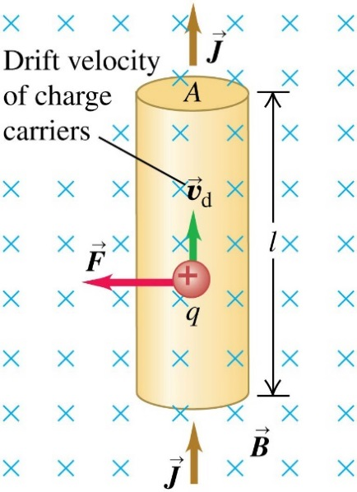

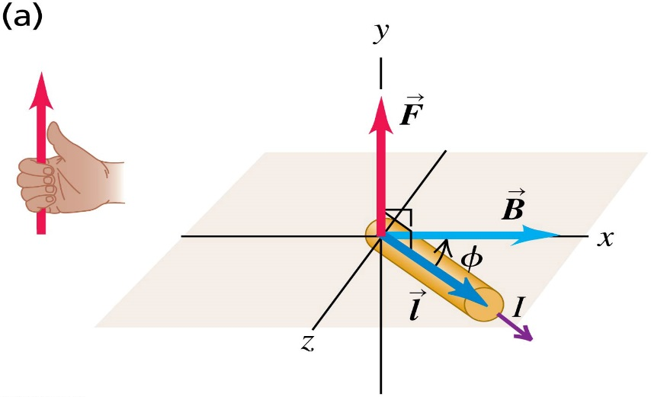

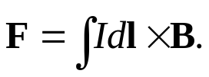
October 23 Magnetic Force on Current
27.6 Magnetic force on a current-carrying conductor
Let v_{d} be the drift velocity, n be the charge density (charge concentration) of the particles. In the figure the total force on the segment of conductor is
In general
Here l (vector length) is along the wire in the current direction.
For an infinitesimal segment conductor,
Id l is the current element.
For a wire of any shape,
F will reverse its direction if either the current or the B field is reversed.

Slide 13
Example 27.7 Magnetic force on a straight conductor
Example 27.8 Magnetic force on a curved conductor
Test 27.6

Slide 14
Read: Ch27: 6
Homework: Ch27: 32,33,34
Due: October 31

Slide 15
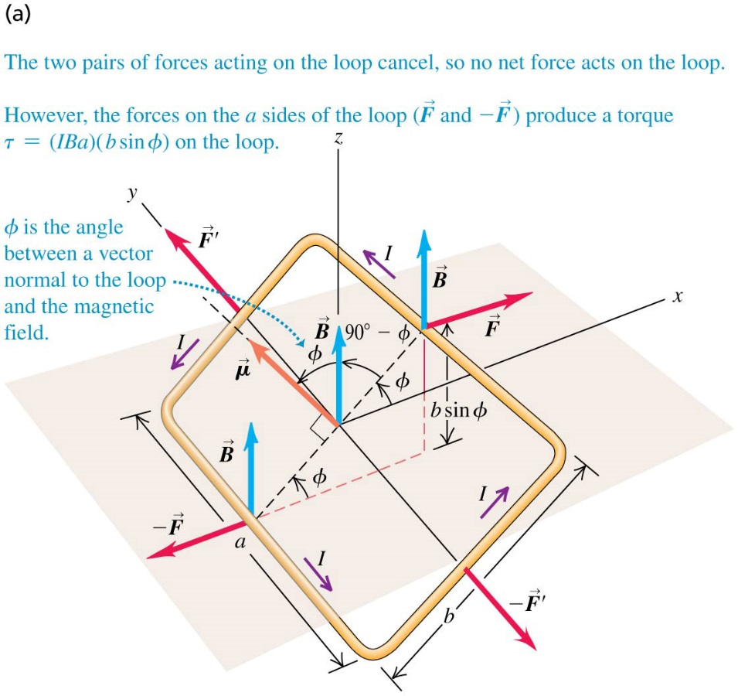
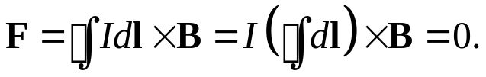

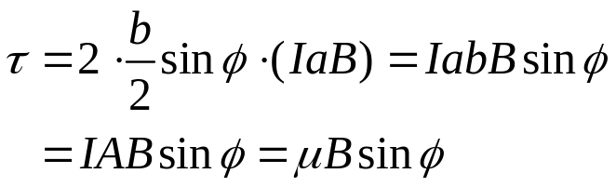


October 24 Magnetic Dipoles
27.7 Force and torque on a current loop
Net force on a current loop in a uniform magnetic field:
The net force on a current loop in a uniform magnetic field is zero.
In the figure on a rectangular loop we have
Torque on a current loop in a uniform magnetic field:
On a rectangular loop
Define magnetic moment (magnetic dipole) as
The vector form of magnetic torque is then

Slide 16



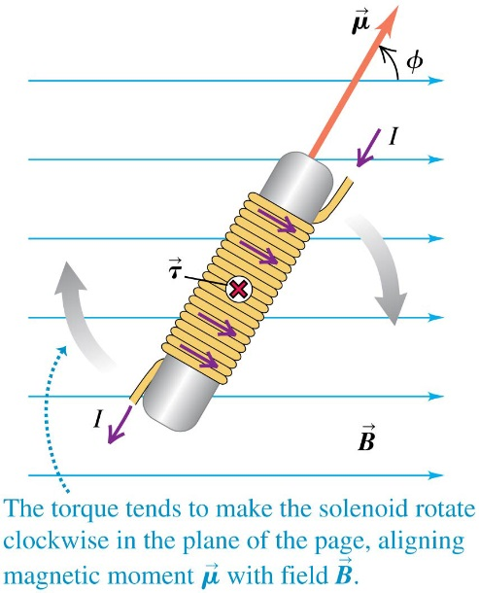

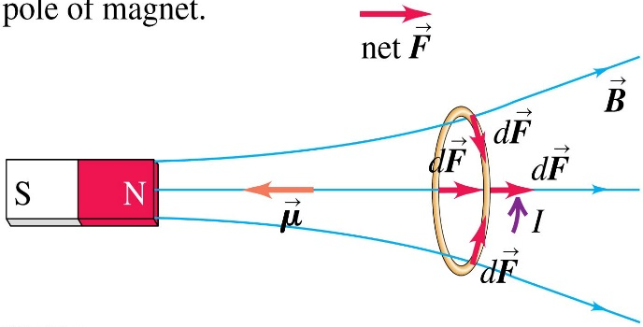
Potential energy of a magnetic dipole:
Similar to electric dipole, which has torque and potential energy
The potential energy of a magnetic dipole in a magnetic field is
Magnetic torque on coils:
For a solenoid coil, the total torque in a uniform magnetic field is
Here N is the total number of turns.
Magnetic dipole in a nonuniform magnetic field:
In the figure, a current loop with magnetic moment pointing to the left is in a nonuniform magnetic field. When all forces are summed to find the net force on the loop, the radial components cancel, so the net force is to the right.
A current loop behaves like a magnet with its magnetic moment pointing internally from its S pole to its N pole.

Slide 17
Example 27.9 Magnetic torque on a circular coil
Confirms that a current loop behaves like a magnet. In a uniform magnetic field it only rotates.
Example 27.10 Potential energy for a coil in a magnetic field
Test 27.7

Slide 18
Read: Ch27: 7-9
Homework: Ch27: 36,38,41
Due: October 31

