Slide 1
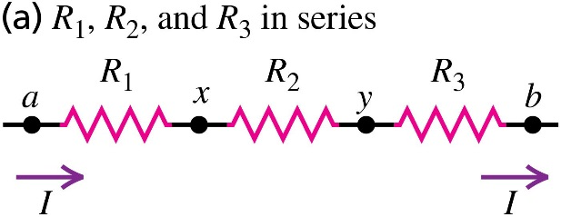


Chapter 26 Direct-Current Circuits
October 8 Resistor Combinations
26.1 Resistors in series and in parallel
For any combination of resistors, we can always find a single resistor that could replace the combination and result in the same total current and potential difference. The replacement has no influence on the part of the circuit outside of the combination. The resistance of this single resistor is called the equivalent resistance of the combination.
Resistors in series:
When the resistors are in series, the current is the same in each of the resistors, while the voltage across the entire combination is the sum of the voltages on each individual resistor.
The equivalent resistance of a series combination equals the sum of the individual resistances. The equivalent resistance is greater than any individual resistance.
It follows that , the larger resistor has more voltage.

Slide 2
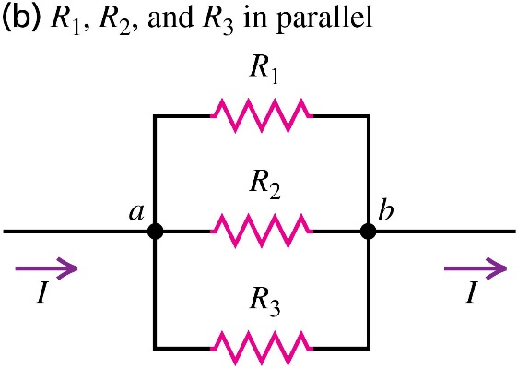
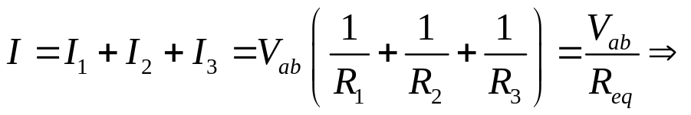
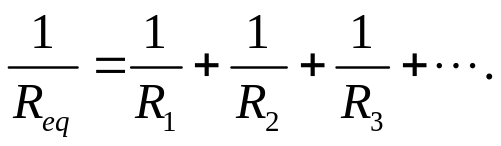
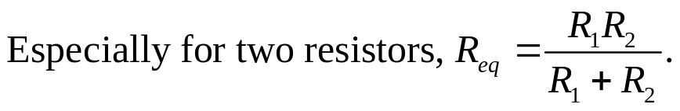
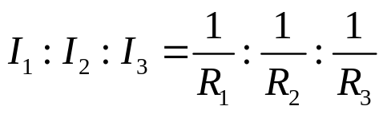
Resistors in parallel:
When the resistors are in parallel, the voltage is the same across each resistor, while the total current through the entire combination is the sum of currents through each individual resistor.
The reciprocal of the equivalent resistance of a parallel combination equals the sum of the reciprocals of the individual resistances. The equivalent resistance is always less than any individual resistance.
It follows that , the smaller resistor carries more current.
Example 26.1 Equivalent resistance
Example 26.2 Series versus parallel combinations
Test 26.1

Slide 3
Read: Ch26: 1
Homework: Ch26: 4,7,11,17
Due: October 17

Slide 4


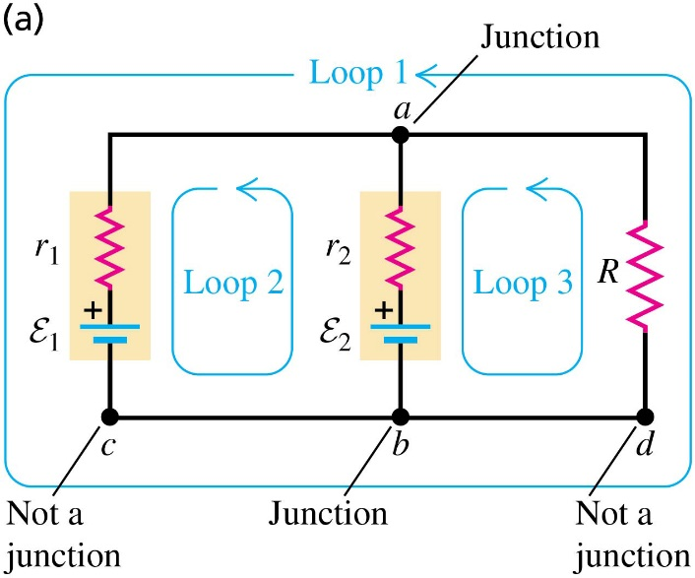
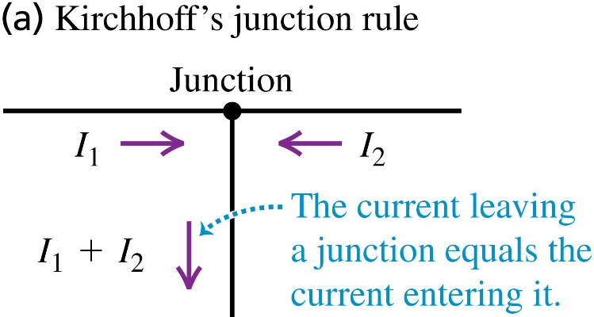
October 13 Kirchhoff’s Rules
26.2 Kirchhoff’s Rules
Many resistor networks cannot be reduced to simple series or parallel combinations. For analyzing complicated networks, we need Kirchhoff’s rules. We define a junction in a circuit as a point where three or more conductors meet. A loop is defined as any closed conducting path.
Kirchhoff’s junction rule:
The sum of the currents into any junction equals zero.
Kirchhoff’s loop rule:
The sum of the potential changes around any loop equals zero.

Slide 5
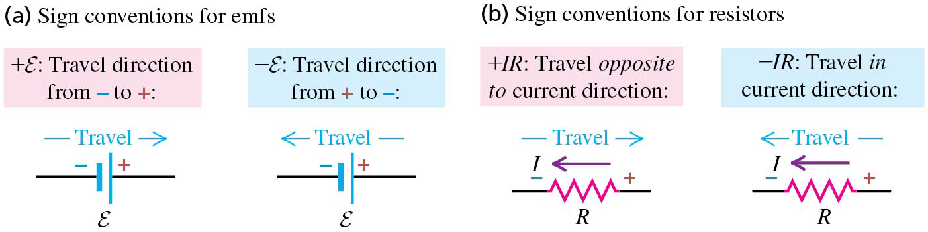
Sign convention of Kirchhoff’s junction rule:
The current is positive when flowing into a junction, and negative when flowing out of a junction.
Sign convention of Kirchhoff’s loop rule:
First assume a current direction, and assume a polarity of a battery in the loop, if they are not given. Don’t worry that our assumptions may be wrong. Then travel around the loop, using the following sign convention for the potential differences (potential changes) through each element.
Note: Not all junctions and loops generate independent equations.
Example 26.3 A single-loop circuit
Example 26.4 Charging a battery
Example 26.5 Power in a battery-charging circuit

Slide 6
Read: Ch26: 2
Homework: Ch26: 22,26,30
Due: October 24

Slide 7
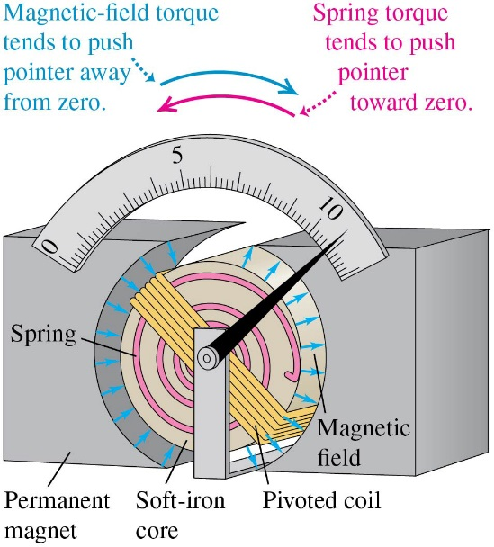
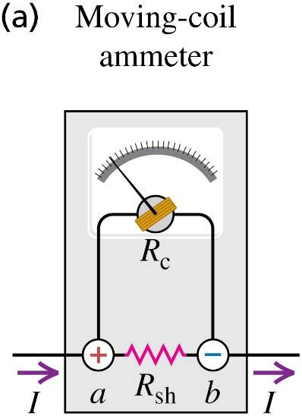
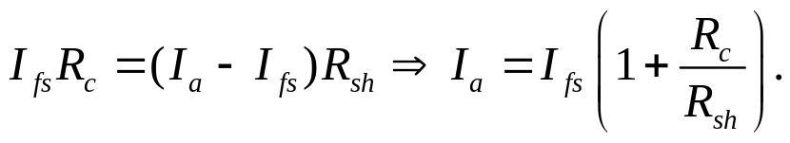
October 15 Ammeters and Voltmeters
26.3 Electrical measuring instruments
Many common devices measure voltage, current, or resistance using a d’Arsonval galvanometer. This meter has a pivoted coil with an attached pointer, a permanent magnet, and a spring opposing the magnetic-field torque on the coil.
The meter deflection is proportional to the current in the coil, and the device can be calibrated to measure current. The maximum deflection of the pointer (I_{fs}) is called the full-scale deflection.
Ammeters:
A current-measuring instrument is called an ammeter. An ammeter measures the current passing through it. An ideal ammeter has zero resistance.
To measure larger current, a shunt resistor R_{sh} is connected in parallel with the meter to bypass the current. In this case the new full scale reading I_{a} is determined by

Slide 8
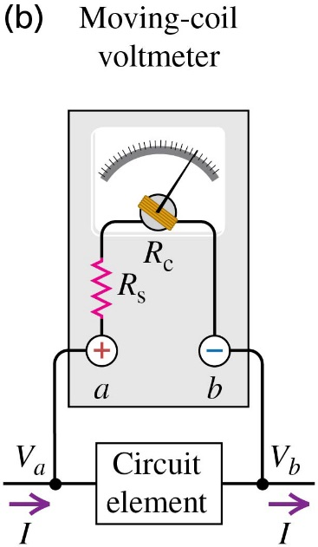

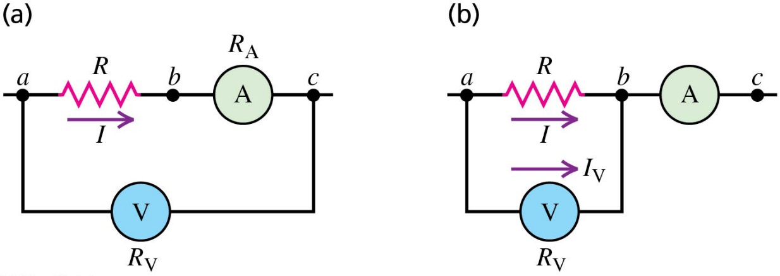
Voltmeters:
A voltage-measuring device is called a voltmeter. A voltmeter measures the potential difference between two points. An ideal voltmeter has infinite resistance.
To measure larger voltage, a series resistor R_{s} is connected in series with the meter to carry away the voltage. In this case the new full scale reading V_{v} is determined by
Ammeters and voltmeters in combination:
In figure a the ammeter measures the correct current I, but the voltmeter reads a little larger than the actual voltage V_{ab}. In figure b the voltmeter measures the correct V_{ab}, but the ammeter reads a little more than the actual current I. In both cases we may need to correct the readings.

Slide 9
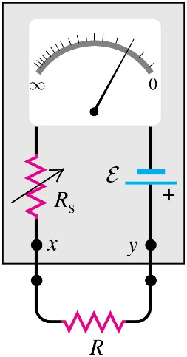
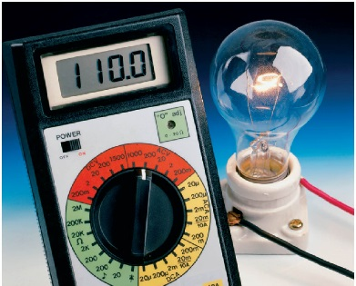
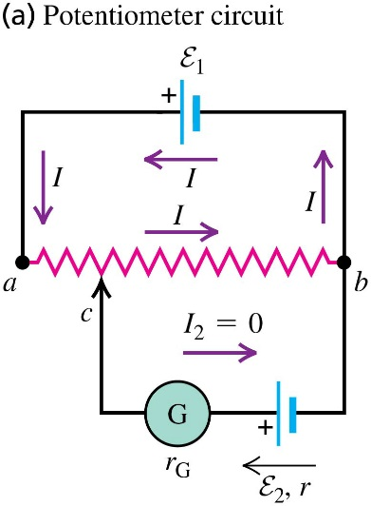
Ohmmeters:
An ohmmeter consists of a meter, a resistor, and a source connected in series. The ohmmeter is designed in such a way that when the two terminals are short-circuited the meter deflects the full scale. When the two terminals are open, the meter has no deflection.
Digital multimeters:
Nowadays a digital multimeter can be used to measure current, voltage, resistance and other parameters quite easily. Every house-hold needs one, and everybody should learn how to use it.
Potentiometers:
A potentiometer is an instrument used to measure the emf of a source without drawing any current from the source. In the figure shown, contact c is moved until the galvanometer shows no deflection; this corresponds to I₂=0. Then E₂= I R_{cb}.
The term potentiometer is also used for a variable resistor.

Slide 10
Example 26.8 Designing an ammeter
Example 26.9 Designing a voltmeter
Example 26.10 Measuring resistance I
Example 26.11 Measuring resistance II

Slide 11
Read: Ch26: 3
Homework: Ch26: 33,35
Due: October 24

Slide 12
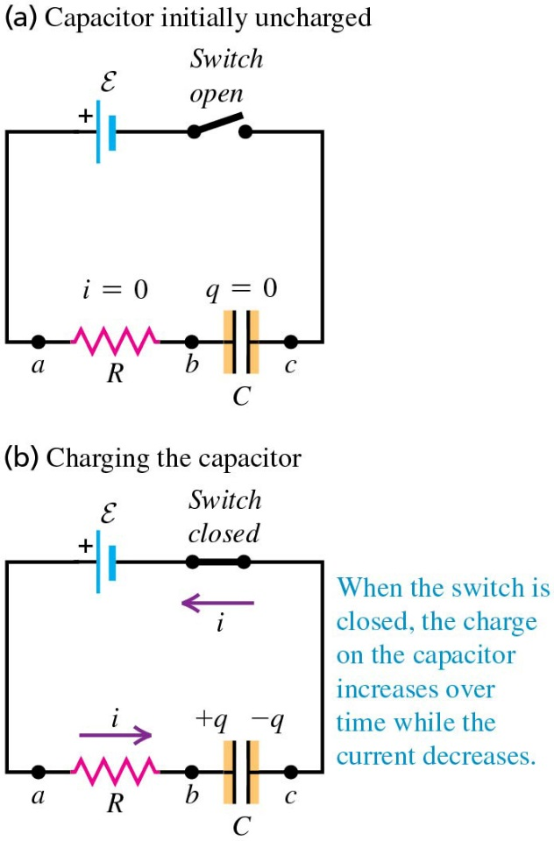
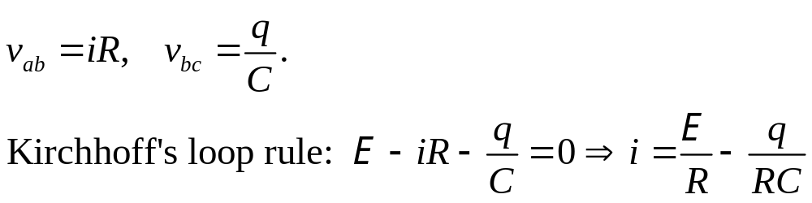
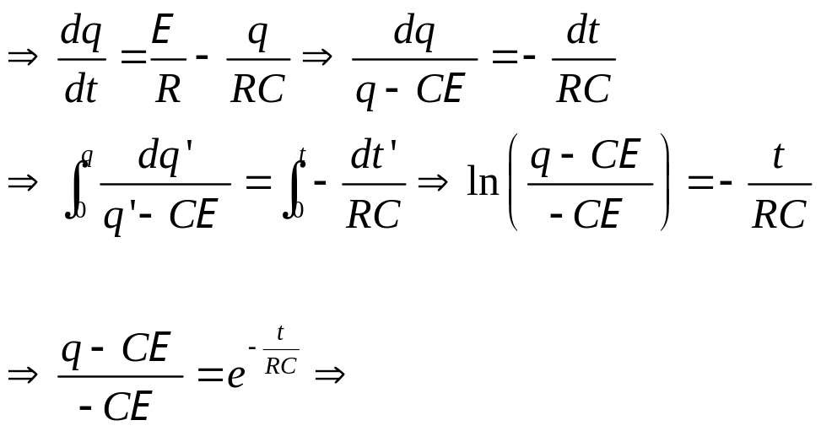
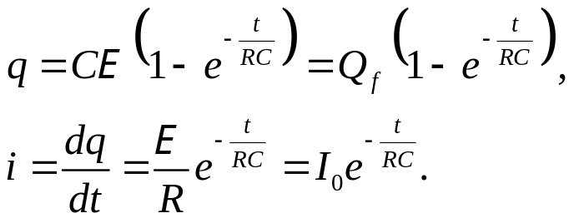
October 16 R-C Circuits
26.4 R-C circuits
Charging a capacitor:
When the switch is closed, the charge on the capacitor increases over time. Let q, i, and v_{bc} be the instantaneous charge, current and voltage on the capacitor.

Slide 13
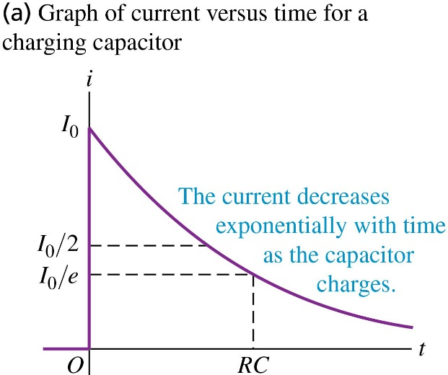
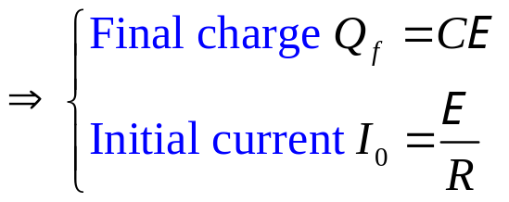
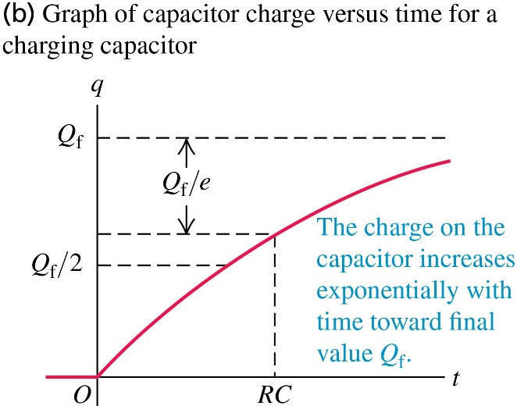
Time constant:
The product RC is called the time constant τ. At t = τ, the current decreases to 1/e = 0.368 ≈ 1/3 of its initial value, and the charge has reached 1−1/e = 0.632 ≈ 2/3 of its final value.

Slide 14
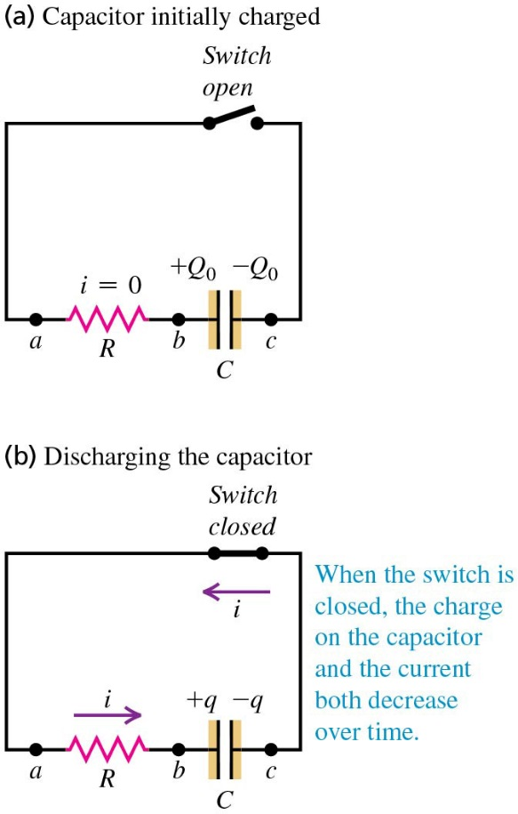
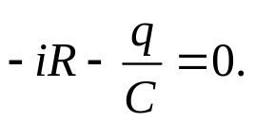
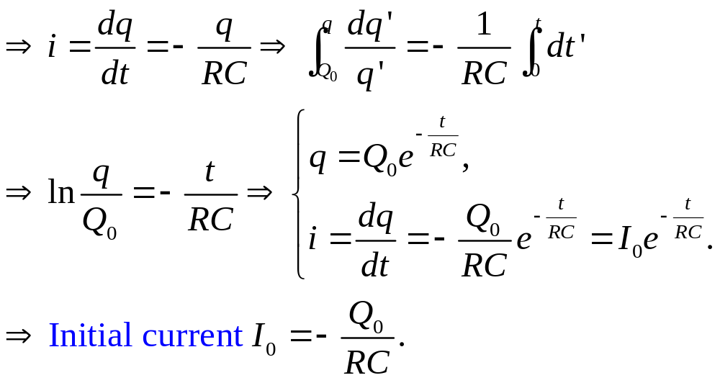
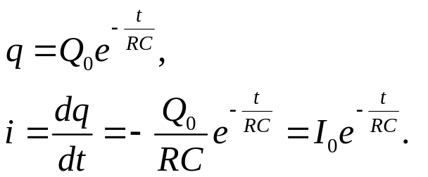
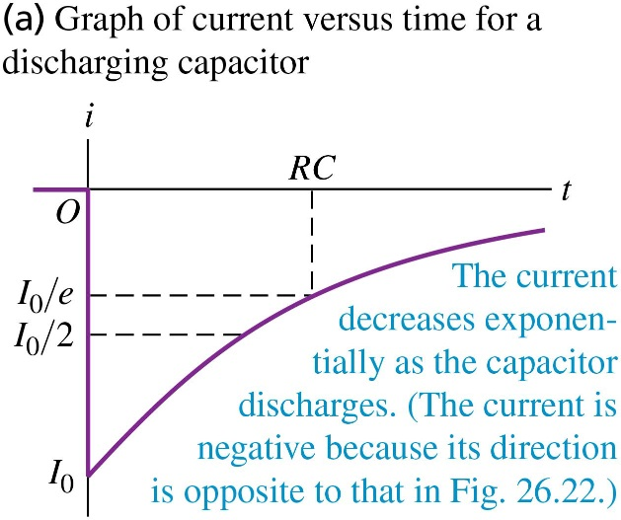
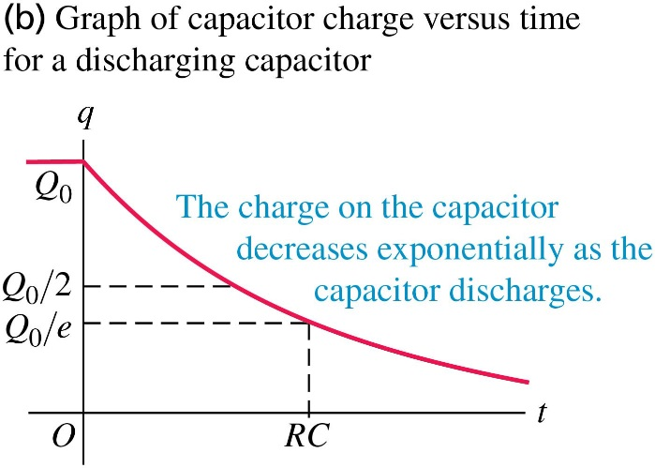
Discharging a capacitor:
Now Kirchhoff’s loop rule gives

Slide 15
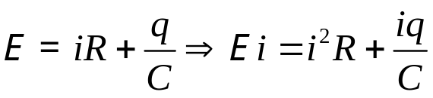
Energy in charging a capacitor:
Of the power E i supplied by the battery, part is dissipated in the resistor (i²R), and part is stored in the capacitor (iq/C).
The total energy supplied by the battery is E Q_{f}. The total energy stored in the capacitor is Q_{f} E /2. Therefore, of the energy supplied by the battery, exactly half is stored in the capacitor, and the other half is dissipated in the resistor.
Example 26.12 Charging a capacitor
Example 26.13 Discharging a capacitor
Test 26.4

Slide 16
Read: Ch26: 4-5
Homework: Ch26: 39,43,48
Due: October 24

