Slide 1
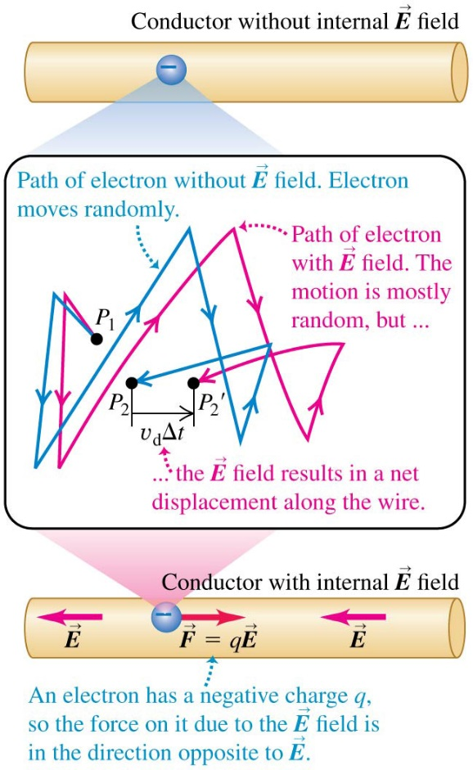
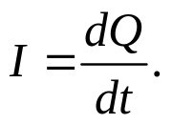
Chapter 25 Current, Resistance, and Electromotive Force
September 26 Current
25.1 Current
A current is a motion of charge.
If there is no electric field in a conductor, the free electrons inside move randomly in all directions at a high speed of 10⁶ m/s, but they do not escape from the surface of the conductor.
If there is an electric field inside the conductor, the electric force causes a slow drift velocity v_{d} of the electrons (10⁻⁴m/s).
Current direction is described by conventional current:
If the charged particles are positive, the direction of the current is the same as the moving direction of the particle. If the charged particles are negative, especially electrons in conductors, the current is in the opposite direction to the actual motion of the particles.
Current through a cross section area A is defined as the net charge flowing through the area per unit time:
The unit of current is ampere, 1 A = 1 C/s.
Current is a scalar.

Slide 2
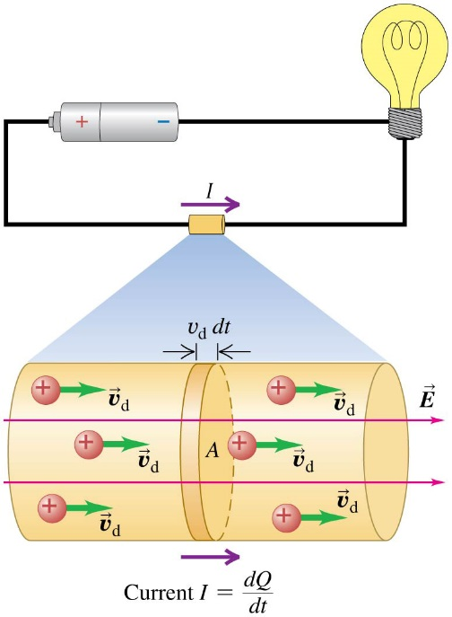
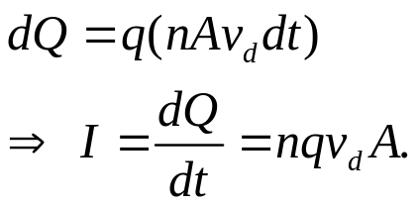
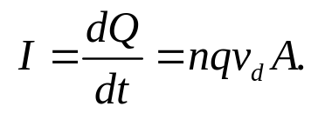
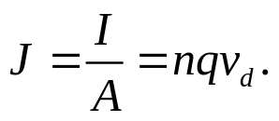

Current, Drift Velocity, and Current Density:
Let n be the concentration (number density) of the particles. The charge dQ that flows out of the end of the cylinder during time dt is
Current density is defined as the current per unit cross section area:
We can then define the vector current density:
A current is steady only if the conducting materials form a closed loop, which is called a circuit. In such a steady situation, the current is the same at all cross sections of the circuit.
In a circuit if the direction of the current is always the same, we call it direct current (DC). If the current continuously changes direction, we call it alternating current (AC).
Example 25.1 Current density and drift velocity in a wire.
Test 25.1

Slide 3
Read: Ch25: 1
Homework: Ch25: 2,3
Due: October 3

Slide 4
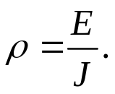
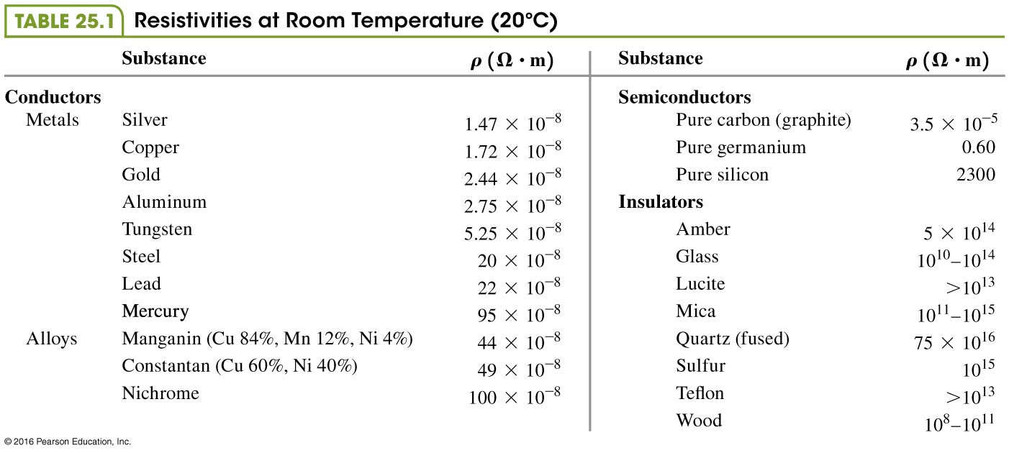
September 29 Resistance
25.2 Resistivity
The current density J in a conductor depends on the electric field E and the properties of the material. For some materials, at a given temperature, J is nearly directly proportional to E. This relationship is called the Ohm’s law, and these materials are said to be ohmic.
Resistivity of a material is defined as
Its unit is V·m/A, or Ω·m.
The reciprocal of resistivity is called the conductivity.

Slide 5

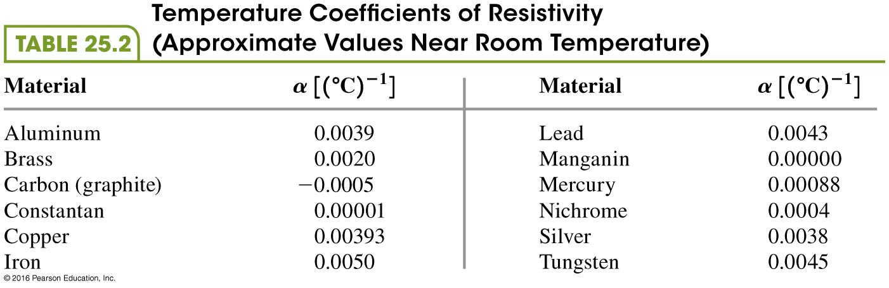
Resistivity and temperature:
The resistivity of a metallic conductor nearly always increases with increasing temperature. As temperature increases, the ions of the conductor vibrate at greater amplitude, making it more likely that a moving electron will collide with an ion.
The resistivity of a metal can be represented
approximately by the equation
Here T₀ is the reference temperature, often 0°C or 20°C. The factor α is called the temperature coefficient of resistivity.
Graphite has a negative temperature coefficient of resistivity because at higher temperatures more electrons “shake loose” from the atoms and become mobile.

Slide 6
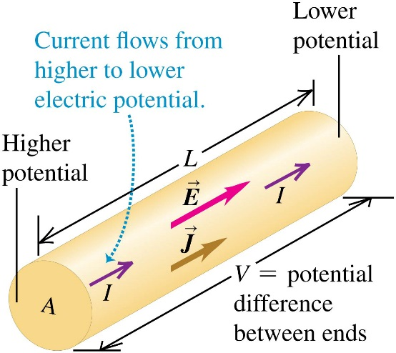
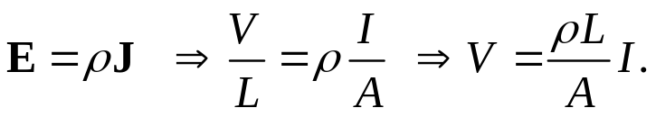
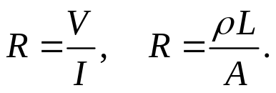


25.3 Resistance
When a conductor obeys Ohm’s law, assuming the electric field E is uniform, we have
The resistance of a conductor is its voltage to current ratio:
Ohm’s law is now
The unit of resistance is ohm, 1 Ω =1 V/A.
The temperature dependence of resistance is the same as that for the resistivity:
Example 25.2 Electric field, potential difference, and resistance in a wire.
Example 25.3 Temperature dependence of resistance.
Test 25.3

Slide 7
Read: Ch25: 2-3
Homework: Ch25: 15,20,24
Due: October 9

Slide 8
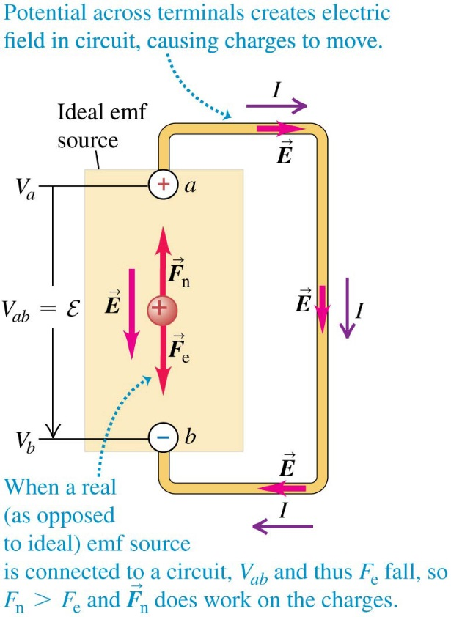

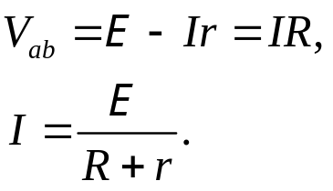
October 1 Electromotive Force
25.4 Electromotive force and circuits
In order to have a steady current in a circuit, there must be a device that makes the current flow from lower potential to higher potential. These devices utilize non-electrostatic forces to complete the work.
The influence that makes current flow from lower to higher potential is called the electromotive force (abbreviated emf, symbol E ). A device that provides emf is called a source of emf. These include batteries and generators. Note that emf is not a force. The SI unit of emf is the same as that for potential, the volt.
In an ideal source of emf, when moving a positive charge q from terminal b (−) to a (+), the non-electrostatic force does work qE, which increases the potential energy of the charge by qE :
A real emf source has internal resistance r. The terminal
voltage is It equals E only when I =0.
When an external R is connected,

Slide 9
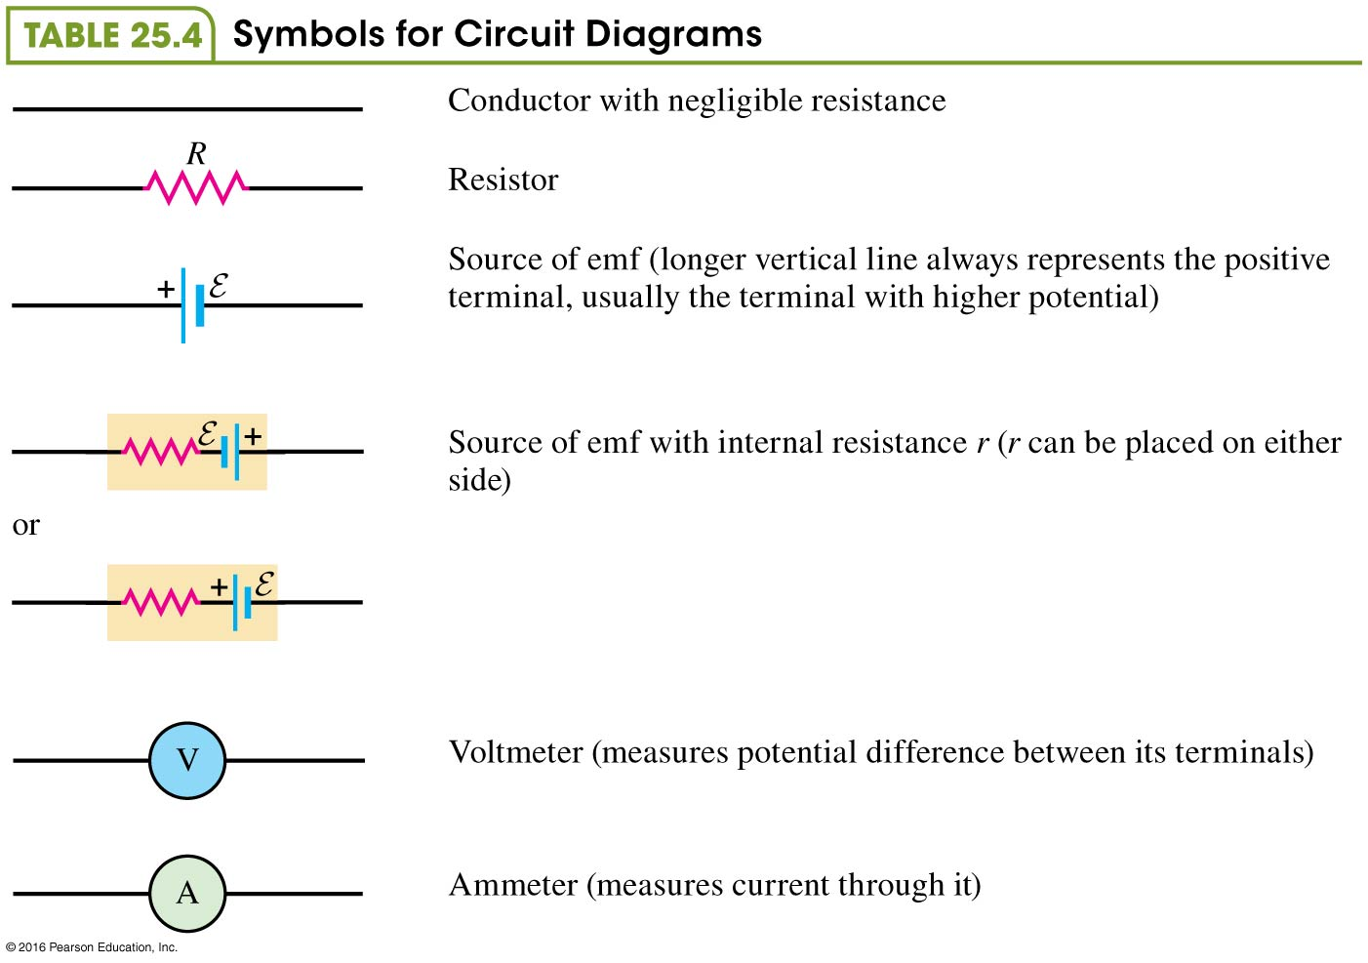
Electric circuits are represented by drawings called the circuit diagrams. In a diagram various electronic elements are represented by their symbols.
An idealized voltmeter has infinitely large resistance and measures potential difference without having any current diverted through it. An ammeter measures the current passing through it. An idealized ammeter has zero resistance and has no potential difference between its terminals.

Slide 10
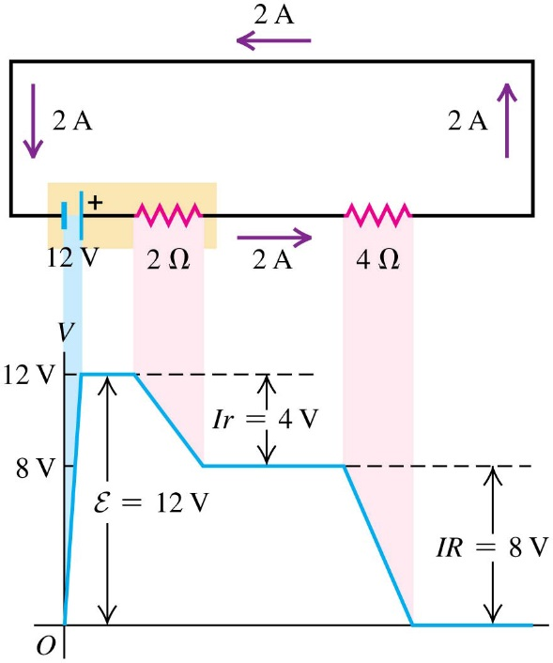

Potential changes around a circuit:
The net change in potential around a circuit must be zero. That is, the algebraic sum of the potential differences and emfs around a loop is zero.
A potential gain of E is associated with the emf, and potential drops of Ir and IR are associated with the internal resistance of the source and the external resistance, respectively.
Example 25.4 A source in an open circuit
Example 25.5 A source in a complete circuit
Example 25.6 Using voltmeters and ammeters
Example 25.7 A source with a short circuit
Test 25.4

Slide 11
Read: Ch25: 4
Homework: Ch25: 26,27,28,30
Due: October 9

Slide 12
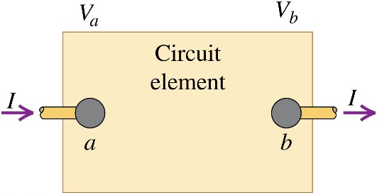

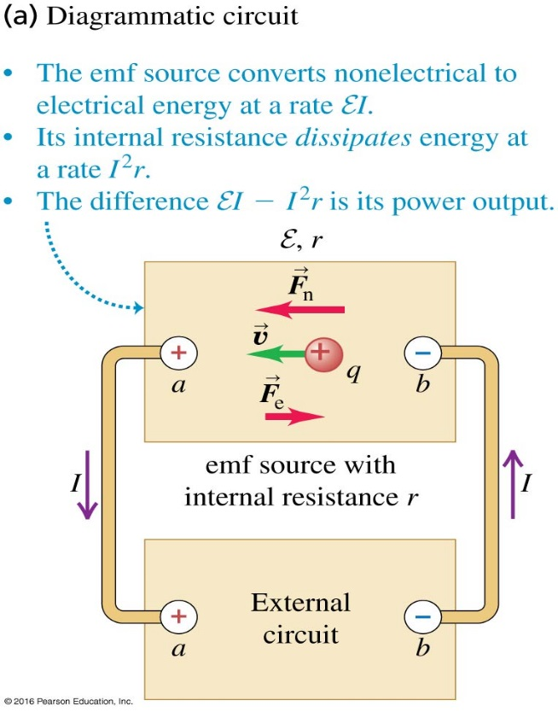
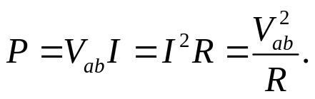

October 6 Electric Energy
25.5 Energy and power in electric circuits
When a charge q passes through a circuit element with potential difference V_{ab}=V_{a} −V_{b} > 0 , its potential energy decreases by qV_{ab}. This amount of energy is transferred into the circuit element. When V_{ab}< 0 the energy is transferred out of the element. The potential energy change of the charges within time dt is V_{ab}dQ = V_{ab}Idt, therefore the rate at which energy is transferred into or out of a circuit element, which is called the power, is
Power input to a pure resistance:
For a resistor, V_{ab}= IR, then
Power output of a source:
For a source (battery) with emf E and internal resistance r,
V_{ab}= E −I r, then the net power output is
Here E I is the rate of energy conversion, and I ²r is the rate of energy dissipation on the internal resistor of the battery.

Slide 13
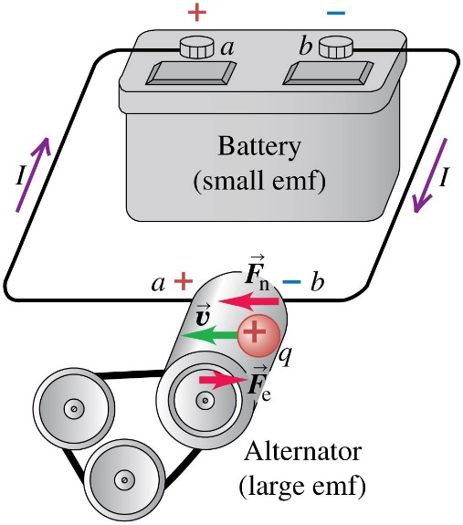

Power input to a source (charging):
When charging the battery, the current in the battery is reversed, V_{ab}= E +I r, then
Here E I is the power of storing energy in the battery, and I²r is the rate at which the energy is dissipated on the internal resistor of the battery.
Example 25.8 Power input and output in a complete circuit
Example 25.9 Increasing the resistance
Example 25.10 Power in a short circuit
Test 25.5

Slide 14
Read: Ch25: 5
Homework: Ch25: 35,42,47
Due: October 17

