Slide 1
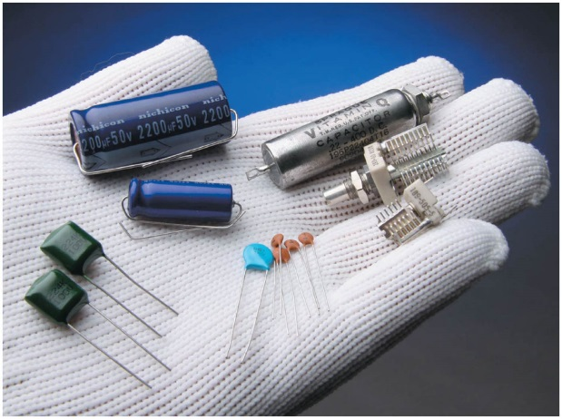

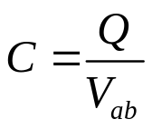

Chapter 24 Capacitance and Dielectrics
September 18 Capacitors
24.1 Capacitors and Capacitance
Capacitor: Any two conductors separated by an insulator or by vacuum.
Usually a capacitor is charged so that one conductor has + Q, they other has – Q. We say that the capacitor has charge Q.
Due to the superposition principle, the electric field at any point between the conductors is proportional to the charge Q on each conductor. Therefore, the potential difference V_{ab} between the conductors is also proportional to Q.
Capacitance: The capacitance of a capacitor is defined as:
The unit of capacitance is farad, 1 F = 1 C/V.
More convenient units for capacitance are μF and pF.
Capacitance measures the ability of a capacitor to store charge,
It also measures the ability of a capacitor to store energy.

Slide 2
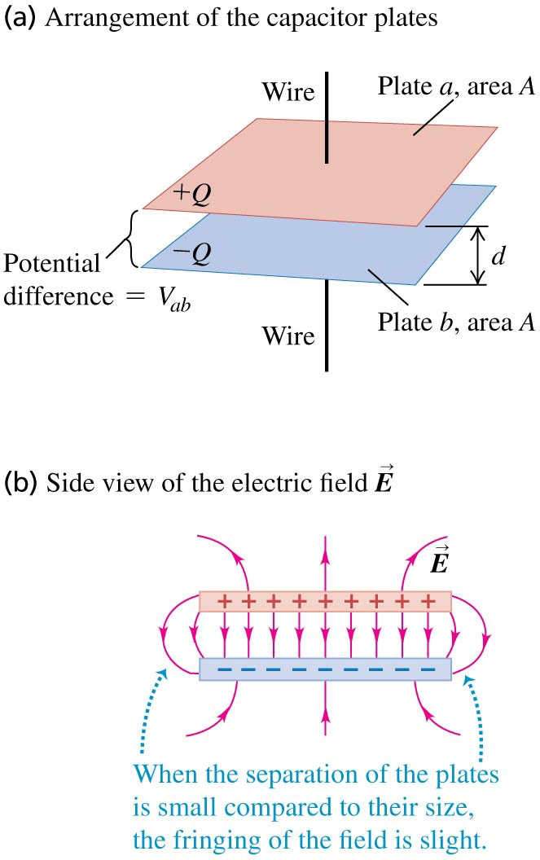
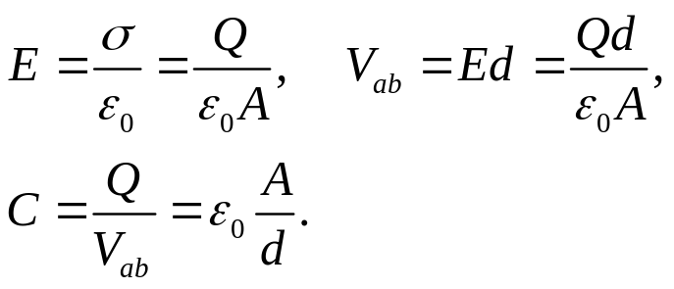
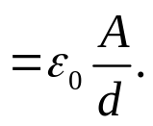
Calculating capacitance: capacitors in vacuum:
A parallel-plate capacitor consists of two parallel conducting plates, each with area A, separated by a small distance d. The electric field between such plates is essentially uniform.
Capacitance only depends on the geometry of the capacitor; it is directly proportional to the area A of each plate and inversely proportional to their separation d.

Slide 3
Example 24.1 Size of a 1-F capacitor
Example 24.2 Properties of a parallel-plate capacitor
Example 24.3 A spherical capacitor
Note that capacitance only depends on the geometry of the capacitor.
Example 24.4 A cylindrical capacitor
Test 24.1

Slide 4
Read: Ch24: 1
Homework: Ch24: 2,7,9
Due: September 26

Slide 5
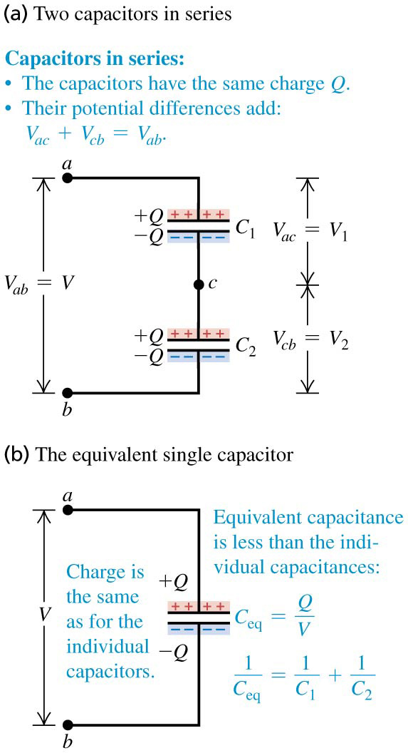
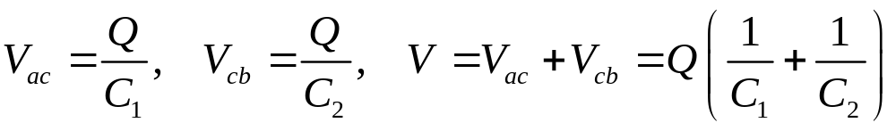
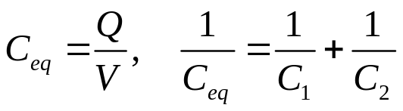
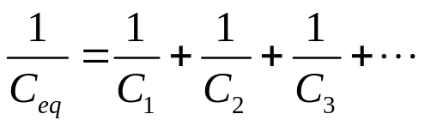
September 19 Capacitor Combinations
24.2 Capacitors in Series and in Parallel
Capacitors are manufactured with standard capacitances. We can obtain certain desired values of capacitances by combining them.
Capacitors in series:
When capacitors are in a series connection, the charge on all capacitors is the same.
The equivalent capacitance C_{eq} of a combination is defined as the capacitance of a single capacitor for which the charge Q and potential difference V are the same as in the combination.
For a number of capacitors in series,

Slide 6
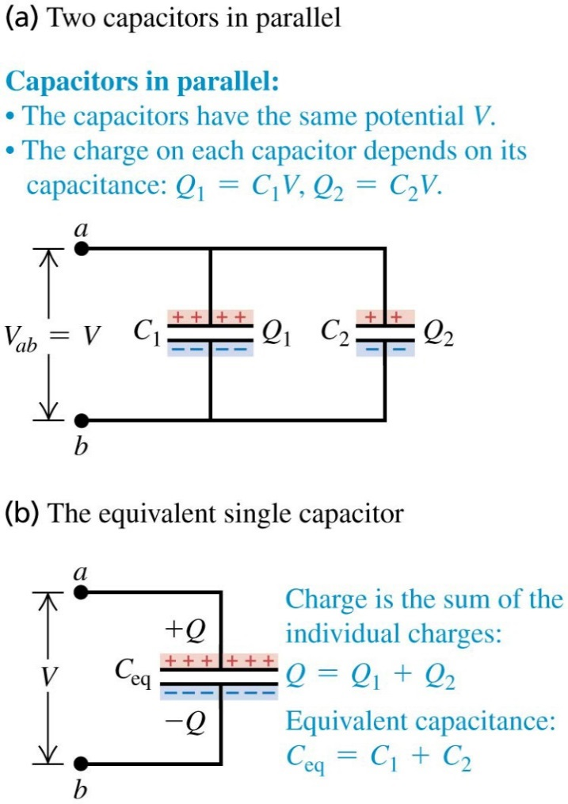
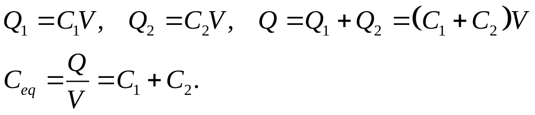

The reciprocal of the equivalent capacitance of a series combination equals the sum of the reciprocals of the individual capacitances.
Capacitors in parallel:
When capacitors are in a parallel connection, the potential difference on each capacitor is the same.
For a number of capacitors in parallel,
The equivalent capacitance of a parallel combination equals the sum of the individual capacitances.

Slide 7
Example 24.5 Capacitors in series and in parallel
Example 24.6 A capacitor network
Test 24.2

Slide 8
Read: Ch24: 2
Homework: Ch24: 16,18,19,21
Due: September 26

Slide 9
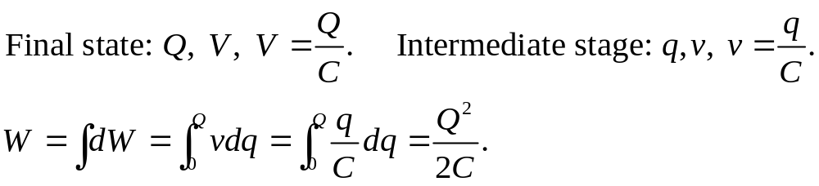
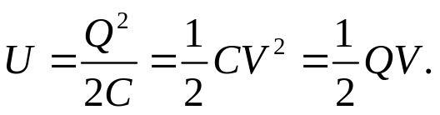
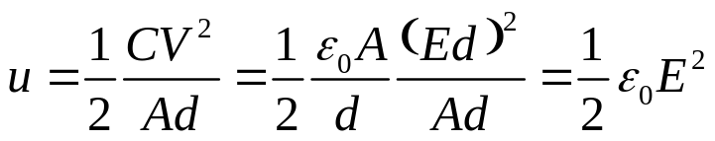
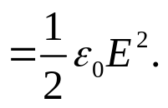
September 22 Energy in Capacitors
24.3 Energy Storage in Capacitors and Electric-field Energy
The electric potential energy stored in a charged capacitor is equal to the amount of work required to charge it.
Potential energy stored in a capacitor:
Electric-field energy:
If we can think of the energy as being stored in the field in the region between the plates, then the energy per unit volume, called the energy density, is
This expression is valid for any electric field in vacuum.
The electric-field energy is a different way of interpreting electric potential energy.
We can regard the energy of a system of charges as being a shared property of all the charges, or as being a property of the electric field they create.

Slide 10
Example 24.7 Transferring charge and energy between capacitors
Example 24.8 Electric-field energy
Example 24.9 Two ways to calculate energy stored in a capacitor
Test 24.3

Slide 11
Read: Ch24: 3
Homework: Ch24: 23,25,29
Due: October 3

Slide 12
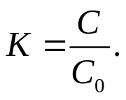
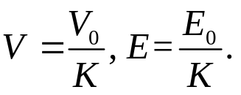
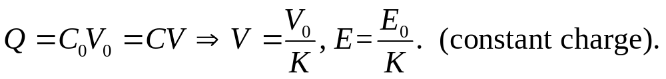
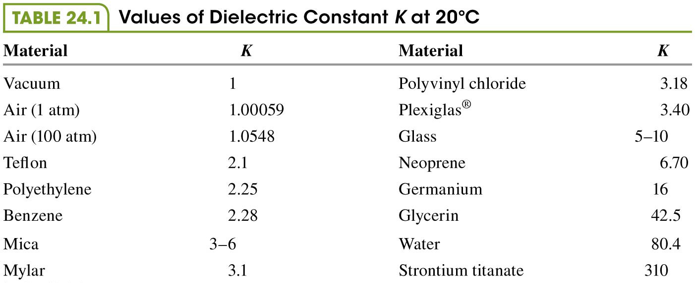
September 24 Dielectrics
24.4 Dielectrics
Dielectrics are non-conducting materials. The capacitance of a capacitor of given dimensions is greater when there is a dielectric material between the plates (C) than when there is vacuum (C₀). This is due to induced surface charge on the dielectric. It can be explained by keeping the charge (or voltage) constant and inserting the dielectric into the capacitor.
The ratio between the two capacitances is called the dielectric constant:
When the charge is a constant,

Slide 13
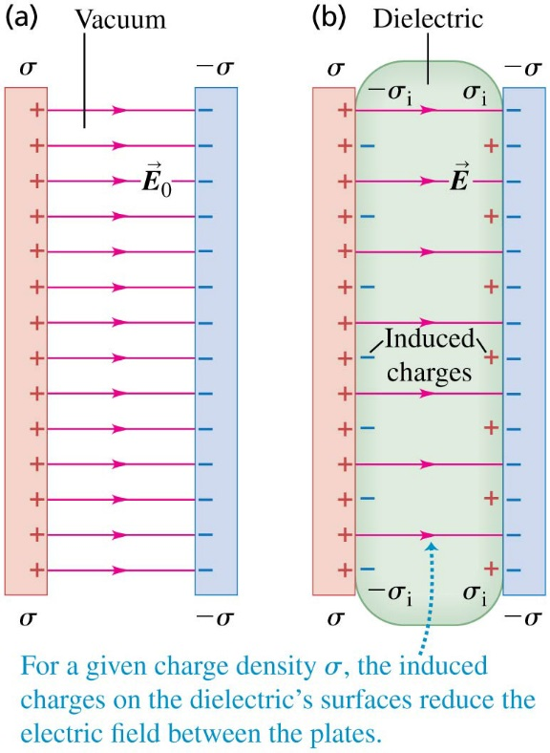
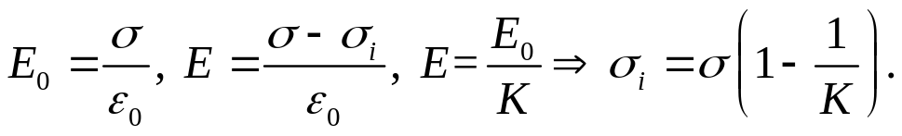

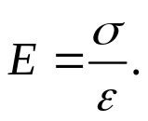
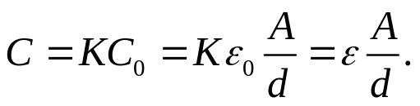
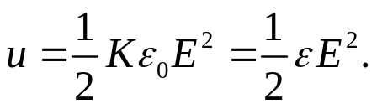
Induced charge and polarization:
In a capacitor with a dielectric, an induced surface charge of the opposite sign appears on each surface of the dielectric. The induced charges arise as a result of redistribution of positive and negative charge within the dielectric material, a phenomenon called polarization.
We assume that the induced surface charge (σ_{i}) is proportional to the electric-field E in the material (similar to Hooke’s law).
Permittivity of a dielectric is
The electric field within the dielectric is
Capacitance of a parallel-plate capacitor with dielectric:
Electric energy density in a dielectric:

Slide 14
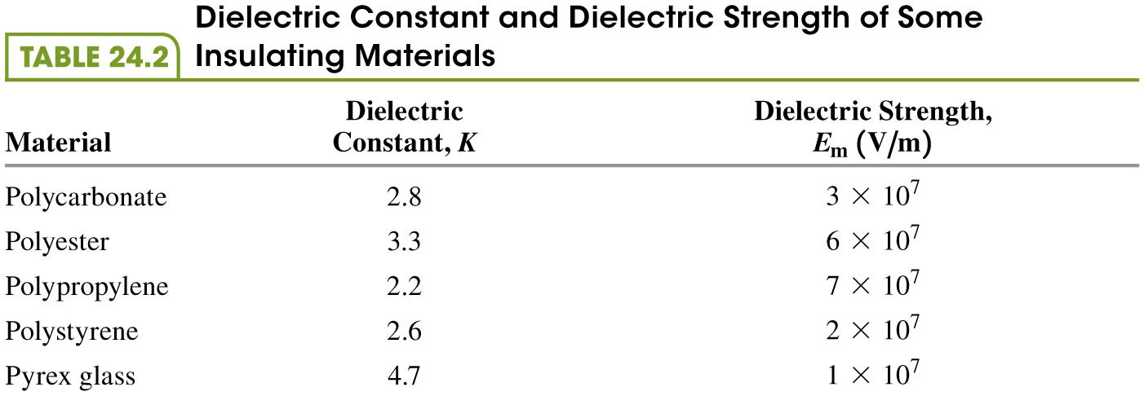
Dielectric strength: the maximum electric field that a material can withstand without breakdown.

Slide 15
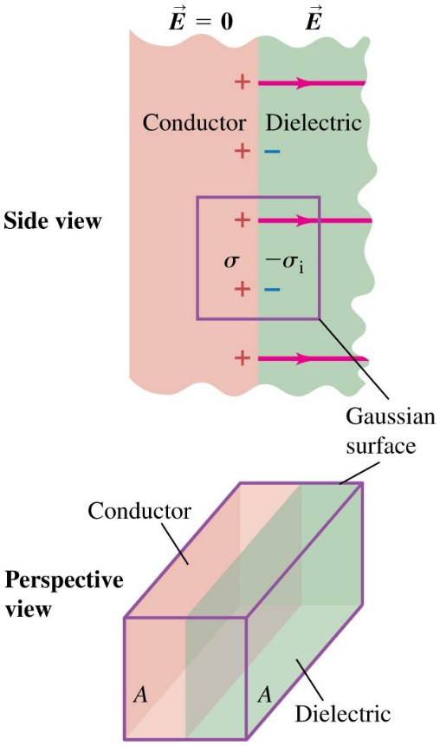
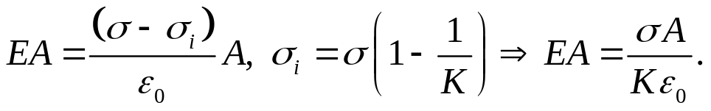
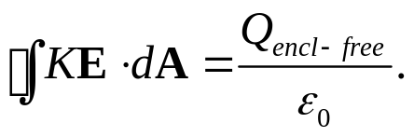

24.6 Gauss’s Law in Dielectrics
Apply Gauss’s law to a dielectric:
The flux of KE through the Gaussian surface is equal to the enclosed free charge σA divided by ε₀.
Let electric displacement D = ε E, then
Example 24.10 A capacitor with and without a dielectric
Example 24.11 Energy storage with and without a dielectric
Test 24.4

Slide 16
Read: Ch24: 4-6
Homework: Ch24: 33,37,40
Due: October 3

