Slide 1
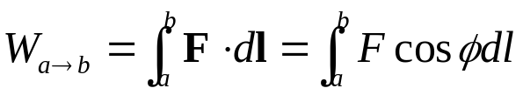

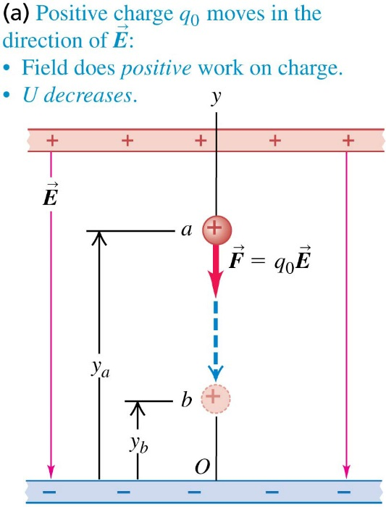



Chapter 23 Electric Potential
September 11 Electric Potential Energy
23.1 Electric Potential Energy
Review: potential energy
Work done by a force:
Work-kinetic energy principle: total work
Conservative force is defined as a force whose work only depends on the two end points of the path. For a conservative force, a potential energy can be defined to a point, so that the change in potential energy is the negative of the work done by the conservative force. You can easily remember this by thinking about the gravitational potential energy.
Conservation of mechanical energy: If only conservative forces do work,
Electric potential energy in a uniform field:
Work done on a charge q₀:
Therefore,
It applies to both positive and negative charges.

Slide 2
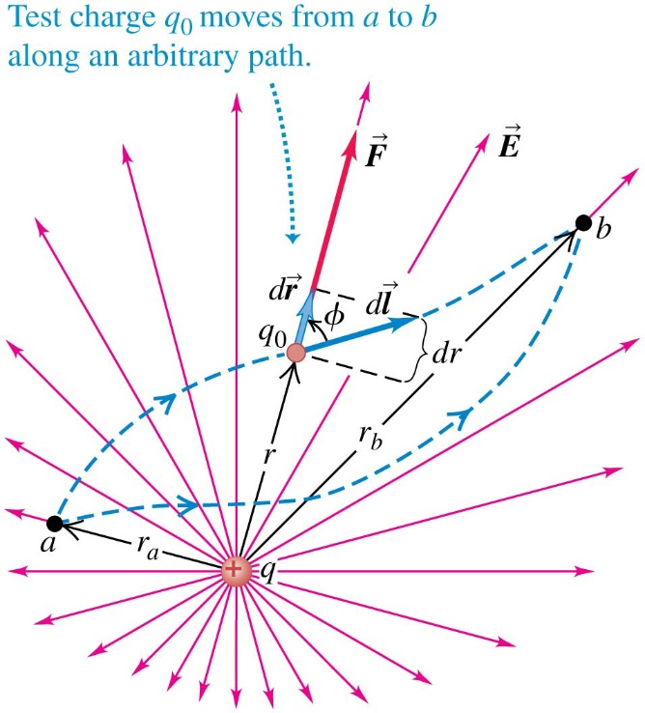
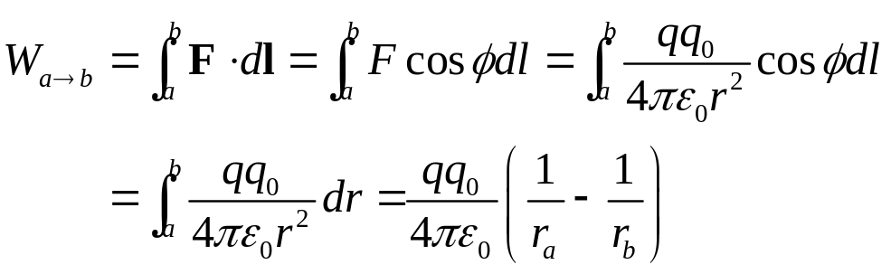
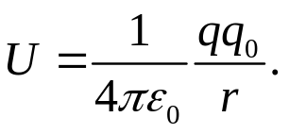
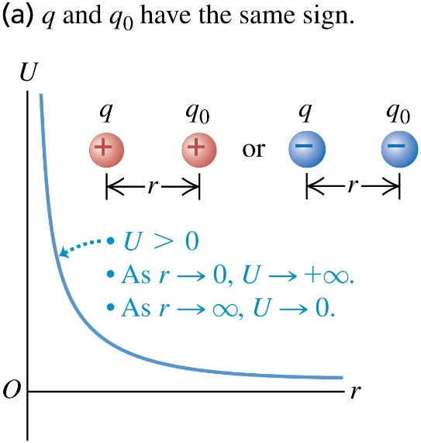
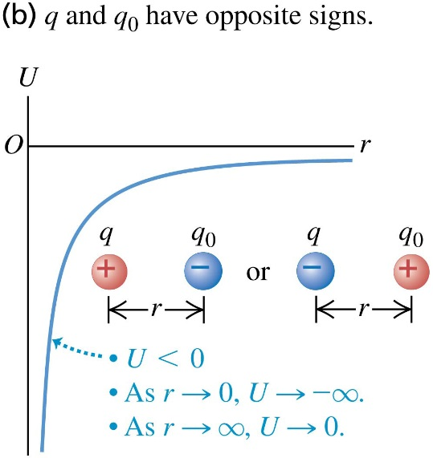
Electric potential energy of two point charges:
Work done on a charge q₀:
Electric potential energy of two point charges is
therefore given by
The electric potential energy of two point charges only depends on the distance between the charges.
This equation is valid no matter what the signs of the charges are.
Potential energy is defined to be zero when the charges are infinitely far apart.

Slide 3
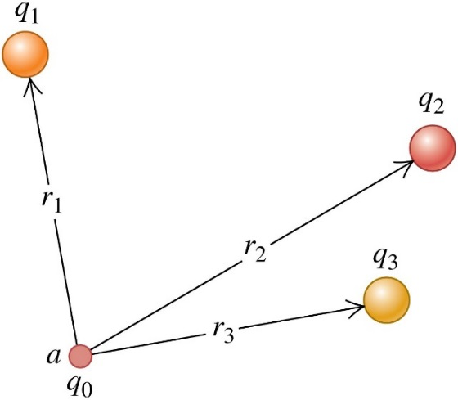
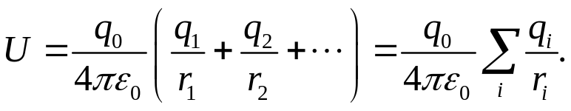
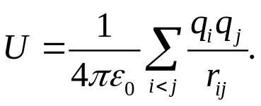
Electrical potential energy with several point charges:
The potential energy associated with a specific q₀ depends on the other charges and their distances from q₀. The electric potential energy is the algebraic sum:
The total potential energy U with respect to the status that all charges are far apart is the sum of the potential energies of interaction for each pair of charges:
Interpreting electric potential energy:
The potential-energy difference U_{a} − U_{b} equals the work that is done by the electric force when the particle moves from a to b:
It is also the work that must be done by an external force to move the particle slowly from b to a against the electric force.
Example 23.1 Conservation of energy with electric forces
Example 23.2 A system of point charges
Test 23.1

Slide 4
Read: Ch23: 1
Homework: Ch23: 4,7,8
Due: September 19

Slide 5
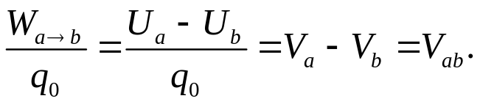
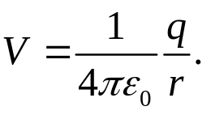
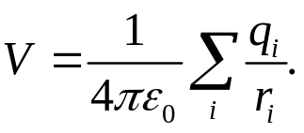
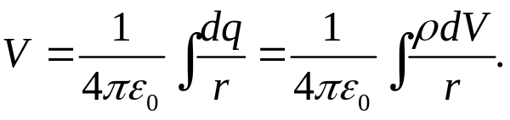
September 12 Electric Potential
23.2 Electric Potential
Electric potential (potential) is the potential energy per unit charge: V = U/q₀.
The SI unit of potential is volt, V: 1 V=1 J/C.
In terms of work done by electric force,
The potential of point a with respect to point b, V_{ab}, equals the work done by the electric force when a unit charge moves from a to b. It also equals the work that must be done by an external force to move a unit charge slowly from b to a against the electric force.
Calculating electric potential:
The potential due to a single point charge q:
This is valid for both positive and negative charges. V= 0 at r = infinity.
For a collection of point charges,
For a continuous distribution of charges,

Slide 6
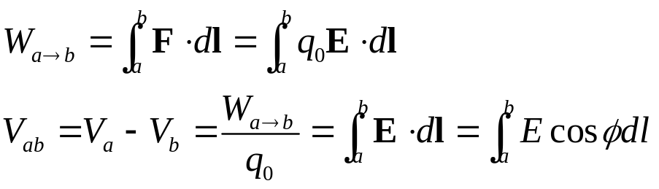
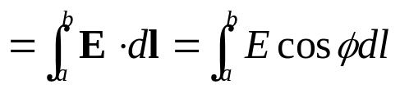

Finding electric potential from electric field:
The electron volt:
When a particle with charge q moves from a point where the potential is V_{b} to a point where it is V_{a} , the change in the potential energy is
The electron volt is defined as the change of potential energy when an electron goes through 1 volt of potential difference: 1 eV= 1.602 ×10⁻¹⁹ J.
Example 23.3 Electric force and electric potential
Example 23.4 Potential due to two point charges
Example 23.5 Potential and potential energy
Example 23.6 Finding potential by integration
Example 23.7 Moving through a potential difference
Test 23.2

Slide 7
Read: Ch23: 2
Homework: Ch23: 12,19,23
Due: September 19

Slide 8
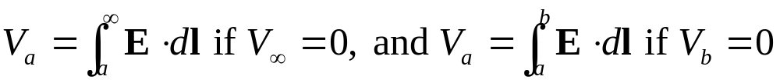
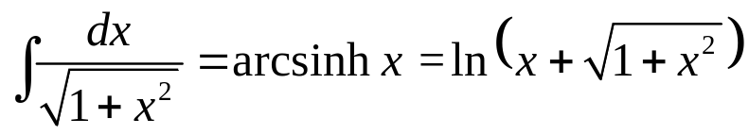
September 15 Calculating Electric Potential
23.3 Calculating Electric Potential
Example 23.8 A charged conducting sphere
Note that
Example 23.9 Oppositely charged parallel plates
Example 23.10 An infinite line charge or charged conducting cylinder
Note that we set V = 0 at point b at an arbitrary but finite radial distance r₀.
Example 23.11 A ring of charge
Example 23.12 Potential of a line of charge
Test 23.3

Slide 9
Read: Ch23: 3
Homework: Ch23: 28,33,36,39
Due: September 26

Slide 10
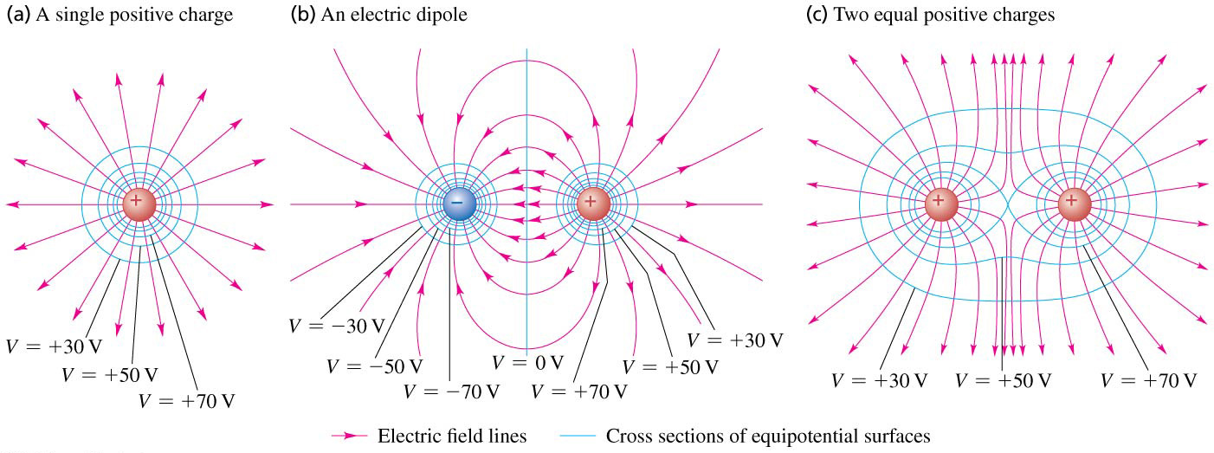
September 17 Equipotential Surfaces
23.4 Equipotential Surfaces
An equipotential surface is a surface on which the electric potential is the same at every point. It is similar to the contour lines on a topographic map.
Field lines and equipotential surfaces are always mutually perpendicular.
Equipotential surfaces are usually drawn so that there are equal potential differences between adjacent surfaces. In regions where the magnitude of the electric field is large, the equipotential surfaces are close together.

Slide 11
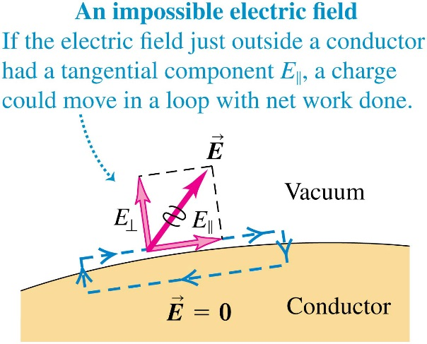
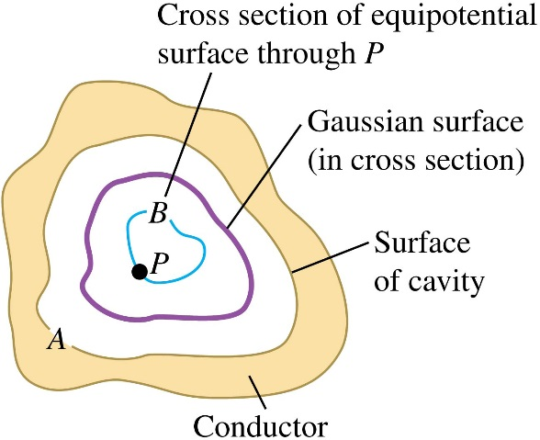
Equipotentials and conductors:
The electric field just outside a conductor is always perpendicular to the surface.
Proof: If E// is not zero, then a charge moving around a small rectangular path will receive nonzero net work. This is impossible because the electric force is conservative. Therefore,
When all charges are at rest, the surface of a conductor is always an equipotential surface.
Also because E=0 inside the conductor, the entire solid volume of the conductor is at the same potential (equipotential volume).
Conductor with a cavity containing no charge:
Every point in the cavity is at the same potential.
Proof: If the cavity has a different potential, construct an equipotential surface and a Gaussian surface as shown in the figure. The electric flux and therefore the charge contained in the Gaussian surface is then nonzero.
The electric field is zero everywhere in the cavity.
There is no charge anywhere on the surface of the cavity.

Slide 12
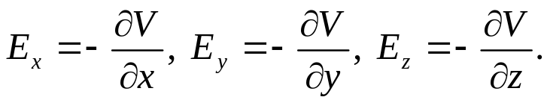
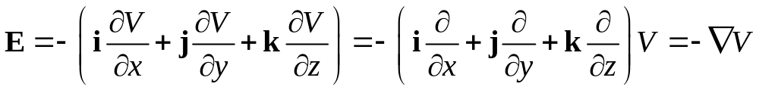
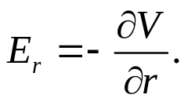
23.5 Potential Gradient
The components of the electric field can be found by taking partial derivatives of the electric potential:
The electric field is the negative gradient of the potential:
For a radial electric field:
Example 23.13 Potential and field of a point charge
Example 23.14 Potential and field of a ring of charge
Test 23.4, 23.5

Slide 13
Read: Ch23: 4-5
Homework: Ch23: 41,43
Due: September 26

