Slide 1
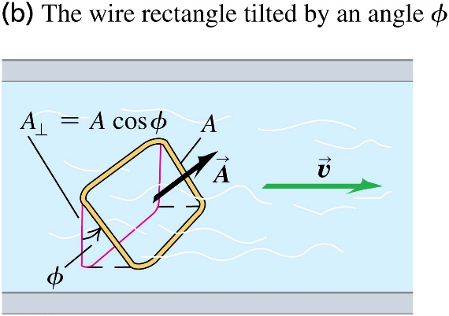
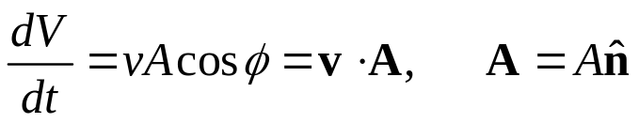

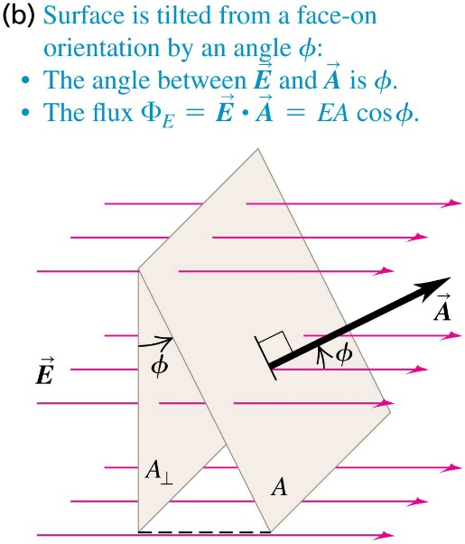

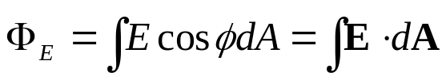
Chapter 22 Gauss’s Law
September 4 Electric Flux
22.2 Calculating Electric Flux
An analogy: volume flow rate of a fluid:
Volume flow rate is the volume of the fluid that has passed across a certain surface area in a unit of time.
For a closed surface, is chosen to be outward. Therefore, outward flux is positive, and inward flux is negative.
Flux of a uniform electric field through a planar area:
Electric flux through an area is defined as
Flux of a non-uniform electric field or through a non-planar area is defined through a surface integral:
Electric flux is a scalar (left or right, inward or outward).

Slide 2
Example 22.1 Electric flux through a disk
Example 22.2 Electric flux through a cube
Example 22.3 Electric flux through a sphere
Test 22.2

Slide 3
Read: Ch22: 1-2
Homework: Ch22: 2,3,6
Due: September 12

Slide 4
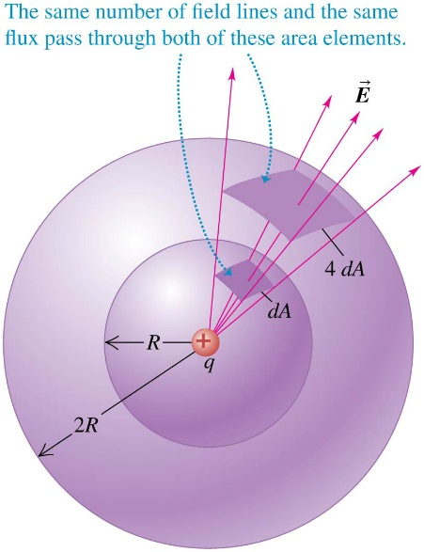
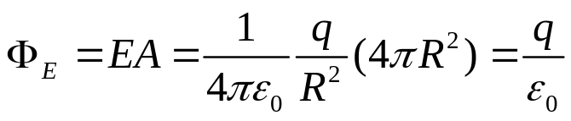
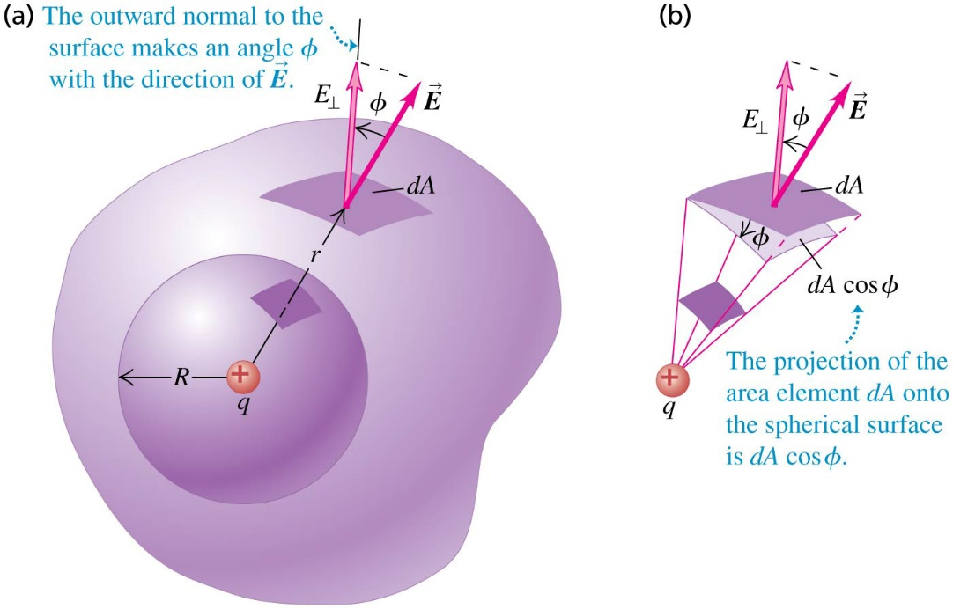
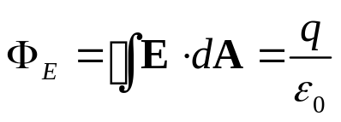
September 5 Gauss’s Law
22.3 Gauss’s Law
Point charge at the center of a spherical surface:
The flux is independent of the radius R of the sphere.
Point charge inside a non-spherical surface:
Charge q is inside a closed irregular surface.
Each element area dA on the surface has the same flux as through its projection dAcosφ, which further has the same flux as through the area dS on the surface of a common small sphere.

Slide 5
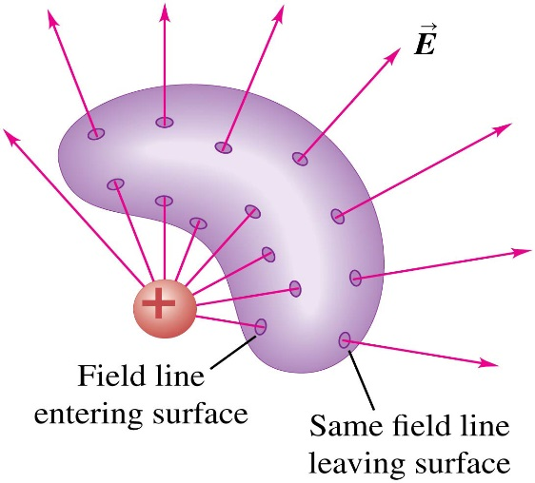


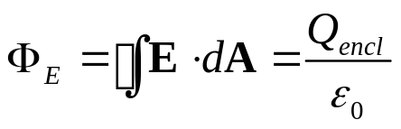
Point charge outside a closed surface:
For any area dA where a field line leaves the surface, there is a corresponding area dA' where the same field line enters the surface. The fluxes from these two element areas cancel exactly.
An outside charge does not contribute to the net flux through a closed surface.
dA
dA'
General form of Gauss’s law:
Total charge enclosed by a surface:
Gauss’s Law
The total electric flux through a closed surface is equal to the net electric charge inside the surface, divided by ε₀.
Example 22.4 Electric flux and enclosed charge
Test 22.3

Slide 6
Read: Ch22: 3
Homework: Ch22: 9,10
Due: September 12

Slide 7
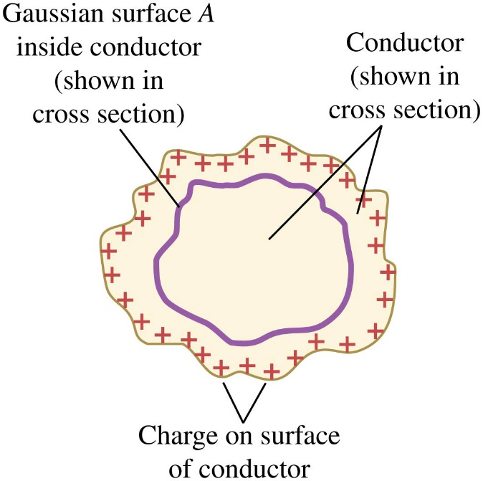
September 8 Applications of Gauss’s Law
22.4 Applications of Gauss’s Law
Gauss’s law is valid for any distribution of charges and for any closed surface.
The closed surfaces are usually imaginary.
If we know the charge distribution with some symmetry, we may find the electric field.
If we know the electric field, we may use Gauss’s law to find the charge distribution.
Charges on a solid conductor:
In electrostatics, excess charges on a solid conductor entirely reside on the surface of the conductor.
Proof: Draw an arbitrary small Gauss surface inside the conductor. On the surface the electric field is zero, so the flux and thus the enclosed charge is zero.

Slide 8
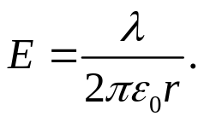
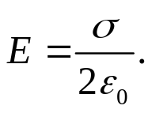
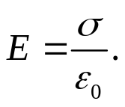
Example 22.5 Field of a charged conducting sphere
Example 22.6 Field of a uniform line charge
Compare with Example 21.10.
Example 22.7 Field of an infinite plane sheet of charge
Compare with Example 21.11.
Example 22.8 Field between oppositely charged parallel conducting plates
Compare with Example 21.12.
Example 22.9 Field of a uniformly charged sphere
Note that inside the sphere the field is proportional to the radius r.
Example 22.10 Charge on a hollow sphere
Test 22.4

Slide 9
Read: Ch22: 4
Homework: Ch22: 14,18,21,24
Due: September 19

Slide 10
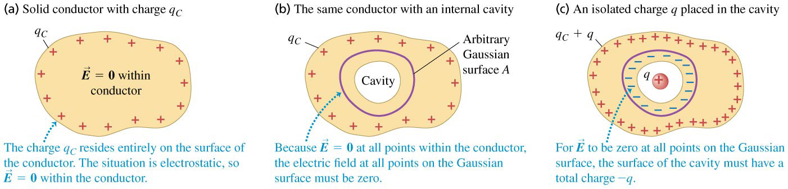
September 10 Charges on Conductors
22.5 Charges on Conductors
In Ch. 21 we know that the electric field at every point within a solid conductor is zero. What if there is a cavity in the conductor?
1) No charge within the cavity:
If there is no charge in the cavity, then Gauss’s law proves that there is no net charge on the surface of the cavity. In Ch. 23 we will prove that there is no charge anywhere on the surface of the cavity. This leads to the principle of electrostatic shielding.
2) Charge within the cavity:
If charge q is introduced to the cavity, then by Gauss’s law there must be a charge – q distributed on the surface of the cavity. In addition, by the law of conservation of charge, there must be an additional charge of +q appear on the outer surface of the conductor.

Slide 11
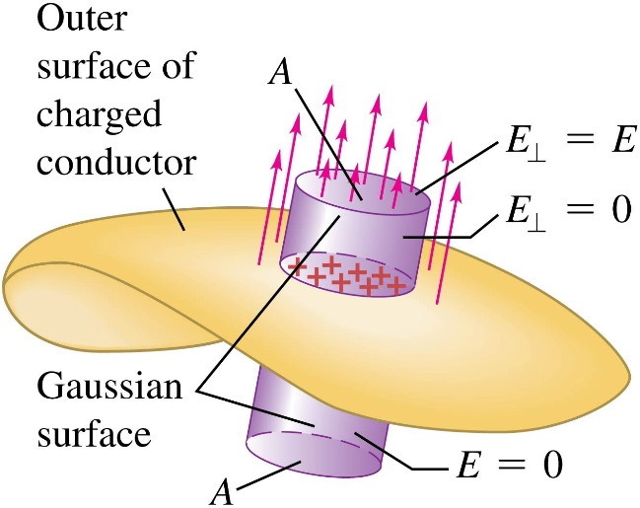
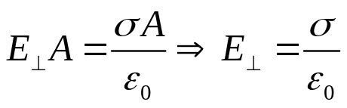
Field at the surface of a conductor:
We already know that the electric field at the surface of a charged conductor is perpendicular to the surface. We now find the relation between the electric field and the charge density at the surface.
Example 22.11 A conductor with a cavity
Example 22.12 Electric field of the earth
Test 22.5

Slide 12
Read: Ch22: 5
Homework: Ch22: 25,27,28
Due: September 19

