Slide 1
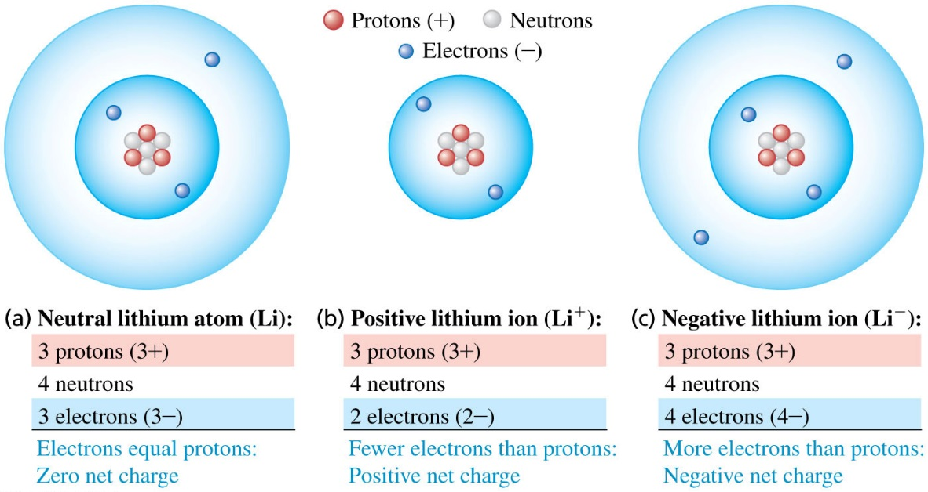
Chapter 21 Electric Charge and Electric Field
August 25 Electric Charge
21.1 Electric Charge
Electric charge is a fundamental property of matters. Electric charges may be positive or negative.
Law of Charges
Two positive charges or two negative charges repel each other. A positive charge and a negative charge attract each other.
Electrostatics studies the interactions between electric charges that are at rest, or nearly at rest.
The atom consists of a small positive nucleus surrounded by negative electrons. The electrons are viewed as orbiting a nucleus. The nucleus consists in positive protons and electrically neutral particles called neutrons.

Slide 2
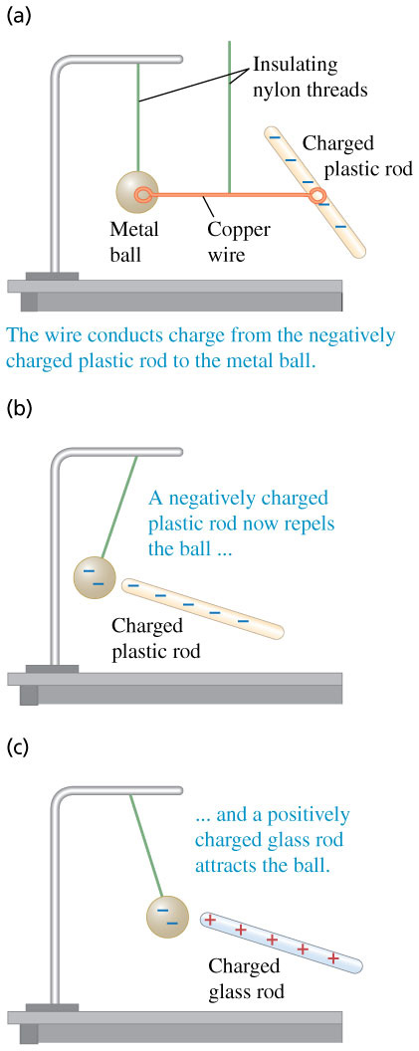


The proton and electron have the same magnitude of charge. The magnitude of charge of the electron or proton is a natural unit of charge. All observable charge is quantized in this unit.
The universal principle of charge conservation states that the algebraic sum of all the electric charges in any closed system is constant.
The SI unit of charge is the coulomb (C).
The charge on the electron is
The charge on the proton is
The units μC and nC are more common.
21.2 Conductors, Insulators, and Induced Charges
Conductors transmit charges easily.
Insulators do not transmit charge.
Semiconductors are intermediate.

Slide 3
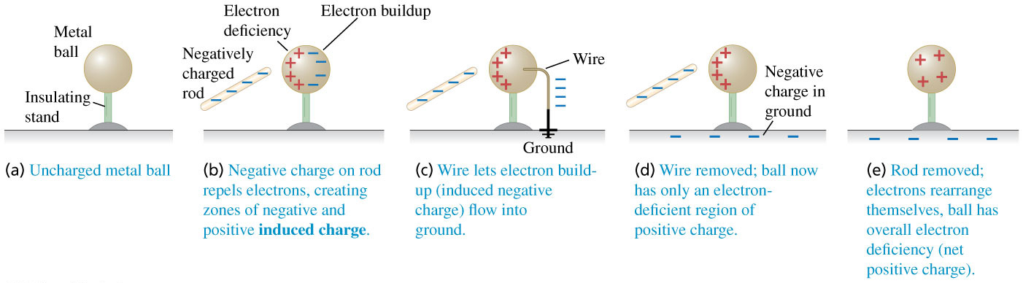
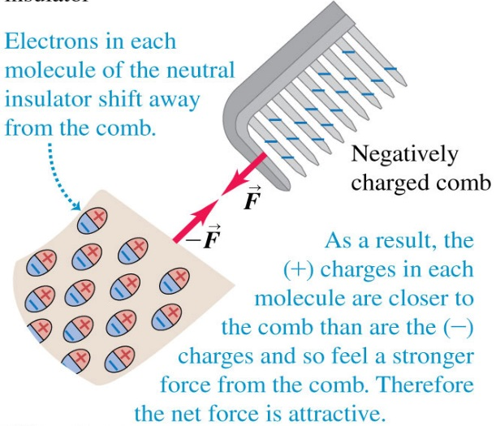
Charging by induction:
Charges can be produced by friction, conduction, and induction.
In induction shown here, the plastic rod can give the metal ball a charge of opposite sign without losing any of its own charge.
Electric forces on uncharged objects:
Here the negatively charged plastic comb causes a slight shifting of charge within the molecules of the neutral insulator. This effect is called polarization.
The net force between the comb and the small insulator is attractive.

Slide 4
Read: Ch21: 1-2
No homework

Slide 5
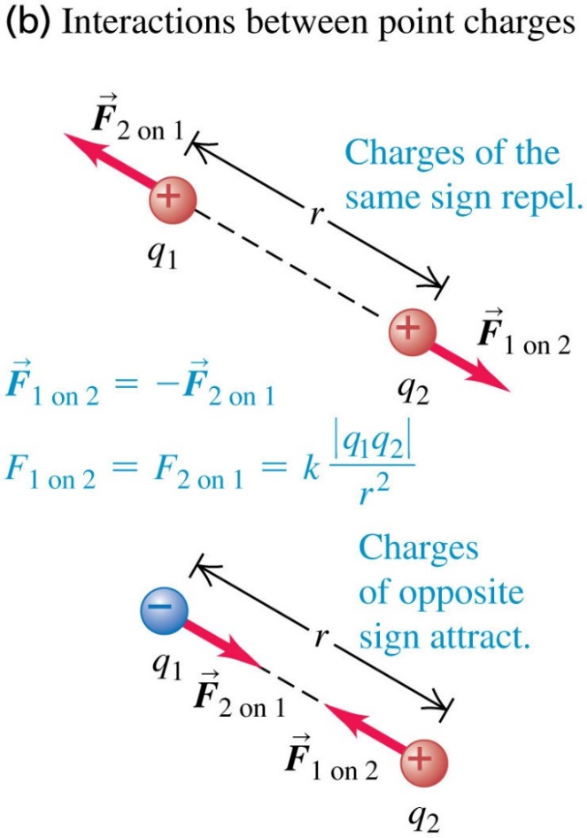
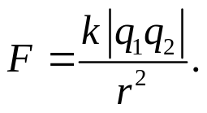
August 27 Coulomb’s Law
21.5 Coulomb’s Law
Point charges are charges that are very small in comparison with the distances between them. It is an ideal model. All actual charged bodies can be thought as composed by point charges.
Coulomb (1784) studied the force between two point charges.
Coulomb’s Law
The magnitude of the electric force between two point charges is directly proportional to the product of their charges and inversely proportional to the square of the distance between them.

Slide 6
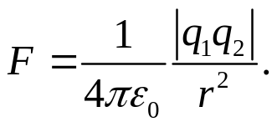

Coulomb’s Law (for scientists) is usually written as
Electric constant (permissivity of free space)
Principle of superposition of forces:
The net electric force on any particular charge is the vector sum of the forces on that charge due to all the other charges.
Example 21.1 Electric force versus gravitational force
For the interactions between atomic and sub-nuclear particles, the gravitational force is completely negligible in comparison to the electric force.
Example 21.2 Force between two point charges
Example 21.3 Vector addition of electric forces on a line
Example 21.4 Vector addition of electric forces in a plane
Test 21.3

Slide 7
Read: Ch21: 3
Homework: Ch21: (Exercises)3,9,10
Due: September 5

Slide 8
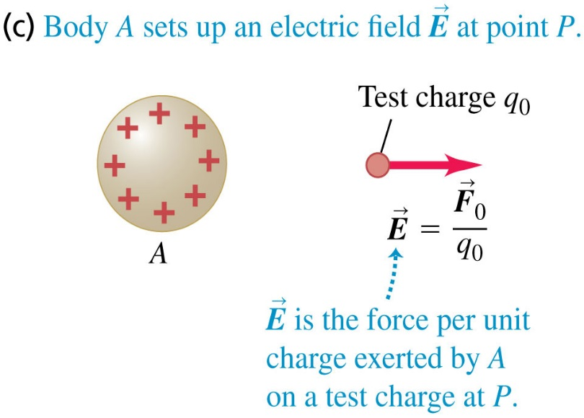
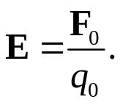
August 28 Electric Field
21.4 Electric Field and Electric Forces
The electric force on a charged body is thought to be exerted by the electric field created by other charged bodies.
Charge configurations create an electric field in space, and the field exerts electric force on a charge.
Electric field was initially introduced for convenience, but was later found to be a reality. Electric field is a kind of matter: it has momentum, energy and other properties.
The electric field E at any location is defined as:
q₀ − test charge,
F₀ − electric force on the test charge.
The magnitude of the electric field is the electric force per unit charge.
The direction of the electric field at any location is in the direction of the electric force experienced by a positive test charge imagined to be placed at that location.
The SI unit of electric field is N/C.

Slide 9
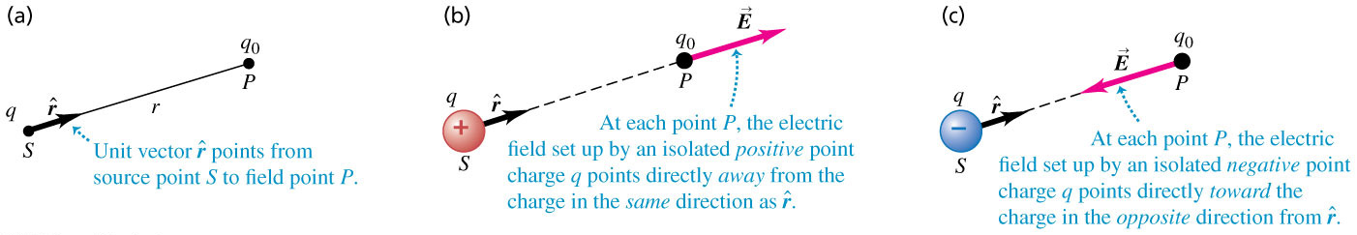
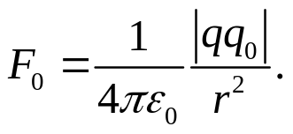
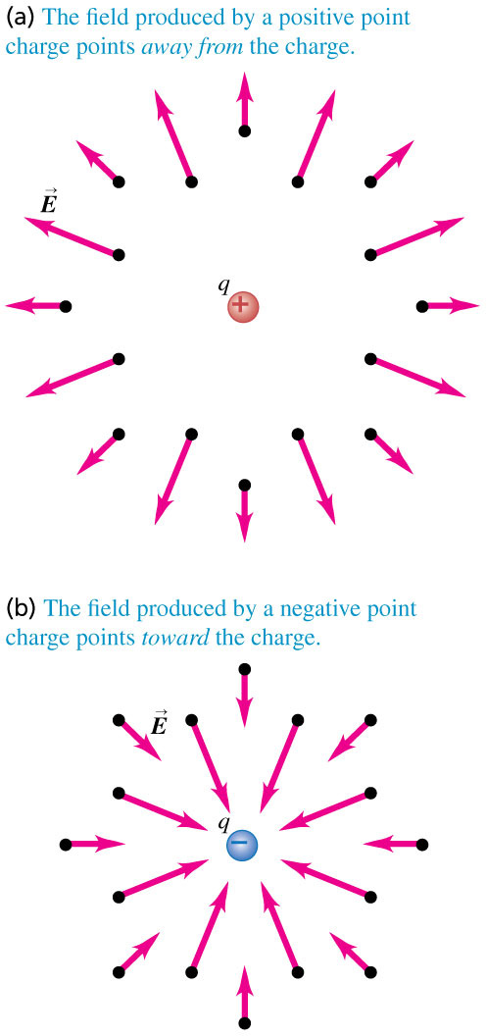
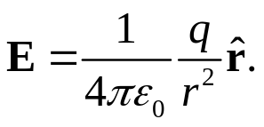

Electric field of a point charge:
$$\hat{r}$$
− Unit vector from source
point to field point.
A point charge q produces an electric field at all points in space.
The field strength decreases with increasing distance.
The field produced by a positive point charge points away from the charge.
The field produced by a negative point charge points toward the charge.

Slide 10
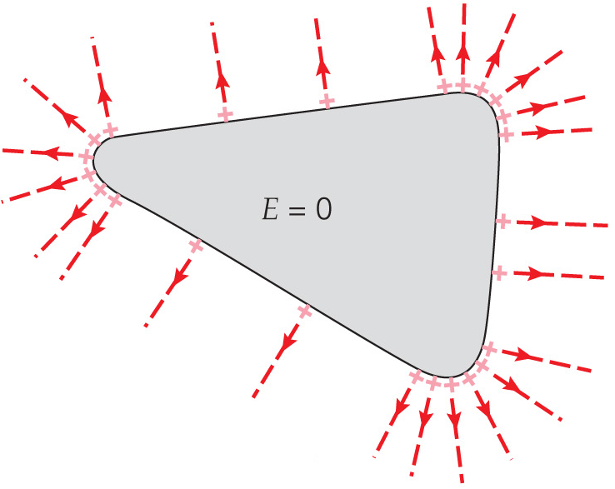
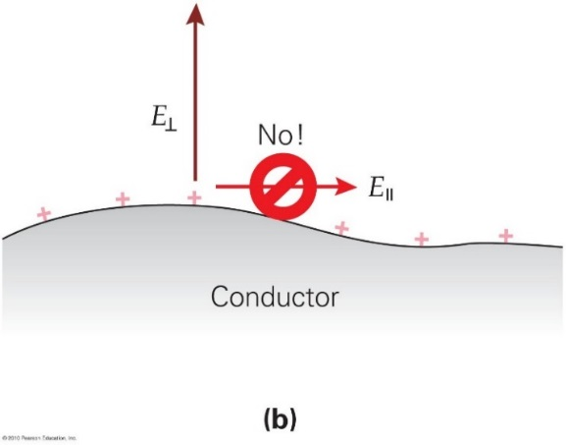
Electric field in a conductor:
In electrostatics, the charges are at rest. Because conductors possess electrons that are free to move but don’t, the electrons must experience no electric force and thus no electric field.
In electrostatics, the electric field at every point within the material of a conductor must be zero.
The electric field at the surface of a charged conductor is perpendicular to the surface.
Example 21.5 Electric-field magnitude for a point charge
Example 21.6 Electric-field vector for a point charge
Example 21.7 Electron in a uniform field
Test 21.4

Slide 11
Read: Ch21: 4
Homework: Ch21:22,25
Due: September 5

Slide 12
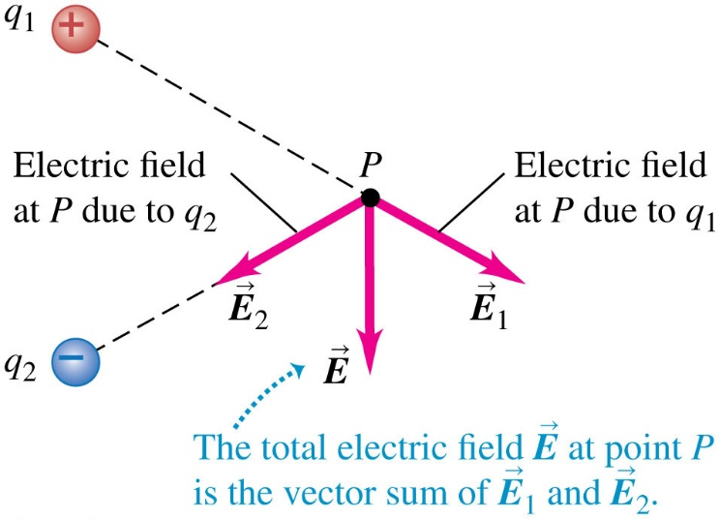
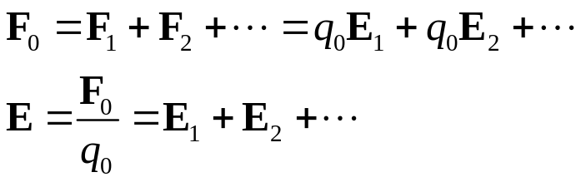
August 29 Electric Field Calculations
21.5 Electric-Field Calculations
Superposition of electric fields:
The total electric field at a point is the vector sum of the fields due to all the charges present.
Though all actual charge distributions are three-dimensional, sometimes we need to consider linear or surface charge distributions.
Volume charge density − ρ, C/m³.
Surface charge density − σ, C/m².
Linear charge density − λ, C/m.

Slide 13
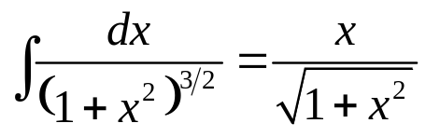
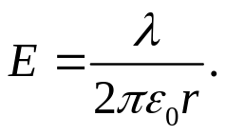
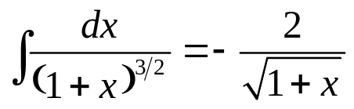
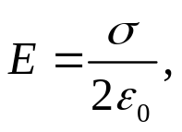
Example 21.8 Field of an electric dipole
Note that the field at point c drops as 1/r³.
Example 21.9 Field of a ring of charge
Note that algebraic problems are more meaningful than numerical calculations.
Example 21.10 Field of a charged line segment
Note that the field of an infinitely long line charge is
Example 21.11 Field of a uniformly charged disk
Note that the field of an infinite plan sheet of charge is which is
independent of the distance from the sheet.
Example 21.12 Field of two oppositely charged infinite sheets
Test 21.5

Slide 14
Read: Ch21: 5
Homework: Ch21:37,38,48,49
Due: September 5

Slide 15
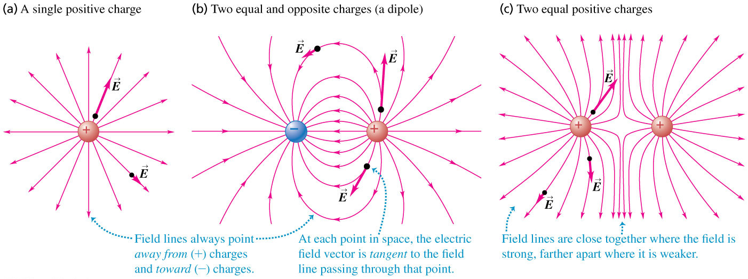
September 3 Electric Dipoles
21.6 Electric Field Lines
An electric field line is an imaginary line or curve whose tangent at any point is the direction of the electric field vector at that point.
Electric field lines show the direction of the electric field at each point.
The spacing of field lines indicates the magnitude of the electric field at each point.
In electrostatics, electric field lines point away from + charges and toward – charges.
Electric field lines never intersect.

Slide 16
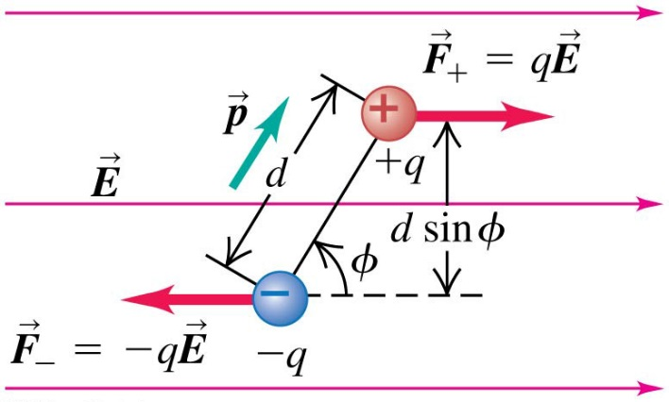


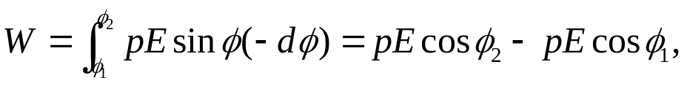




21.7 Electric Dipoles
An electric dipole is a pair of point charges with equal magnitude and opposite sign (q and −q) separated by a distance d. Electric dipoles are important models for physical systems.
Electric dipole moment : p = q d (pointing from −q to +q).
Force and torque on an electric dipole:
The net force on an electric dipole in a uniform external electric field is zero.
The net torque on the dipole is
Potential energy of an electric dipole (rotational):
Work done on the dipole by the field,
which is the negative of the change of the potential energy:
Check: 1) 2) The minimum U occurs at p//E.

Slide 17
Example 21.13 Force and torque on an electric dipole
Field of an electric dipole:
Figure 21.28b shows the general shape of the field due to a dipole.
Example 21.14 Field of an electric dipole, revisited
At points far away from the dipole, in all directions, the field drops off as 1/r³.
Test 21.7

Slide 18
Read: Ch21: 6-7
Homework: Ch21:51,53,54
Due: September 12

